Slide 1

Clinical Definitions
Epidemiology Track Day 1

Slide 2

Phenotyping process

Slide 3
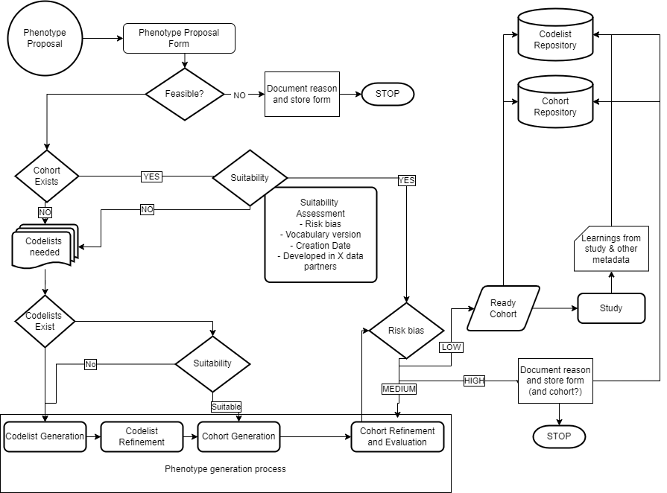
1. PROPOSAL
2. COHORT EXISTS?
Risk of
misclassification
3. CODELIST GENERATION
4. COHORT GENERATION

Slide 4
1. Proposal
Phenotype proposal form
– Who asks? What is it for?
Evaluate:
- Feasibility – If non-feasible – STOP + reason
- Different than study feasibility (but related)
- Need for clinical description
- If yes, clinical description form

Slide 5
Clinical Description
Overview
Presentation
Assessment
(Staging)
Management/RX
Prognosis
Disqualifiers
Strengtheners
Suggested Logic Description:
  Proposed Flavours

Slide 6
Clinical Description with Dynamed
try to connect!
https://dpa-pde-oxford.shinyapps.io/OSS_Dynamed_shiny/
User: hdruk2026
Password: nottingham

Slide 7
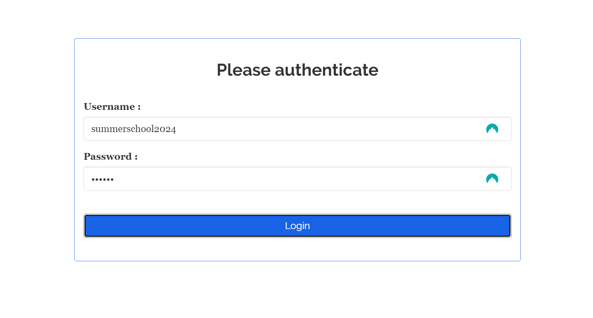
Clinical Description with Dynamed
1 – Log In

Slide 8
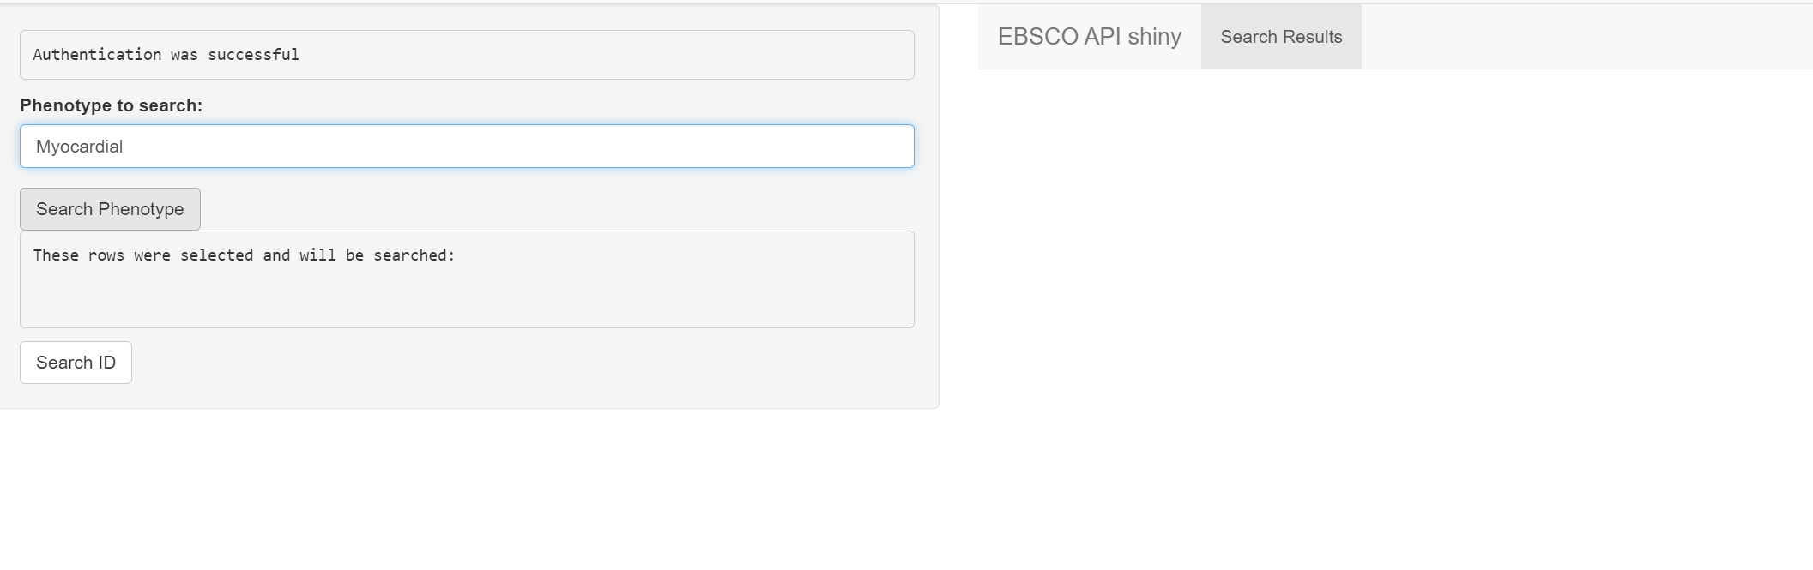
Clinical Description with Dynamed
2 – Search
1- Search word goes here
3- Results appear here
2- Click here

Slide 9
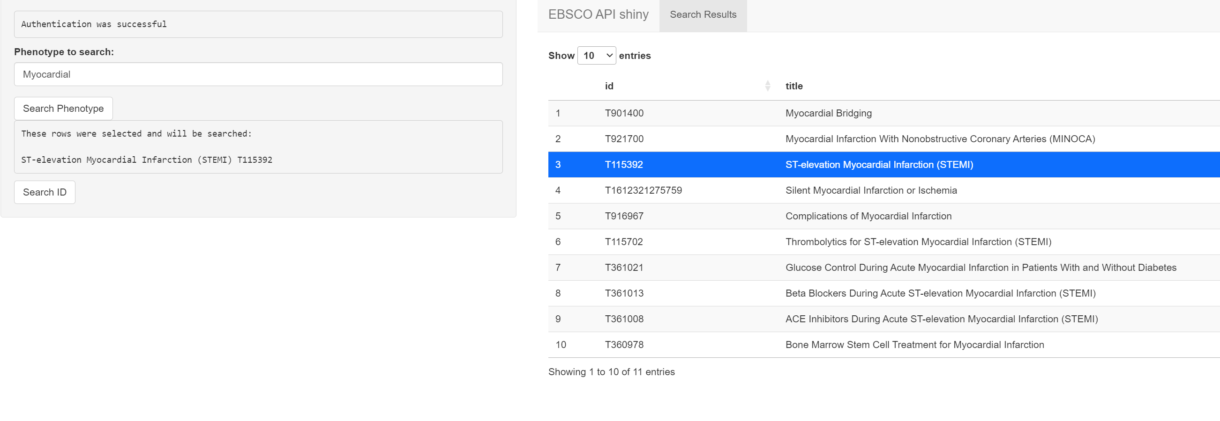
Clinical Description with Dynamed
2 – Search
3- New tabs will appear here
(Selected result gets
printed here too)
2- Click here
1 – Click on one of the results
(it gets highlighted)

Slide 10
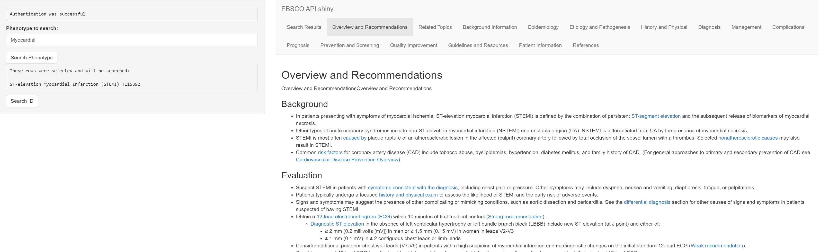
Clinical Description with Dynamed
Consult
1- Click the selected tab
Relevant information
to copy paste
appears here

Slide 11
Breakout Session
Complete a clinical description
of the selected phenotypes
for an incidence/prevalence study
Most Important:
Think about flavours,
possible logics,
What code lists/concept sets would you need?

Slide 12
Breakout Session
15.30 – 16.00 Breakout session: Clinical descriptions
16.00 – 16.30 Clinical descriptions and flavours chosen presented
https://dpa-pde-oxford.shinyapps.io/OSS_Dynamed_shiny/
User: hdruk2026
Password: nottingham

