Slide 1

CodelistGenerator and
Cohorts
Epidemiology Track

Slide 2
Schedule
13.30 – 11.15 Phenotyping steb by step
11.15 – 12.15 Clinical description and Phenotyping plan
12.15 – 13.00 Codelist Generator
13.00 - 14.00 Lunch
14.00 – 14.15 Codelist generation
14.15 – 15.15 Creating cohorts
15.15 –16.30 PhenotypeR

Slide 3


Phenotyping reminder

Slide 4
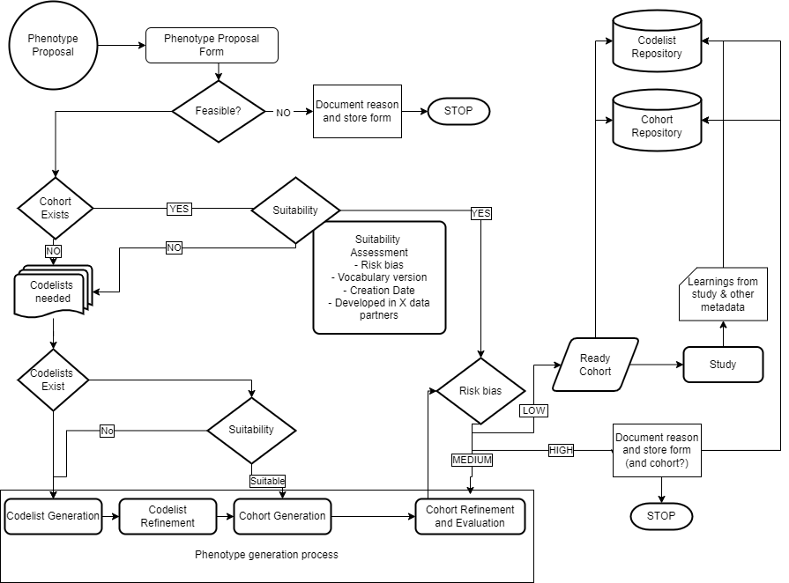
1. PROPOSAL
2. COHORT EXISTS?
Risk of
misclassification
3. CODELIST GENERATION
4. COHORT GENERATION

Slide 5
3. New phenotype generation
3.1 – Codelist generation
3.2 – Codelist refinement
3.3 – Cohorts generation

Slide 6

3.1 Codelist generation
Generate a first codelist (systematic way if possible)
That works with all the vocabularies potentially involved
Tools:
Codelist generator

Slide 7
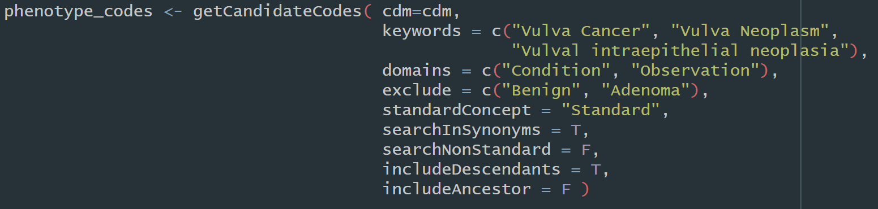
Codelist generator

Slide 8
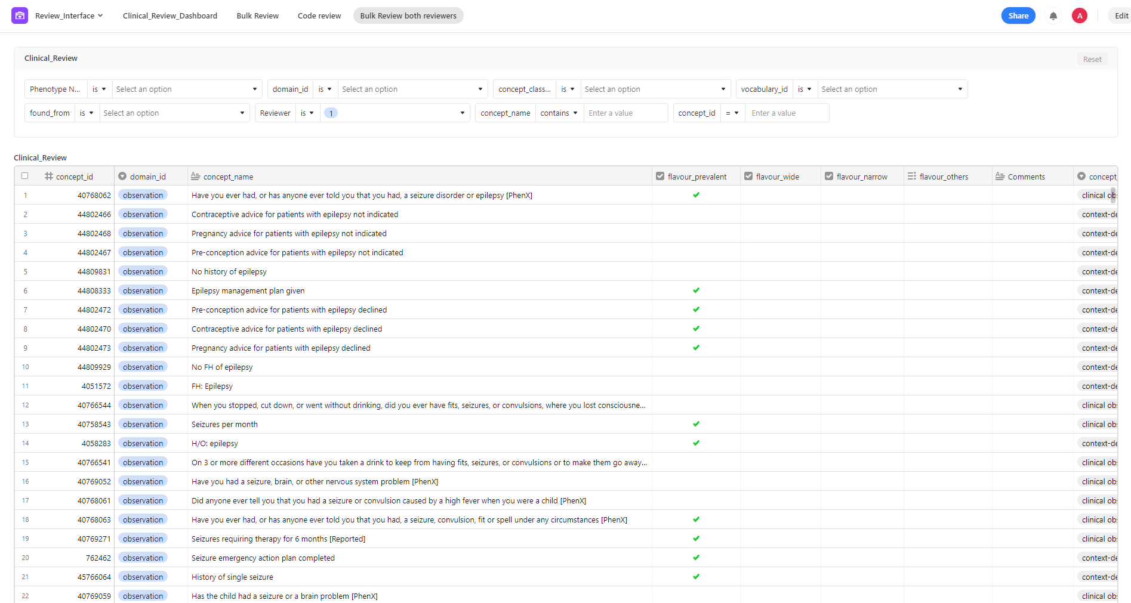

Slide 9
3.2 Codelist refinement
Clinical review
- Two independent reviewers
- Third ‘referee’
Potentially code recommender tools
Delimitate cohort flavours
- Narrow vs Broad
- Incident vs Prevalent
- Secondary vs Primary vs All
- …

Slide 10
Breakout Session
Try codelist generator
Use codelist generator and Athena
https://dpa-pde-oxford.shinyapps.io/CodeListGenerator_shiny_SS24_2/
https://dpa-pde-oxford.shinyapps.io/CodeListGenerator_shiny_SS24/
https://athena.ohdsi.org/

Slide 11
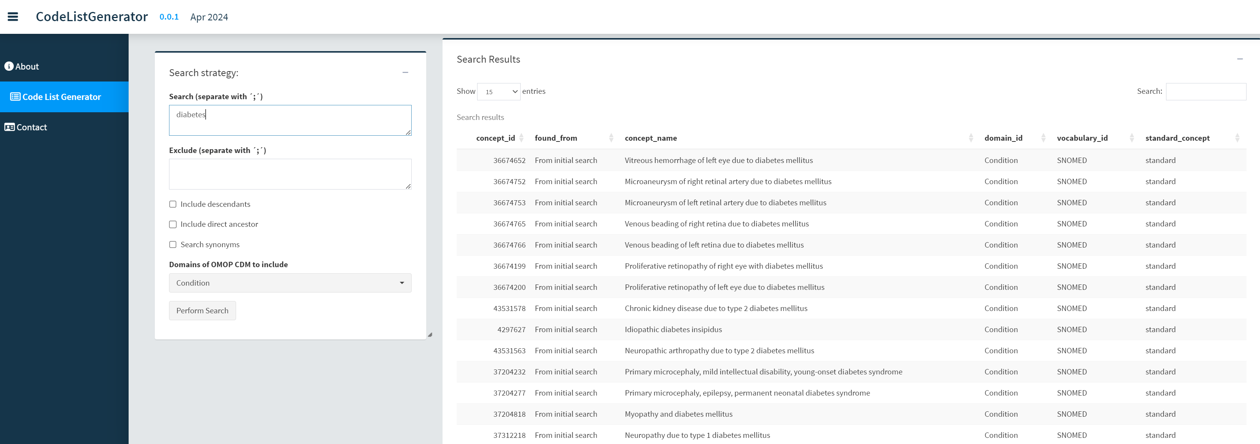
Codelist Generator
1. Keywords to search
and options here
Results will appear here
2- Click here

Slide 12
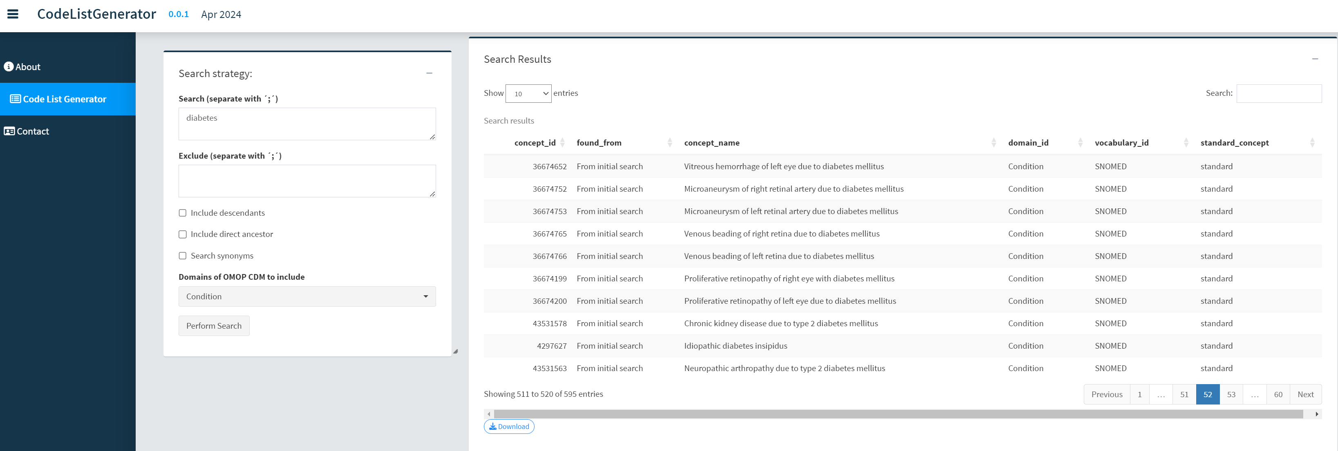
Codelist Generator
3- Download excel file here

Slide 13
Breakout Session
Try codelist generator
Use codelist generator and Athena
https://dpa-pde-oxford.shinyapps.io/CodeListGenerator_shiny_SS24_2/
https://dpa-pde-oxford.shinyapps.io/CodeListGenerator_shiny_SS24/
https://athena.ohdsi.org/

Slide 14
Breakout Session
Try codelist generator
Use codelist generator and Athena
Outputs:
Keywords
Any exclusions?
Options: descendants/ancestors/synonyms
Domains
N of codes
https://dpa-pde-oxford.shinyapps.io/CodeListGenerator_shiny_SS24/
https://dpa-pde-oxford.shinyapps.io/CodeListGenerator_shiny_SS24_2/
https://athena.ohdsi.org/search-terms/start

Slide 15
Cohort creation

Slide 16
Cohort creation
Cohort for each flavour
Determine start of follow up criteria:
- Index event/s
- Inclusion/exclusion criteria
- Time in observation
Determine end of follow up:
- Duration disease/drug use
- Death
- End of observation
- Censor at certain events

Slide 17

Cohort creation
Cohort for each flavour
Determine start of follow up criteria:
- Index event/s
- Inclusion/exclusion criteria
- Time in observation
Determine end of follow up:
- Duration disease/drug use
- Death
- End of observation
- Censor at certain events
Which code lists/concept sets do you need?
Do you want to apply any logics?

Slide 18
Cohort creation
Tools:
- ATLAS
- CohortConstructor

Slide 19
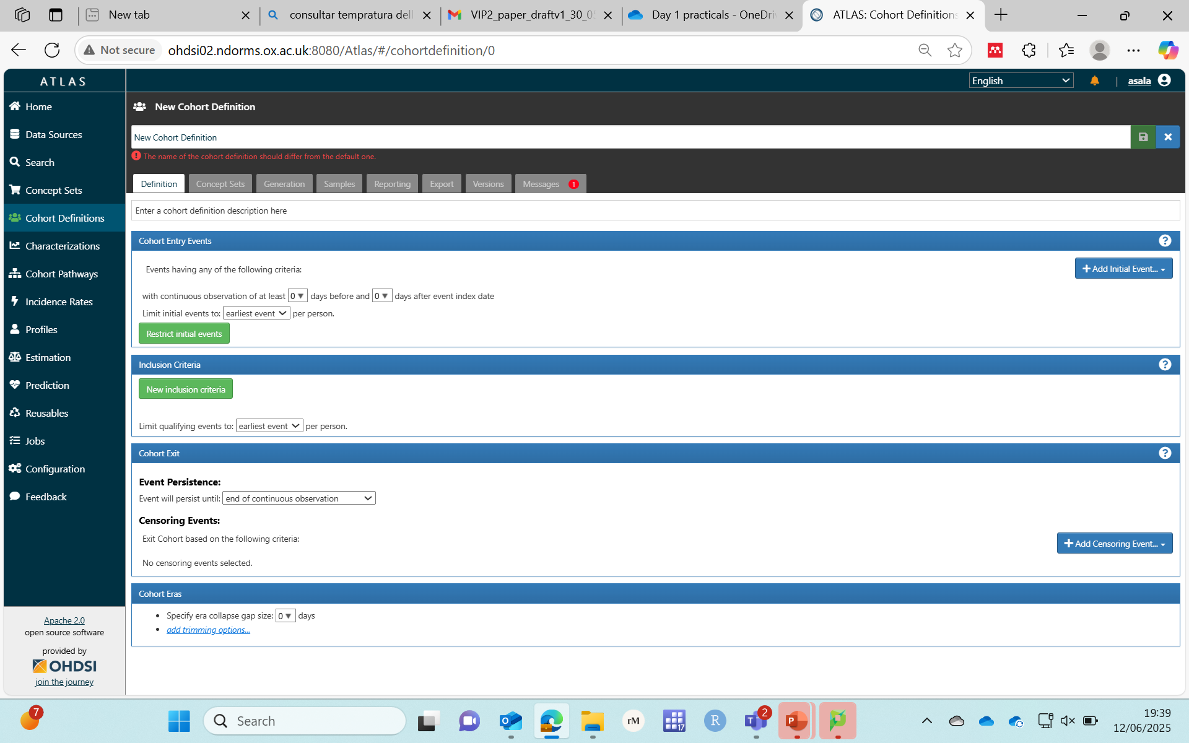
ATLAS
Cohort creation

Slide 20
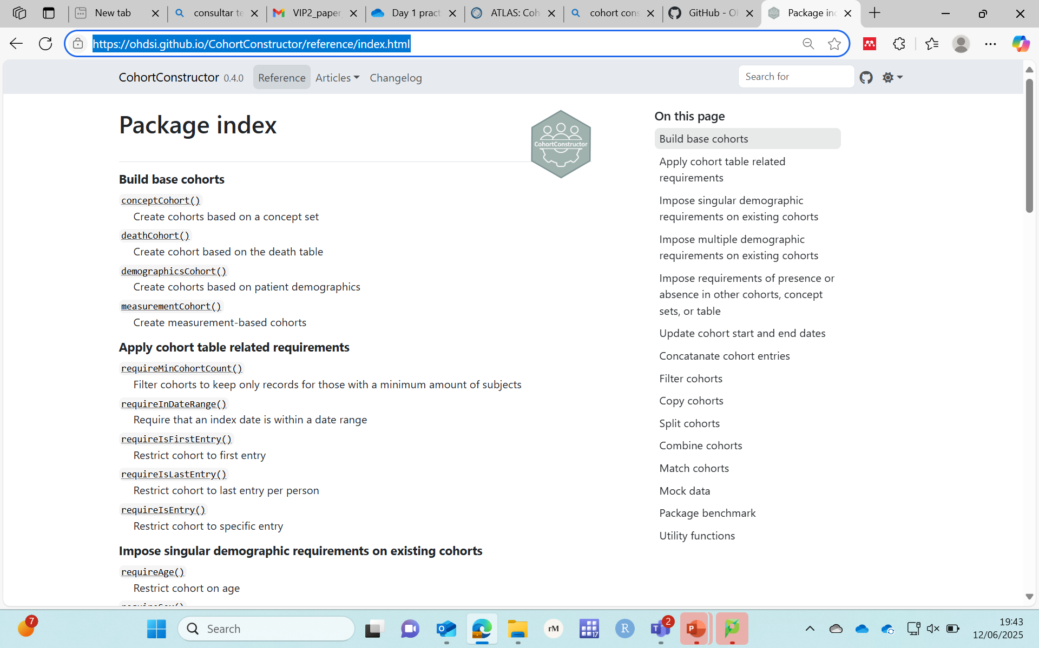

Cohort creation
Package index • CohortConstructor

Slide 21
Cohort creation
The HARPER diagram
An example:
DARWIN EU® - Prevalence of hypertrophic cardiomyopathy (HCM) and obstructive hypertrophic cardiomyopathy (oHCM) in Europe
INDEX Date
(First recorded diagnosis of HCM or oHCM)
INCLUSION Assessment Window
(Aged ≥18 years)
Days [0, 0]
INCLUSION Assessment Window
(continuous enrollment in the database)
Days [-365, -1]
EXCLUSION Assessment Window
(Diagnosis of HCM or oHCM)
Days (-∞, -1]
FOLLOW-UP Window
Days [0, Censorª]
COVARIATE Assessment Window
(comorbidities, measurements, medications, procedures)
Years (- ∞, -5] (- 5, -3] ​(-3, -1]
Days [-364, -181] [-180, -91] [-90, -1]​ ​(- ∞, -1]​​
COVARIATE Assessment Window
(demographics, comorbidities, measurements, medications, procedures)
Days [0, 0]
COVARIATE Assessment Window
(comorbidities, measurements, medications, procedures)
Days [1, 90] [91, 180] [181, 364]
Years [1, 3) [3, 5) ​[5, ∞)
Observation period
Start date – database inception date
End data availability
Follow-up until the earliest of loss to follow-up, end of data availability, or death
Graphical Depiction of Longitudinal Study Designs in Health Care Databases | Annals of Internal Medicine

Slide 22
Breakout Session
Generate the cohorts by drawing the Harper diagram based on the phenotypes needed to answer your research question

Slide 23
Pending to align with Annika and Xintong
Research questions
What is long-term risk of stroke in patients with atrial fibrillation and hypertension?
What is the short-term impact of aortic valve replacement in reducing the incidence of heart failure in patients with severe aortic stenosis?
What is the prognosis of patients with coronary artery disease who also have hypertension?
What is the risk of developing heart failure in patients with acute pericarditis?
What is the 1-year mortality rate for patients diagnosed with myocardial infarction?

Slide 24
Research questions
What is long-term risk of stroke in patients with atrial fibrillation and hypertension?

Slide 25
Research questions
What is the short-term impact of aortic valve replacement in reducing the incidence of heart failure in patients with severe aortic stenosis?

Slide 26
Research questions
What is the prognosis of patients with coronary artery disease who also have hypertension?

Slide 27
Research questions
What is the risk of developing heart failure in patients with acute pericarditis?

Slide 28
Research questions
What is the 1-year mortality rate for patients diagnosed with myocardial infarction?

