Slide 1

Phenotyping beyond (national) borders
Tools, processes, and examples of transportable phenotypes based on the OMOP CDM
Prof Dani Prieto-Alhambra
Section Lead, Health Data Sciences
Botnar Research Centre, NDORMS, U of Oxford

Slide 2
AGENDA
Phenotyping in RWD
Phenotyping OMOPped data
The DARWIN EU® Phenotyping SOP

Slide 3
AGENDA
Phenotyping in RWD
Phenotyping OMOPped data
The DARWIN EU® Phenotyping SOP

Slide 4



Phenotyping in RWD: The Problem
Finding patients that:
      Have or had certain disease
      Use/d certain treatment (drug or surgeries)
      With certain characteristic/s

Slide 5

1st - Define
Have or had certain disease
Notice: phenotypes are cohorts (time-bound features)
For example: Diabetes

Slide 6
Diabetes in the clinic
How do we do it in the clinic?
Tests
a random venous plasma glucose concentration ≥ 11.1 mmol/l or
a fasting plasma glucose concentration ≥ 7.0 mmol/l (whole blood ≥ 6.1 mmol/l) or
two hour plasma glucose concentration ≥ 11.1 mmol/l two hours after 75g anhydrous glucose in an oral glucose tolerance test (OGTT).
An HbA1c of 48mmol/mol (6.5%) is recommended as the cut off point for diagnosing diabetes
Symptoms
feeling very thirsty
peeing more frequently than usual
feeling very tired
weight loss and loss of muscle bulk
itching, or frequent episodes of thrush
blurred vision
-Screening e.g. NHS Health Check
Diagnosis
With no symptoms diagnosis should not be based on a single glucose determination but requires confirmatory plasma venous determination

Slide 7
Diabetes in Real life
What happens then?
Complications: Long term
Short-term problems
Treatment
Eye problems – retinopathy
Foot problems – Diabetic foot disease
Heart attack and stroke
Kidney problems - nephropathy
Nerve damage - neuropathy
Gum disease and other mouth problems
Related conditions, like cancer
Sexual and genitourinary problems
Hypos –blood sugars are too low
Hypers– blood sugars are too high
Hyperosmolar Hyperglycaemia – emergency by severe dehydration and very high blood sugars.
Diabetic ketoacidosis
Diet and exercise
Insulin
Tablets: Metformin and others
Weight loss surgery

Slide 8







Diabetes in RWD
Symptoms
Tests
Diagnosis
Treatment
Long-term
complications
Short-term
complications

Slide 9
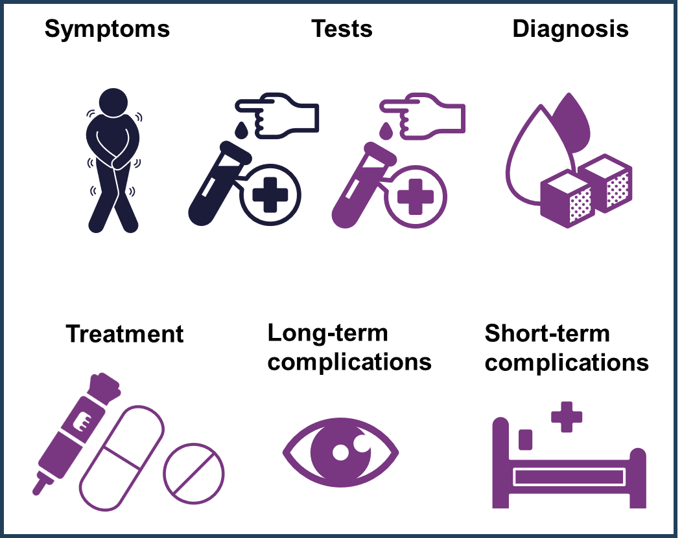
Diabetes in RWD

Slide 10
Diabetes in Multiple Datasets
Symptoms
Tests
Diagnosis
ICD-9
ICD-10
MeSH
Read (e.g. CPRD GOLD)
SNOMED (e.g. CPRD AURUM)
Cpt4
Edi
MeSH
Read
SNOMED
ICD-9
ICD-10
MeSH
Read
SNOMED
Long-term
complications
Short-term
complications
Treatment
Dm+d
MeSH
SNOMED
ATC
ICD-9
ICD-10
MeSH
Read
SNOMED
ICD-9
ICD-10
MeSH
Read
SNOMED

Slide 11




Diabetes in Multiple Datasets
Symptoms
Tests
Diagnosis
ICD-9
ICD-10
MeSH
Read (e.g. CPRD GOLD)
SNOMED (e.g. CPRD AURUM)
Cpt4
Edi
MeSH
Read
SNOMED
ICD-9
ICD-10
MeSH
Read
SNOMED
Long-term
complications
Short-term
complications
Treatment
Dm+d
MeSH
SNOMED
ATC
ICD-9
ICD-10
MeSH
Read
SNOMED
ICD-9
ICD-10
MeSH
Read
SNOMED

Slide 12
AGENDA
Phenotyping in RWD
Phenotyping OMOPped data
The DARWIN EU® Phenotyping SOP

Slide 13
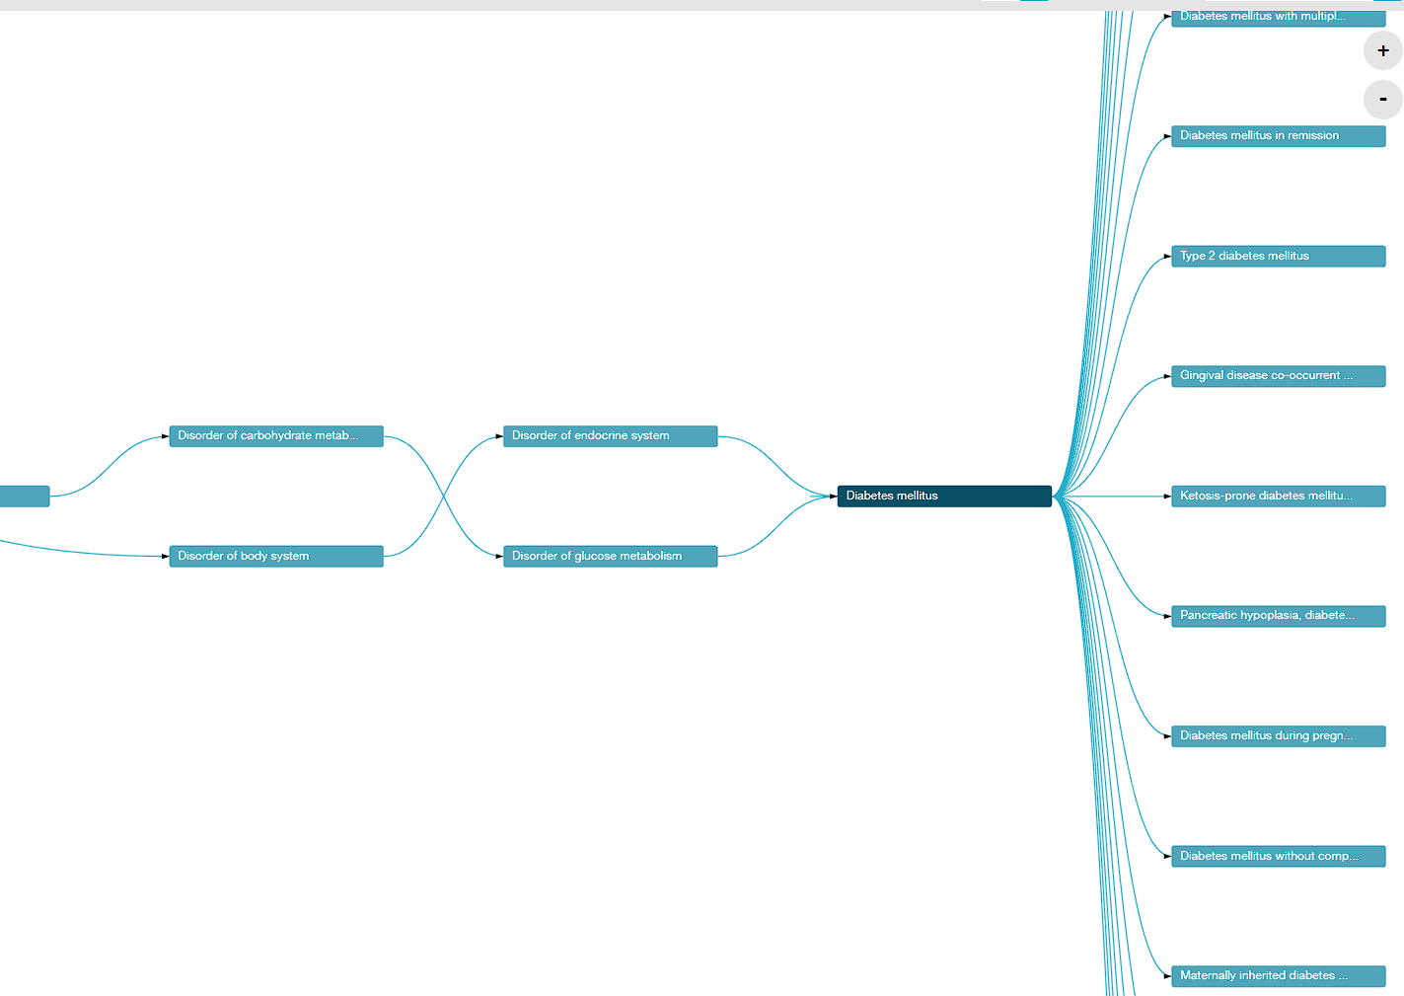
Building blocks
Concept sets / Code lists
List of codes
Included
Exclude: Exclude this concept (and any of its descendants if selected) from the concept set.
Descendants: Consider not only this concept, but also all of its descendants.
Cohorts / Phenotypes
Set of persons who satisfy one or more inclusion criteria for a duration of time
Usually: Concept set/s + logic

Slide 14
Diabetes Cohort/Phenotype

Slide 15
AGENDA
Phenotyping in RWD
Phenotyping OMOPped data
The DARWIN EU® Phenotyping SOP

Slide 16
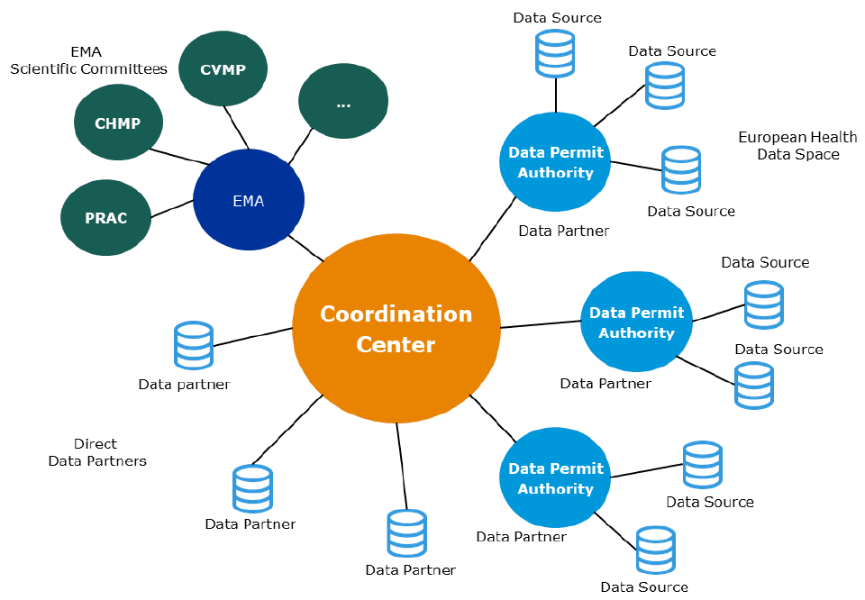
DARWIN EU® is a federated network of data, expertise and services that supports better decision-making throughout the product lifecycle by generating reliable evidence from real world healthcare data
FEDERATED NETWORK PRINCIPLES
Data stays local
Use of Common Data Model to perform studies in a timely manner and increase consistency of results
Notes:
- A Federated Network of Data Holders and expertise, exposing data using a common data model and working under a common governance, set of standards and service levels with regards to studies and analysis of data.
- A Coordination Centre that acts as the entry point into this federated network and manages the network on behalf of EMA and the EMRN.
EMA with strategic control and oversight of operations, e.g. interface with EMA committees, EMA own analysis, driving standards, specifications, guidelines, management of the coordination centre.
Partners who have access to data, or who may request analyses in a data source and provide results to the Coordination Centre. This includes Data Permit Authorities (DPAs), already existing or to be created as part for the European Health Data Space

Slide 17
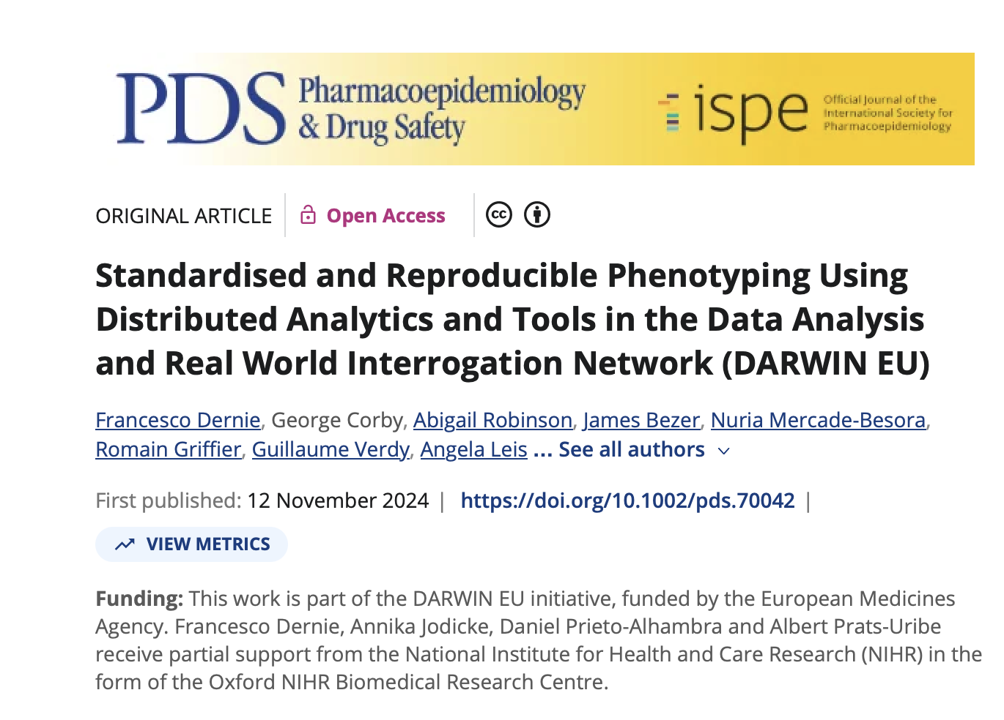
The Process and Tools

Slide 18
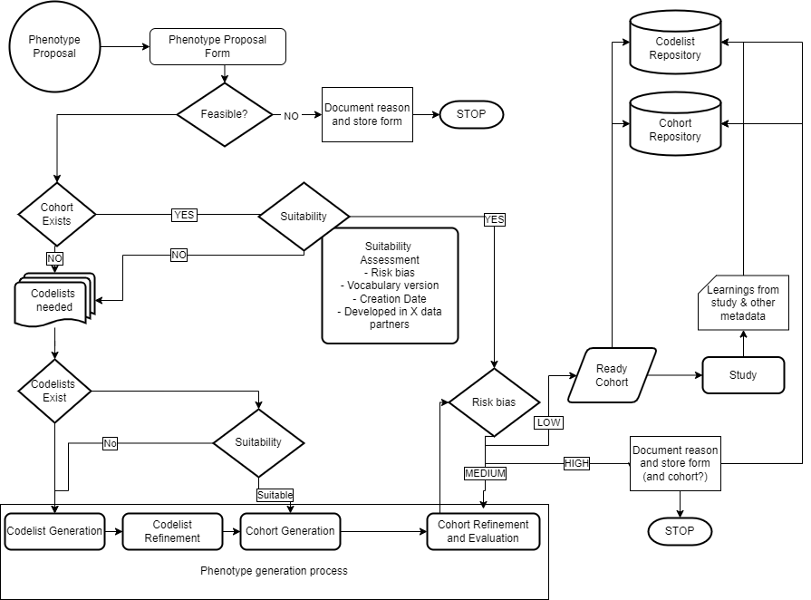
5. DECK
METADATA DB
1. PROPOSAL
Database that follows the process and contains data on all forms and decisions
2. COHORT EXISTS?
Diagnostics DB
Risk of
misclassification
3. CODELIST GENERATION
4. COHORT GENERATION

Slide 19
1. Proposal
Phenotype proposal form
– Who asks? What is it for?
Evaluate:
- Feasibility – If non-feasible – STOP + reason
- Different than study feasibility (but related)
- Need for clinical description
- If yes, clinical description form

Slide 20
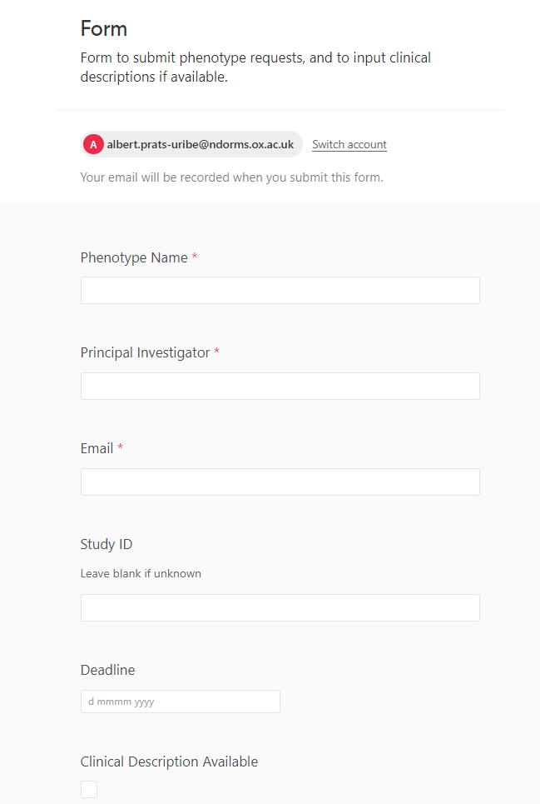
Proposal form

Slide 21
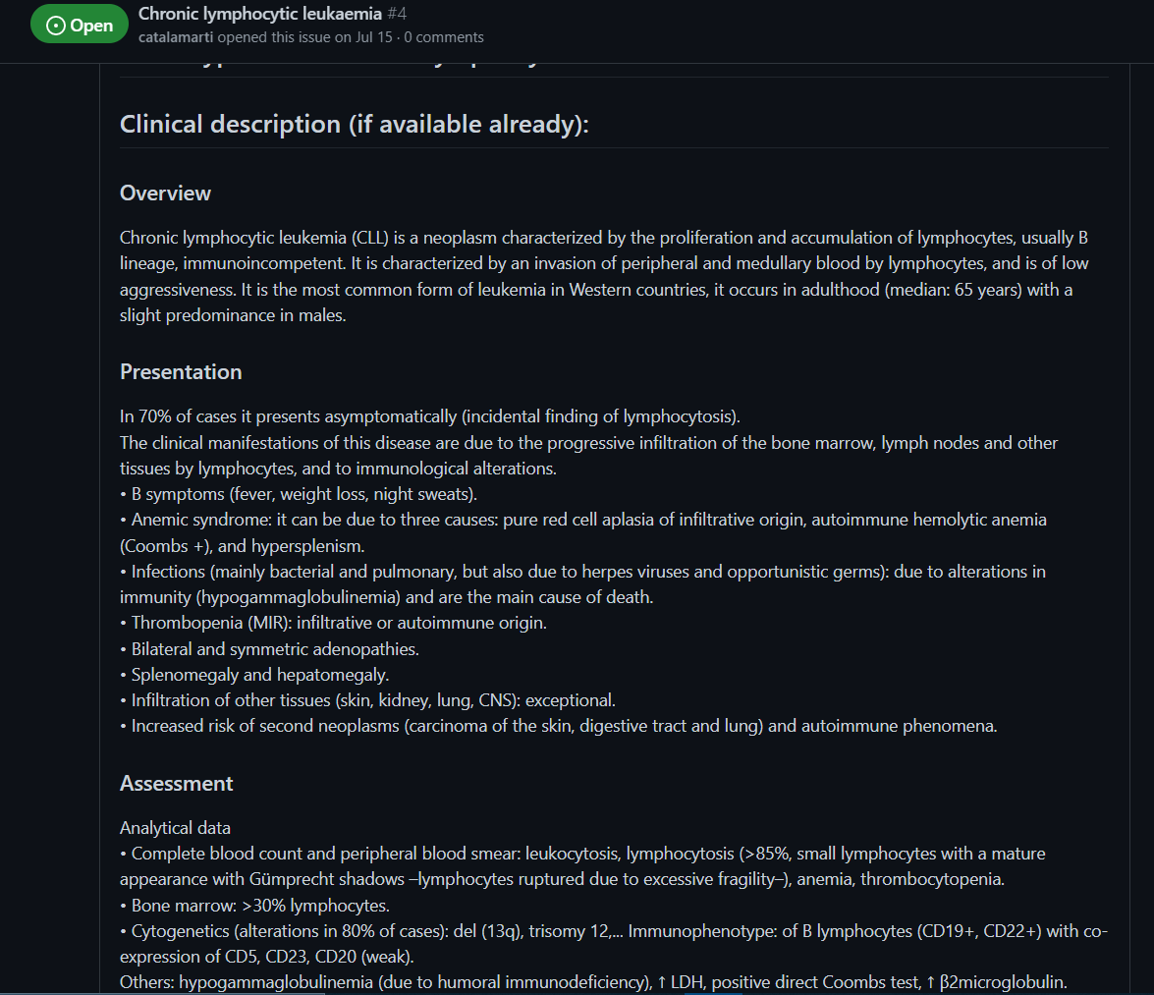
Clinical Description
Overview
Presentation
Assessment
Staging
Management/RX
Prognosis
MedDRA PTs
Disqualifiers
Strengtheners
Suggested Logic Description

Slide 22
2. Does a suitable cohort exist?
2.1 Does a cohort exist?
NO – move to 2.2
YES – Suitability and Risk assessment forms
- Suitable/low risk - Ready cohort
- Suitable/Mid risk – move to 4. cohort refinement and evaluation
- Non Suitable/High risk – document in cohort & move to 2.2
2.2 Does a code list exist?
YES – Move to 3.3 Cohort generation
NO – Move to 3. New phenotype generation process
Risk of
misclassification

Slide 23
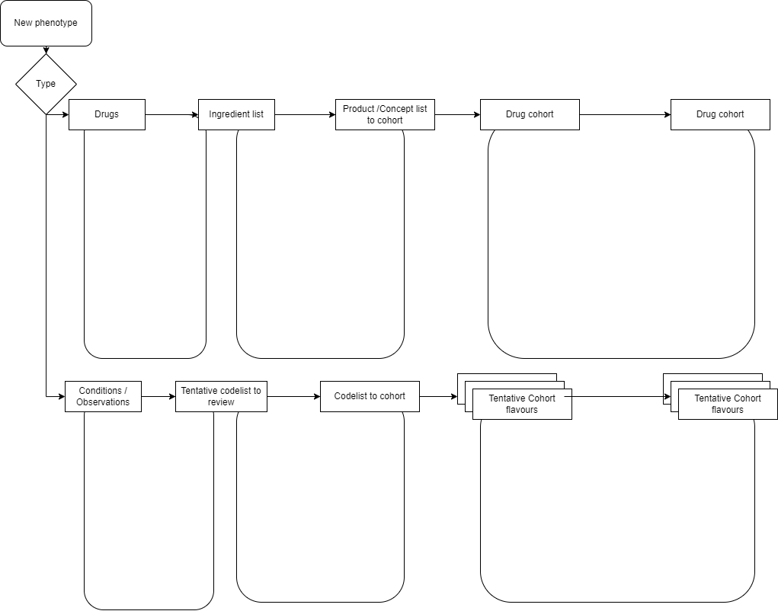
3 - 4
capR
Think about groupings, forms, route, ATC?
Which grouping we first review to avoid a huge list of products?
Codelist
generator
Code review tool and flavour
Flavours:
Mono
combination
Systemic
local
….
Drug exposure diagnostics
ATLAS
ATLAS
DED review form
Search strategy, vocab & codes reached
Code review results per reviewer
Review form per reviewer and db
DECK
capR
Codelist
generator
Code review tool and flavour
Cohort diagnostics
Flavours:
Narrow,
Wide,
Prevalent,
Inpatient,
Others….
ATLAS
Code context
CD review form
PHOEBE
Search strategy, vocab & codes reached
Code review results per reviewer
Review form per reviewer and db

Slide 24
3. New phenotype generation
3.1 – Codelist generation
3.2 – Codelist refinement
3.3 – Cohorts generation

Slide 25

3.1 Codelist generation
Generate a first codelist (systematic way if possible)
Tools:
CodelistGenerator

Slide 26
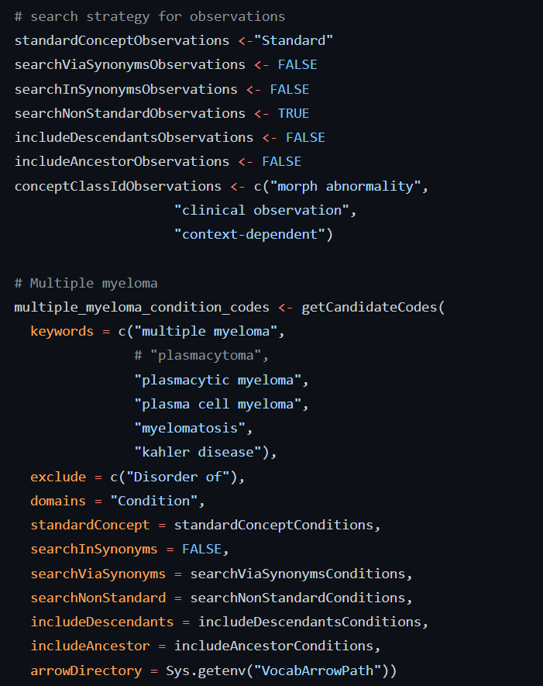
CodelistGenerator

Slide 27
3.2 Codelist refinement
Clinical review. In DARWIN EU®:
- Two independent reviewers
- Third ‘referee’
Delimitate cohort flavours
- Narrow vs Broad
- Incident vs Prevalent
- Secondary vs Primary vs All
- …

Slide 28
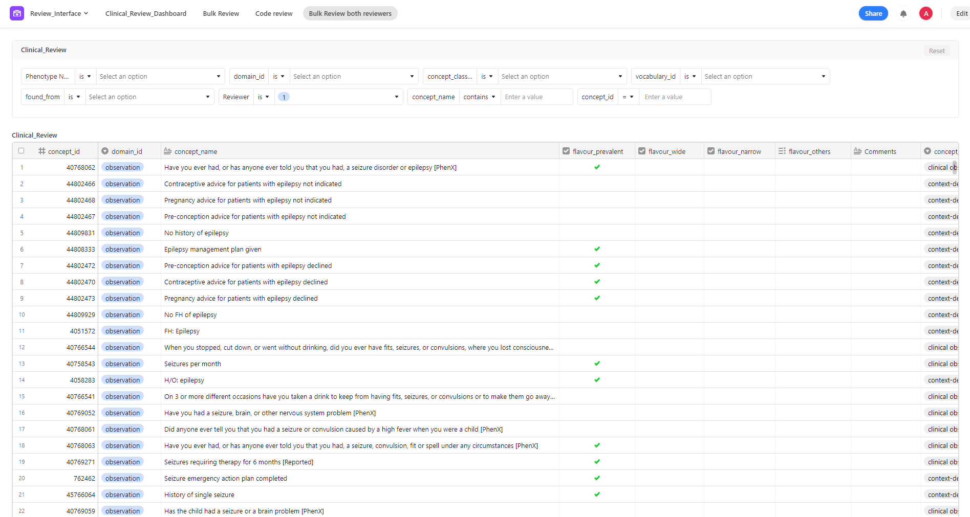
Codelist review

Slide 29
3.3 Cohort definition
Cohort for each flavours
Determine all lookback, forward periods and other times and censoring
Tools:
- CohortConstructor
- caprR
- ATLAS

Slide 30
4 Cohort review / diagnostics
Make sure cohorts represent what we want
Check for every database:
Included / index concepts
‘Orphan’ (missed) concepts: source or standard
Disease epi – incidence/prevalence ~ previous knowledge
Socio-demographics – age and sex profiles ~ previous knowledge
Work/up etc before index date ~ Clinical Description
Consistent treatments after index date ~ Clinical Description
Overlap between different phenotypes: e.g. broad vs narrow

Slide 31
4 Cohort review / diagnostics (2)
TOOLS
- Cohort diagnostics (by OHDSI)
- Drug exposure diagnostics (by DARWIN EU®)
- PhenotypeR (by OHDSI)
+
Phenotype/cohort diagnostics review form
Drug exposure review form

Slide 32
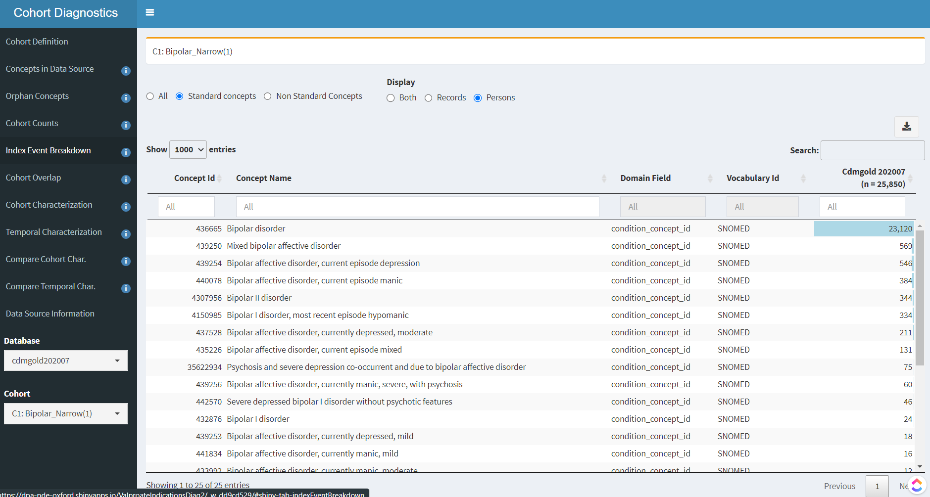

Slide 33
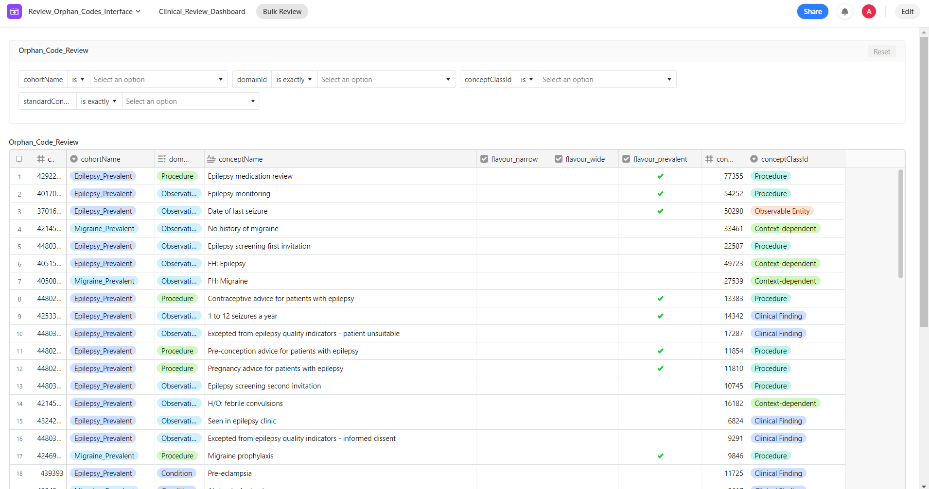
Orphan codes review

Slide 34
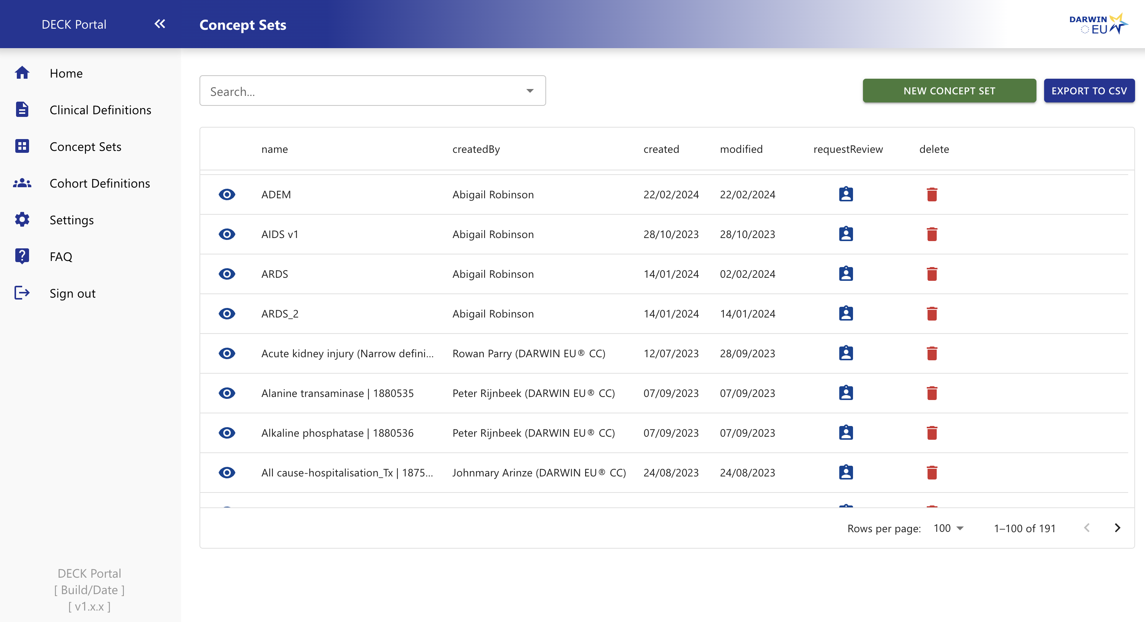
5 – DECK Portal
Store cohort definitions in DECK
- for indications: happy with cohort diagnostics
- for regulatory outcomes: EMA / senior approval
All metadata stored and reusable for future studies

Slide 35
DECK
METADATA DB
Database that follows the process and contains data on all forms and decisions
Diagnostics DB
Risk of
misclassification

Slide 36

QUESTIONS?

