Slide 1
Introduction to Drug Utilisation Studies (in DARWIN EU®)
Dani Prieto-Alhambra, Deputy Director – DARWIN EU®
OHDSI Tutorial
October 2024

Slide 2
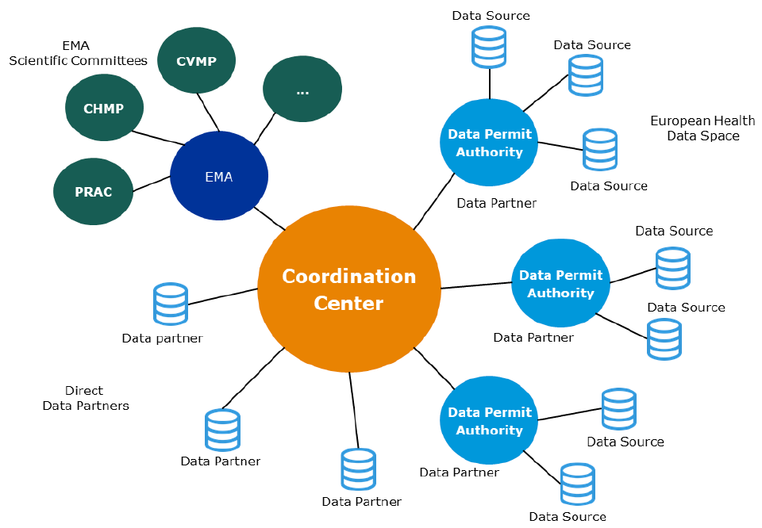
Methods: what is DARWIN EU®?
DARWIN EU® is a federated network of data, expertise and services that supports better decision-making throughout the product lifecycle by generating reliable evidence from real world healthcare data
FEDERATED NETWORK PRINCIPLES
Data stays local
Use of OMOP Common Data Model and related open source standardized analytics
Notes:
- A Federated Network of Data Holders and expertise, exposing data using a common data model and working under a common governance, set of standards and service levels with regards to studies and analysis of data.
- A Coordination Centre that acts as the entry point into this federated network and manages the network on behalf of EMA and the EMRN.
EMA with strategic control and oversight of operations, e.g. interface with EMA committees, EMA own analysis, driving standards, specifications, guidelines, management of the coordination centre.
Partners who have access to data, or who may request analyses in a data source and provide results to the Coordination Centre. This includes Data Permit Authorities (DPAs), already existing or to be created as part for the European Health Data Space

Slide 3
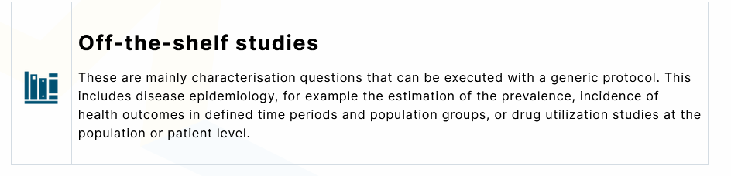
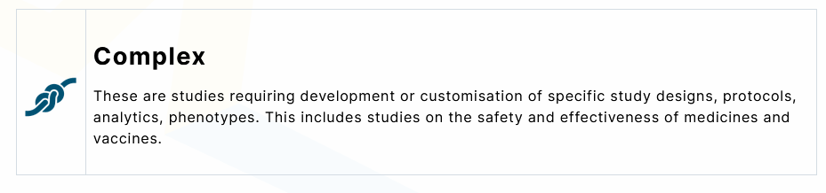
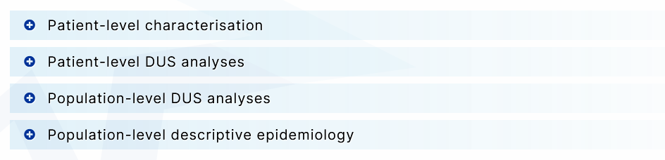
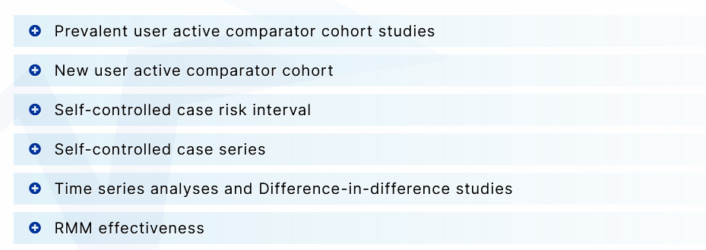
DARWIN EU® Catalogue of Standard Data Analyses

Slide 4

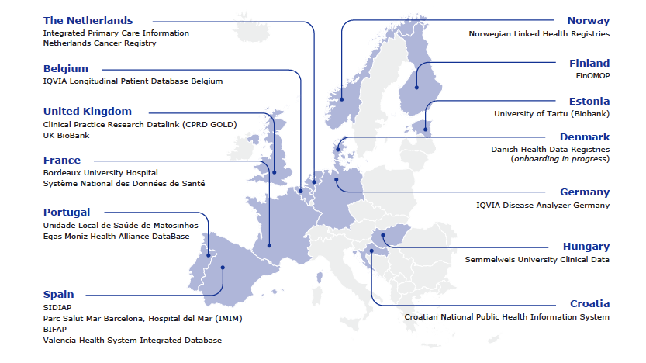
DARWIN EU Current Data Partners
4

Slide 5
RWE Buckets
Clinical characterization:
What happened to them?
OBSERVATION
Patient-level prediction:
What will happen to me?
Population-level effect estimation:
What are the causal effects?
INFERENCE
CAUSAL INFERENCE

Slide 6
RWE Buckets
DUS
Clinical characterization:
What happened to them?
OBSERVATION
RMM
EFFECTIVENESS
Patient-level prediction:
What will happen to me?
Population-level effect estimation:
What are the causal effects?
INFERENCE
CAUSAL INFERENCE

Slide 7
Potential motivation for Descriptive DUS - At the population level …
Understand the uptake of a new medicine
Understand how many people use a medicine/group at a given time
Understand the trends in the use of a medicine/class
Understand the use of a medicine/group in different geographies, age groups, or healthcare settings
Maybe, monitor risk of drug shortages

Slide 8
Potential motivation for Descriptive DUS - At the person/patient level …
Characterise the users of a medicine: age, sex, comorbidities, potential indications, use of concomitant medicines
Analyse how medicine/s are prescribed and used in routine care
Duration of treatment
Quantity
Strength
Dose, etc

Slide 9
Potential motivation for Causal DUS - RMM Effectiveness
Aim to measure the impact of a regulatory action, e.g. change in indication or DHCP letter
Typically combining population- and patient-level assessments
Change (decline?) in the use of a medicine after regulatory action
Change in the characteristics of new drug users. E.g.:
Lower prevalence of new contraindication/s after change in label
Lower % of users for ‘milder’ indication/s

Slide 10

Walk before you run… Drug Exposure Diagnostics
Needed to know what information and granularity is available for DUS research
For provided ingredient concept, provides detailed statistics on a.o.:
Duration
Routes
Duration days
Quantity
Strength
Dose Form
https://darwin-eu.github.io/DrugExposureDiagnostics
Notes:
The Drug Exposure is the most important, but at the same time most complex domain in OMOP research.
We have to deal with multiple levels of information: ingredient, dose, quantity, duration, etc. The granularity of information will differ between databases.
DED provides in-depth statistics by ingredient.

Slide 11
Standard Population-level DUS
Off-the-shelf
Study Design
Population-level cohort study
Participants
Entire database population with at least some time of data visibility available.
Additional eligibility criteria:
Incidence will exclude previously prevalent users of the same drug/drug class
Study population can be restricted to a specific subpopulation e.g., age 18 or older, or with a diagnosis of a pre-specified clinical feature, e.g., prior history of diabetes

Slide 12
Standard Population-level DUS (2)
Off-the-shelf
Output/s
Population-based incidence rates (and 95% confidence intervals) of use of a drug/class
Population-based prevalence (and 95% confidence intervals) of use of a drug/drug class, including point and period prevalence
Either can be stratified by pre-specified criteria such as
Age bands
Sex
Calendar period
Database
Pre-specified characteristic e.g. previous history of a condition

Slide 13

Standard Population-level DUS (3)
Off-the-shelf
Analyses
Incidence rates: number of new users / the time which the eligible population spent at risk (i.e. in person-time)
Prevalence: number of users (prevalent or new) / whole database population at a specific time point (i.e., point prevalence) or over a specific time window (i.e., period prevalence).
Analyses may be stratified by socio-demographics (e.g., age bands or sex), calendar period (i.e. months, years), or additional criteria if pre-specified

Slide 14
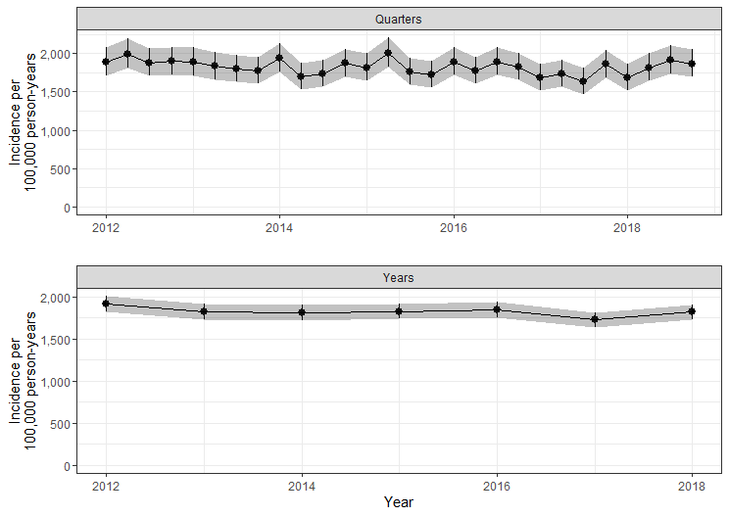
Standard Population-level DUS (4)
Off-the-shelf
Results
- Pre-specified tables, figures, etc as per COSA

Slide 15
Standard Patient/person-level DUS
Off-the-shelf
Study Design
New drug/s user cohort
Participants
One or more cohort/s of incident drug users, typically with people having some pre-specified time of data visibility, and no use of the same drug/drug class in that time
Study population can be restricted to a specific subpopulation, e.g. pre-specified diagnosis, indication or age at start of treatment

Slide 16
Standard Patient/person-level DUS (2)
Off-the-shelf
Outputs
Patient-level characteristics on and/or before treatment initiation
Indication, defined based on a list of pre-defined indications
Initial dose/strength (as prescribed/dispensed at therapy initiation, where available)
Cumulative use within a pre-specified time period (e.g. 1 year), calculated based on number of prescriptions and dose/strength
Treatment duration
Count of repeated prescriptions during a pre-specified time period (e.g. 1 year)

Slide 17

Standard Population-level DUS (3)
Off-the-shelf
Analyses
Large-scale characterisation of patient-level features based on code/concept and descendants, including socio-demographics, comorbidity, and previous medicines use any time, in the year and month before treatment start
Frequency and % of indication/s, based on pre-specified list of diagnoses recorded before therapy initiation
Summary of initial dose/strength, treatment duration, cumulative drug use and number of repeated prescriptions within a pre-specified time period (e.g. 1 year)
Treatment discontinuation, estimated based on the Kaplan-Meier method
Notes:
Summary of = minimum, p25, median, p75, mean, standard deviation, and maximum

Slide 18
Standard Population-level DUS (4)
Off-the-shelf
Results
Notes:
Summary of = minimum, p25, median, p75, mean, standard deviation, and maximum

Slide 19
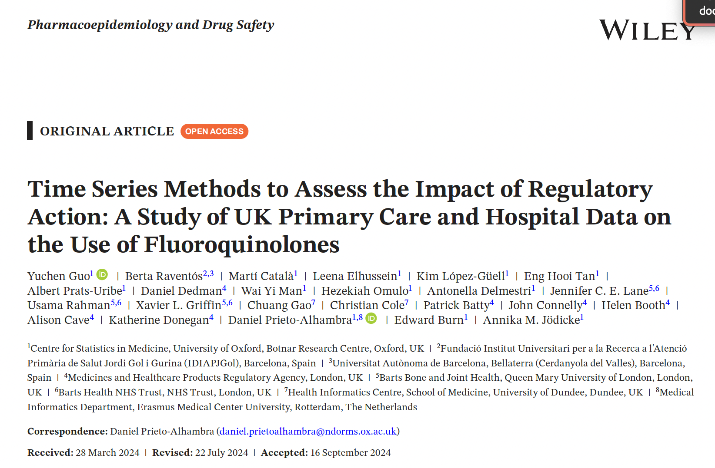
Analyses of RMM Effectiveness
complex
Study design
Complex study: requires bespoke modelling of interventions like risk minimization measures after the completion of population- and/or patient-level DUS.
Typically interrupted time series to analyse the impact of a regulatory action on the use of a medicine
Not covered today! No std pipeline
Read Y Guo et al. PDS 2024 if interested

Slide 20
QUESTIONS?

