Slide 1
Analyze Financial Data with Python Capstone
Capstone project for the Analyze Financial Data with Python Skill Path.
Josef Hazi

Slide 2
Summary

Slide 3
Content
Data import
Initial data analysis
Data analysis and discussion
Portfolio optimisation
Conclusion

Slide 4
Data import
Could use Tiingo + Pandas DataReader / or Yahoo Finance
Can use get_data_yahoo function instead of using an API
stock_data = pdr.get_data_yahoo(symbols, start_date, end_date)
Time period: 1.1.2019 until today
Chose these companies: ["MSFT","INTC", "AMZN", "EBAY", "AAPL", "GOOG", "FB", "TSLA", "GE"]
Would like to know how to find the ticker symbols easily though

Slide 5
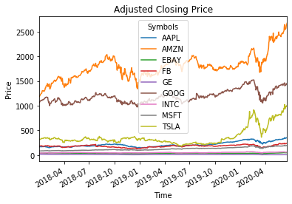
Initial data analysis – big picture
When we plot the Adjusted Closing Price data we can notice the events around Black Thursday in March 2020 as well as following recovery thanks to Fed QE
Adjuste Closing Price (ACP) is price adjusted for corporate actions such as dividends payouts, stock splits etc.

Slide 6
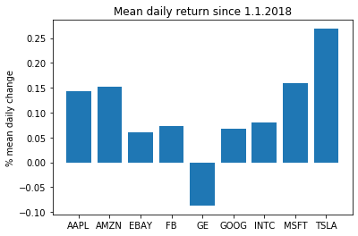
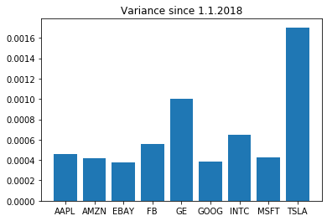
Initial data analysis – return vs risk
Daily mean returns based on ACP
Variance of ACP

Slide 7
Data analysis – correlation of returns and covariance of risks
Correlation
Covariance
Symbols | AAPL | AMZN | EBAY | FB | GE | GOOG | INTC | MSFT | TSLA
Symbols
AAPL | 1.000000 | 0.646536 | 0.492537 | 0.615885 | 0.458439 | 0.745614 | 0.678765 | 0.795699 | 0.405388
AMZN | 0.646536 | 1.000000 | 0.409051 | 0.615235 | 0.314970 | 0.698217 | 0.539217 | 0.733588 | 0.375698
EBAY | 0.492537 | 0.409051 | 1.000000 | 0.390265 | 0.283594 | 0.471080 | 0.427465 | 0.517827 | 0.230294
FB | 0.615885 | 0.615235 | 0.390265 | 1.000000 | 0.376672 | 0.709383 | 0.533656 | 0.668586 | 0.336233
GE | 0.458439 | 0.314970 | 0.283594 | 0.376672 | 1.000000 | 0.409761 | 0.365161 | 0.435658 | 0.271292
GOOG | 0.745614 | 0.698217 | 0.471080 | 0.709383 | 0.409761 | 1.000000 | 0.636824 | 0.818286 | 0.384801
INTC | 0.678765 | 0.539217 | 0.427465 | 0.533656 | 0.365161 | 0.636824 | 1.000000 | 0.735453 | 0.352317
MSFT | 0.795699 | 0.733588 | 0.517827 | 0.668586 | 0.435658 | 0.818286 | 0.735453 | 1.000000 | 0.434062
TSLA | 0.405388 | 0.375698 | 0.230294 | 0.336233 | 0.271292 | 0.384801 | 0.352317 | 0.434062 | 1.000000
Symbols | AAPL | AMZN | EBAY | FB | GE | GOOG | INTC | MSFT | TSLA
Symbols
AAPL | 0.000462 | 0.000284 | 0.000205 | 0.000313 | 0.000311 | 0.000314 | 0.000371 | 0.000352 | 0.000360
AMZN | 0.000284 | 0.000419 | 0.000162 | 0.000298 | 0.000204 | 0.000280 | 0.000281 | 0.000309 | 0.000318
EBAY | 0.000205 | 0.000162 | 0.000375 | 0.000179 | 0.000173 | 0.000179 | 0.000210 | 0.000206 | 0.000184
FB | 0.000313 | 0.000298 | 0.000179 | 0.000561 | 0.000282 | 0.000330 | 0.000322 | 0.000326 | 0.000329
GE | 0.000311 | 0.000204 | 0.000173 | 0.000282 | 0.000998 | 0.000254 | 0.000293 | 0.000283 | 0.000354
GOOG | 0.000314 | 0.000280 | 0.000179 | 0.000330 | 0.000254 | 0.000385 | 0.000318 | 0.000331 | 0.000312
INTC | 0.000371 | 0.000281 | 0.000210 | 0.000322 | 0.000293 | 0.000318 | 0.000647 | 0.000385 | 0.000370
MSFT | 0.000352 | 0.000309 | 0.000206 | 0.000326 | 0.000283 | 0.000331 | 0.000385 | 0.000424 | 0.000369
TSLA | 0.000360 | 0.000318 | 0.000184 | 0.000329 | 0.000354 | 0.000312 | 0.000370 | 0.000369 | 0.001703

Slide 8
Data analysis - discussion
We can see that all the stocks movement have been very correlated
GE was the only one that would have lost us money
Tesla has done spectacularly, although we should bear in mind that past performance is not predictive of future profits
Tesla was also the most volatile of the 9 analysed stocks

Slide 9
Portfolio optimisation
We use two functions provided by Codecademy
return_portfolios(expected_returns, cov_matrix)
This function generates random portfolios to visualise (non-optimised) examples of the portfolios’ expected returns versus risks based on the covariance of the chosen stocks
optimal_portfolio(returns)
This function provides specific weights of portfolios that are optimised for the best expected returns at lowest risks

Slide 10
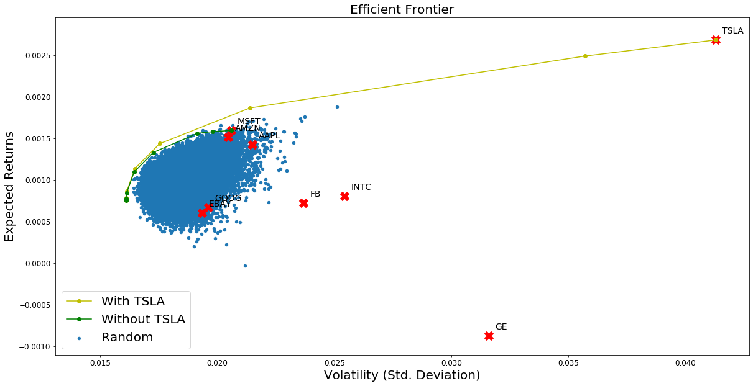
Portfolio optimisation – efficient frontier

Slide 11
Portfolio optimisation – efficient frontier - Highest return
When we print the shape of the weights by print(weights.shape) we find out that the optimal_portfolio function only provides one suggeston and that’s the one with the highest return – this is useless since the portfolio of highest return is just 100% of the stock that had the best previous performance

Slide 12
Portfolio optimisation – efficient frontier - Lowest risk / best return
In order to get low risk / good return portfolio we unfortunately have to use the sub-optimal “return_portfolios” function
We specify the conditions for the risk and return:

Slide 13
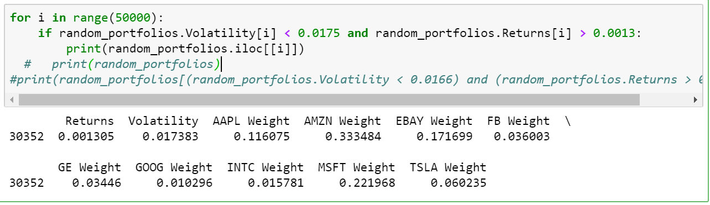
Portfolio optimisation – efficient frontier - Lowest risk / best return
AAPL : 11.6%
AMZN: 33,34%
EBAY: 17,17%
FB: 3.6%
GE: 3.45%
GOOG: 1.02%
INTC: 1.58%
MSFT: 22.2%
TSLA: 6%

Slide 14
Portfolio optimisation – efficient frontier
To simplify the results we have plotted only 10 examples of optimised portfolios falling on the efficient frontier
As we can see both the portfolio for least risk and the portfolio for highest return are 99.999% composed of Tesla

Slide 15
Conclusion
Whilst the “optimal_portfolio” function is great for visualising the efficient frontier and giving us idea for what kind of returns and risks to expect, it does not generate the weights of the optimised portfolios, it only generates the highest return portfolio
However the highest return portfolio is 100% of the best performing stock from the previous data
We need to use “return_portfolios” and specify expected risk and return to generate low-risk, high return portfolio approaching the efficient frontier
One should also remember that past performance is not predictive of future results, just because Tesla did well last year, does not mean it will do well next year

Slide 16
Notes 1
Note: in previous Codecademy projects we used “Adj Close” which means Adjusted Closing price
https://www.investopedia.com/terms/a/adjusted_closing_price.asp

Slide 17
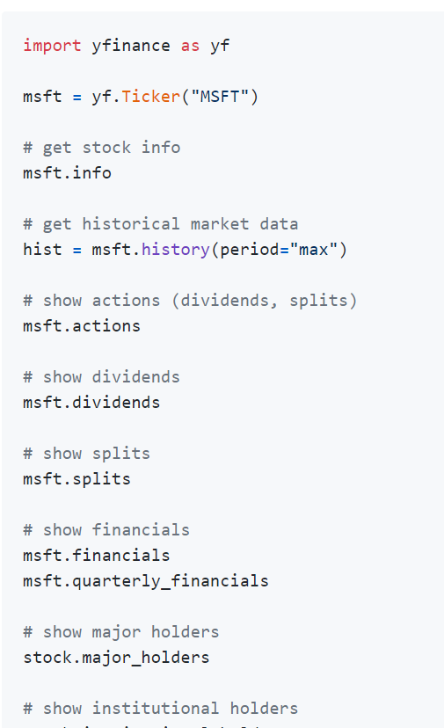
Notes 2
There’s much more data you can get from Yahoo Finance
https://github.com/ranaroussi/yfinance

