Slide 1
MergeSort
Source: Gibbs & Tamassia

Slide 2
MergeSort
MergeSort is a divide and conquer method of sorting

Slide 3
MergeSort Algorithm
MergeSort is a recursive sorting procedure that uses at most O(n lg(n)) comparisons.
To sort an array of n elements, we perform the following steps in sequence:
If n < 2 then the array is already sorted.
Otherwise, n > 1, and we perform the following three steps in sequence:
  Sort the left half of the the array using MergeSort.
  Sort the right half of the the array using MergeSort.
  Merge the sorted left and right halves.

Slide 4
How to Merge
Here are two lists to be merged:
  First: (12, 16, 17, 20, 21, 27)
  Second: (9, 10, 11, 12, 19)
Compare12 and 9
  First: (12, 16, 17, 20, 21, 27)
  Second: (10, 11, 12, 19)
  New: (9)
Compare 12 and 10
  First: (12, 16, 17, 20, 21, 27)
  Second: (11, 12, 19)
  New: (9, 10)

Slide 5
Merge Example
Compare 12 and 11
  First: (12, 16, 17, 20, 21, 27)
  Second: (12, 19)
  New: (9, 10, 11)
Compare 12 and 12
  First: (16, 17, 20, 21, 27)
  Second: (12, 19)
  New: (9, 10, 11, 12)

Slide 6
Merge Example
Compare 16 and 12
  First: (16, 17, 20, 21, 27)
  Second: (19)
  New: (9, 10, 11, 12, 12)
Compare 16 and 19
  First: (17, 20, 21, 27)
  Second: (19)
  New: (9, 10, 11, 12, 12, 16)

Slide 7
Merge Example
Compare 17 and 19
  First: (20, 21, 27)
  Second: (19)
  New: (9, 10, 11, 12, 12, 16, 17)
Compare 20 and 19
  First: (20, 21, 27)
  Second: ( )
  New: (9, 10, 11, 12, 12, 16, 17, 19)

Slide 8
Merge Example
Checkout 20 and empty list
  First: ( )
  Second: ( )
  New: (9, 10, 11, 12, 12, 16, 17, 19, 20, 21, 27)

Slide 9
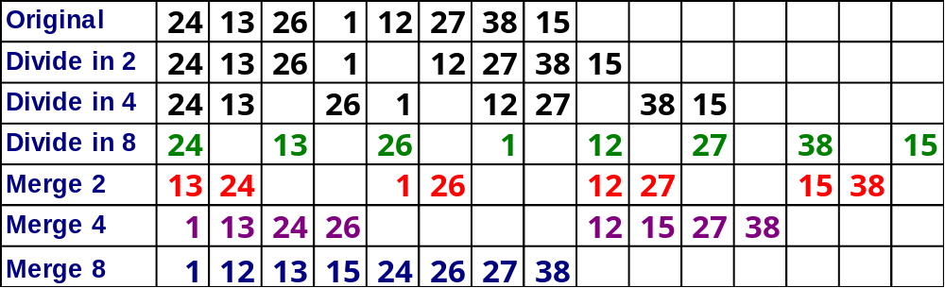
MergeSort

Slide 10
Merge-Sort Tree
An execution of merge-sort is depicted by a binary tree
  each node represents a recursive call of merge-sort and stores
    unsorted sequence before the execution and its partition
    sorted sequence at the end of the execution
  the root is the initial call
  the leaves are calls on subsequences of size 0 or 1
7 2 ⏐ 9 4 → 2 4 7 9
7 ⏐ 2 → 2 7
9 ⏐ 4 → 4 9
7 → 7
2 → 2
9 → 9
4 → 4

Slide 11
Execution Example
Partition
7 2 9 4 ⏐ 3 8 6 1

Slide 12
Execution Example (cont.)
Recursive call, partition
7 2 9 4 ⏐ 3 8 6 1
7 2 ⏐ 9 4

Slide 13
Execution Example (cont.)
Recursive call, partition
7 2 9 4 ⏐ 3 8 6 1
7 2 ⏐ 9 4
7 ⏐ 2

Slide 14
Execution Example (cont.)
Recursive call, base case
7 2 9 4 ⏐ 3 8 6 1
7 2 ⏐ 9 4
7 ⏐ 2
7 → 7

Slide 15
Execution Example (cont.)
Recursive call, base case
7 2 9 4 ⏐ 3 8 6 1
7 2 ⏐ 9 4
7 ⏐ 2
7 → 7
2 → 2

Slide 16
Execution Example (cont.)
Merge
7 2 9 4 ⏐ 3 8 6 1
7 2 ⏐ 9 4
7 ⏐ 2 → 2 7
7 → 7
2 → 2

Slide 17
Execution Example (cont.)
Recursive call, …, base case, merge
7 2 9 4 ⏐ 3 8 6 1
7 2 ⏐ 9 4
7 ⏐ 2 → 2 7
9 4 → 4 9
7 → 7
2 → 2
9 → 9
4 → 4

Slide 18
Execution Example (cont.)
Merge
7 2 9 4 ⏐ 3 8 6 1
7 2 ⏐ 9 4 → 2 4 7 9
7 ⏐ 2 → 2 7
9 4 → 4 9
7 → 7
2 → 2
9 → 9
4 → 4

Slide 19
Execution Example (cont.)
Recursive call, …, merge, merge
7 2 9 4 ⏐ 3 8 6 1
7 2 ⏐ 9 4 → 2 4 7 9
3 8 6 1 → 1 3 6 8
7 ⏐ 2 → 2 7
9 4 → 4 9
3 8 → 3 8
6 1 → 1 6
7 → 7
2 → 2
9 → 9
4 → 4
3 → 3
8 → 8
6 → 6
1 → 1

Slide 20
Execution Example (cont.)
Merge
7 2 9 4 ⏐ 3 8 6 1 → 1 2 3 4 6 7 8 9
7 2 ⏐ 9 4 → 2 4 7 9
3 8 6 1 → 1 3 6 8
7 ⏐ 2 → 2 7
9 4 → 4 9
3 8 → 3 8
6 1 → 1 6
7 → 7
2 → 2
9 → 9
4 → 4
3 → 3
8 → 8
6 → 6
1 → 1

Slide 21
Complexity of MergeSort
Pass Number | Number of merges | Merge list length | # of comps / moves per merge
1 | 2^{k-1} or n/2 | 1 or n/2^{k} | ≤ 2¹
2 | 2^{k-2} or n/4 | 2 or n/2^{k-1} | ≤ 2²
3 | 2^{k-3} or n/8 | 4 or n/2^{k-2} | ≤ 2³
. | . | . | .
. | . | . | .
. | . | . | .
k – 1 | 2¹ or n/2^{k-1} | 2^{k-2} or n/4 | ≤ 2^{k-1}
k | 2⁰ or n/2^{k} | 2^{k-1} or n/2 | ≤ 2^{k}
k = log n

Slide 22
Complexity of MergeSort
Multiplying the number of merges by the maximum number of comparisons per merge, we get:
(2^{k-1})2¹ = 2^{k}
(2^{k-2})2² = 2^{k}
•
•
•
(2¹)2^{k-1} = 2^{k}
(2⁰)2^{k} = 2^{k}
k passes each require 2^{k} comparisons (and moves). But k = lg n and hence, we get lg(n) • n comparisons or O(n lgn)

