Slide 1
Convex hAR
Aishwary Pramanik and Orens Xhagolli
December 6th, 2017

Slide 2
Convex hAR (hull) - Background

Slide 3
Convex hAR - Motivation
Application of Convex Hull in a security setting
Manhunt simulation

Slide 4
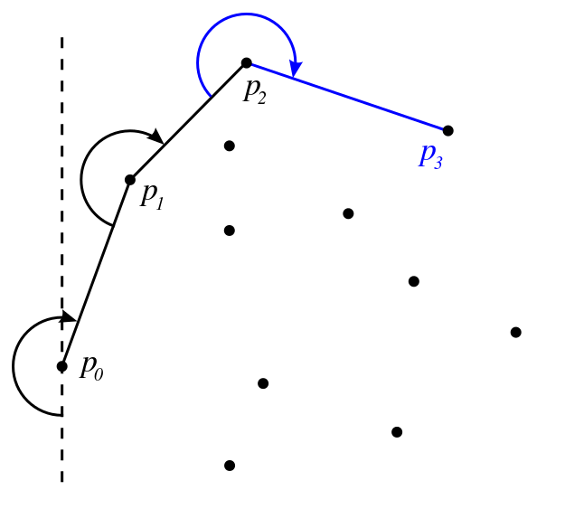
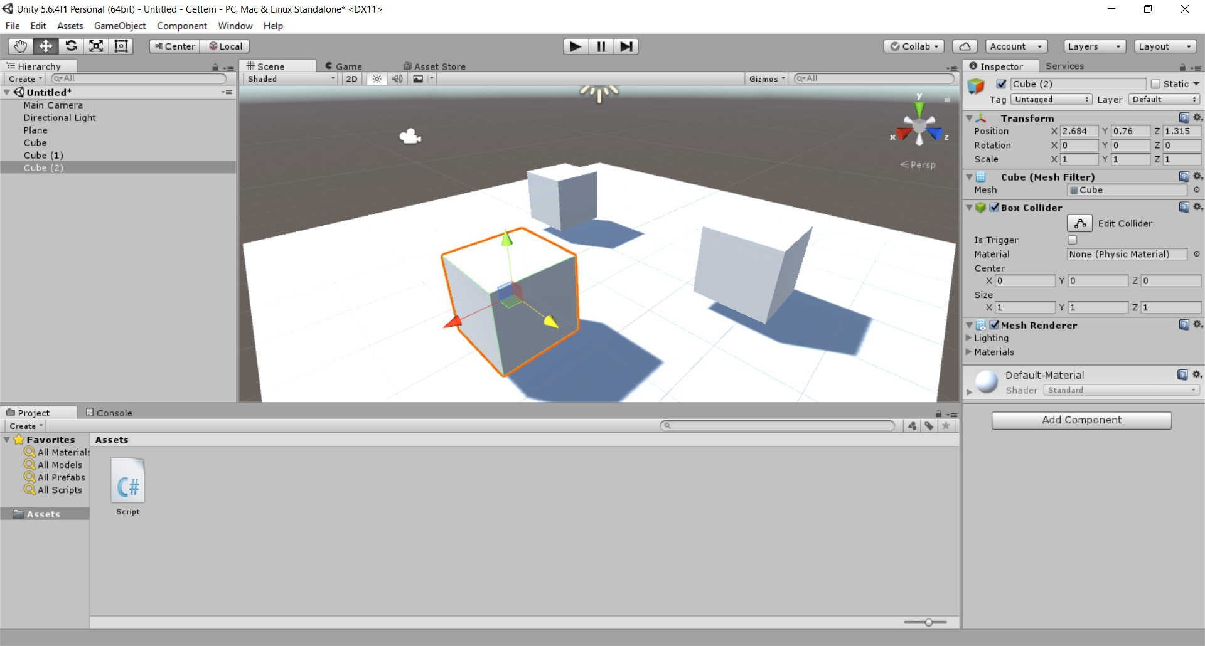
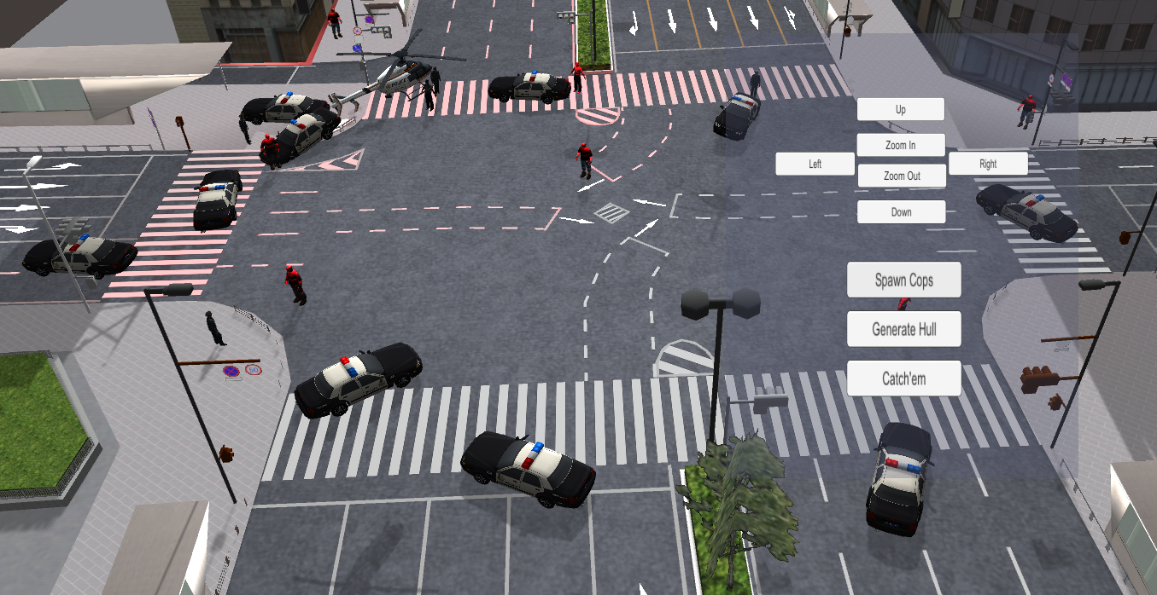
Convex hAR - Technical Details
Algorithm
Unity
Augmented Reality
Jarvis’ March
Implemented in C#
Use Unity
Pair Visuals + AR
Visual Engagement
Complete world

Slide 5
Project Demo

Slide 6
Questions?

