Slide 1
Rusty USB Gadgets Make Barking BeagleBones
Andrew P. Lentvorski
VP, Engineering
Thirdwayv
oxidize2020@thirdwayv.com
https://github.com/oxidize2020-thirdwayv/barkingbeaglebone

Slide 2
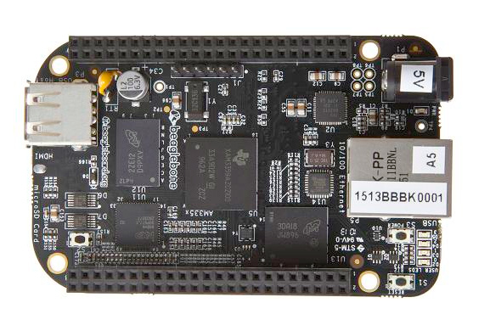
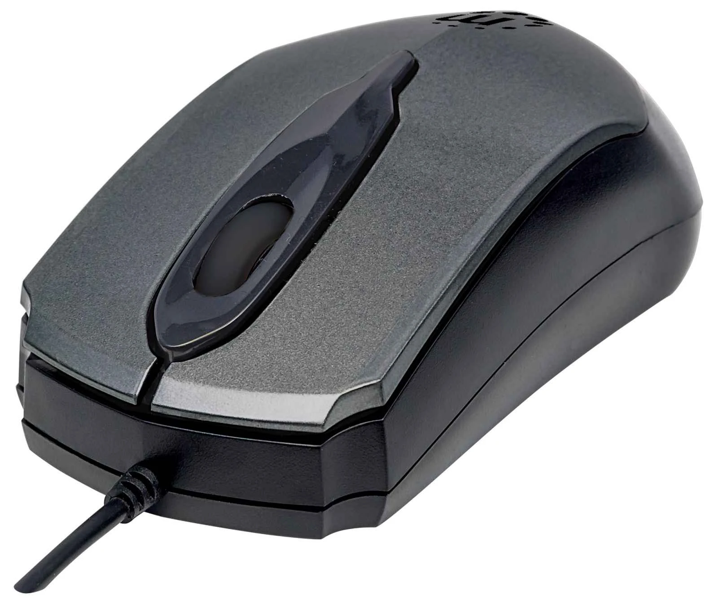
What are we doing?
Convert This
Into This

Slide 3
$whoami
Currently VP of Engineering for Thirdwayv—an IoT company specializing in secured, FDA-cleared systems
Expatriate full custom VLSI designer from IBM PowerPC and DEC Alpha teams who now hides behind software
First wrote C on an OS9 system (Yes, the beard is very grey)
Oldest open source contribution was probably rewriting the VGA driver for MILO and EV56/PCA56 so it would not destroy SCSI cards in dual monitor setups (circa 1996?)
Also rewrote NFS rpc.lockd for FreeBSD to do partial file locking (circa 2000?)

Slide 4
Why are we doing this?
You want to make a USB device
Generally to connect some piece of hardware or hardware interface to Windows
Building the USB device code in Linux is FAR easier than a microcontroller development kit
The biggest problem is documentation—the code repository has a HID Mouse Driver (this talk) but also a HID Generic driver (not covered)

Slide 5

Baseline: What’s a Beaglebone?
https://beagleboard.org/static/ti/product_detail_black_lg.jpg
https://raw.githubusercontent.com/wiki/beagleboard/pocketbeagle/images/PocketBeagle-size-compare-small.jpg

Slide 6
Baseline: What’s a Beaglebone?
ARM-based computer with mainline Linux OS
1GHz, 512MB RAM, microSD storage (eMMC on some)
Beaglebone Black: ~$50 PocketBeagle: ~$25
Standard Computer Interfaces: Ethernet, USB Host, HDMI, microSD
Standard Embedded Interfaces: USB device, GPIO, SPI, I2C, UART, CAN, LCD
PRUs—a pair of 200MHz RISC cores with excessively useful weirdness (some other talk)

Slide 7
Baseline: What’s a USB HID Device?
A USB Device that is nominally supposed to be a Human Interface Device
Devices like keyboards, mice, game controllers, numeric keypads, foot pedals, etc.
Devices want to be guaranteed to be polled regularly and generally return small amounts of data (64 bytes or less—more on this later)
Comply with “Device Class Definition for HID”

Slide 8
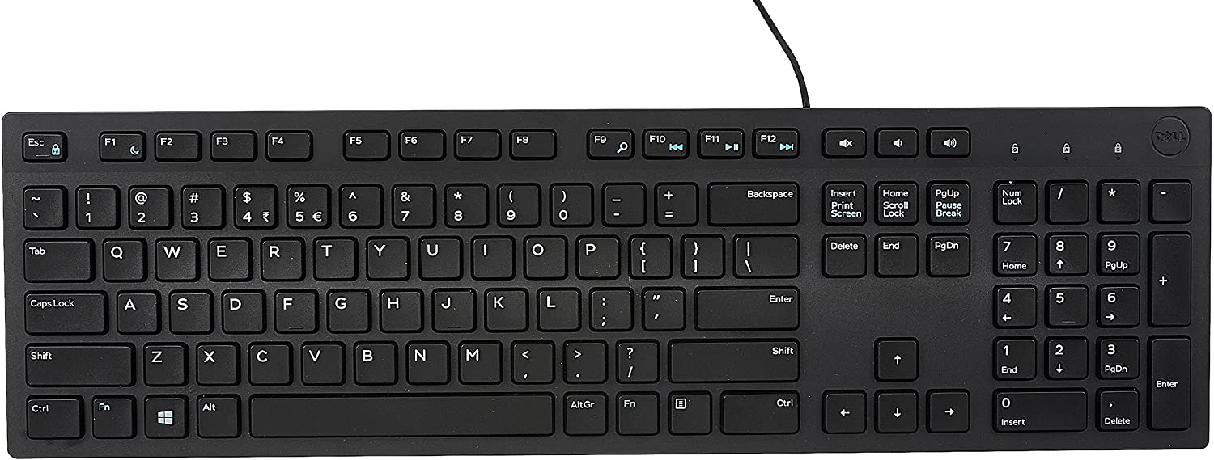
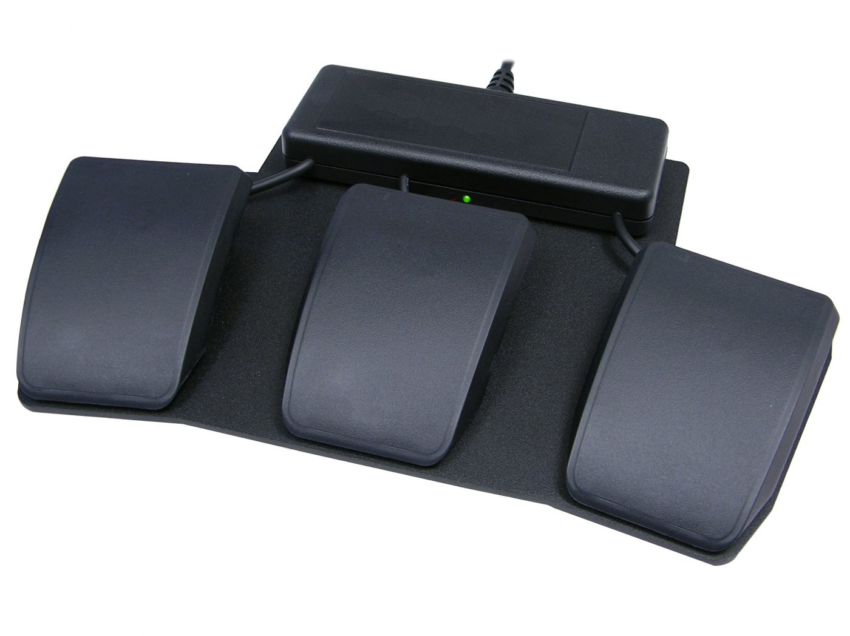
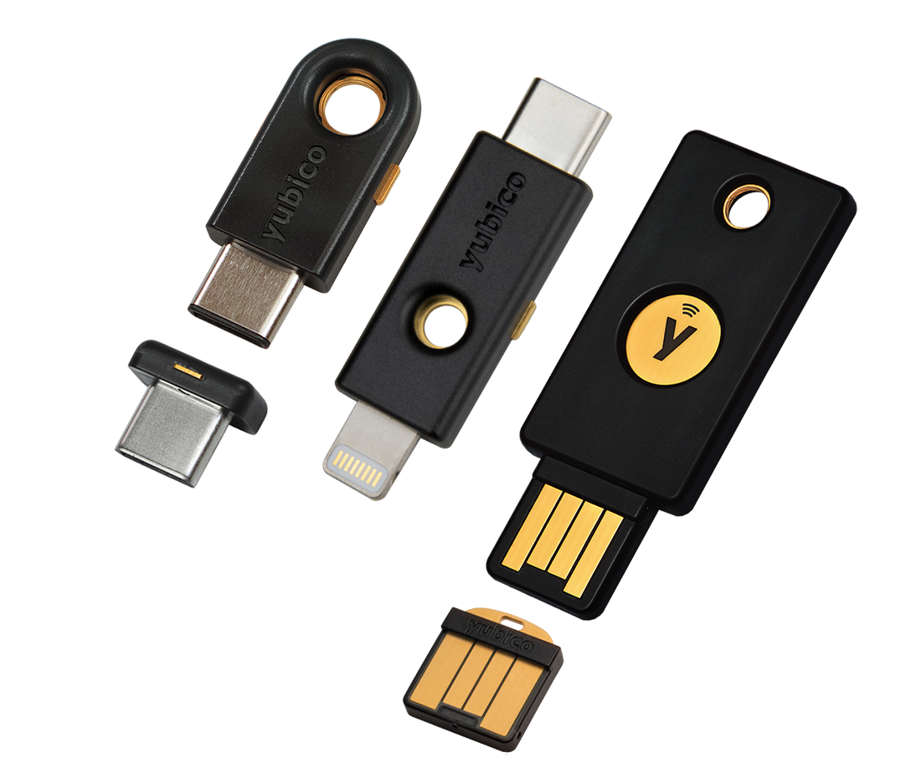
USB HID Devices

Slide 9
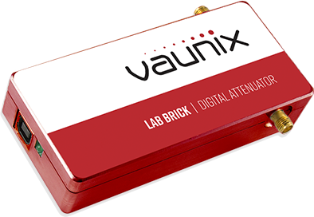
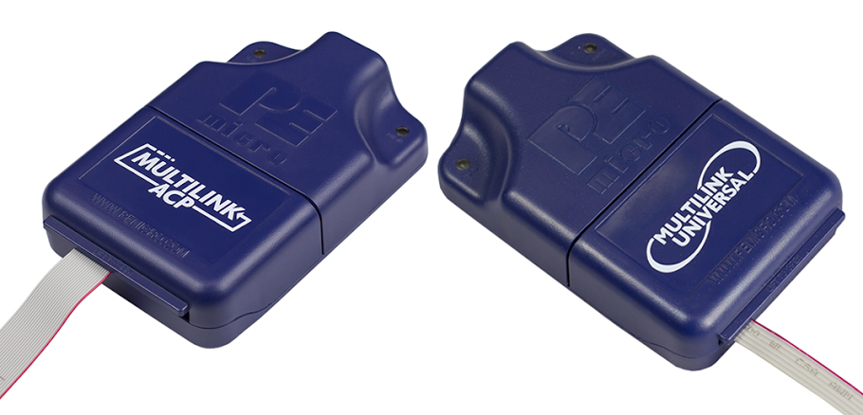
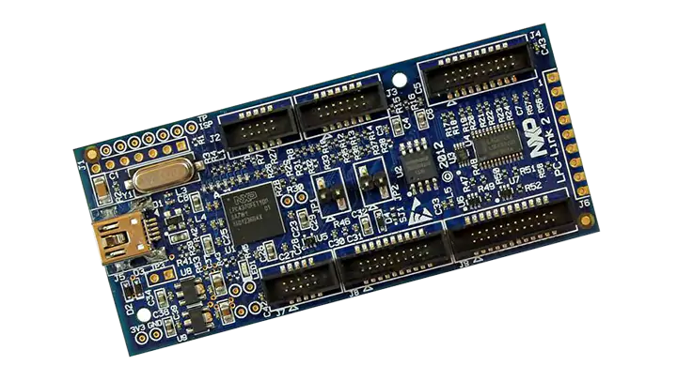
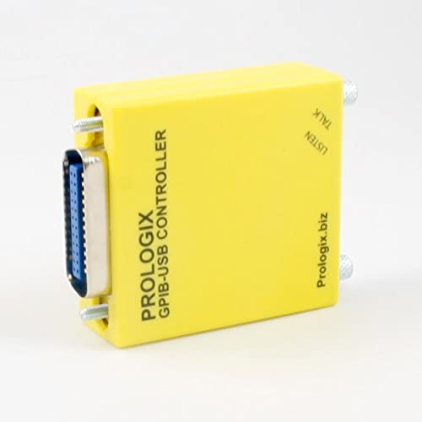
USB HID Devices

Slide 10
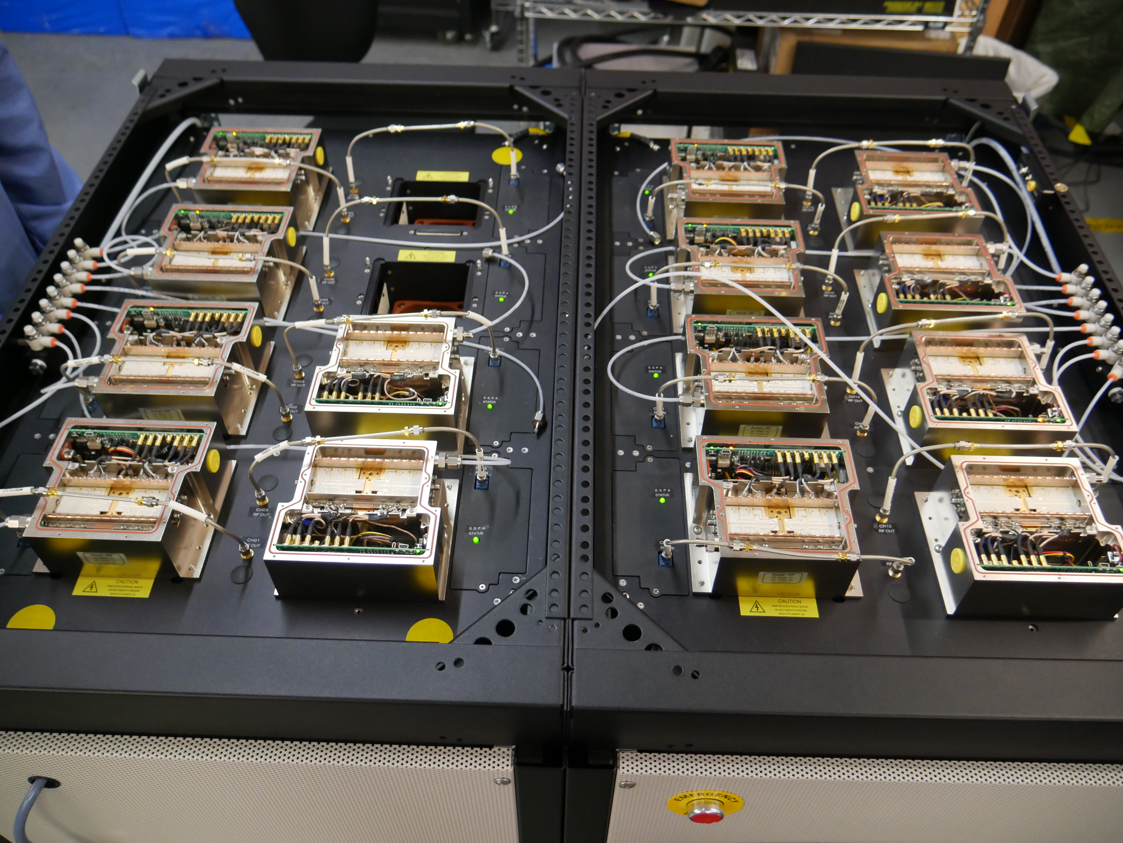
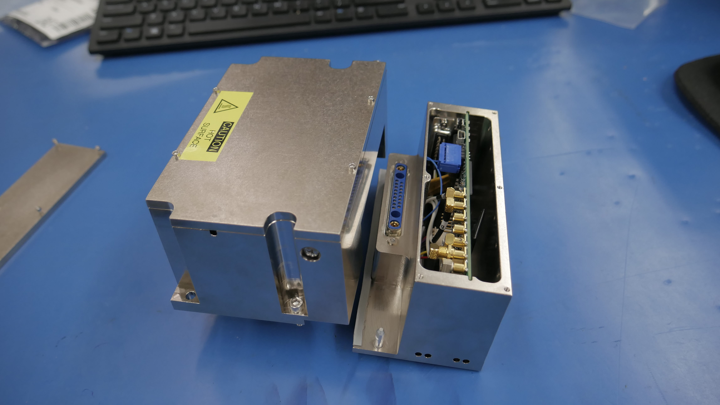
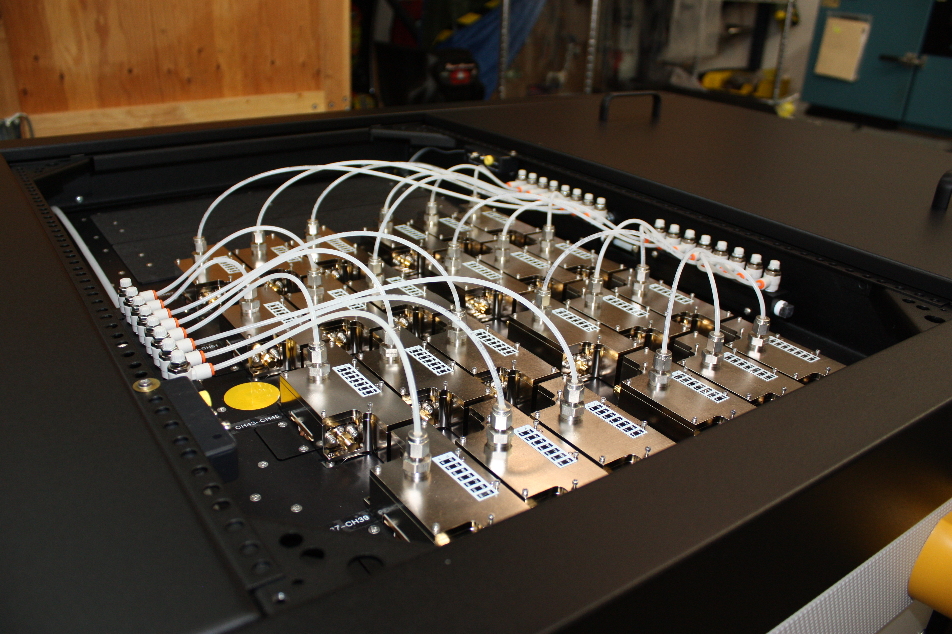
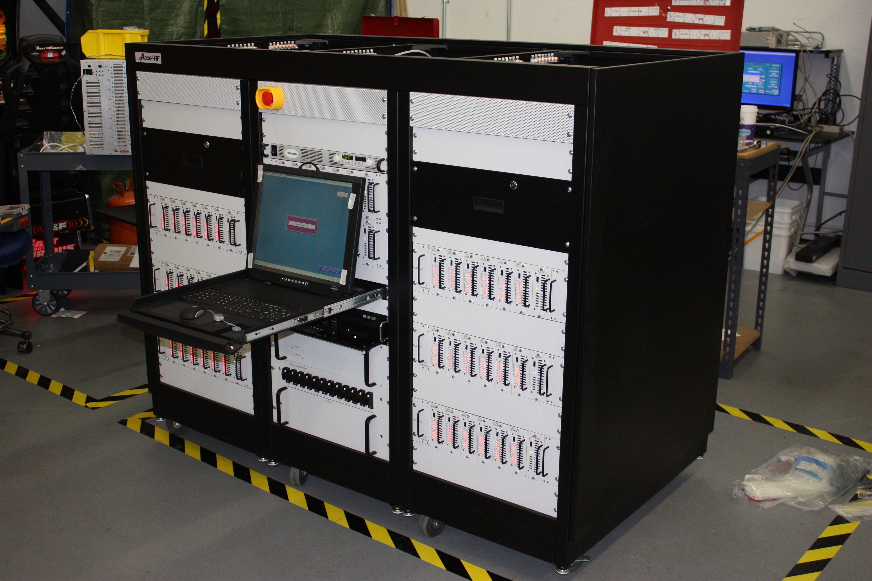

USB HID Devices
96 HID Devices Actually—Photos Courtesy of

Slide 11
Wait …
WHAT?!?!?

Slide 12
Engineering (Ab)Use of HID Specification
Engineers almost always created USB HID devices for two reasons
The primary reason was that for 15+ years USB HID devices were the only way to connect to Windows WITHOUT WRITING DRIVERS
The secondary reason was that USB HID devices used a minimum of USB Endpoints
  Minimizes RAM Usage
  Important in the days of 8-bit microcontrollers

Slide 13
Why Implement a new HID Device?
You need an actual USB HID device
  Using multiple foot pedals, for example
New hardware that needs software development running immediately
  A lot of stuff can be faked and sometimes even fully implemented on a small Linux computer
Upgrade USB Full Speed(16Mbps) to High Speed(480Mbps)
Adding features to a domain specific device that uses HID (debug probes—yeah, that is what created this talk)
Legacy—replacement is unavailable or too expensive

Slide 14
How To HID on Linux
Take over gadget system (Beaglebone specific)
Set up USB Gadget on the Linux side using shell commands to write to Linux ConfigFS
  Report Descriptor is a bit magical
Attach to the created character device to then read and write USB reports
  Rust is being used but C and Python(!) even work
  Epoll() is being used and called directly—<groan>
PROFIT! (or, perhaps, “It’s alive!”)

Slide 15
DEMO
Fake USB Rodentia

Slide 16
Thanks for attending!

Slide 18
Why unwrapped epoll()?
epoll() is the primary mechanism on Linux to notify you when I/O is ready (see: the bowels of Tokio or smol)
epoll() is toxic sewage and horribly broken but we’re all stuck with it on Linux as the fundamental building block
  Outsourced rant courtesy of Bryan Cantrill
  https://youtu.be/l6XQUciI-Sc?t=3521
tokio/smol/etc. wrap epoll() but it escapes and causes issues (character device? What’s that?)
epoll() is broken in exactly the ways you don’t want—but you can handle it if you are single threaded

Slide 19
Rusty Wrapping Rant
“Need to simply wrap this library/OS thing to use in Rust.”--Generally okay with just a few quirks-- :)
“Need to make my thing work across different OS’s or libraries”--Not bad, but generally has errors due to lack of testing -- ¯\_(ツ)_/¯
“Need to wrap this thing in a Rusty(tm) Way”--Normally have very weird edge failures -- ಠ_ಠ
“Need to create an abstraction for these OS’s or libraries”-- Rage inducing -- (┛◉Д◉)┛彡┻━┻
  “This blocked on a nonblocking FD?! WTF!”

Slide 20
Why Rust?--More secure
Sure, sure, we hear that all the time
Driver code (of any form) is in a unique place where you really can’t trust the other side (or any side) of the pipe
Poorly written code and active attacks look remarkably similar to the end device (is that packet really 64 bytes?)
With embedded devices, even if we somehow design perfect security—hackers will then break all the (mostly proprietary) communication stacks around us
Rust really is the only new thing in the space

Slide 21
Why Rust?--Force Multiplier
Looking for another force multiplier level (I have gone from ASM to C to Perl to Python and have been on Python for probably too long)
Force multiplier in the large: Computational geometry engines, for an example, seem not to map well to current languages
Force multiplier in the small: Protocol stacks on microcontrollers are screaming for something to help manage complexity without runtime overhead

Slide 22
Getting On With It

Slide 23
DEMO
USB HID Echo

Slide 24
Why NOT to make a USB HID Device?
USB can be a poor choice for industrial areas
  USB data is differential but connection detection is not
USB HID really may not be the correct class
  Data does not need need guaranteed bandwidth
  Data packets > 64 bytes (Limit of Full Speed HID)
  Windows now does serial and Ethernet USB classes natively—they are likely faster and do not require driver installs
You really need a custom USB device driver
  Do you really? That’s a lot of work for very little gain.

Slide 25
Alternatives to USB HID
Standard Ethernet
  Truly differential signalling—much better for industrial
  High Speed USB (USB 2.0) often needs transceivers (aka a PHY) to handle signal integrity anyway
  Ethernet PHY and USB transceiver are same price
  Transformerless Ethernet is a thing
USB Ethernet (RNDIS or ECM—USB Bulk)
USB Serial (CDC-ACM class—also USB Bulk)

