Slide 1
Overview
Phrase Translation
Lossy Compression
Reversible
Phrase Embeddings
Abstractive Summarisation
Signal Processing Methods
Language Smoothing/Naturalisation

Slide 2
Phrase Embeddings (I)
How many ways can we say the same thing?
The boy destroyed the house
The house was destroyed by the boy
The house was demolished by the boy
The young man destroyed the residential building
The boy was responsible for the house's destruction
Requirements For Sentence Embedding:
All those phrases should be mapped to the same (or similar) vectors.
Why do we want to De-embed?
Not just recover input
Manipulate Phrases in Vector Space
Output vector not (nesc) equal to any
known phrase embedding

Slide 3
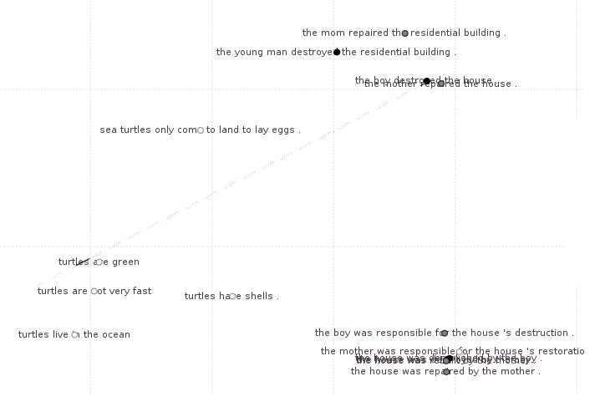
PCA(ndim=2) Socher's URAE

Slide 4
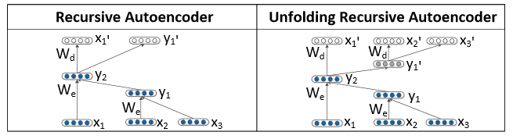
Phrase De-Embeddings (Recursive)
Socher et al. 2011
What is the De-embedding problem:
Search over all possible output tree structures (An Infinite Space)
Optimisation function:
  to match phrase embedding (y2 in diagram), on refold.
  Or assess output at x'1 , x'2 ,x'3 closeness to existent word embeddings
Optionally constrain to be Grammatical
In the URAE by Sorcher et al. the unfolded tree's structure is a given (as the same as the input tree)

Slide 5
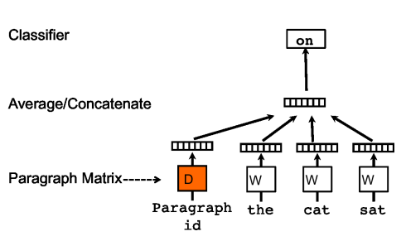
Phrase De-Embeddings (Windowed)
Le and Mikolov, 2014
*START* the cat sat on the mat *END*
What is the De-embedding problem:
Lock Classifier and Paragraph Vector, train to convergence word vectors.
Predicted word starts at terminal marker, move back.
Then predict estimated second last word etc.

Slide 6
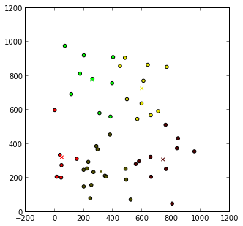
Abstract Summarisation
Embed Phrases
Apply techniques Like clustering to find central points
De-embed centroids
  Or Extractive via finding closes input embedding to centroids.

Slide 7
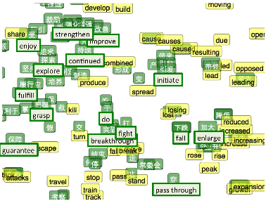
Phrase Translation
Zou 2013 Bilingual Word Embeddings
(Green Chinese, Yellow English)
Most Phrase Translation is word translation with alignment
Instead Embed Sentences in 2 languages (A,B) to common embedding space. To translate use language A to embed and Language B to de-embed
This has been done with word vectors

Slide 8
Language Naturalisation/Smoothing
A reversible embedding will be trained using native written English
The model will “know” not only what words go together, what structures go together
Beyond this signal processing techniques could be applied to remove “error” in the expressions, over multiple phrases in the document.

Slide 9
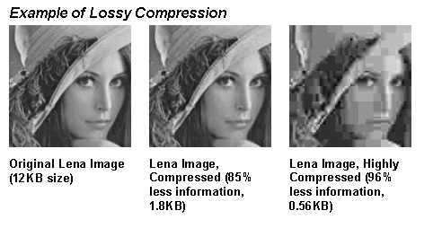
Lossy Compression
By using undersized phrase vectors we can (theoretically) compress information.
Eg input:
  Woman in hat
Eg output:
  Person in headpiece
  Person wearing clothing

