Slide 1
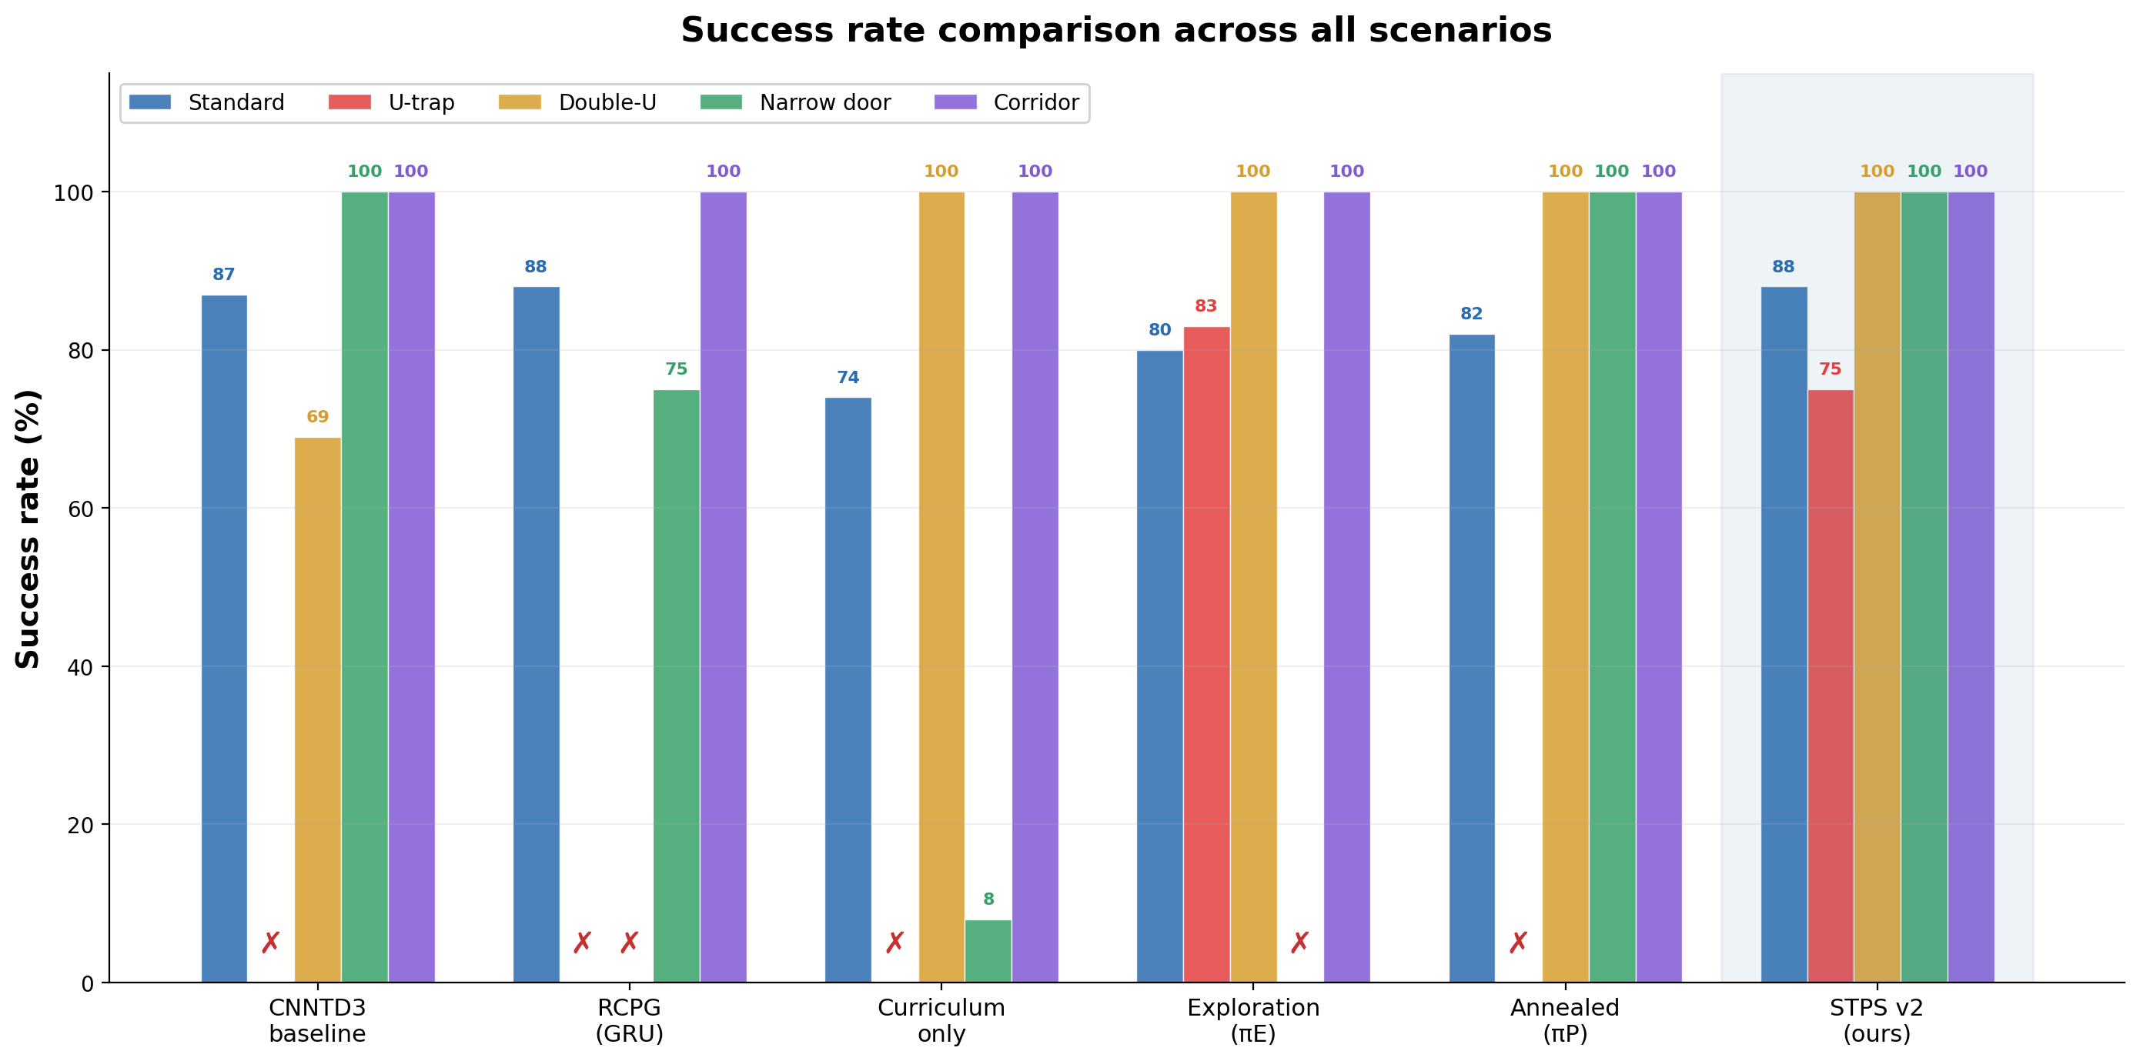
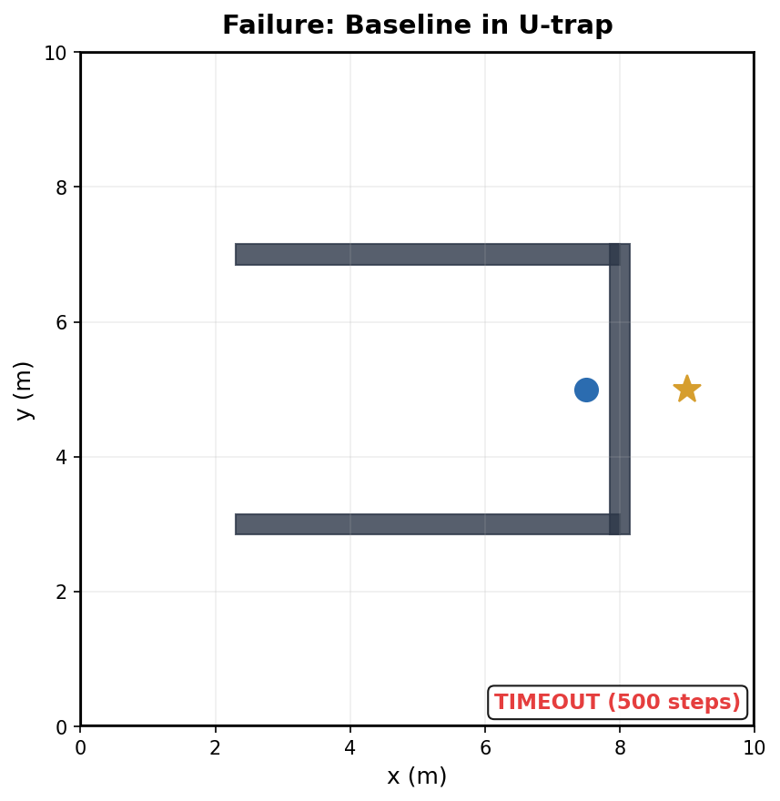
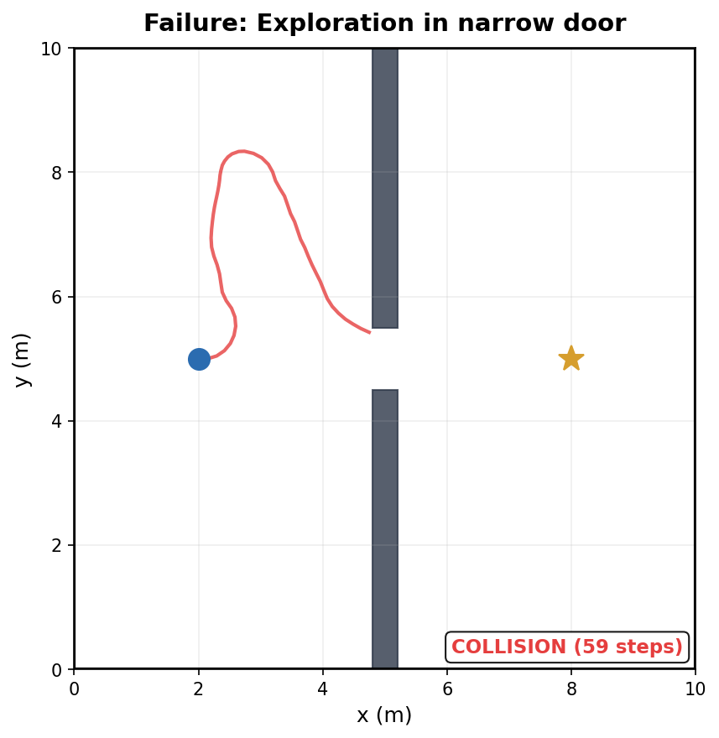
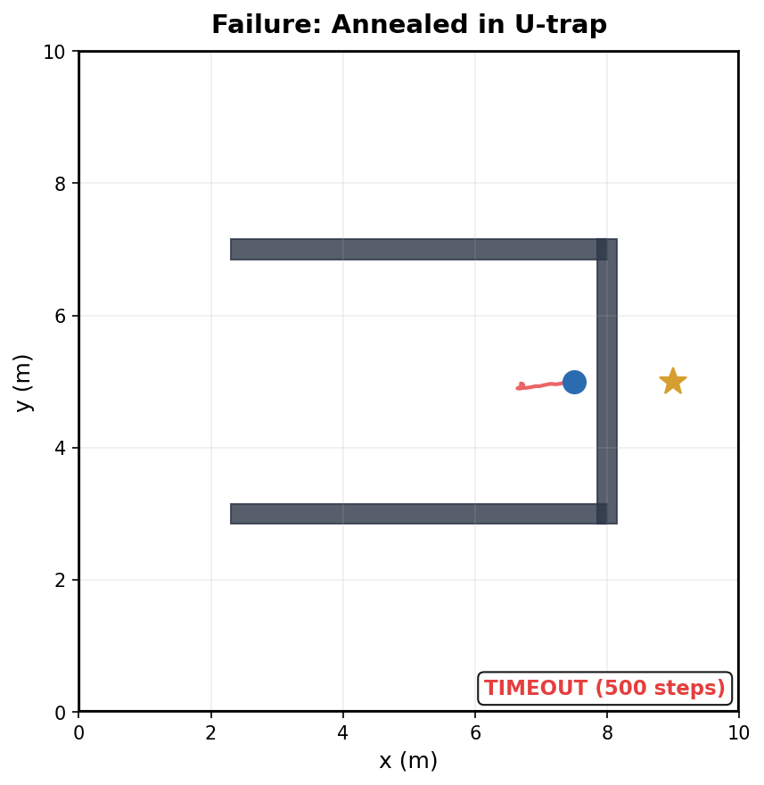
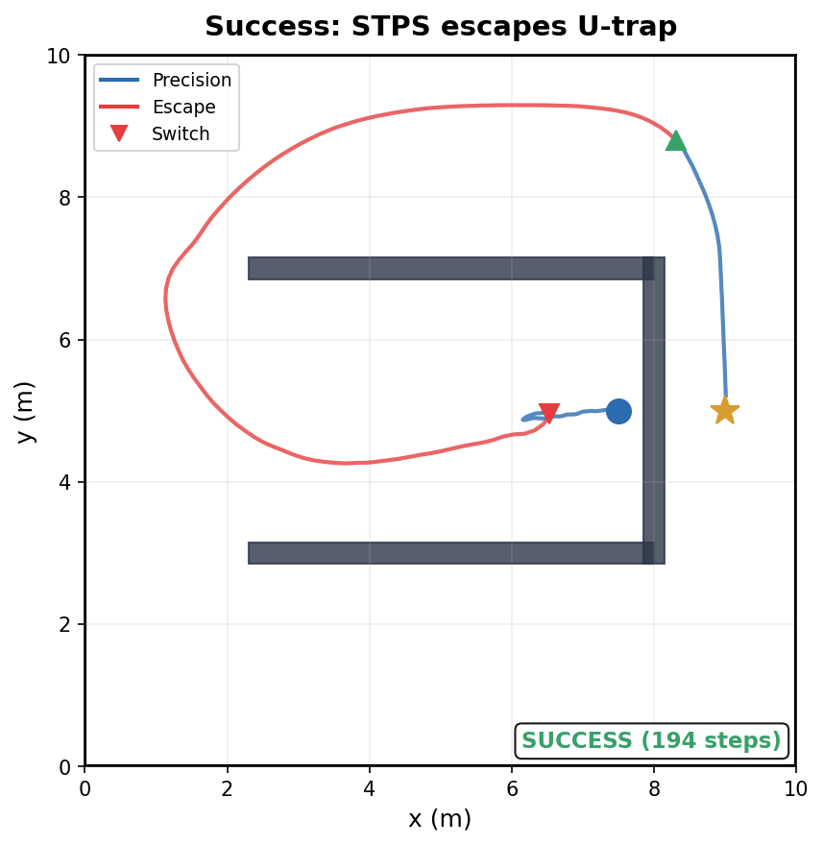
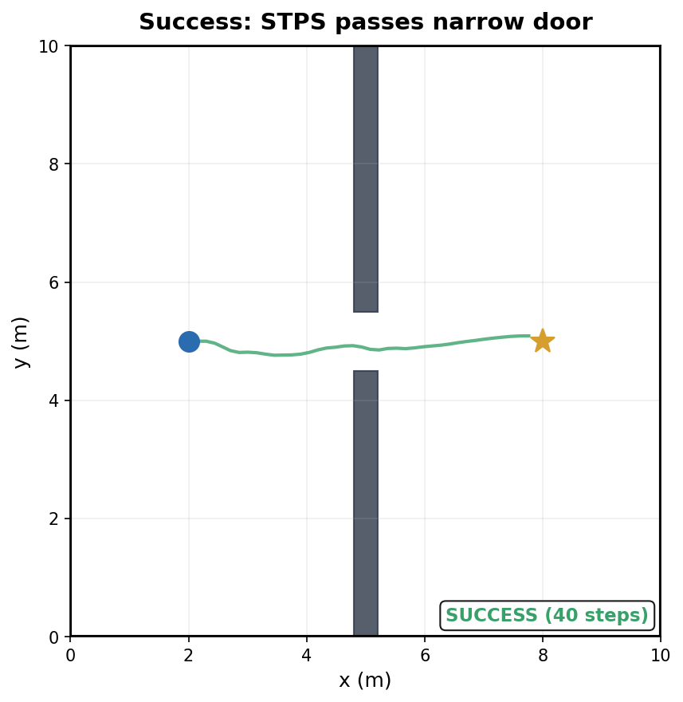
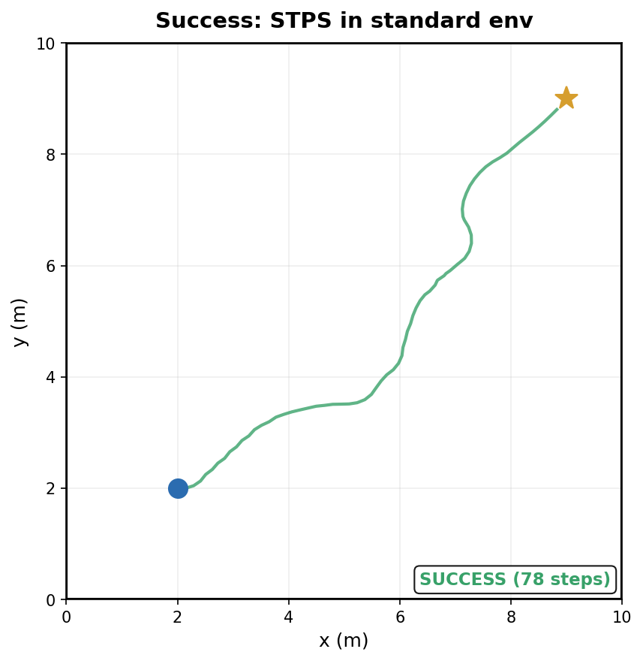
Stall-Triggered Policy Switching for
DRL Navigation in Trap Scenarios
Composing complementary policies at runtime to eliminate catastrophic navigation failures
[Author Name] · [University Name] · Summer Research 2026
94%
88%
0
0
Scenario avg SR
(+27 vs baseline)
Standard env SR
(matches baseline)
Catastrophic
failures (0% cells)
Additional
training cost
1
Abstract
2
Key finding: exploration-precision conflict
Deep reinforcement learning (DRL) enables mapless mobile robot navigation from local sensory observations, but reactive policies can still fail catastrophically in trap-like layouts where reaching the goal requires temporarily moving away from it. In our IR-SIM benchmark, a CNNTD3 baseline achieves 87% success in the standard environment but 0% in the U-trap scenario. We identify an exploration-precision conflict: exploration reward improves U-trap escape but destroys narrow-door precision, while annealing restores precision but loses escape behavior. To address this, we propose Stall-Triggered Policy Switching (STPS), a training-free runtime mechanism that switches between a precision policy and an exploration policy only when stagnation or oscillation is detected. Across four hard scenarios and three seeds, STPS improves scenario-average success from 67% to 94% while preserving standard-environment performance at 88%.
Exploration bonus fixes U-trap (0→83%) but destroys narrow door (100→0%). Annealing recovers narrow door but loses U-trap. Irreconcilable.
Method
Std
U-trap
Narrow
Avg
Baseline
87%
0%
100%
67%
Curriculum only
74%
0%
8%
52%
Exploration (πE)
80%
83%
0%
71%
Annealed (πP)
82%
0%
100%
75%
No single policy avoids all 0% cells
3
Method: Stall-Triggered Policy Switching (STPS)
Main mode
Stall: ‖xₜ − xₜ₋₂₀‖ < 0.15m
OR oscillation ≥ 5 reversals/12 steps
Escape mode
Execute precision policy πP
(standard navigation)
Execute exploration policy πE
(novelty-seeking navigation)
DEFAULT
Escaped: k ≥ 120 AND ‖xₜ − xsw‖ > 0.5m
TEMPORARY
1
Zero training cost
2
Negligible overhead
3
Real-robot ready
Both policies frozen; only runtime logic
One distance check per step (<0.1ms)
Simple if-else, no GPU for switching
4
Results: STPS outperforms all single policies
Method
Standard
(100 ep)
S1
U-trap
S2
Double-U
S3
Narrow door
S5
Corridor
Scenario
avg
CNNTD3 baseline
87%
0 ± 0%
69 ± 4%
100 ± 0%
100 ± 0%
67%
RCPG (GRU)
88%
0 ± 0%
0 ± 0%
75 ± 0%
100 ± 0%
44%
Curriculum only
74%
0 ± 0%
100 ± 0%
8 ± 0%
100 ± 0%
52%
Exploration (πE)
80%
83 ± 0%
100 ± 0%
0 ± 0%
100 ± 0%
71%
Annealed (πP)
82%
0 ± 0%
100 ± 0%
100 ± 0%
100 ± 0%
75%
STPS v2 (ours)
88%
75 ± 7%
100 ± 0%
100 ± 0%
100 ± 0%
94%
3 seeds × 12 perturbed starts. STPS is the only method without any 0% catastrophic failure.
5
Success and failure case analysis
Failure: Baseline
in U-trap
SR = 0%
Failure: πE
in narrow door
SR = 0%
Failure: Annealed
U-trap reverts
SR = 0%
Success: STPS
U-trap escape
SR = 75%
Success: STPS
narrow door
SR = 100%
Success: STPS
std env
SR = 88%
6
Parameter sensitivity
7
Error taxonomy and what didn't work
U-trap SR (%) / Narrow-door SR (%)
K=120, δ_prog=0.5m fixed
Greedy tracking
δ=0.10
δ=0.15
δ=0.20
Cannot retreat — Baseline in U-trap
Reward conflict
W=15
42/100
42/100
67/100
Exploration vs precision — πE in narrow door
W=20
67/100
67/100
67/100
Parameter space limit
W=30
0/100
17/100
25/100
Single network can't encode both — Annealing
Narrow door = 100% across entire grid
→ switching never harms precision
Detection latency
20 steps to confirm stall — STPS 75%<83%
What didn't work:
8 Conclusion
• STPS v3 (goal-distance + progressive escape): no gain over v2
• U-trap specialist: 83%, same as original improved
• Bottleneck = geometric difficulty, not detection/model
1. We reproduced and diagnosed a CNNTD3 navigation baseline that performs well in standard scenes but fails in trap-like layouts.
2. We identified an exploration-precision conflict: exploration helps local-minimum escape but damages narrow-door alignment.
3. STPS resolves this conflict by composing two frozen policies at runtime using stall and oscillation evidence.
4. In our hard-scenario benchmark, STPS improves scenario-average SR from 67% to 94% and removes all 0%-SR hard-scenario cells while preserving standard-environment performance.
9 References
1
Code and data available | Contact: [email] | Summer Research Program 2026

