Slide 1
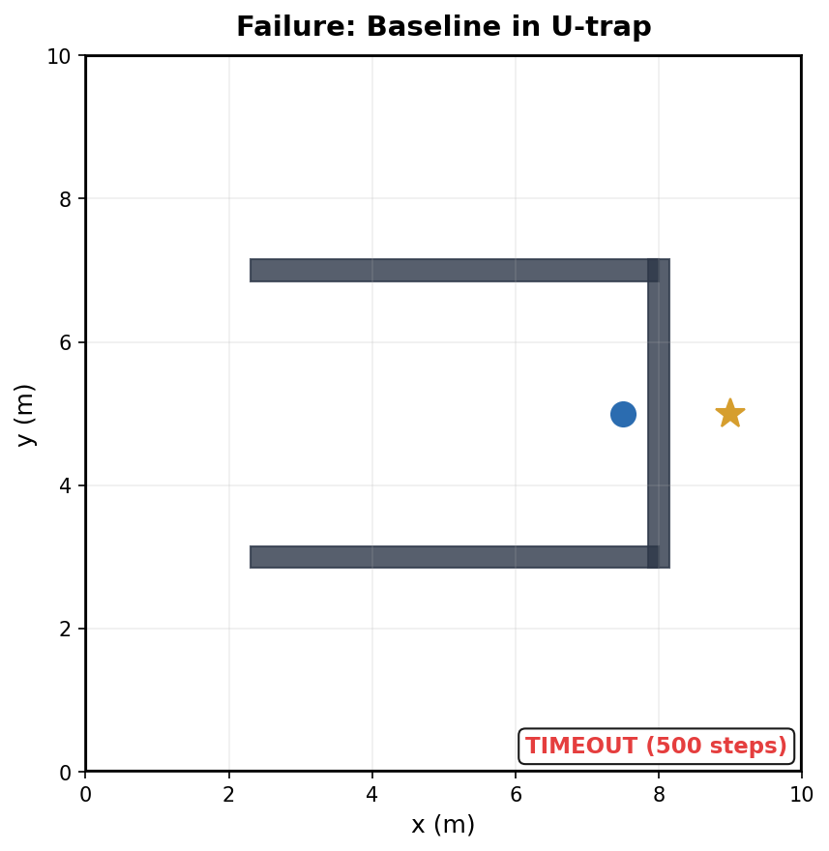
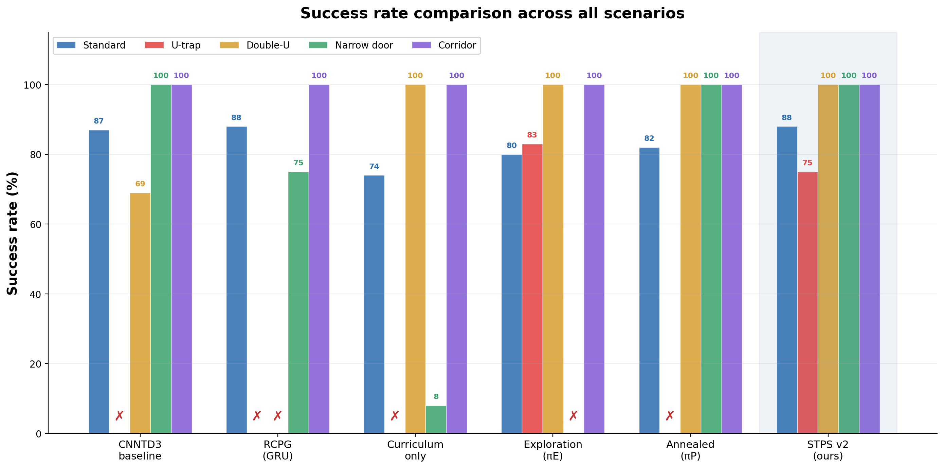
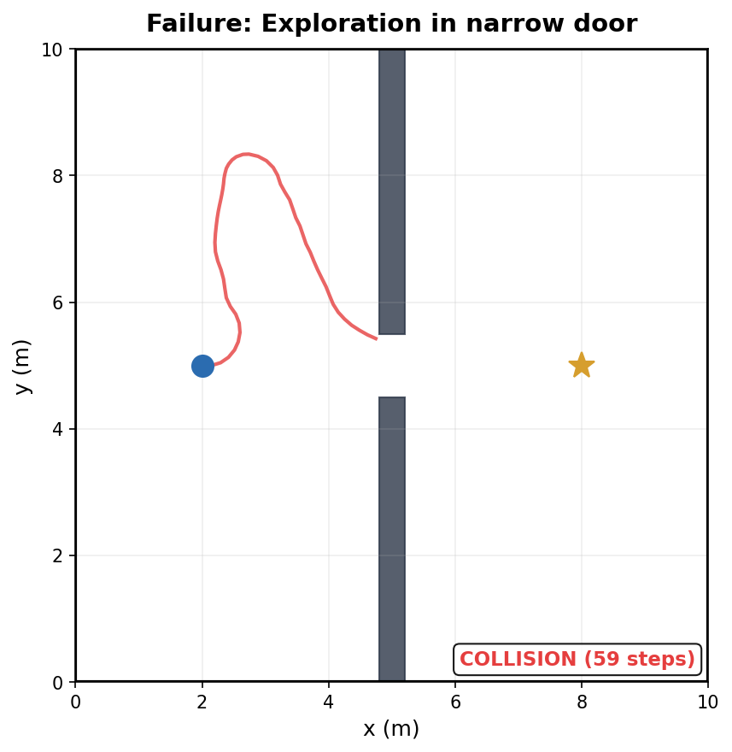
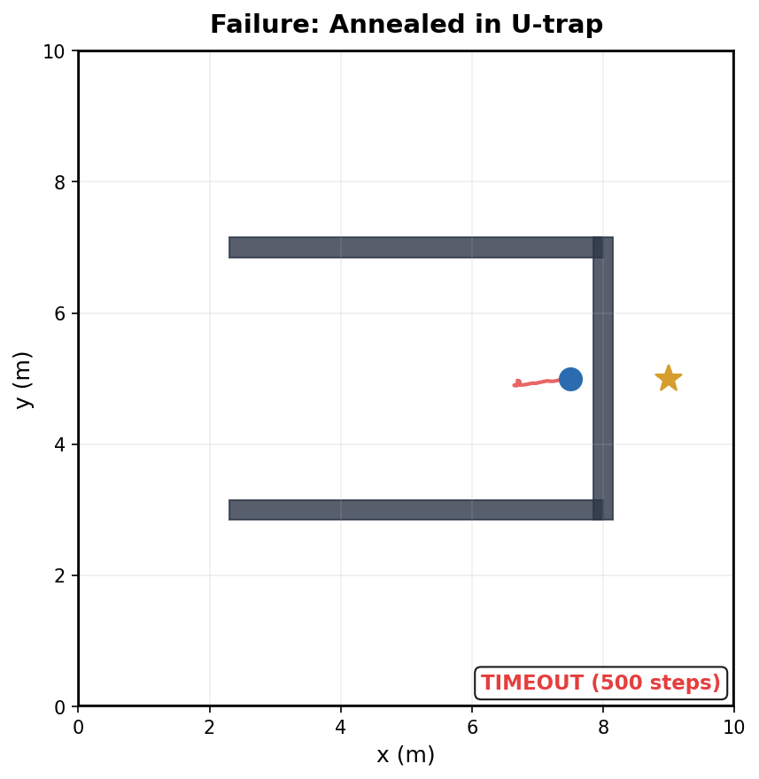
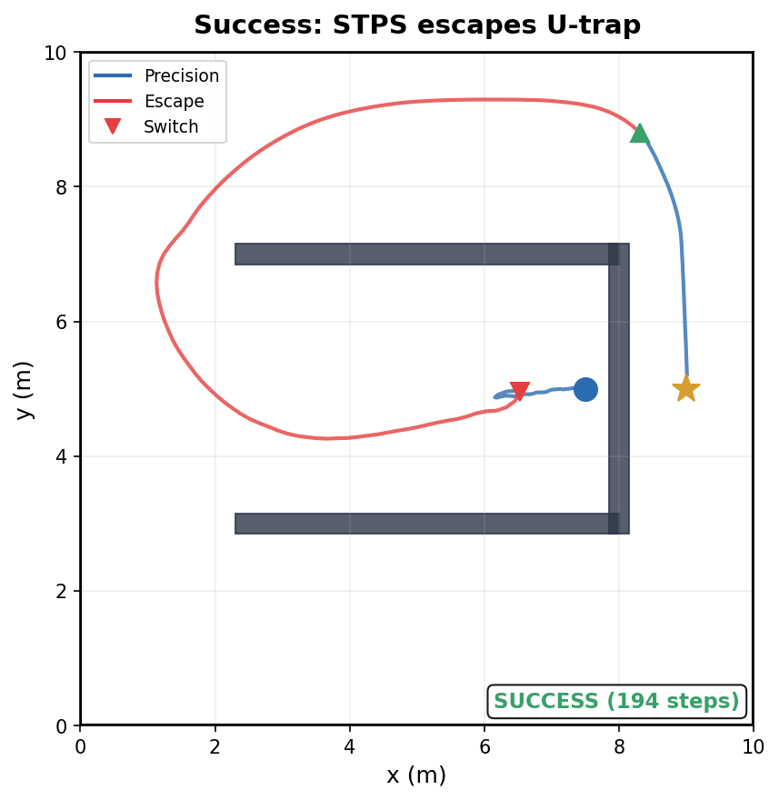
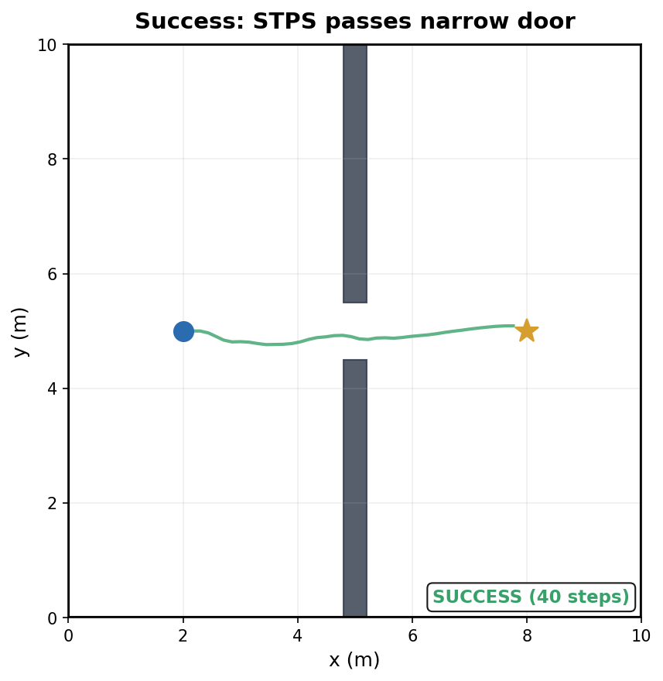
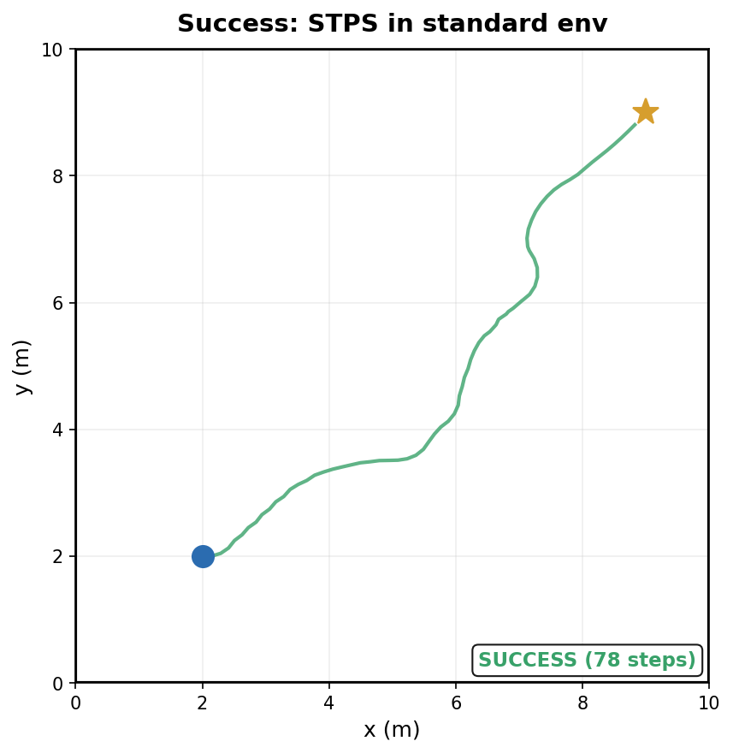
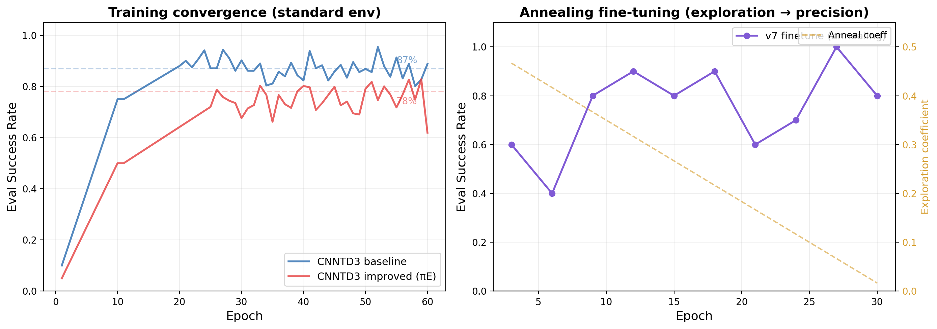
Stall-Triggered Policy Switching for
DRL Navigation in Trap Scenarios
[Author] · [University] · Summer Research 2026
94% scenario avg SR
88% standard SR
0 catastrophic failures
0 training cost
A
Abstract
Problem: DRL navigation policies achieve >85% success in open environments but catastrophically fail (0% SR) in trap scenarios requiring temporary retreat from the goal. Gap: Exploration rewards fix traps (0→83%) but destroy precision (narrow door 100→0%). Reward annealing cannot resolve this conflict. Method: We propose Stall-Triggered Policy Switching (STPS), a training-free runtime architecture that detects motion stagnation and dynamically switches between precision and exploration policies. Result: STPS achieves 94% average scenario SR (+27 points vs baseline), is the only method without catastrophic failure on any scenario, and matches baseline on standard environments (88%).
1
Introduction
2
Key Finding: Exploration–Precision Conflict
Deep reinforcement learning (DRL) has become standard for mapless robot navigation, mapping raw LiDAR to velocity commands. CNN-TD3 achieves high success rates in cluttered environments.
However, in trap scenarios — U-shaped dead ends, narrow corridors requiring retreat — greedy goal-directed rewards cause the robot to oscillate until timeout.
Existing approaches:
• Intrinsic motivation/curiosity — helps exploration but hurts precision
• GRU memory — improves symmetry but worsens trap escape
• Curriculum learning — insufficient alone for trap escape
• Hierarchical RL — requires expensive end-to-end retraining
Exploration bonus solves U-trap (0→83%) but kills narrow door (100→0%).
Annealing recovers narrow door but loses U-trap.
Method
Std
U-trap
Narrow
Avg
Baseline
87%
0%
100%
67%
Curriculum
74%
0%
8%
52%
Exploration
80%
83%
0%
71%
Annealed
82%
0%
100%
75%
Baseline freezes
in U-trap (0% SR)
3
Method: Stall-Triggered Policy Switching (STPS)
MAIN MODE
Precision policy πP
Stall: ‖xₜ−xₜ₋₂₀‖<0.15m OR oscillation≥5/12
ESCAPE MODE
Exploration policy πE
Standard goal-directed
navigation (DEFAULT)
Escaped: k≥120 AND ‖xₜ−xsw‖>0.5m
Novelty-seeking
navigation (TEMPORARY)
● Zero training cost: Frozen policies + runtime logic
● <0.1ms overhead: One distance check per step
● Real-robot ready: Simple if-else, deployable on LIMO
4
Experiment Setup
5
Full RL Metrics (Standard Env, 100ep)
Simulator: IR-SIM 2D, differential-drive robot (r=0.2m, v_max=0.5m/s)
Environment: 10×10m worlds, 180-beam LiDAR (180° FOV, 7m range), 0.3s steps
Network: CNN-TD3, state_dim=185, lr=1e-4, batch=64, replay buffer=100K
Scenarios: Standard (random obs, 100ep), S1 U-trap, S2 Double-U, S3 Narrow door (0.45m gap), S5 Corridor
Evaluation: 3 seeds × 12 perturbed starts per scenario (±0.3m pos, ±0.4rad heading)
Baselines: CNNTD3, RCPG (GRU+TD3), Curriculum-only, Exploration-only, Annealed
Reproducibility: Seeds={42,123,2026}, IR-SIM v2.7.5, PyTorch 2.12, Python 3.10
Cmd: python eval_stps_v2.py
Metric
Baseline
STPS v2
Success Rate
80%
81%
Collision Rate
19%
19%
Avg Reward
63.5
65.6
Avg Path Length
4.13m
5.59m
Path Efficiency
0.93
0.81
Avg Steps
32
41
STPS trades path efficiency (0.93→0.81) for robustness:
longer paths due to escape detours, but zero catastrophic failures.
6
Main Results: STPS Outperforms All Single Policies
Method
Standard
S1 U-trap
S2 Double-U
S3 Narrow
S5 Corridor
Scenario Avg
CNNTD3 baseline
87%
0±0%
69±4%
100±0%
100±0%
67%
RCPG (GRU)
88%
0±0%
0±0%
75±0%
100±0%
44%
Curriculum only
74%
0±0%
100±0%
8±0%
100±0%
52%
Exploration (πE)
80%
83±0%
100±0%
0±0%
100±0%
71%
Annealed (πP)
82%
0±0%
100±0%
100±0%
100±0%
75%
STPS v2 (ours)
88%
75±7%
100±0%
100±0%
100±0%
94%
7
Success & Failure Case Analysis
8
Training Curves
9
Parameter Sensitivity
Baseline
U-trap: TIMEOUT
πE Narrow:
COLLISION
Annealed
U-trap: TIMEOUT
STPS U-trap:
SUCCESS
STPS Narrow:
SUCCESS
STPS Standard:
SUCCESS
W=15
δ=0.10
δ=0.15
δ=0.20
W=20
42/100
42/100
67/100
W=30
67/100
67/100
67/100
0/100
17/100
25/100
Narrow door = 100% across entire grid → switching never harms precision
W=20: stable 67% U-trap regardless of δ → no per-env tuning needed
What didn't work:
• STPS v3 (progressive escape): no gain
• U-trap specialist model: 83% = original improved
• Bottleneck = geometric difficulty
10
Conclusion
11
Future Work
12
Application
1. Exploration rewards create a hard, irreconcilable conflict with precision navigation in DRL.
2. STPS resolves this by composing complementary frozen policies at runtime with stall/oscillation detection.
3. STPS achieves 94% scenario avg (+27pts), 88% standard SR, and is the only method with zero catastrophic failures.
4. The method requires zero additional training and adds negligible (<0.1ms) computational overhead.
1. Real-robot deployment: Deploy STPS on AgileX LIMO differential-drive platform with onboard LiDAR.
2. Learned switch trigger: Replace hand-designed stall detector with RL-based scene classifier for faster, more accurate switching.
3. Policy library expansion: Add policies for additional failure modes (e.g., dynamic obstacles, multi-robot).
4. Isaac Lab integration: Leverage GPU-parallel simulation for large-scale training and evaluation.
5. PINN-based delay compensation: Physics-informed neural networks for real-time observation delay correction.
Target platform:
AgileX LIMO (0.322×0.22m), diff-drive, 360° LiDAR, ROS 2 Humble.
Sim-to-real advantages:
• STPS switching logic is pure Python if-else — no GPU, no retrain
• Both policies use standard LiDAR input, directly transferable
• ROS 2 node (dc_neupan_node.py) already written and tested
Deployable scenarios:
• Warehouse navigation with shelf dead-ends
• Hospital corridors with doorways
• Office environments with furniture traps
• Any indoor space with concave obstacles
Left: Baseline converges to ~87% SR; Improved (πE) to ~78% (exploration bonus reduces standard SR).
Right: Annealing v7 — SR oscillates as exploration coefficient decays.
IR-SIM v2.7.5 | PyTorch 2.12 | Seeds: {42, 123, 2026} | Cmd: python eval_stps_v2.py | Contact: [email]

