Slide 1
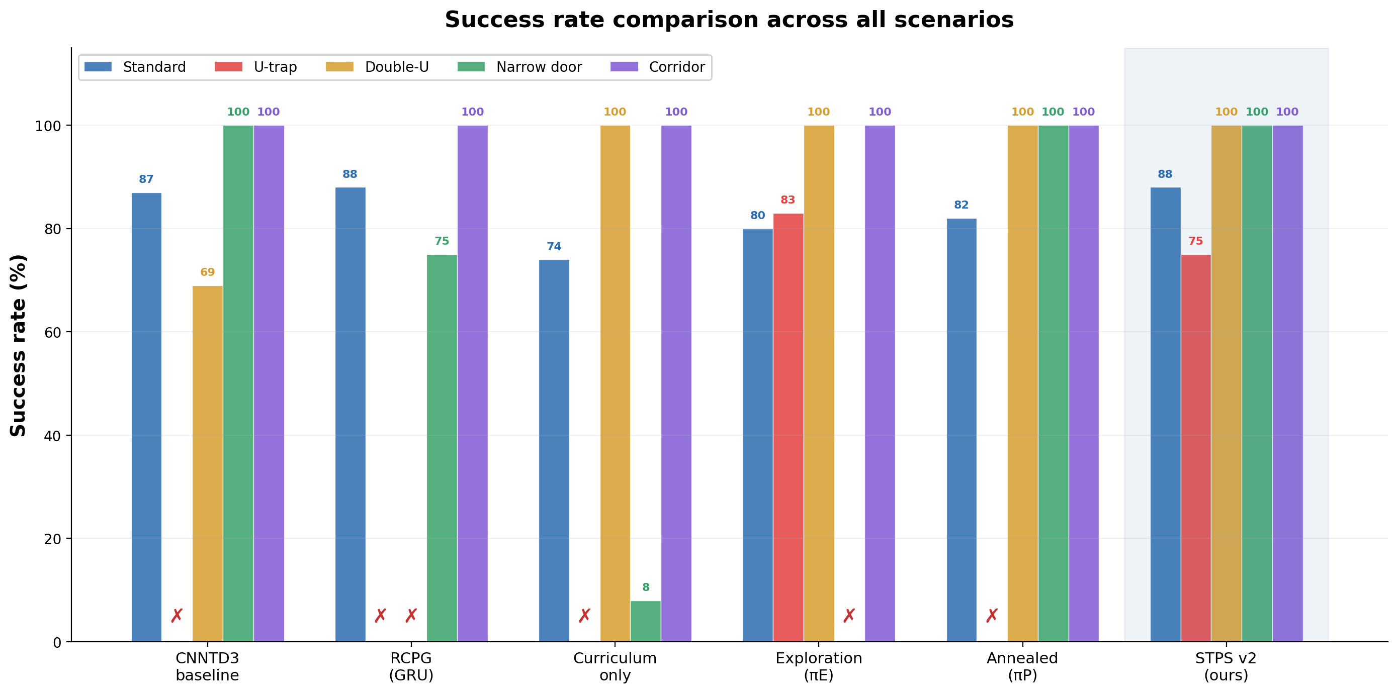
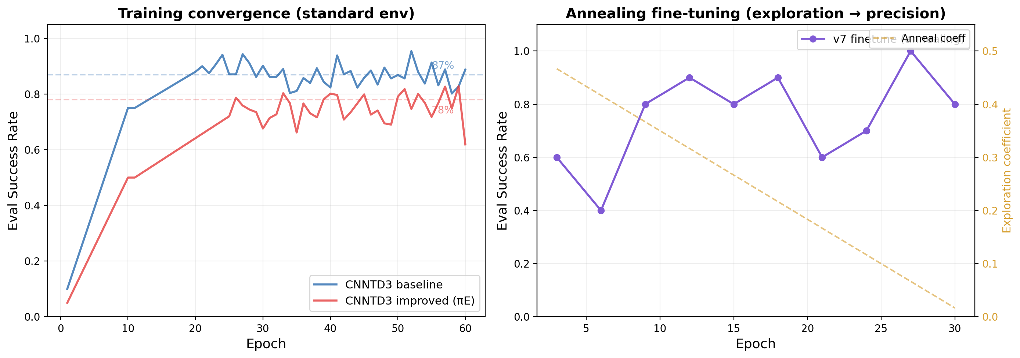
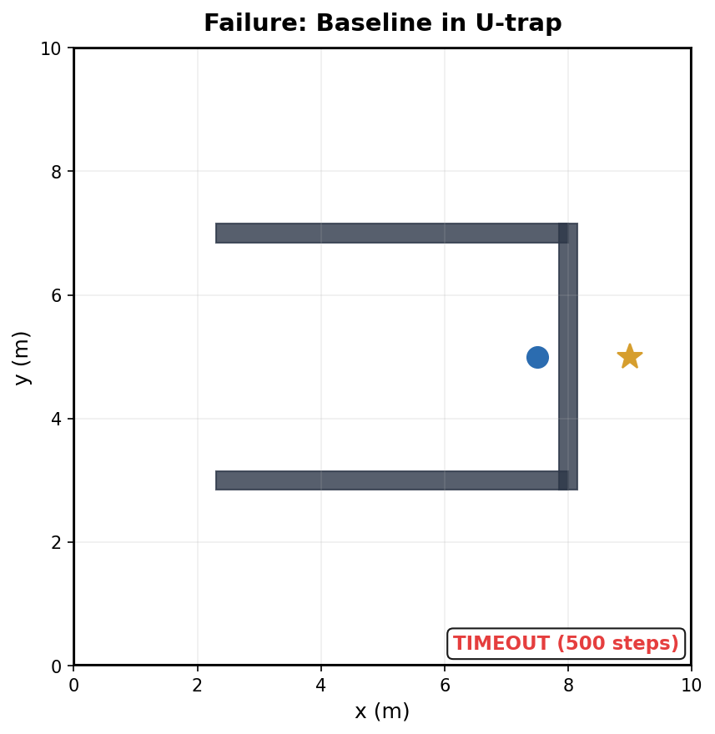
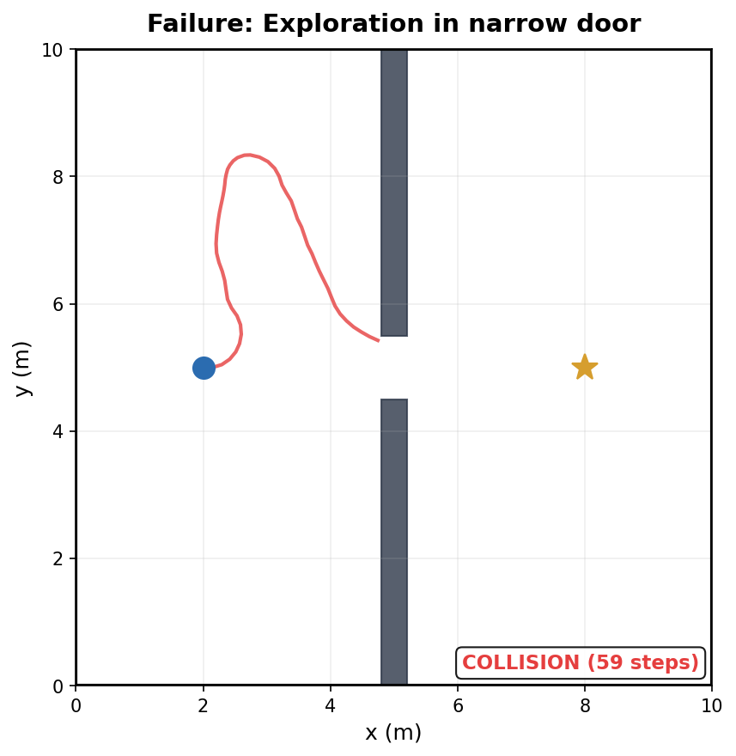
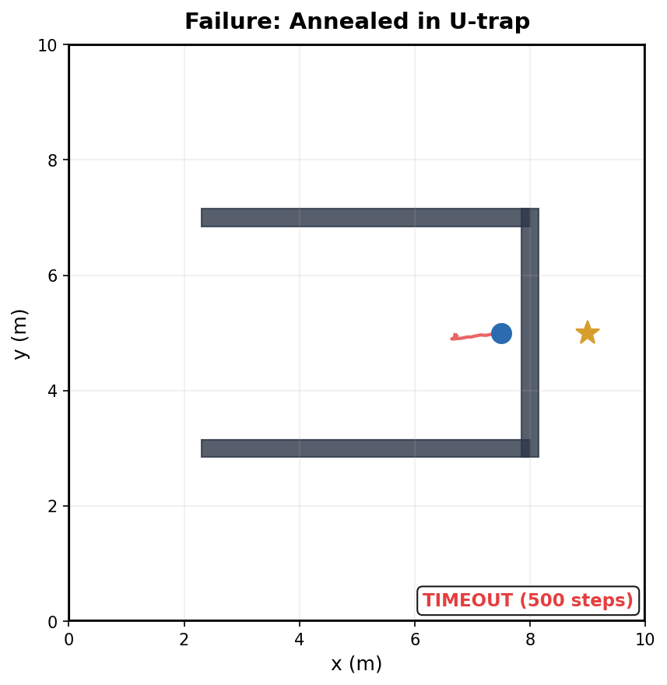
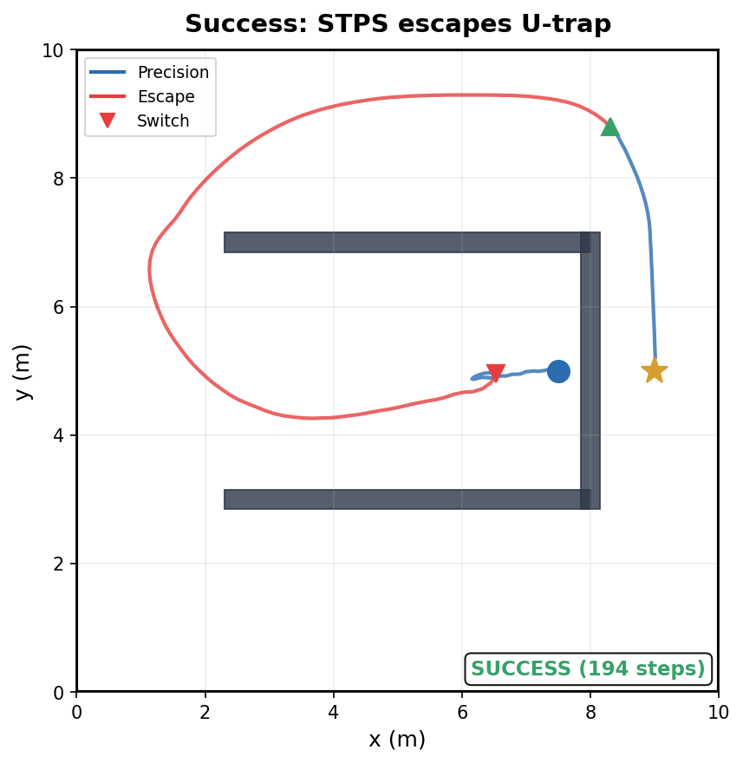
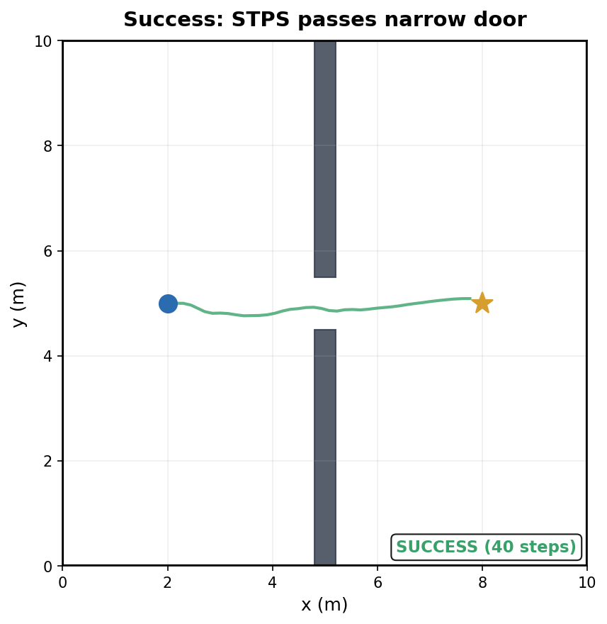
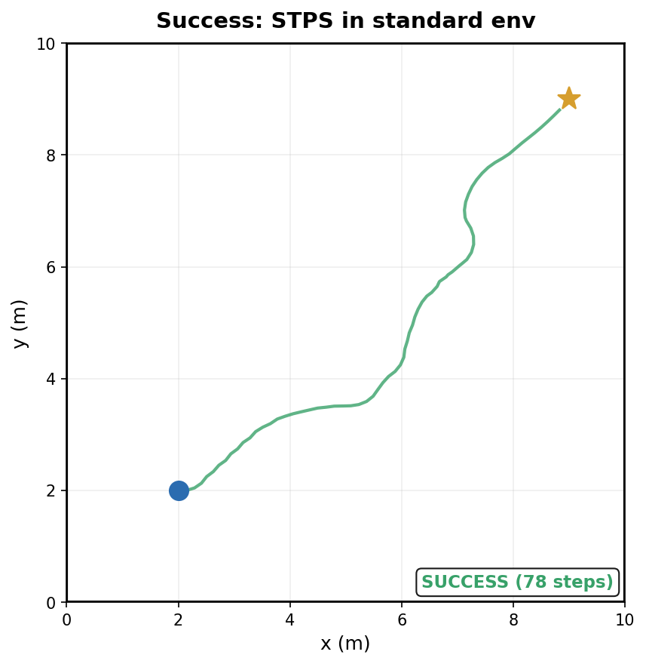
Stall-Triggered Policy Switching for DRL
Navigation in Trap Scenarios
[Author Name]¹, [Advisor Name]¹*
¹ Department of [XXX], [University Name] * Corresponding author: [email]
✓ 94% scenario avg SR (+27 pts vs baseline)
✓ 88% standard environment SR
✓ Zero catastrophic failures (no 0% cells)
✓ Zero additional training cost
ABSTRACT
KEY RESULTS
Motivation: DRL navigation policies achieve >85% success in open environments but catastrophically fail (0% SR) in trap scenarios requiring temporary retreat. Gap: Exploration rewards fix traps (0→83%) but destroy precision (narrow door 100→0%). Reward annealing cannot resolve this conflict. Method: We propose STPS, a training-free runtime architecture that detects motion stagnation and dynamically switches between precision and exploration policies. Result: 94% average scenario SR, the only method without catastrophic failure, matching baseline on standard environments.
BACKGROUND
EXPLORATION–PRECISION CONFLICT
■ DRL (TD3, SAC) achieves high SR in open environments using raw LiDAR-to-velocity mapping. ■ In trap scenarios (U-shaped dead ends, narrow corridors), greedy goal-directed rewards cause oscillation until timeout → 0% success rate. ■ Existing solutions have critical weaknesses: • Intrinsic motivation — helps exploration, hurts precision • GRU memory — improves symmetry, worsens trap escape • Curriculum learning — insufficient alone • Hierarchical RL — expensive end-to-end retraining ■ We discover an irreconcilable exploration–precision conflict and propose STPS to resolve it via runtime policy composition.
The exploration bonus solves U-trap but destroys narrow door.
Annealing recovers precision but loses exploration. Single policy cannot do both.
Method
Std SR
U-trap
Narrow
Avg
CNNTD3 baseline
87%
0%
100%
67%
Curriculum only
74%
0%
8%
52%
Exploration (πE)
80%
83%
0%
71%
Annealed (πP)
82%
0%
100%
75%
STPS v2 (ours)
88%
75%
100%
94%
Red = catastrophic failure (0%). STPS is the only row without red.
Baseline oscillates at
U-trap wall (0% SR).
Goal ★ is just 1.5m away
but unreachable via
greedy policy.
METHOD: STALL-TRIGGERED POLICY SWITCHING (STPS)
MAIN MODE — Precision Policy πP
‖xₜ − xₜ₋₂₀‖ < 0.15m OR oscillation ≥ 5 rev/12 steps
ESCAPE MODE — Exploration Policy πE
Standard goal-directed navigation
Forward-only differential drive
DEFAULT STATE
Novelty-seeking navigation
Position-history exploration bonus
TEMPORARY (≥120 steps)
✓ Zero training cost — both policies frozen, only runtime logic added
k ≥ 120 steps AND ‖xₜ − xₛᵥ‖ > 0.5m
EXPERIMENT SETUP
✓ Negligible overhead — one distance check per step (<0.1ms)
✓ Real-robot ready — simple if-else logic, deployable on AgileX LIMO
Simulator: IR-SIM 2D v2.7.5 Robot: Differential-drive, r=0.2m, v_max=0.5m/s, ω_max=1.0rad/s Sensor: 180-beam LiDAR, 180° FOV, 7m range Environment: 10×10m worlds, 0.3s control steps Network: CNN-TD3, state=185-dim, lr=1e-4, batch=64 Scenarios: Standard (100ep), U-trap, Double-U, Narrow door (0.45m), Corridor Evaluation: 3 seeds × 12 perturbed starts/scenario Seeds: {42, 123, 2026} Command: python eval_stps_v2.py
FULL RL METRICS (Standard Env, n=100)
Metric
Baseline
STPS v2
Δ
Success Rate
80%
81%
+1%
Collision Rate
19%
19%
0%
Avg Reward
63.5
65.6
+2.1
Path Length (succ)
4.13m
5.59m
+1.46m
Path Efficiency
0.93
0.81
−0.12
Avg Steps
32
41
+9
STPS trades path efficiency (0.93→0.81) for robustness:
longer paths due to escape detours, but zero catastrophic failures.
SUCCESS & FAILURE CASE ANALYSIS (3 Failures + 3 Successes)
FAIL: Baseline
U-trap (TIMEOUT)
FAIL: πE Narrow
(COLLISION)
FAIL: Annealed
U-trap (TIMEOUT)
PASS: STPS
U-trap (SUCCESS)
PASS: STPS
Narrow (SUCCESS)
PASS: STPS
Standard (SUCCESS)
PARAMETER SENSITIVITY
ERROR TAXONOMY & WHAT DIDN'T WORK
U-trap SR (%) / Narrow-door SR (%) — K=120, δ_prog=0.5m
■ Greedy tracking failure
δ=0.10
δ=0.15
δ=0.20
Policy always moves toward goal, cannot retreat — Baseline in U-trap (0%)
W=15
42 / 100
42 / 100
67 / 100
■ Reward design conflict
W=20
67 / 100
67 / 100
67 / 100
Exploration bonus incompatible with precision control — πE in narrow door (0%)
■ Parameter space limitation
W=30
0 / 100
17 / 100
25 / 100
Single network cannot encode opposing behaviors — Annealing experiment
■ Narrow door = 100% across entire grid → switching never harms precision
■ W=20 row: stable 67% regardless of δ → robust, no per-env tuning
■ Detection latency cost
20 steps needed to confirm stall before switching — STPS: 75% < πE's 83%
Unsuccessful attempts:
• STPS v3 (goal-distance detection + progressive escape): no gain over v2
• U-trap specialist model: 83% SR, identical to original improved model
• Bottleneck is geometric difficulty of specific start orientations
CONCLUSION
FUTURE WORK
APPLICATION
■ Exploration rewards create a hard, irreconcilable conflict with precision navigation — exploration solves traps but destroys narrow-passage traversal.
■ STPS resolves this by composing complementary frozen policies at runtime via stall and oscillation detection.
■ STPS achieves 94% scenario average SR (+27 points vs baseline) and 88% standard SR, and is the only method without catastrophic failure on any scenario.
■ The method requires zero additional training and adds negligible computational overhead (<0.1ms per step).
1. Real-robot deployment: Deploy STPS on AgileX LIMO platform with onboard 360° LiDAR and ROS 2 Humble.
2. Learned switch trigger: Replace hand-designed stall detector with RL-based scene classifier for faster, more accurate mode switching.
3. Policy library expansion: Add specialized policies for dynamic obstacles, multi-robot scenarios, and outdoor terrain.
4. Isaac Lab integration: Leverage GPU-parallel simulation (1000+ envs) for large-scale training.
5. PINN delay compensation: Physics-informed neural networks for real-time observation delay correction on real hardware.
Target platform:
AgileX LIMO (0.32×0.22m), diff-drive,
360° LiDAR, ROS 2 Humble
Sim-to-real advantages:
■ STPS logic is pure Python if-else
■ Both policies use standard LiDAR input
■ ROS 2 node already written & tested
■ No GPU required for switching
Deployable scenarios:
■ Warehouse shelving dead-ends
■ Hospital corridors with doorways
■ Office furniture traps
■ Indoor concave obstacles
IR-SIM v2.7.5 | PyTorch 2.12 | Python 3.10 | Seeds: {42, 123, 2026} | Cmd: python eval_stps_v2.py | Summer Research Program 2026

