Slide 1
Yelp data analysis
Group 5: Ouyang Xu, Shuren He, Ziyue Zheng

Slide 2
Raw data
More than 8 millions of review data
More than 50 thousands of business data
Our goal
Analyze how customers judge a sandwich restaurant
What are the essential qualities of a good sandwich shop
The difference between topics of reviews belonging to
high-star restaurants and low-star ones

Slide 3
Data clean process
1. Filtering all restaurants which categories include sandwich.
2. Filtering out the review data of the sandwich restaurants.
3. Join these two parts of data and conduct further analysis.
Result
4795 business & approximately 1 million reviews

Slide 4
STATE | NUMBER OF SHOP | NUMBER OF REVIEW | AVERAGE SCORE
BC | 654 | 29480 | 3.52
CO | 135 | 12768 | 3.54
FL | 1154 | 94128 | 3.62
GA | 856 | 91671 | 3.36
MA | 1891 | 197817 | 3.51
OH | 719 | 39346 | 3.36
OR | 1025 | 116833 | 3.75
TX | 735 | 112443 | 3.58
WA | 103 | 6459 | 3.48

Slide 5
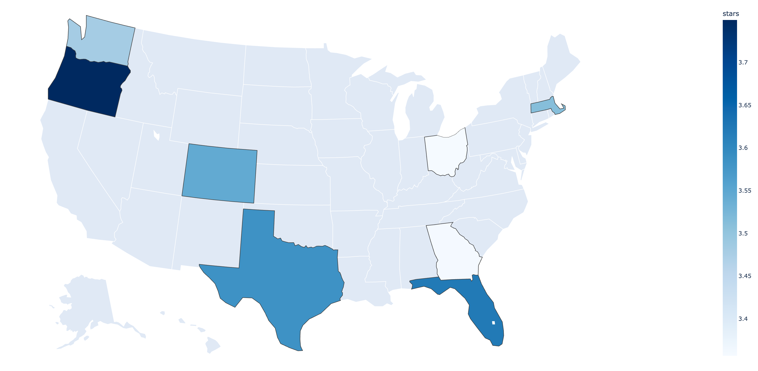
Average stars by state
Interactive web page: stars.html

Slide 6
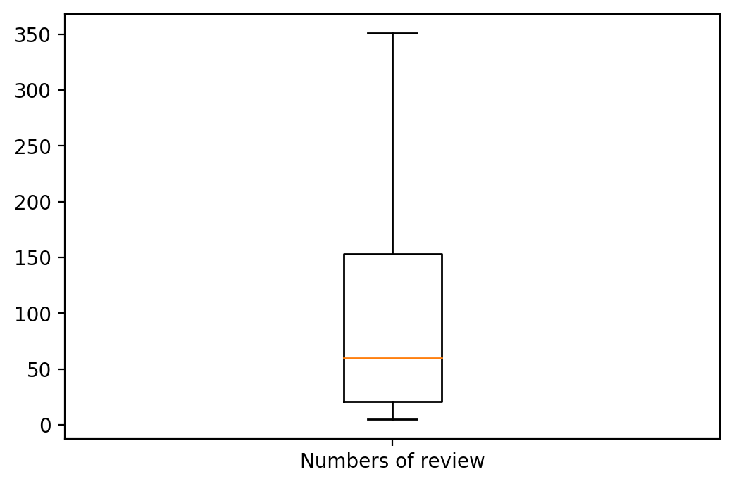

Number of reviews for restaurants
Most restaurants have less than 400 reviews.
(However, Panera Bread has nearly 10,000 reviews.)

Slide 7
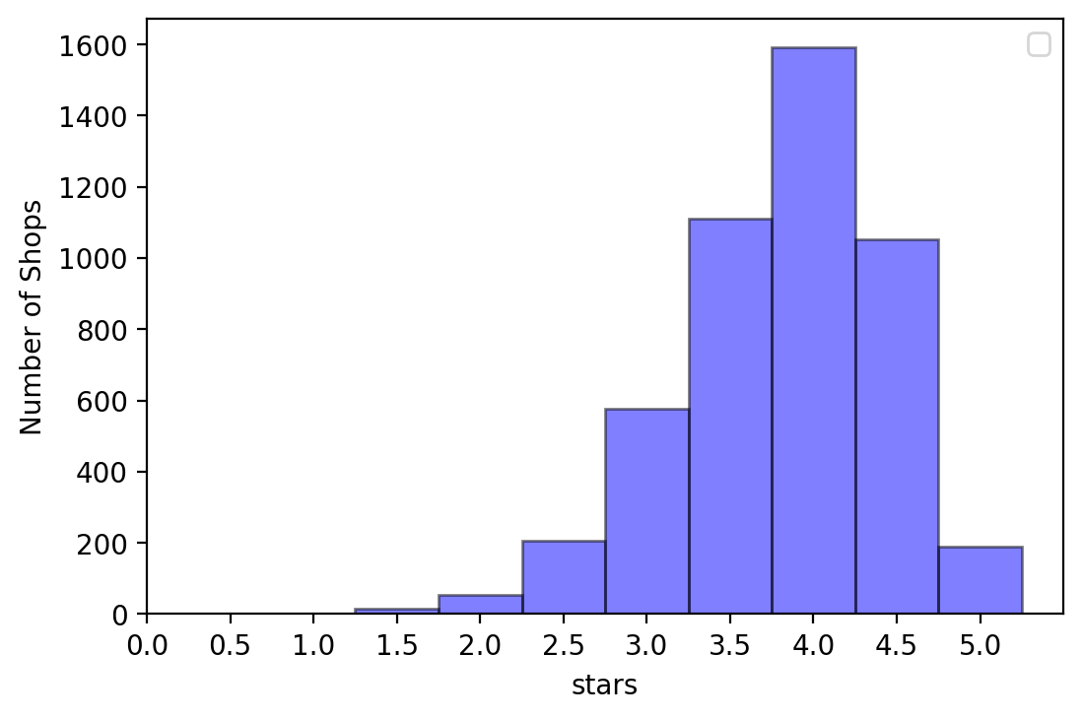
The distribution of shop scores
Most shops are rated around 4. Extremely low rate or extremely high rate is rare.

Slide 8
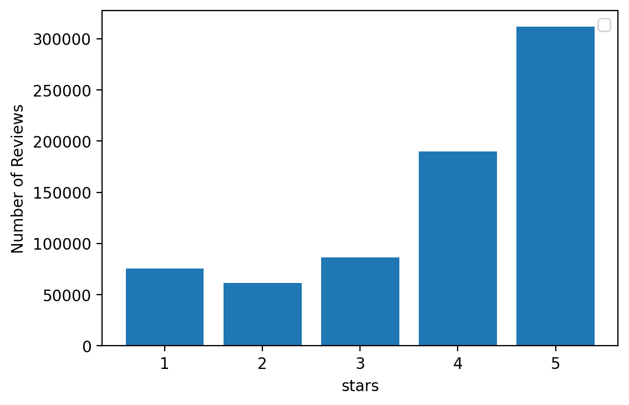
The distribution of review scores
Customer are ‘friendly’, they are willing to give 4 or 5 scores

Slide 9
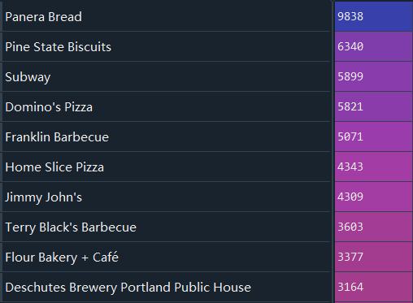
Top 10 most “popular” sandwich restaurants with most reviews
2.55
4.2
2.6
2.39
4.5
4.5
2.76
4.5
4.25
4.0

Slide 10
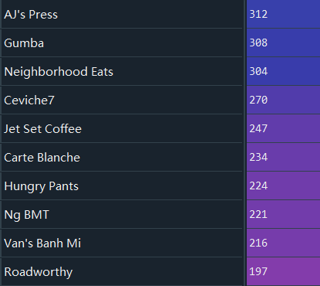
The distribution of reviews scores
5-star restaurants are all small size

Slide 11
Customers are “mean”
166 customers gave one-star stores with a five-star review
5,190 customers gave five-star stores with a one-star review
Work TODO: Explore key words of giving good and bad reviews:
1.Good reviews of top restaurants
2.Bad reviews of poor restaurants
3.Good reviews of poor restaurants
4.Bad reviews of top restaurants

Slide 12
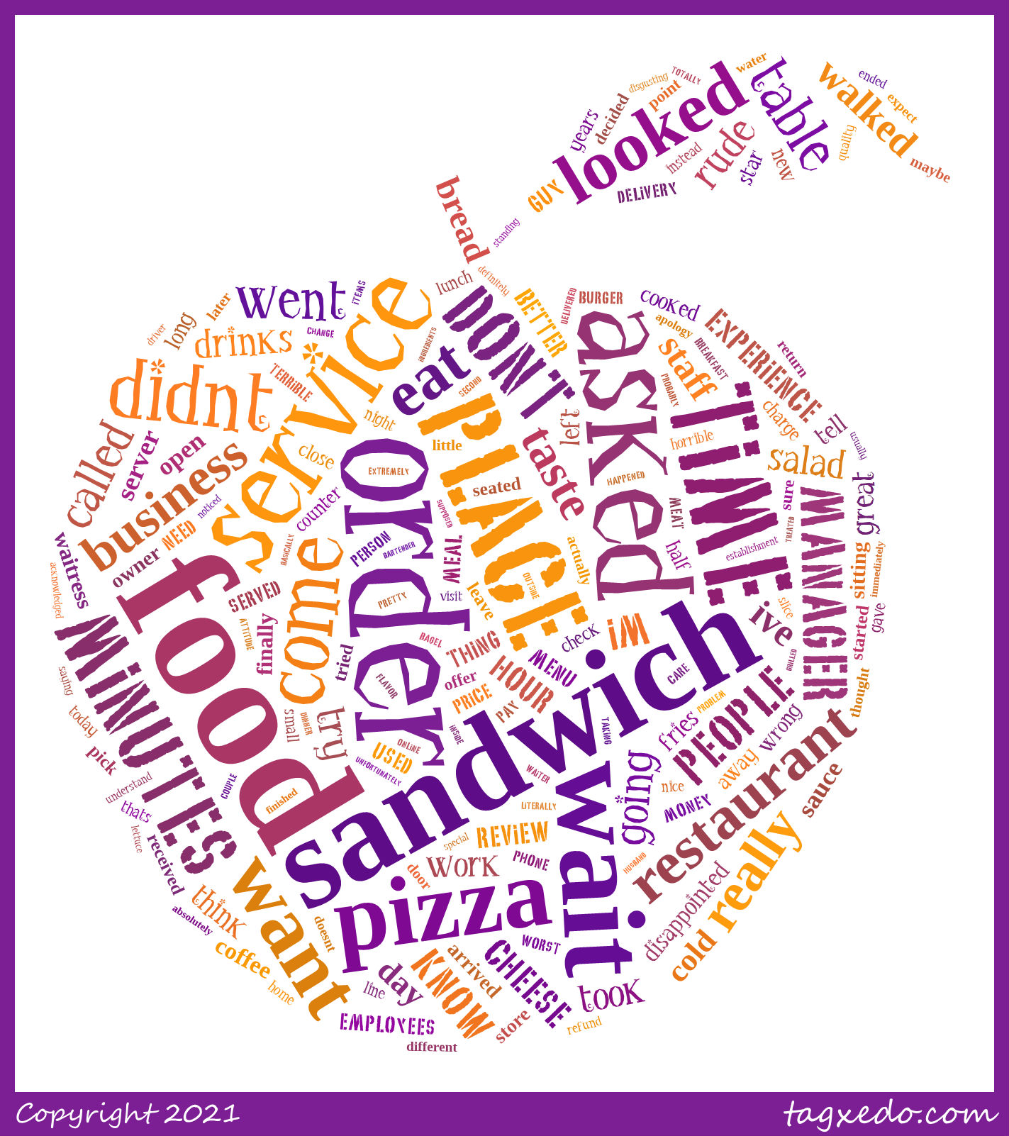
1 star

Slide 13
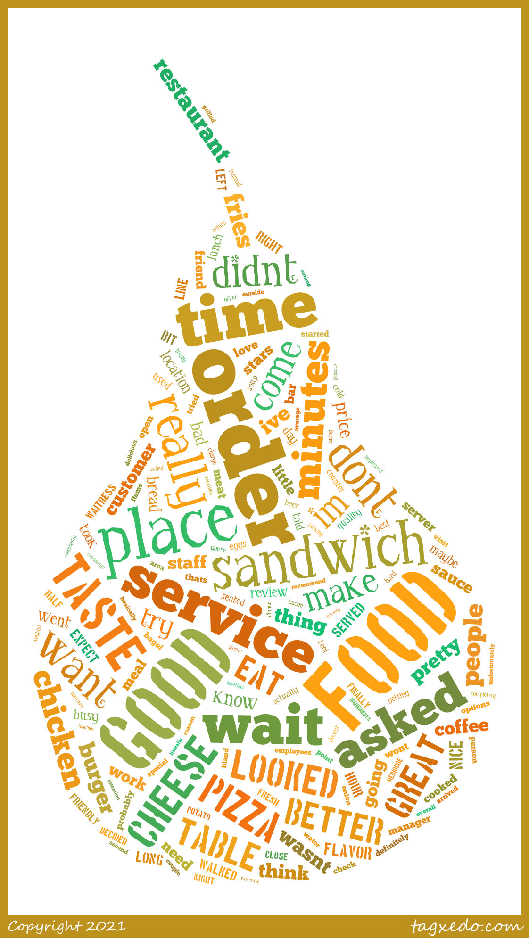
2 star

Slide 14
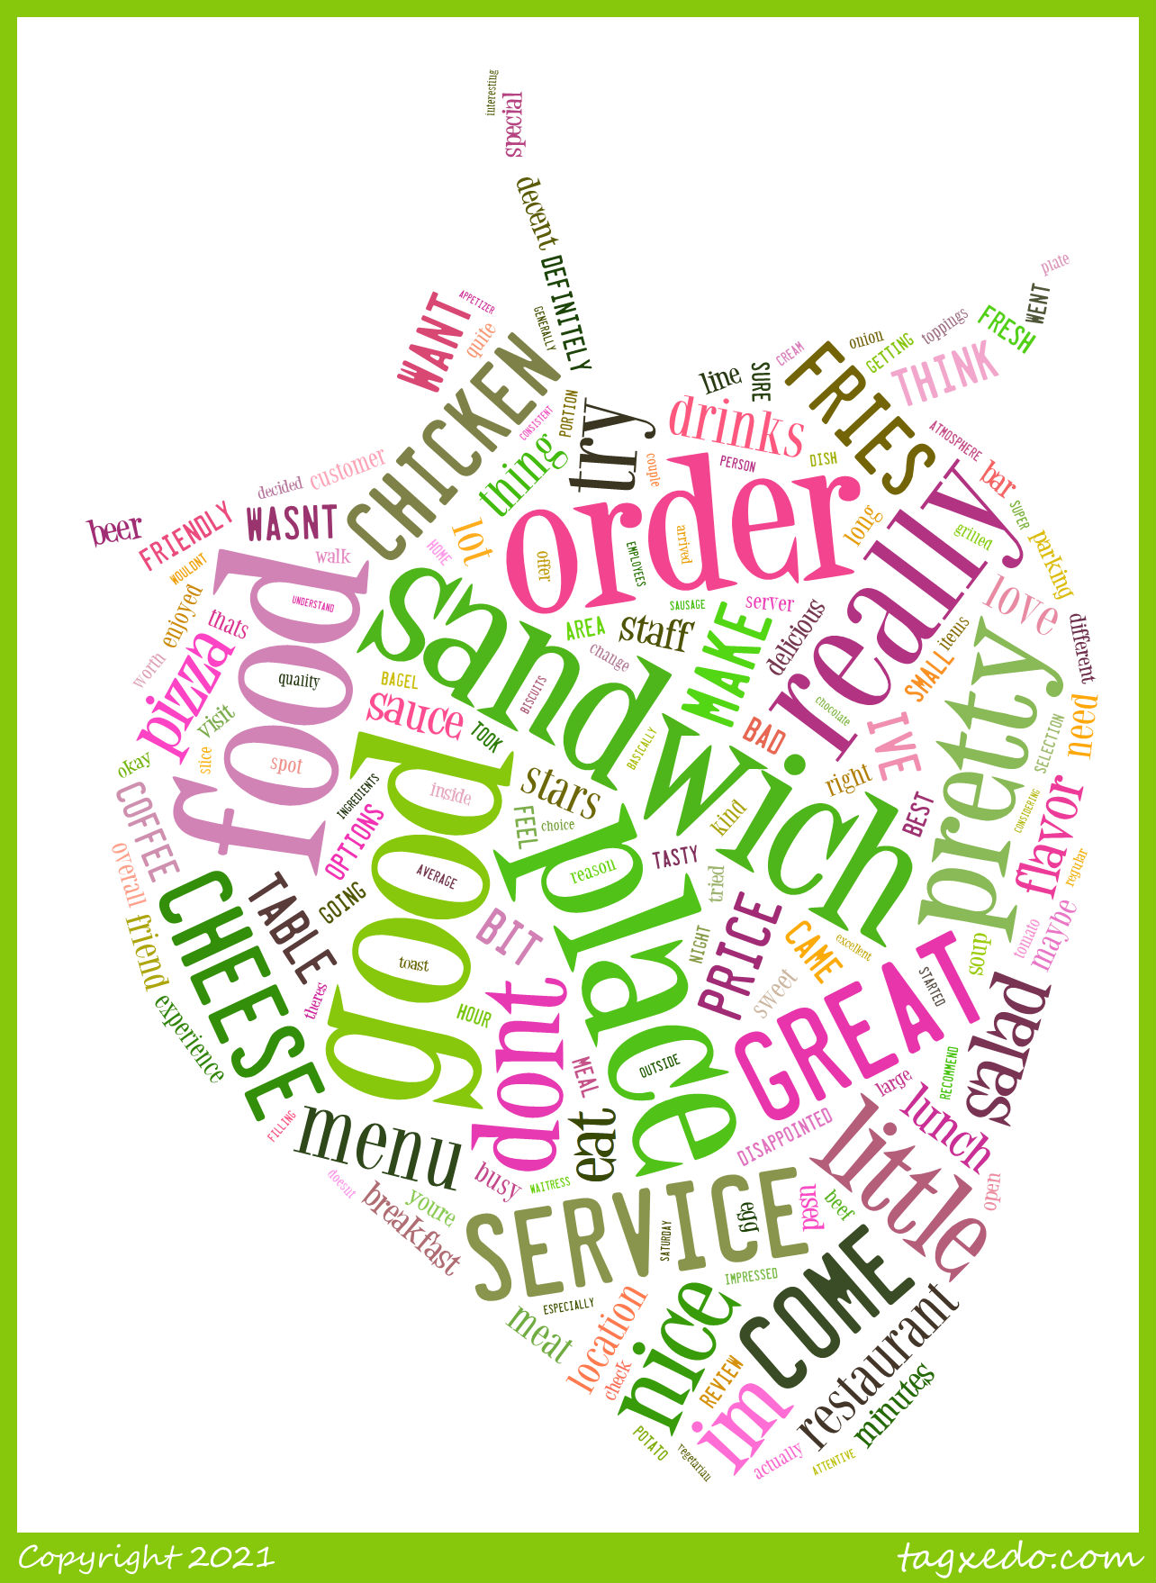
3 star

Slide 15
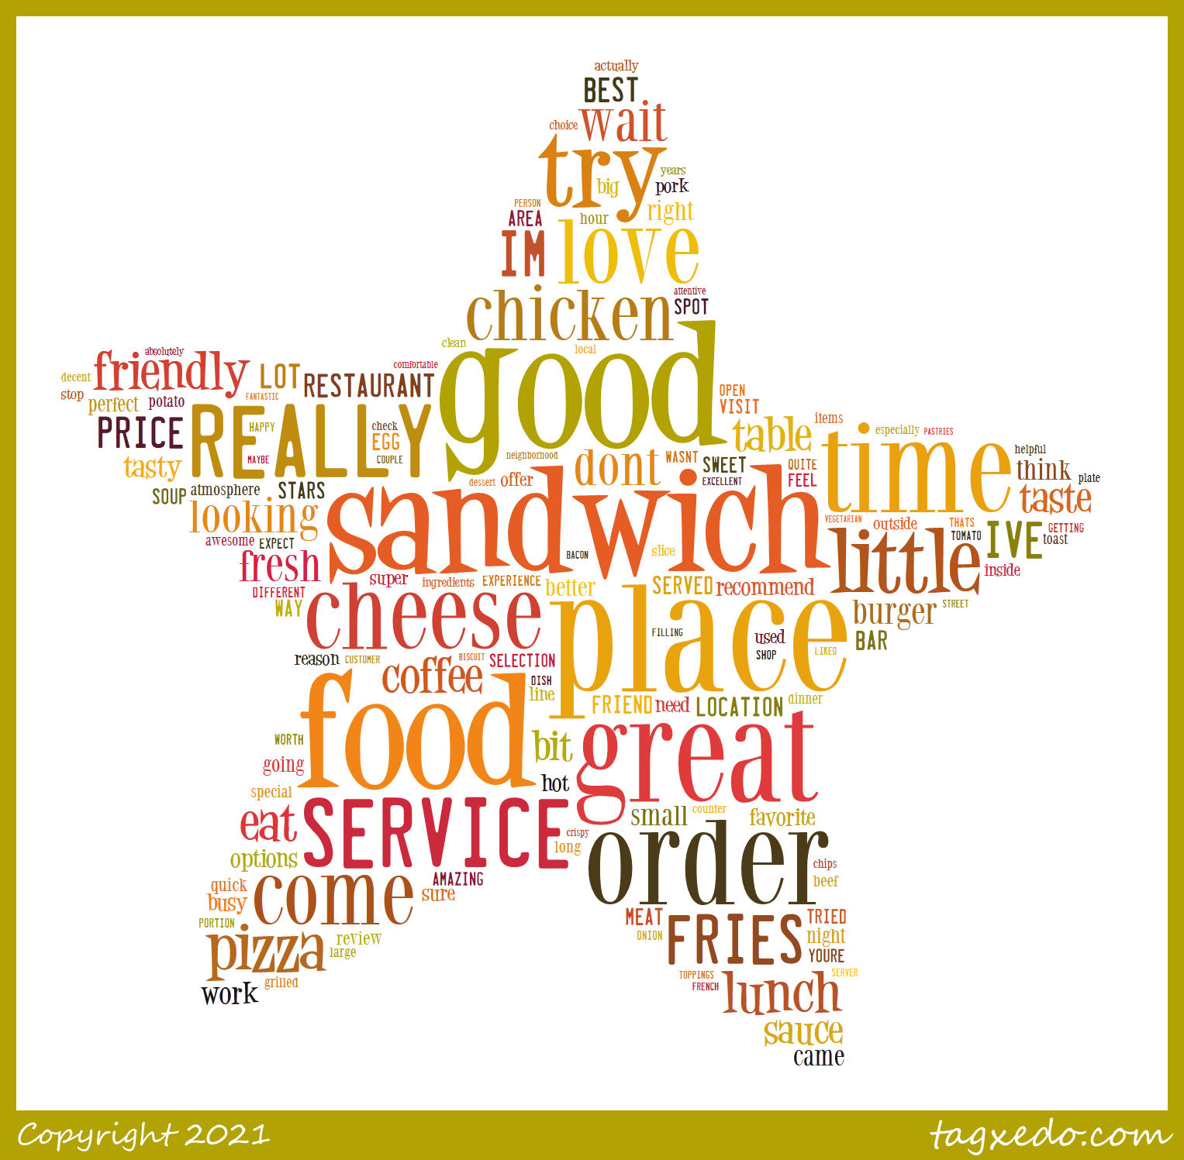
4 star

Slide 16
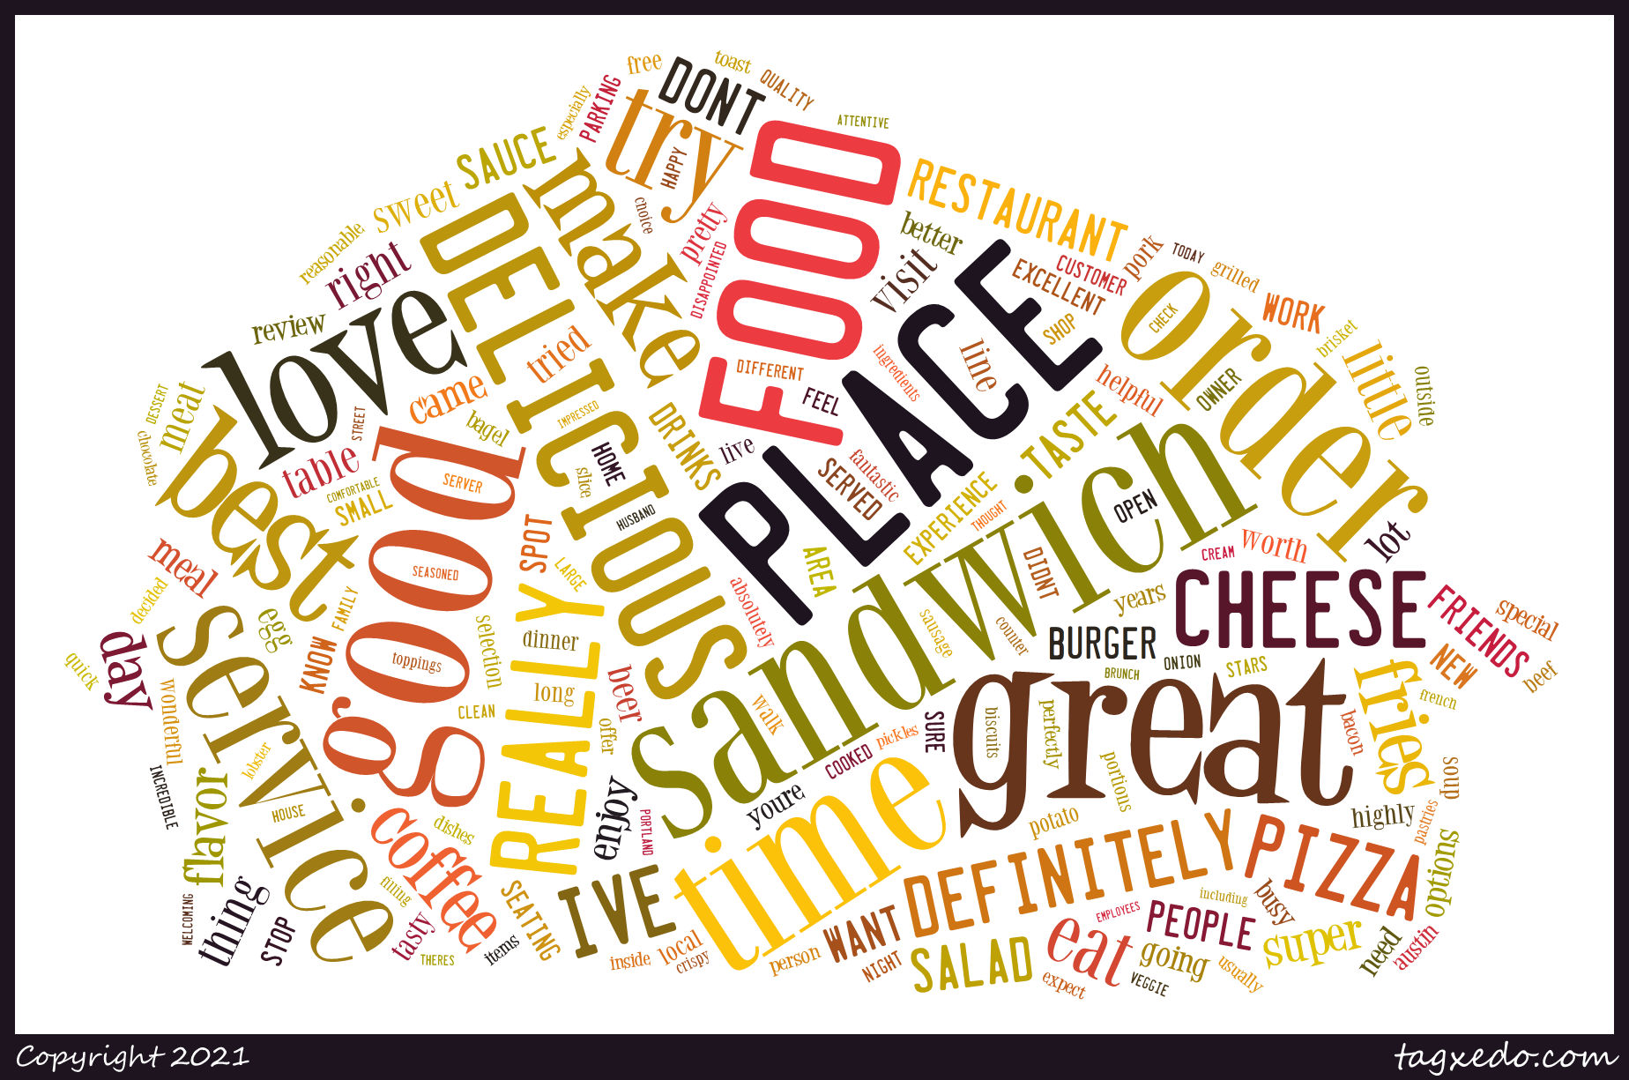
5 star

Slide 17
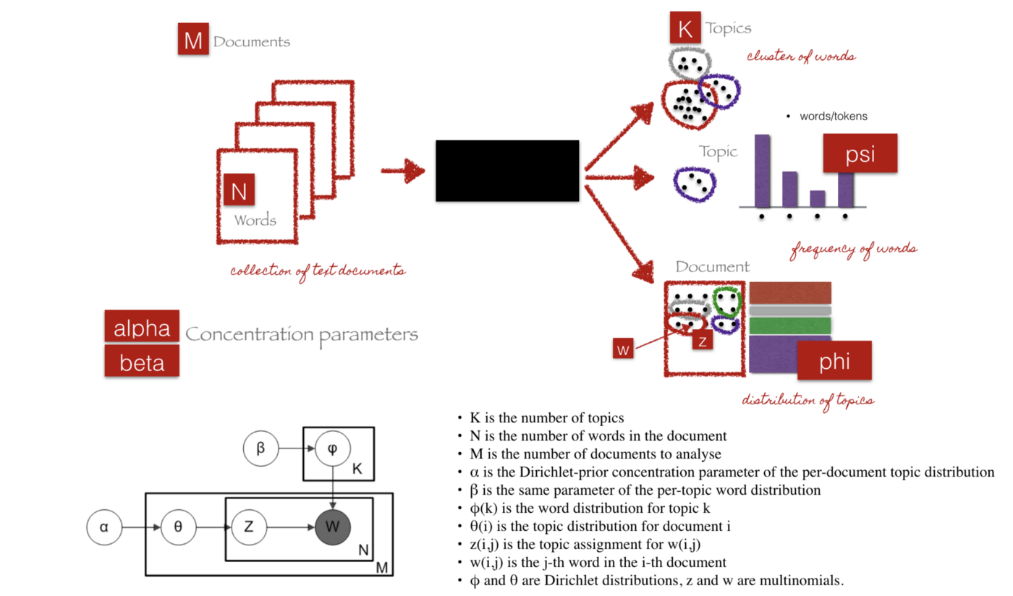
LDA Model Theoretical Overview
LDA is a generative probabilistic model that assumes each topic is a mixture over an underlying set of words, and each document is a mixture of over a set of topic probabilities.

Slide 18
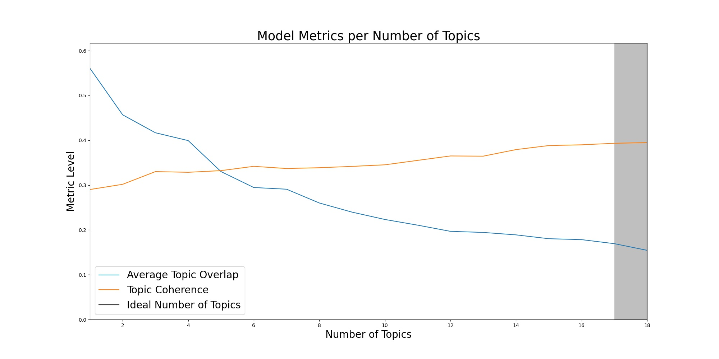

Slide 19
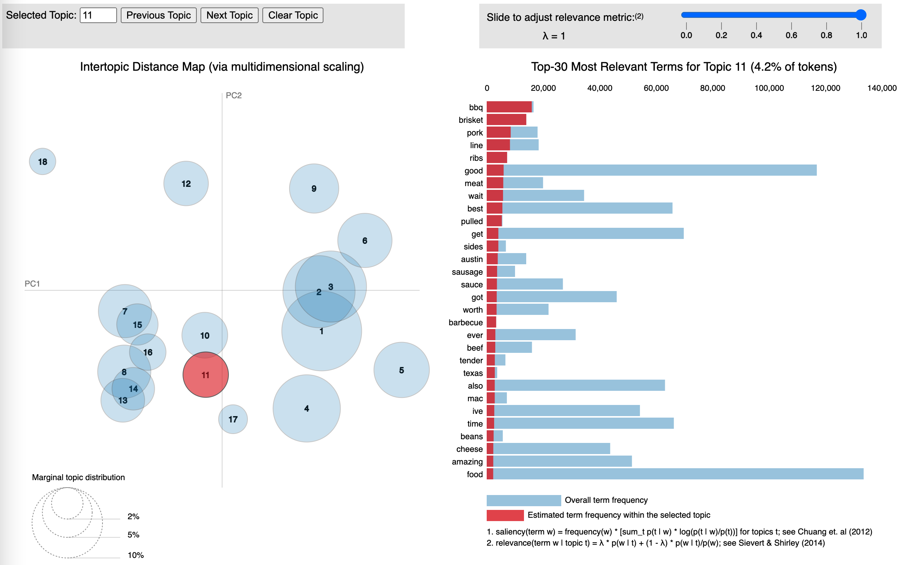
LDA Model Result
Interactive web page: vis_lda.html
Preview:
Theoretical Overview

Slide 20



Thank you!

