Slide 1
Yelp data analysis
By Group 5

Slide 2
Raw data
More than 8 millions of review data
More than 50 thousands of business data
Our goal
To analyze how customers judge a sandwich restaurant. And What are the essential qualities of a good sandwich shop.

Slide 3
Data clean process
1. Filtering all restaurants which categories include sandwich.
2. Filtering out the review data of the sandwich restaurants.
3. Join these two parts of data and do further analysis.
Cleaned data
4795 business & approximately 1 million reviews

Slide 4
STATE | NUMBER OF SHOP | NUMBER OF REVIEW | AVERAGE SCORE
BC | 654 | 29480 | 3.52
CO | 135 | 12768 | 3.54
FL | 1154 | 94128 | 3.62
GA | 856 | 91671 | 3.36
MA | 1891 | 197817 | 3.51
OH | 719 | 39346 | 3.36
OR | 1025 | 116833 | 3.75
TX | 735 | 112443 | 3.58
WA | 103 | 6459 | 3.48

Slide 5
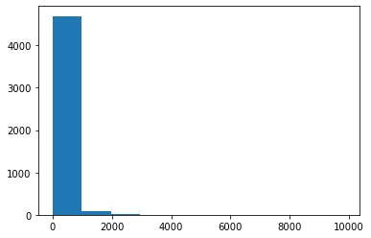
Number of reviews for each restaurant
99% of restaurants have less than 1,000 reviews. However, Panera Bread has near 10,000 reviews.

Slide 6
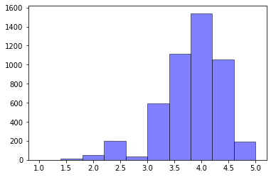
The distribution of shop scores
Most shops are rated around 4. Both very low and very high are rare.

Slide 7
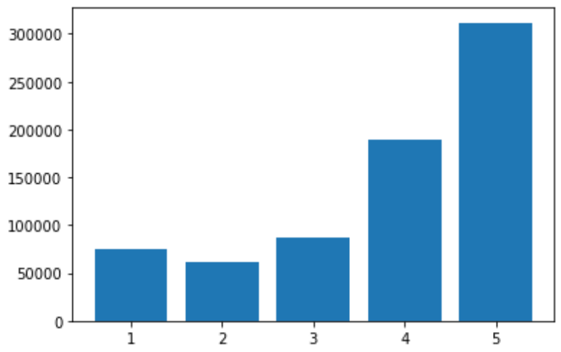
The distribution of reviews scores
Customer are ‘friendly’, they are willing to give 4 or 5 scores

Slide 8
Customers are ‘strict’:
166 customers gave one-star stores with a five-star review
5,190 customers gave five-star stores with a one-star review.

Slide 9
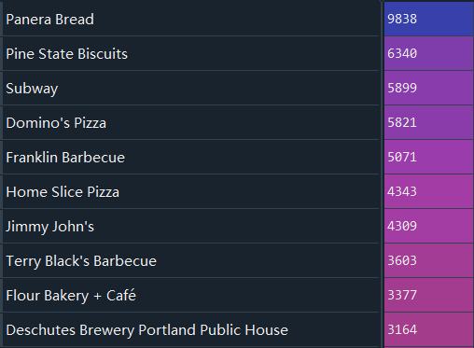
Top 10 most ‘popular’ sandwich restaurants
2.55
4.2
2.6
2.39
4.5
4.5
2.76
4.5
4.25
4.0

Slide 10
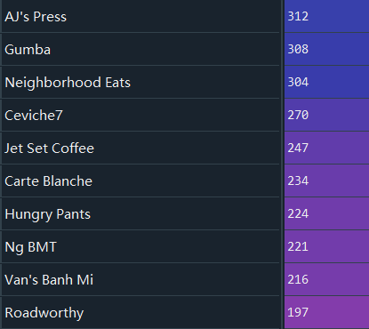
Top 10 most popular 5-star sandwich restaurants
5-star restaurants are all small size

Slide 11
Explore key words of giving good and bad reviews:
1.Good reviews of top restaurants
2.Bad reviews of poor restaurants
3.Good reviews of poor restaurants
4.Bad reviews of top restaurants

Slide 12
NLP model:
Topic model, find out the topics of good and bad reviews(not only the key words)

