Slide 2
MATPLOTLIB

Slide 3
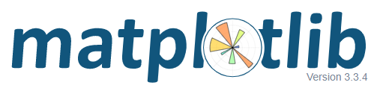
What is matplotlib
matplotlib is a comprehensive library for creating static, animated, and interactive visualizations in Python.
Written in python, C, C#, JS
It is used along with NumPy and other important libraries
Author – John D. Hunter
First version – 2003
Licension – BSD (liberal) ← open source
https://github.com/matplotlib/matplotlib

Slide 4
First steps
Import matplotlib
Import matplotlib.pyplot
Import matplotlib.pyplot as plt
Importing whole library…
… however, you often need just pyplot submodule…
… which is by custom imported as „plt”

Slide 5
First chart
We import libraries, that we need using customary aliases
import matplotlib.pyplot as plt
import numpy as np
xs = np.arange(10)
ys = np.arange(10)
plt.plot(xs, ys)
plt.show()
We can use the numpy library to generate dataset for our chart
This command is responsible for adding feauture to the chart
This command is responsible for displaying chart

Slide 6
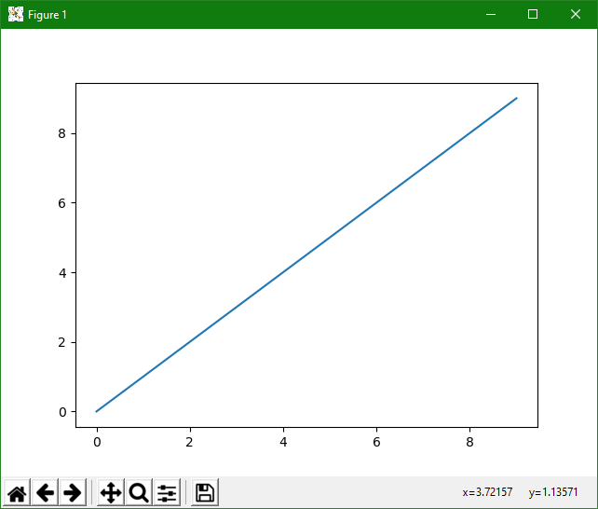

Slide 7
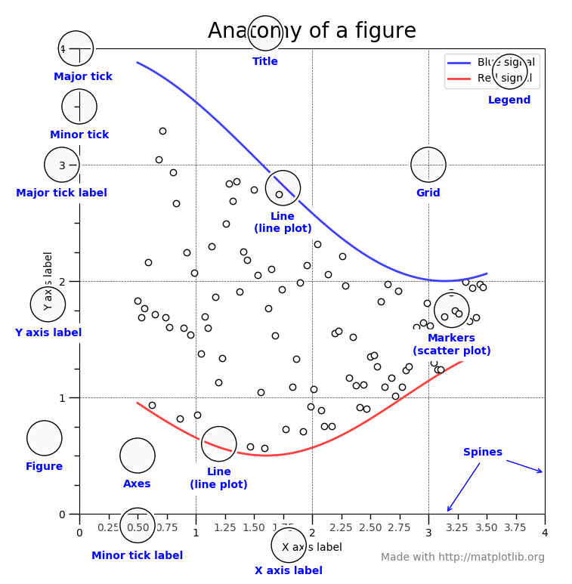
https://matplotlib.org/2.0.2/examples/showcase/anatomy.html

Slide 8
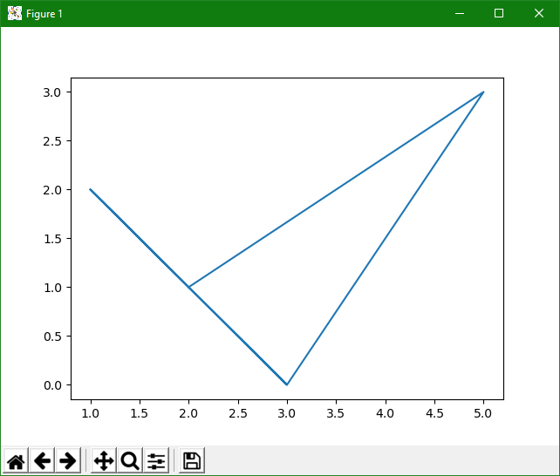

Slide 9
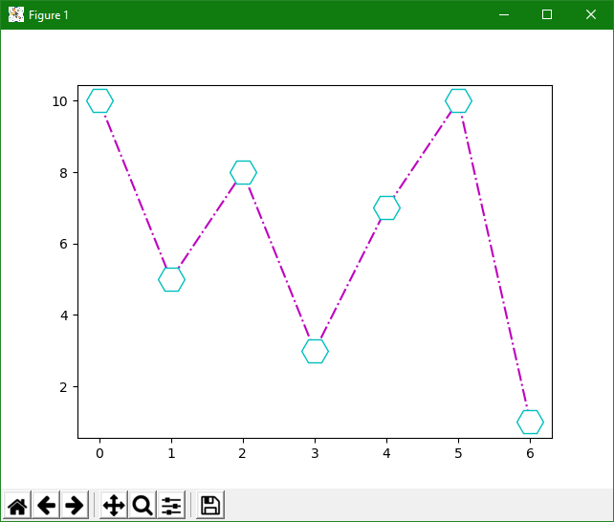
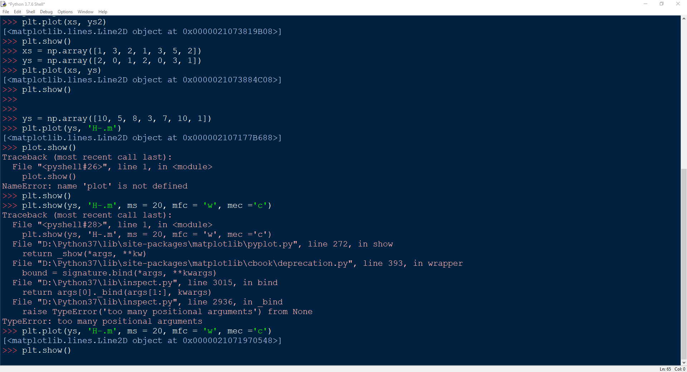
Notes:
145

Slide 10
plot()
If you omit this, default is 1, 2, 3, 4, 5…
plot(points_on_x_axis, point_on_y_axis)
plot(points_on_x_axis, point_on_y_axis, marker)
plot(points_on_x_axis, point_on_y_axis, fmt)
Default is line chart
However, you can define marker
Or fmt parameter which has syntax:
marker|line|colour

Slide 11
Markers and lines
plt.plot(xpoints, ypoints, marker = PLACEHOLDER)
plt.plot(xpoints, ypoints, marker+line+color)
Check the table in the next slide
-
:
--
-.
R G B
C M Y K
W
mec = ‚marker edge colour’
mfc = ‚marker foreground colour’
ms = int(markersize)
lw = int(linewidth)

Slide 12
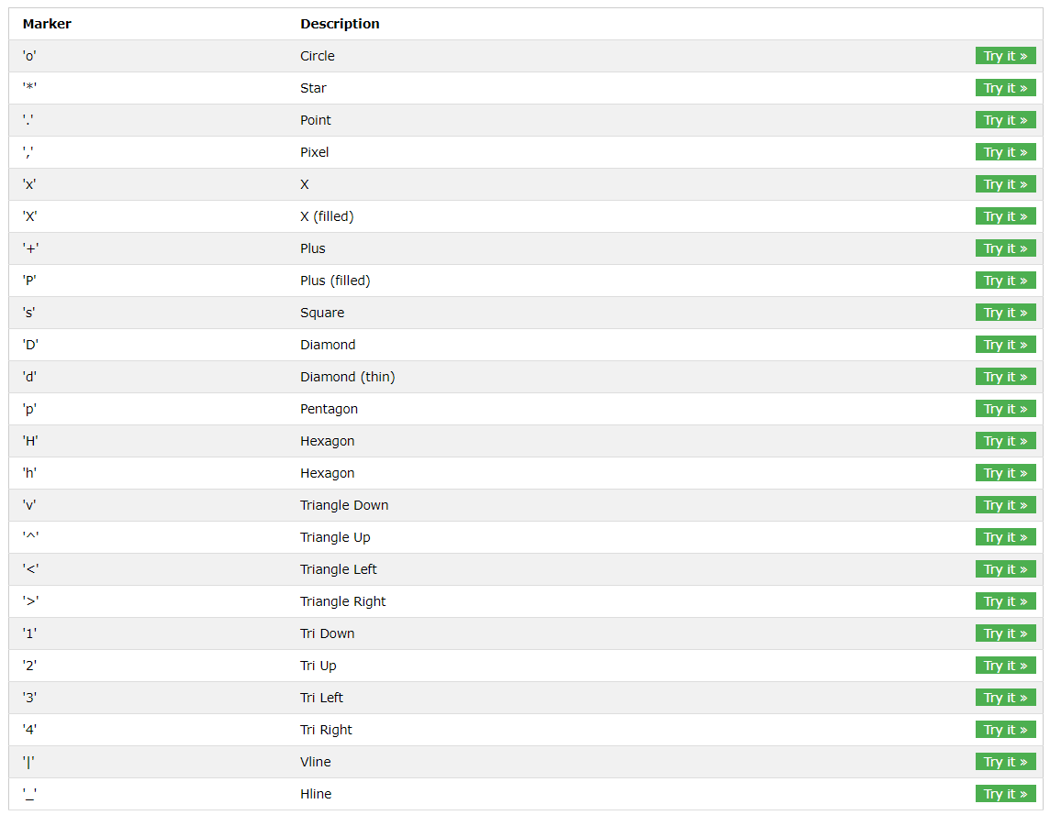

Slide 13
Notes:
149

Slide 14
Multiple plots
You can call plt.plot() multiple Times until you display chart with plt.show()
If you don't define colours etc. they will be automatically different

Slide 15
Adding titles, labels to axis
plt.title(„Title text”, loc = „left|center|right| …”)
plt.xlabel(„Text to display”)
plt.ylabel(„Text to display”)

Slide 16
Adding grid
plt.grid()
plt.grid(axis = „x|y”, color= „r|g|b| …”, linewidth = numer, linestyle= „-|:| … ”)

Slide 17
Ticks and limits
plt.xlim(min_x, max_x)
plt.ylim(min_y, max_y)
plt.axis([0.0, 1.0, 0.0, 1.0])
plt.xticks(list of x ticks)
plt.yticks(list of y ticks)
plt.minorticks_on()

Slide 18
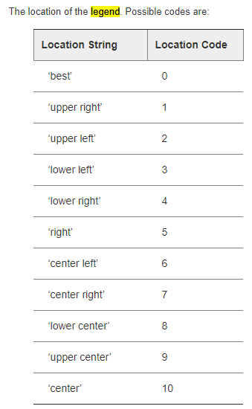
Legend
plt.legend()
  loc = „upper left …”,
  frameon =„True/False”
  fontsize = 20 …
  title = „text”

Slide 19
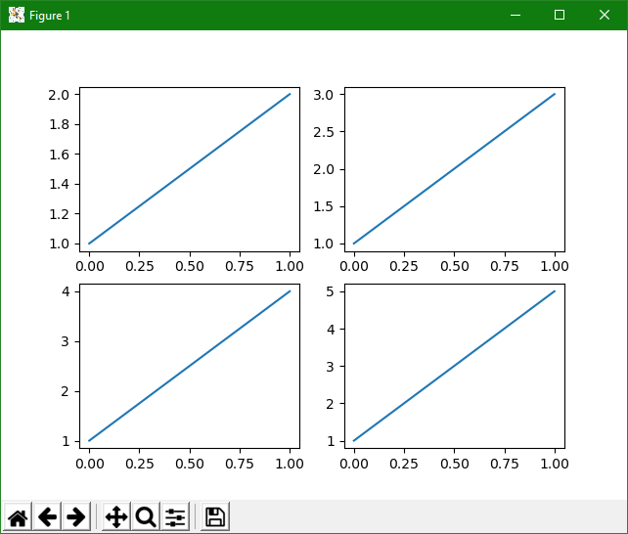

Slide 20
Subplots
1
2
You can plot more than one chart in one plt.show()
plt.subplot(how_many_rows, how_many_columns, which_subplot_is_this)
3
4

Slide 21
Bar chart
plt.bar(category_list, values_list)
plt.barh(category_list, values_list)
Parameters:
  color
  Width/height
Vertical bars
horizontal
By default 0.8

Slide 22
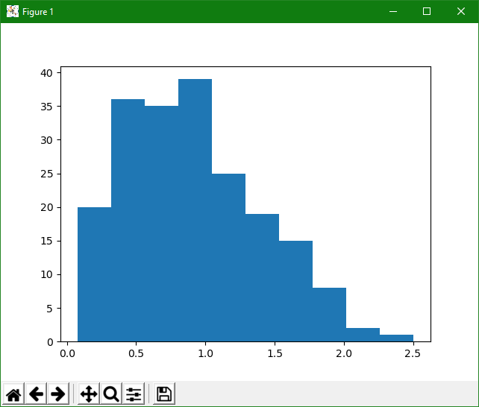

Slide 23
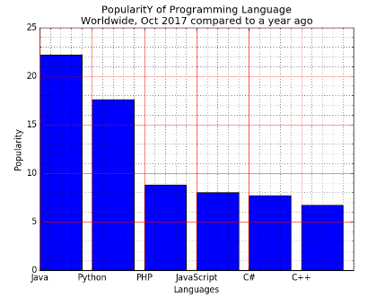

Slide 24
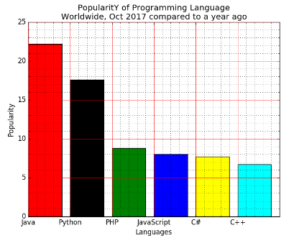

Slide 25
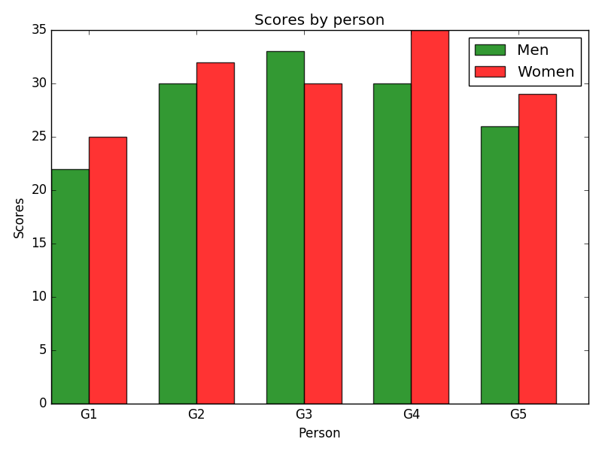

Slide 26
Histograms
plt.hist(list_of_values)
https://numpy.org/doc/1.16/reference/routines.random.html

Slide 27
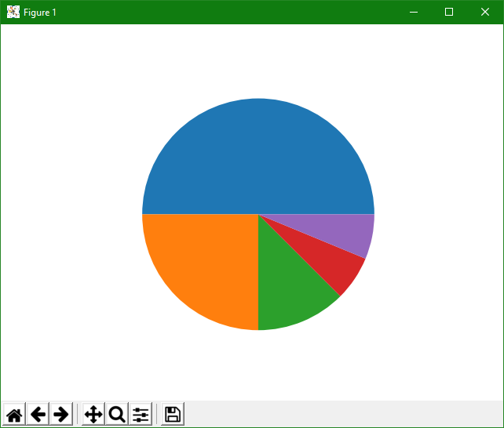

Slide 28
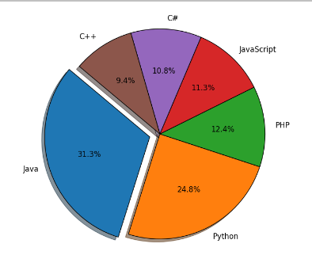
Pie charts
plt.pie(values, explode, labels, colors)

Slide 29
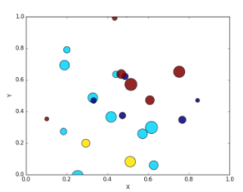
Scatter
plt.scatter(x, y, s=areas, c=colors, alpha=0.85)
https://numpy.org/doc/1.16/reference/routines.random.html

Slide 30
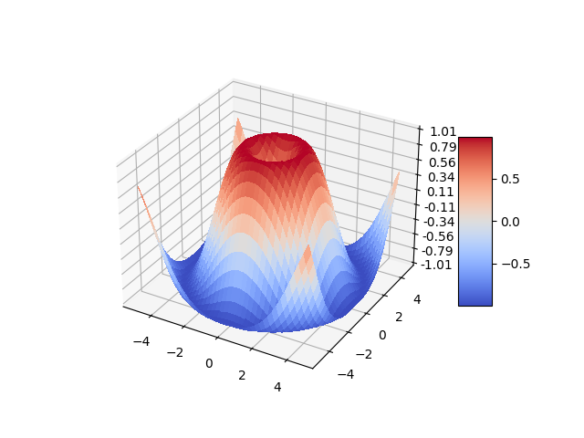
3d plotting

Slide 31
https://www.w3resource.com/graphics/matplotlib/barchart/matplotlib-barchart-exercise-1.php

Slide 32
PANDAS

Slide 33
What is Panda?
Library for Python to manage data sets
It is possible to make analysis, do some cleaning, change of data etc.
Pandas name is based on:
  „Panel data”
  „Python Data Analysis”
The creater of the Pandas is Wes McKinney
First release was in 2008
https://github.com/pandas-dev/pandas

Slide 34
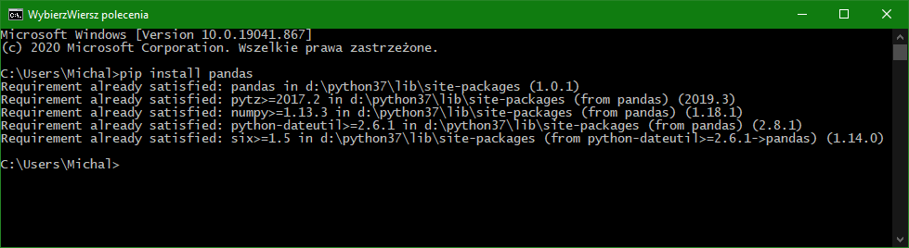
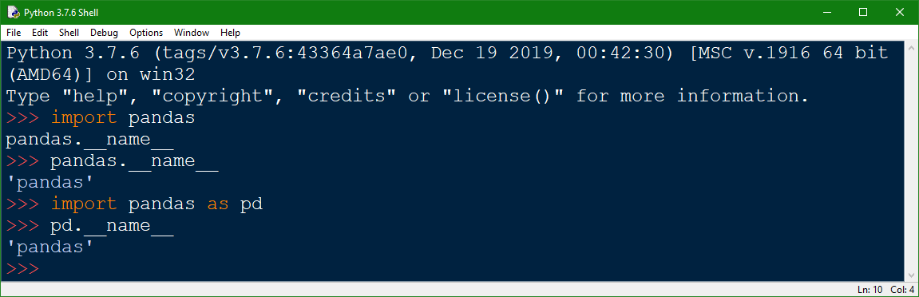
First steps… as always:

Slide 35
Pandas Series – basic data structure
Pandas series can be understand as a column
It is also similar in some way to Python Standard Library list – it can hold data of any type. It can be created from the list by using Series() function
Pandas series is indexed
  By deflaut the indexes are consectutive numbers

Slide 36
pd.Series()
pd.Series(list)
pd.Series(list, index = [list])
pd.Series(dictionary)
Default labels are consecutive numbers
If you label your data you can access data cel by these indices
Keys from dictionary will become labels

Slide 37
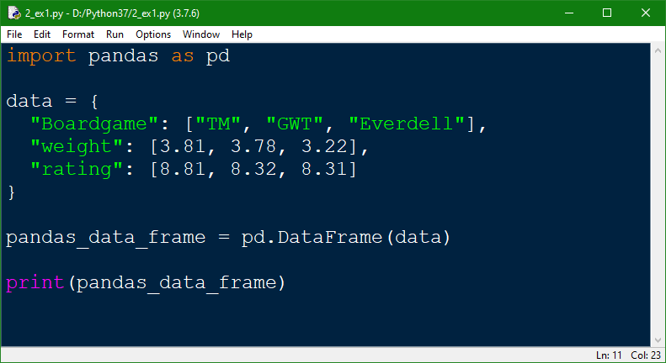
pd.DataFrame
In practice main data structure during usage of Pandas. It represents multidimensional tables. It is build from series

Slide 38
Define data from csv or json
pd.read_csv(‚filename.csv’)
pd.read_json(‚filename.json’)
You can use print(dataframe.to_string()) to print whole DataFrame
JSON have sama structure as Python dictionary

Slide 39
What we can do with DataFrame
loc[]← return one or more rows
  loc[number]
  loc[[list of rows]]
dataframe.rename(columns={„old” : „new”})
You can modify the data in this way, however it is not efficient way to do this

Slide 40
Repair the data
You can modify current dataframe if you use inplace = True parameter
df.dropna() <- removes the empty cells – the effect is new dataframe
df.fillna() <- fills rows with data – the effect is new dataframe
for x in dataframe.index:
  do something
  dataframe.loc[x, „column”] = True
  dataframe.drop(x) if …

Slide 41
Analyze the data
dataframe.mean()
dataframe.median()
dataframe.mode()
Can be call for whole dataframe or just for one column

