Slide 1

Practical Git Workflows for Tech Docs
Radu Coravu
radu_coravu@oxygenxml.com
@radu_coravu

Slide 2


About the Author
Feedback (questions, problems, improvement requests)
Technical Writers
Things I do
Improve Oxygen XML Editor
Improve Oxygen product documentation
Blogs/Presentations
Open Source Projects

Slide 3

The Git Version Control System is a feasible solution to work and collaborate on technical documentation projects big or small.

Slide 4
Advantages of Using Git
Free and stable system:
used by many,
with available tutorials, documentation.

Slide 5
Advantages of Using Git
Version control.
Collaboration.
Support for branching.
Work offline.
Users with no write access can propose changes.

Slide 6
Disadvantages of Using Git
No built-in support for a ticketing system.
No built-in support for publishing.
No way to lock resources when editing in order to avoid conflicts.
Some training is required to use and understand the branching and history models in Git.
No granular support for user roles.

Slide 7
Resources - Learning Git
Git Basics tutorial by Atlassian.
The Pro Git Book.
Learn Git Braching Interactive Tutorial.
Lots of courses about learning Git on Udemy.

Slide 8
Resources – Workflows/Collaboration
DITA for Small Teams Oxygen Blog Post
GitLab Docs As Code blog post
Docs as Code blog post
Write the Docs - Docs as code blog post
Git WorkflowsTactical Git - Micro Commits

Slide 9
Lots of Client-Side Applications
Git Fork.
Git Tower.
SourceTree.
GitHub Desktop.
Git console.
Git client add-on in Oxygen XML Editor.
Web-based clients like Oxygen Web Author.
etc…

Slide 10
Popular Server-Side Solutions
GitHub (either online or on-premise).
GitLab (either online or on-premise).
Both solutions come with features to:
Create organizations.
Support to create and manage private/public repositories.
Cloud Storage.
Basic support to create and handle tickets/issues.
Support to create pull/merge requests.

Slide 11
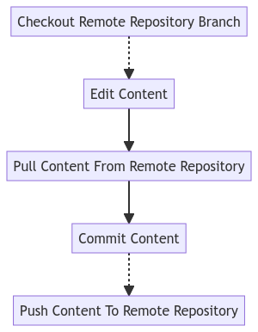
Typical Editing Session
Local Repository

Slide 12
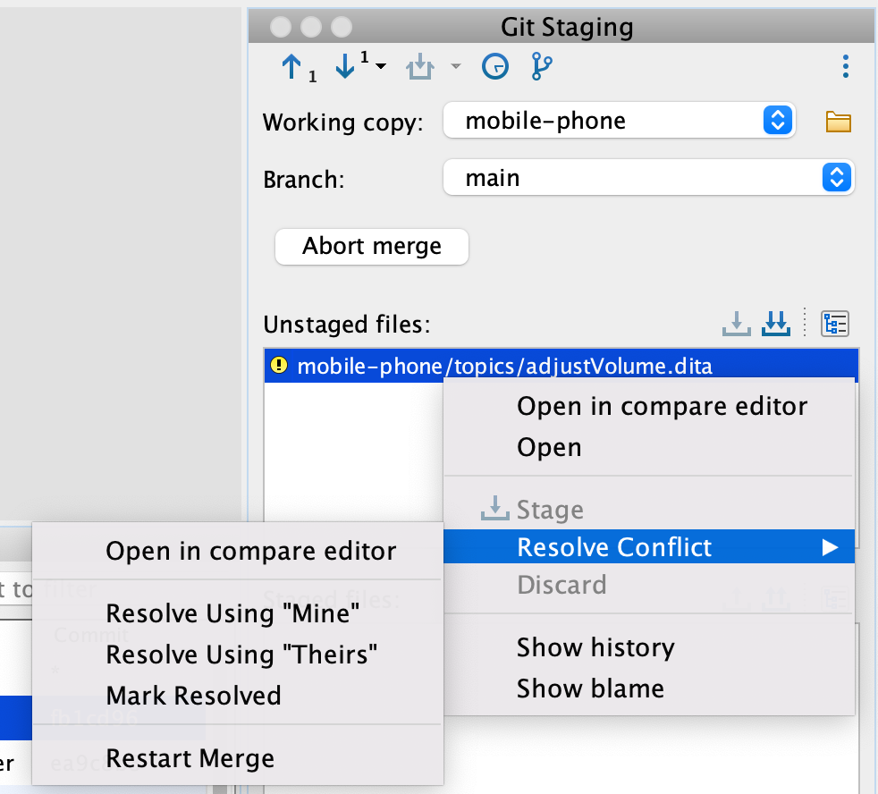
Handling Simple Conflicts
If changes are made to text files on different lines, the conflicts are automatically merged.
If the conflicting changes are on the same lines, you can manually resolve the conflict.

Slide 13
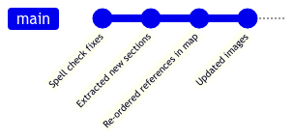
Micro Commits
Commit often, whenever a small change makes sense by itself.
Use Git Tactically

Slide 14
Validation of Proposed Changes
DITA XML content needs to be validated against the DITA schemas and possibly with additional business rules.
Server side-validation using an integration server.
Client-side validation.

Slide 15
Workflows
A Git workflow is a recipe or recommendation for how to use Git to accomplish work in a consistent and productive manner.
Git workflows encourage developers and DevOps teams to leverage Git effectively and consistently.
Comparing Workflows

Slide 16
(1) Centralized Workflow
We all work with the same project(s) on the main repository branch.
We have separate branches which mark past releases.
For features which may take a longer time to implement, we work on the main branch, and we connect them to the live content when they are done.

Slide 17
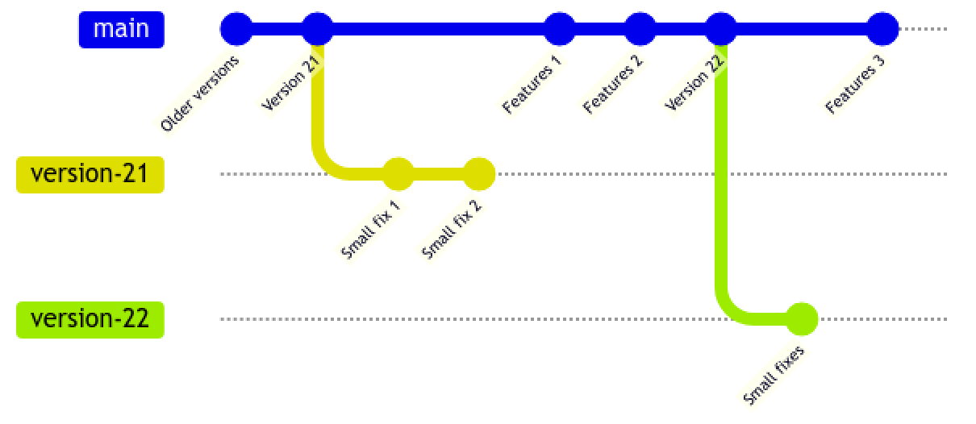
Centralized Workflow Graph

Slide 18
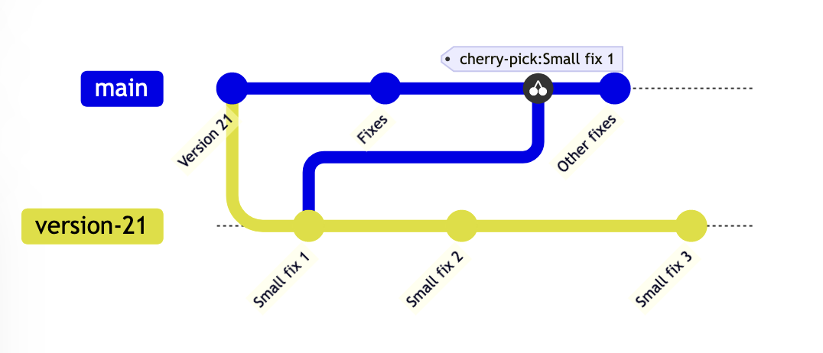
Cherry Pick
Pick a commit from another branch and incorporate it in the current working branch.

Slide 19
(2) Feature Branches
We work on the smaller fixes on the main branch.
We create separate branches for larger features/fixes.

Slide 20
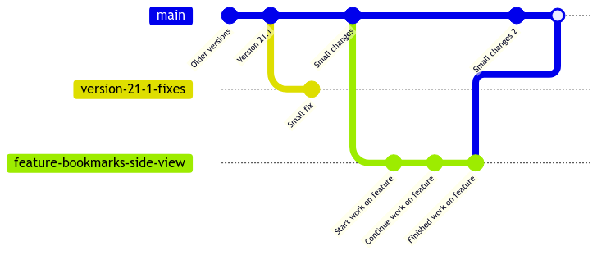
Feature Branches Graph

Slide 21
Merging a feature branch
Once work on a feature is finished and your colleagues review the content, you can merge the feature branch back in the main branch.
The merging can be done using a pull request. You can think of pull requests as a discussion dedicated to a particular branch.

Slide 22
Feature Branches Variation
Release Branches
Writers work only on release branches.
Content from a release is automatically merged with the next one.

Slide 23
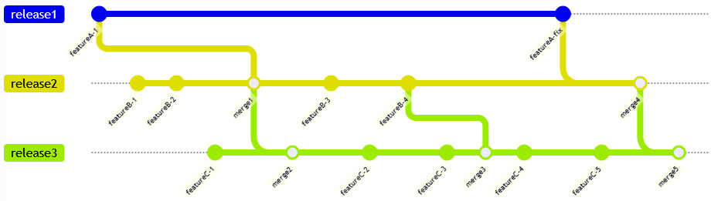
Feature Branches Variation
Release Branches

Slide 24
(3) GitFlow
The main branch holds the official content which will be released.
We create feature branches based on a development branch.

Slide 25
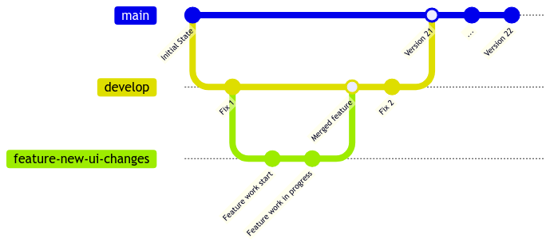
GitFlow Graph

Slide 26
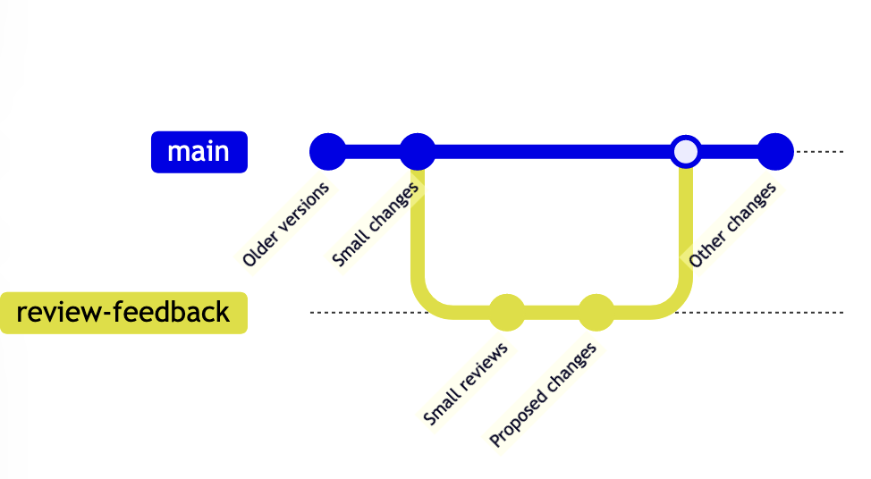
Propose Changes (Pull Requests)
Collaborators who have read access to the repository may sometimes want to propose changes. You can think of pull requests as a discussion dedicated to a particular branch.

Slide 27
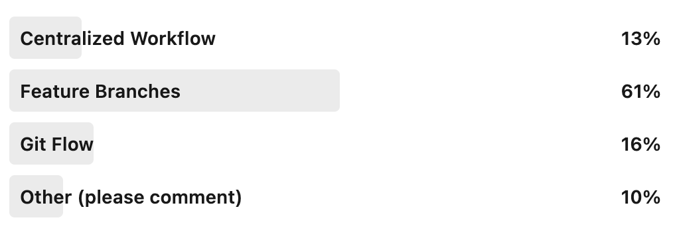
LinkedIn Poll
What type of Git workflow are you using for technical documentation?

Slide 28
Centralized Workflow vs Feature Branches
Centralized Workflow | Feature Branches
Conflicts are smaller and easier to fix. | Better when trust between team members is lower.
Easier to set up and use by junior writers | Content on the main branch is more stable, unfinished content is kept away from the main branch.
Easier to review the content in its current state.

Slide 29
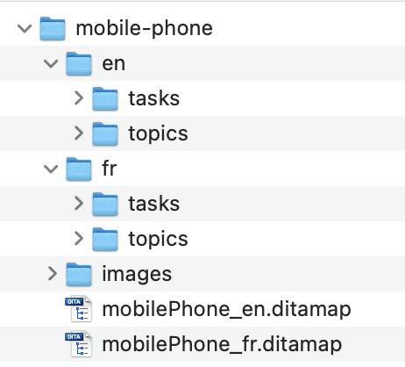
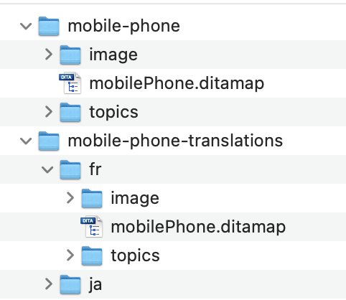
Handling Translations
Keep the translation for each language in a separate folder in the same Git project.
Keep a separate parallel project with all the translations.

Slide 30
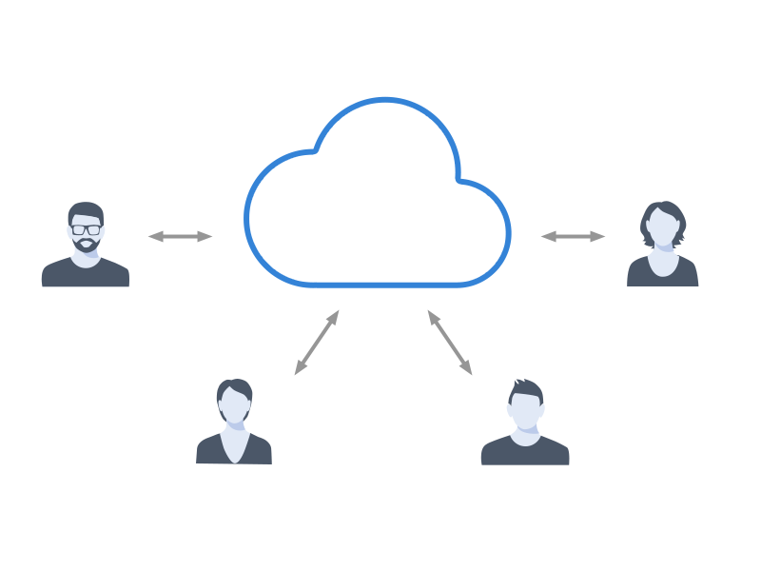
Sharing Common Settings
Share common settings directly in the Git project:
Spell check dictionaries and learned words.
Terminology checker settings.
Actions and behaviors for editing content.
Custom validation and quick fixes.
Publishing templates.

Slide 31


Publishing Content
Publish by connecting an integration server to the Git project. For example, for publishing DITA XML content to PDF you can create a Jenkins or Travis job or run a command line.
For each version branch a separate server-side job could be created to run when the content is modified on that branch.

Slide 32
Integration With Ticketing System
Ticketing systems like Atlassian JIRA have APIs and hooks which allow showing Git changes directly on opened issues.

Slide 33
Useful links:
More details about this presentation can be found on the Oxygen XML Blog:
Using Git For Technical Writing

Slide 34
Thank You!
Questions time…
Radu Coravu
radu_coravu@oxygenxml.com
@radu_coravu

