Slide 1



Restructuring DITA
Radu Coravu
radu_coravu@oxygenxml.com
@radu_coravu

Slide 2

Restructuring DITA
Summation:
In which Radu attempts to present to you 30+ practical examples of applying automatic changes to DITA content in about 40 minutes.

Slide 3


About the Author
Feedback (questions, problems, improvement requests)
Technical Writers
Me
Improve Oxygen XML Editor
Improve product documentation
Blogs/Presentations
Open Source Projects

Slide 4
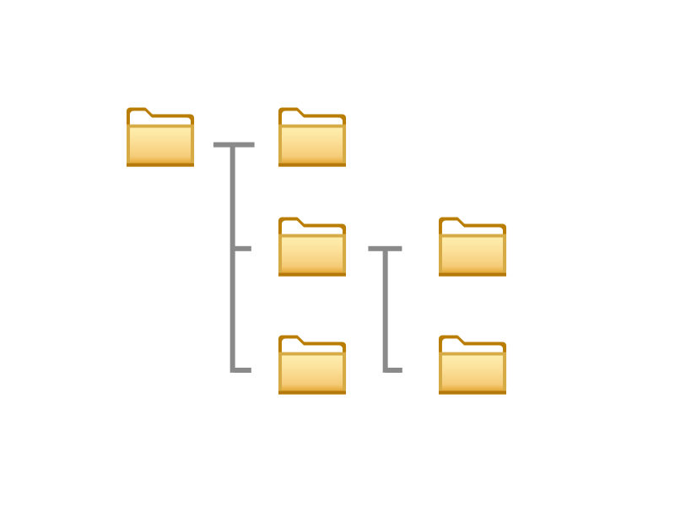
DITA Project Aspects
Assembly of DITA maps, topics and other resources used to produce output deliverables
Projects increase in complexity over time:
  More resources
  More relationships between resources
  More output formats

Slide 5
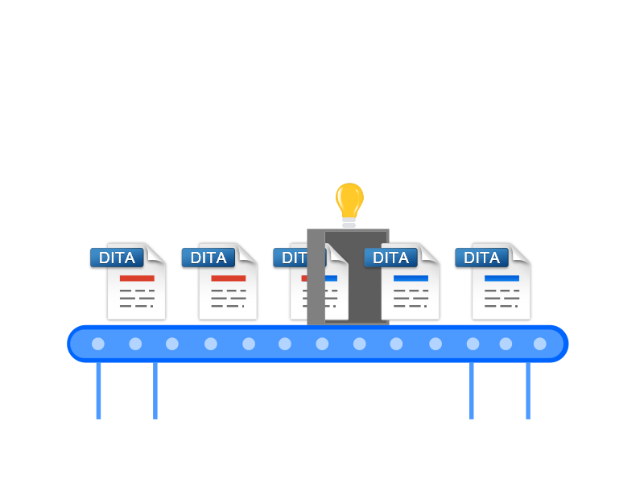
Project-wide restructuring operations
Modify DITA content in lots of topics and maps
Modify file and folder structures
Can we find some way to automate our changes?

Slide 6
Can I solve my problem using automation?
Do I understand all aspects of my problem?
Can I break my problem in simpler to solve problems?
Can I come up with a fixed set of steps anybody could use to resolve the problem?
Can I precisely identify all places where my problem occurs?

Slide 7
Automation Benefits:
Problems:
Speed
Consistency
Wrongly configured automation can corrupt an enormous amount of content

Slide 8
How can we apply multiple changes to DITA/XML content?
Text Find/Replace (+ Regexp support)
Mixture of text find/replace with XPaths
XSLT stylesheets
XQuery Update

Slide 9
Automation steps for batch XSLT-based processing
Comment out DOCTYPE declaration
Apply XSLT script
Remove comment around original DOCTYPE declaration

Slide 10
Project-wide restructuring examples
Convert DocBook to DITA
Convert between various topic types.
Rename or move one or more topics.
Change XML structure in topics from the entire project.

Slide 11
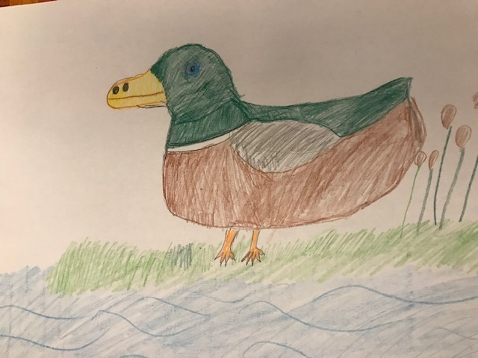
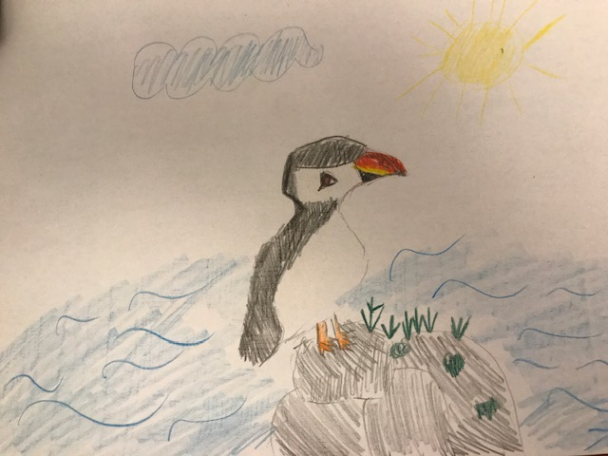
DocBook to DITA
  “Converting from DocBook to DITA is like converting between two different types of birds”

Slide 12
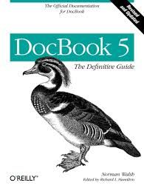

Convert DocBook to DITA
Generate a single DITA composite from DocBook.
Apply custom XSLT to create DITA Map and topics.

Slide 13
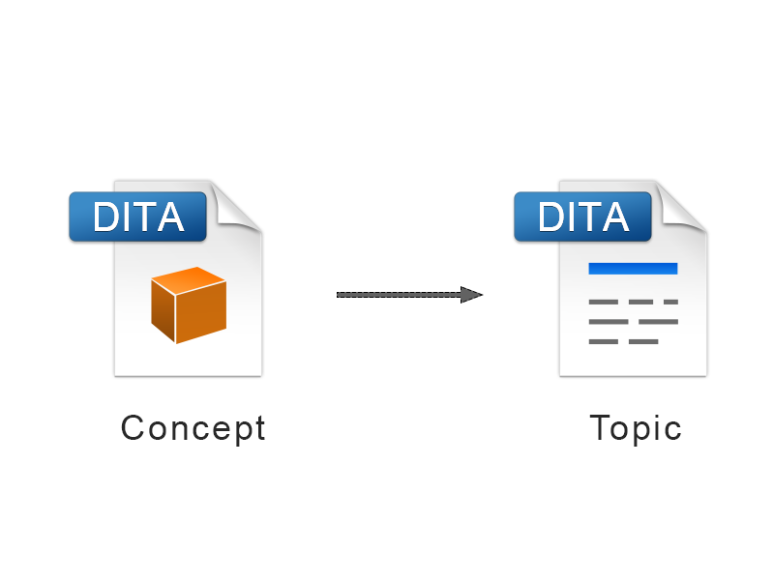
Convert between topic types
Topic to Concept or Task
Task to Topic or Concept
so on...

Slide 14

Change Reference to DTDs
Change the DOCTYPE to associate specialization DTDs with existing tasks/topics/concepts/references
<!DOCTYPE concept PUBLIC "-//OASIS//DTD DITA Concept//EN" "concept.dtd">
<concept id="my_concept">
<!DOCTYPE concept PUBLIC "-//OASIS//DTD DITA My Concept//EN" "myconcept.dtd">
<concept id="my_concept">

Slide 15
Restructuring resources
Add prefixes to all files in a folder
  Change file names on disk
  Change references to file names inside the DITA content

Slide 16
Converting from direct to indirect (key-based references)
Convert direct links to indirect links.
Convert conrefs to conkeyrefs.
Convert image references to image key references.
  Automatically create DITA Map with key definition
  Replace image hrefs with keyrefs

Slide 17

Keys related restructuring
Rename key (and all its references)
Delete key (and all its references)

Slide 18
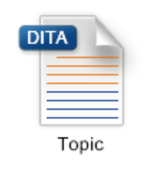
Topic restructuring (1)
Surround table cell content with paragraphs
Surround list item content with paragraphs
Add menucascade around ui controls
Move attribute from one element to another (example from fig to title)
Move images inside figure titles to be after titles

Slide 19
Topic restructuring (2)
Extract sections to separate topic files
Extract inner topics to separate topic files (Example: Docbook->DITA->Map + topics)
Identify and replace product names with key references.
Sort keywords in prolog.
Change attribute name (e.g. id->appid)

Slide 20
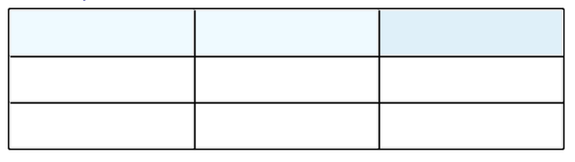
Table Restructuring
Convert between CALS tables and simple tables
Sort tables
Change 2-column table to definition list

Slide 21
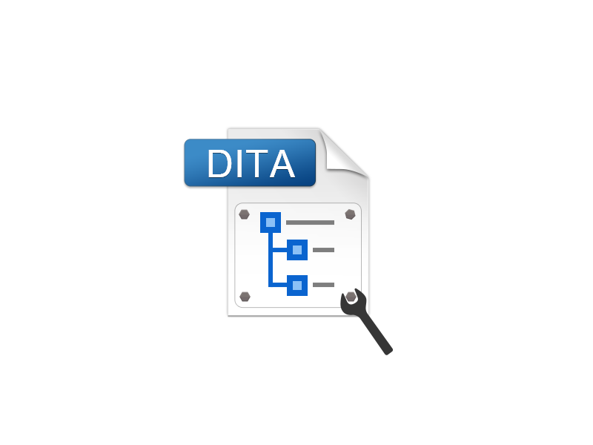
DITA Map Restructuring (1)
Move @navtitle attribute to <navtitle> element
Update navigation title from topic title
Sort glossary entries
Extract topic references to new DITA Map
Convert between Book Maps and plain Maps

Slide 22
DITA Map Restructuring (2)
Convert topicref with format="ditamap" to mapref.
Convert topicref with keys and processing-role resource only to "keydef"
Convert topicheads to topicrefs

Slide 23
Translation helpers
Add xml:lang attributes to all topics and maps.
Remove draft-comments
Add on all draft-comments the attribute translate='no'
Remove all elements with attribute translate='no'

Slide 24
Profiling
Change profiling attribute name:
Change value for profiling condition:
Remove profiling attribute value from all places:
otherprops="engineering" category="engineering"
platform="windows ubuntu mac" platform="windows linux mac"
platform="windows ubuntu mac" platform="windows mac"

Slide 25
Useful links
DITA XSLT-based refactoring examples:
https://github.com/oxygenxml/dita-refactoring-examples
Sort glossary entries: http://blog.oxygenxml.com/2018/01/sorting-glossary-lists-in-dita-bookmap.html
Convert image hrefs to keyrefs:
http://blog.oxygenxml.com/2016/10/replacing-direct-image-references-with.html

Slide 26
Conclusion
Manual corrections are prone to human error.
You can gain time and consistency by having some automated way of restructuring content.
Trying to automate problem is also a good way to better understand the problem.
If you can give somebody precise manual steps to fix a structure problem then you can probably also automate it (fully or partially).
But manually checking the end results is usually a good idea.

Slide 27
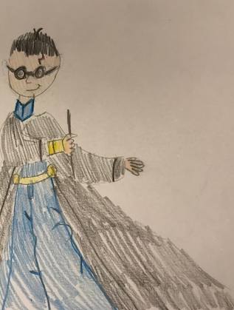
Conclusion
You too can be an automation wizard.

Slide 28
Thank You!
Questions?
Radu Coravu
radu_coravu@oxygenxml.com
@radu_coravu

