Slide 1


Slide 2
C:\Users\oyahi\git\nlp4j\nlp4j>mvn -DperformRelease=true deploy
[INFO] Scanning for projects...
[WARNING]
[WARNING] Some problems were encountered while building the effective model for org.nlp4j:nlp4j:pom:1.0
[WARNING] 'build.plugins.plugin.(groupId:artifactId)' must be unique but found duplicate declaration of plugin org.apache.maven.plugins:maven-javadoc-plugin @ line 164, column 12
[WARNING] 'build.plugins.plugin.version' for org.apache.maven.plugins:maven-deploy-plugin is missing. @ org.apache.maven:maven-model-builder:3.6.1:super-pom, jar:file:/C:/apache-maven-3.6.1/bin/../lib/maven-model-builder-3.6.1.jar!/org/apache/maven/model/pom-4.0.0.xml, line 137, column 19
[WARNING]
[WARNING] It is highly recommended to fix these problems because they threaten the stability of your build.
[WARNING]
[WARNING] For this reason, future Maven versions might no longer support building such malformed projects.
[WARNING]
[INFO] Inspecting build with total of 1 modules...
[INFO] Installing Nexus Staging features:
[INFO] ... total of 1 executions of maven-deploy-plugin replaced with nexus-staging-maven-plugin
[INFO]
[INFO] --------------------------< org.nlp4j:nlp4j >---------------------------
[INFO] Building NLP4J 1.0
[INFO] --------------------------------[ pom ]---------------------------------
[INFO]
[INFO] --- maven-source-plugin:2.2.1:jar-no-fork (attach-sources) @ nlp4j ---
[INFO]
[INFO] --- maven-javadoc-plugin:2.9.1:jar (attach-javadocs) @ nlp4j ---
[INFO] Not executing Javadoc as the project is not a Java classpath-capable package
[INFO]
[INFO] --- maven-gpg-plugin:1.6:sign (sign-artifacts) @ nlp4j ---
[INFO]
[INFO] --- maven-install-plugin:2.4:install (default-install) @ nlp4j ---
[INFO] Installing C:\Users\oyahi\git\nlp4j\nlp4j\pom.xml to C:\Users\oyahi\.m2\repository\org\nlp4j\nlp4j\1.0\nlp4j-1.0.pom
[INFO] Installing C:\Users\oyahi\git\nlp4j\nlp4j\target\nlp4j-1.0.pom.asc to C:\Users\oyahi\.m2\repository\org\nlp4j\nlp4j\1.0\nlp4j-1.0.pom.asc
[INFO]
[INFO] --- nexus-staging-maven-plugin:1.6.8:deploy (injected-nexus-deploy) @ nlp4j ---
[INFO] Performing local staging (local stagingDirectory="C:\Users\oyahi\git\nlp4j\nlp4j\target\nexus-staging\staging")...
[INFO] + Using server credentials "ossrh" from Maven settings.
[INFO] * Connected to Nexus at https://oss.sonatype.org:443/, is version 2.14.15-01 and edition "Professional"
[INFO] * Using staging profile ID "94c0fdabb471f" (matched by Nexus).
[INFO] Installing C:\Users\oyahi\git\nlp4j\nlp4j\pom.xml to C:\Users\oyahi\git\nlp4j\nlp4j\target\nexus-staging\staging\94c0fdabb471f\org\nlp4j\nlp4j\1.0\nlp4j-1.0.pom
[INFO] Installing C:\Users\oyahi\git\nlp4j\nlp4j\target\nlp4j-1.0.pom.asc to C:\Users\oyahi\git\nlp4j\nlp4j\target\nexus-staging\staging\94c0fdabb471f\org\nlp4j\nlp4j\1.0\nlp4j-1.0.pom.asc
[INFO] Performing remote staging...
[INFO]
[INFO] * Remote staging into staging profile ID "94c0fdabb471f"
[INFO] * Created staging repository with ID "orgnlp4j-1000".
[INFO] * Staging repository at https://oss.sonatype.org:443/service/local/staging/deployByRepositoryId/orgnlp4j-1000
[INFO] * Uploading locally staged artifacts to profile org.nlp4j
Uploading to ossrh: https://oss.sonatype.org:443/service/local/staging/deployByRepositoryId/orgnlp4j-1000/org/nlp4j/nlp4j/1.0/nlp4j-1.0.pom
Uploaded to ossrh: https://oss.sonatype.org:443/service/local/staging/deployByRepositoryId/orgnlp4j-1000/org/nlp4j/nlp4j/1.0/nlp4j-1.0.pom (5.9 kB at 2.0 kB/s)
Downloading from ossrh: https://oss.sonatype.org:443/service/local/staging/deployByRepositoryId/orgnlp4j-1000/org/nlp4j/nlp4j/maven-metadata.xml
Uploading to ossrh: https://oss.sonatype.org:443/service/local/staging/deployByRepositoryId/orgnlp4j-1000/org/nlp4j/nlp4j/maven-metadata.xml
Uploaded to ossrh: https://oss.sonatype.org:443/service/local/staging/deployByRepositoryId/orgnlp4j-1000/org/nlp4j/nlp4j/maven-metadata.xml (290 B at 124 B/s)
Uploading to ossrh: https://oss.sonatype.org:443/service/local/staging/deployByRepositoryId/orgnlp4j-1000/org/nlp4j/nlp4j/1.0/nlp4j-1.0.pom.asc
Uploaded to ossrh: https://oss.sonatype.org:443/service/local/staging/deployByRepositoryId/orgnlp4j-1000/org/nlp4j/nlp4j/1.0/nlp4j-1.0.pom.asc (673 B at 1.4 kB/s)
[INFO] * Upload of locally staged artifacts finished.
[INFO] * Closing staging repository with ID "orgnlp4j-1000".
Waiting for operation to complete...
.......
[INFO] Remote staged 1 repositories, finished with success.
[INFO] Remote staging repositories are being released...
Waiting for operation to complete...
...........
[INFO] Remote staging repositories released.
[INFO] ------------------------------------------------------------------------
[INFO] BUILD SUCCESS
[INFO] ------------------------------------------------------------------------
[INFO] Total time: 01:31 min
[INFO] Finished at: 2019-10-25T01:14:28+09:00
[INFO] ------------------------------------------------------------------------
C:\Users\oyahi\git\nlp4j\nlp4j>

Slide 3
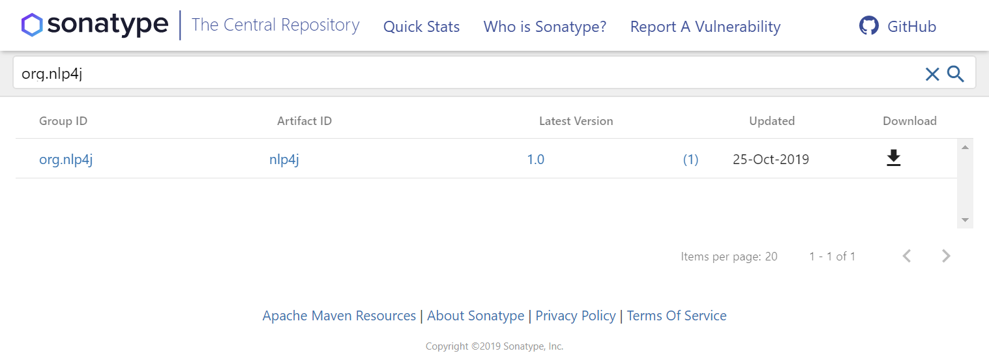
https://search.maven.org/search?q=org.nlp4j

Slide 4
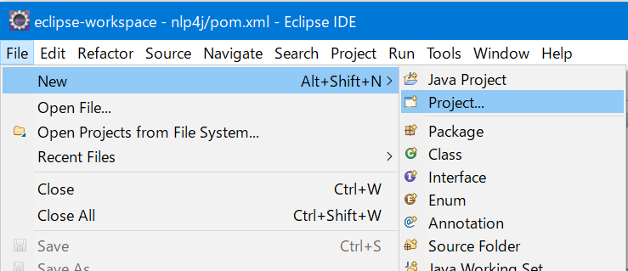
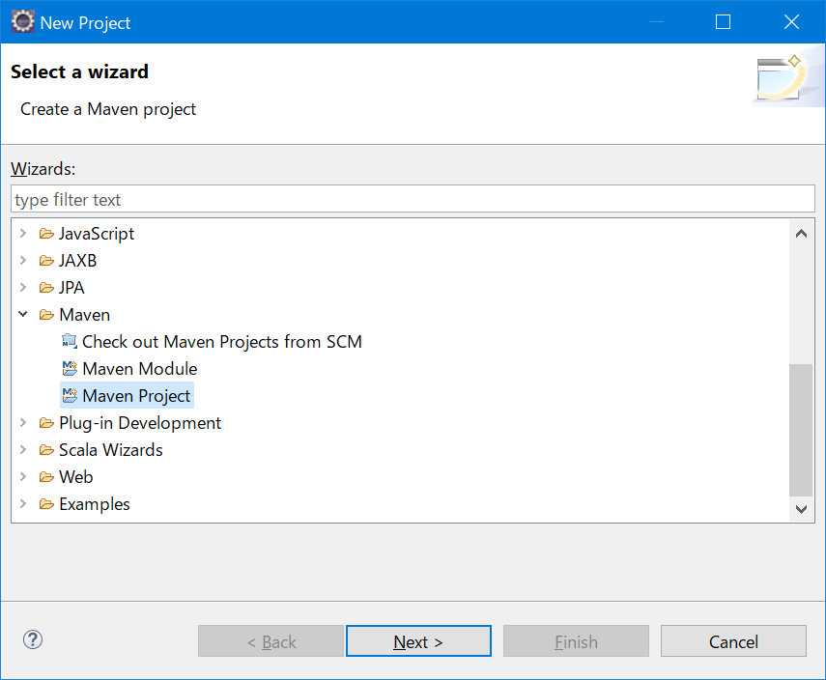
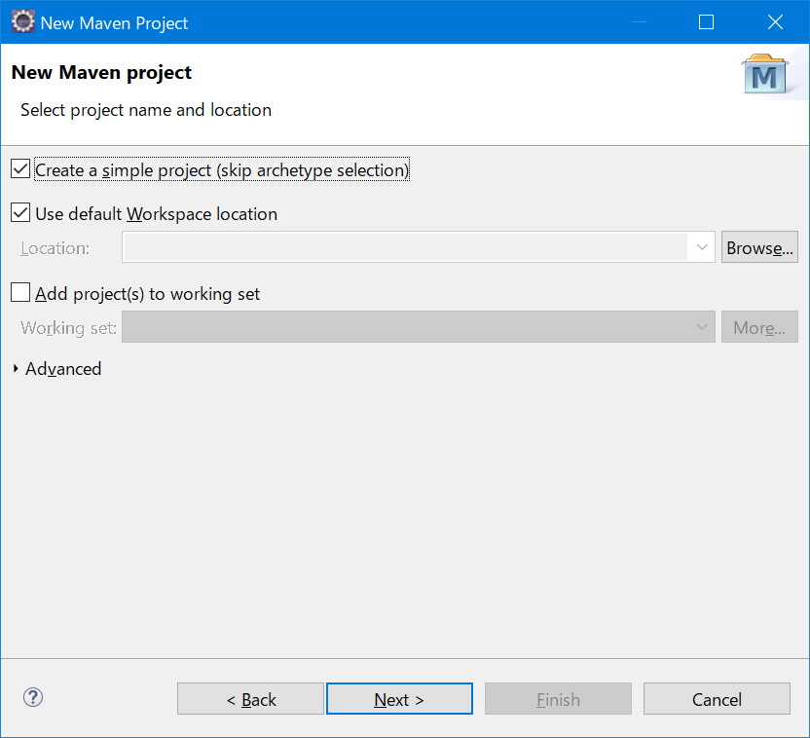

Slide 5
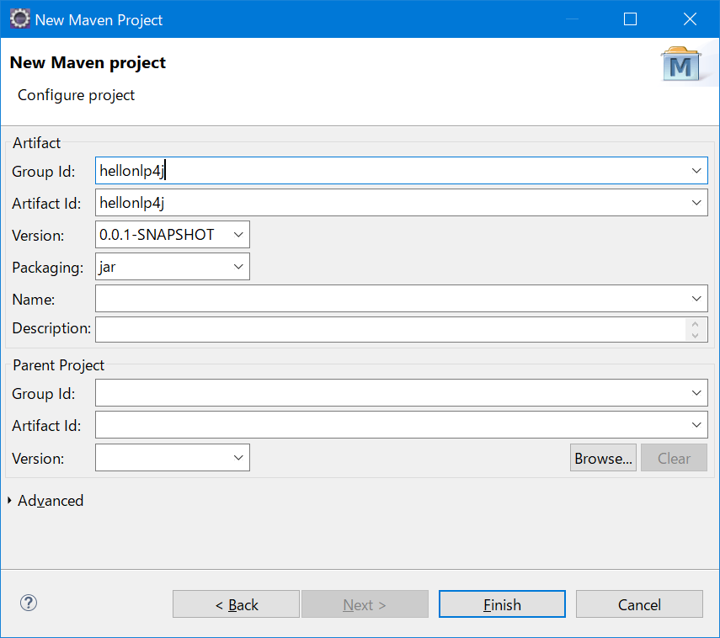
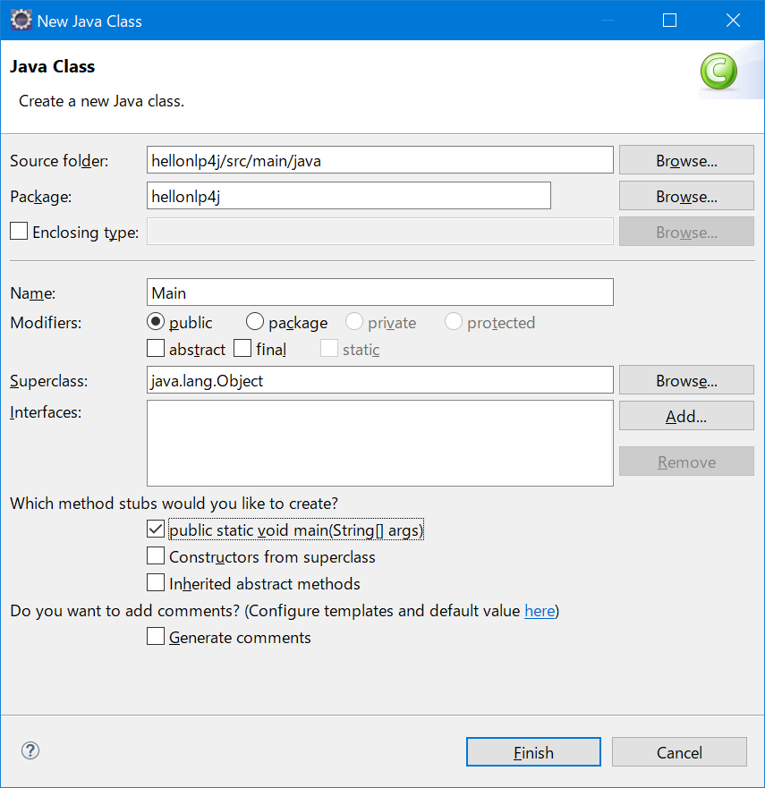
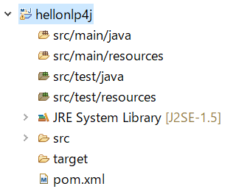

Slide 6
<dependency>
<groupId>org.nlp4j</groupId>
<artifactId>nlp4j</artifactId>
<version>1.0</version>
<type>pom</type>
</dependency>

Slide 7
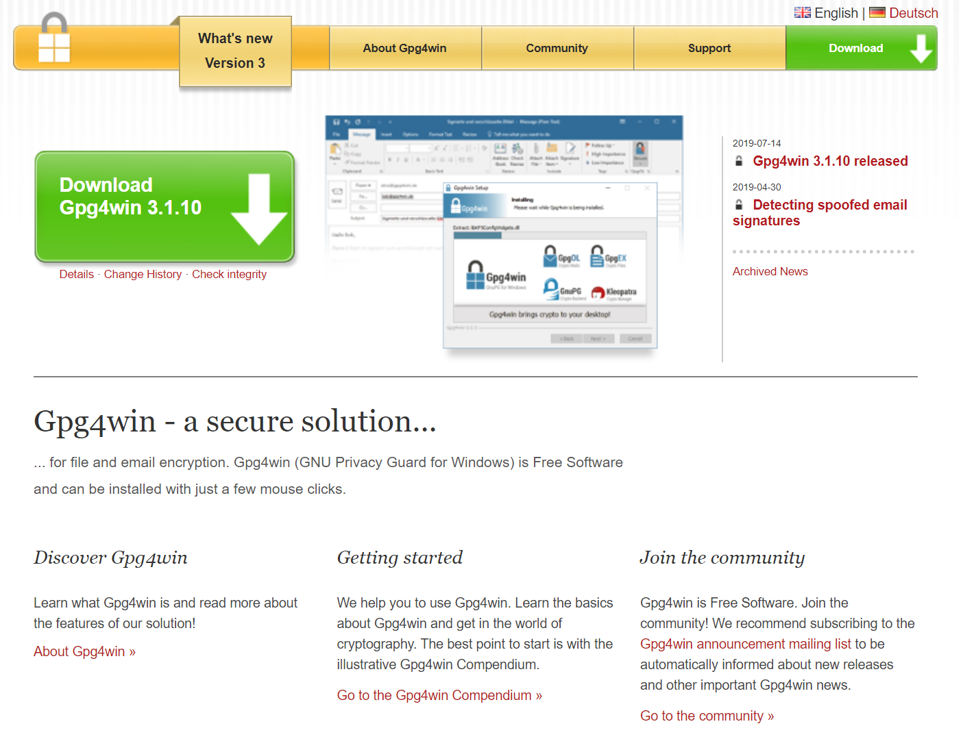
https://www.gpg4win.org/

Slide 8
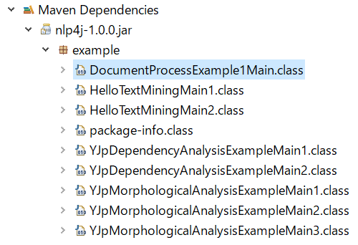

Slide 9
