Slide 1
Checkpoint Alpha ElderGuard Smartwatch: A Health and Safety Monitoring Device
Chujian Xiao 300256072
Zuqing Gui 300120281
Ouyi Yang 300142307
Haochen Qin 300187831
Shaonan Cui 300131330
Kuan-Yu Chang 300201058

Slide 2
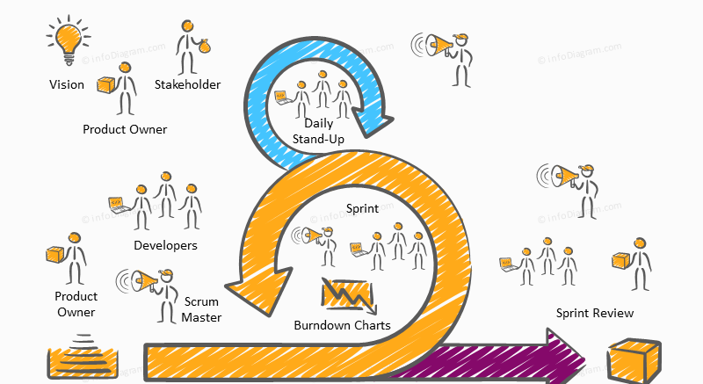

Roles
Ouyi Yang - Internal Project Manager/Scrum Master Chujian Xiao - Firmware/UI
Zuqing Gui - Hardware design
Haochen Qin - Back-End Developer
Shaonan Cui - Hardware design
Kuan-Yu Chang - Front-End Developer

Slide 3
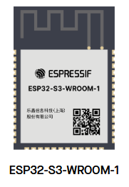
Sprint 9
2025-01-13 to 2025-01-20
Tuesday 17:30-20:30
Meetings
Hosted by scrum Master
Making final decision to use ESP32 series microcontroller
Start migrating to ESP32
Key Artifacts
Sprint Goal: Migrate to ESP32 System
Sprint Backlog:
Change UI header files for compatibility
Implement Wi-Fi using new system
Begin drawing circuit schematic
Blocks List:
MCU system change
Increment:
Versions
Firmware: 1.1.0
Web UI: 1.0.8
Database: 1.1.0
New Functionalities: N/A

Slide 4
Sprint 10
2025-01-21 to 2025-01-28
Tuesday 17:30-20:30
Meetings
Hosted by scrum Master
Determined UI direction (continue using LVGL or change to simpler design)
Determined database structure
Increment:
Versions
Firmware: 1.1.1
Web UI: 1.0.8
Database: 1.1.0
New Functionalities:
Updated UI header files and driver, fixing bugs
Implemented Wi-Fi functionality without UI
Key Artifacts
Sprint Backlog:
Fix UI bugs and instability issues
Integrate Wi-Fi and UI, make sure that both can run at same time
Blocks List:
Bugs on new display driver

Slide 5
​ Sprint 11
2025-01-29 to 2025-02-05
Tuesday 17:30-20:30
Meetings
Hosted by scrum Master
Implement FreeRTOS to resolve UI updating and backed updating clashes
Determined database structure
Increment:
Versions
Firmware: 2.0.0
Web UI: 1.0.9
Database: 1.1.2
New Functionalities:
Updated Database sensor data and user info
Successfully migrated Firmware to new system and fixed all bugs
Key Artifacts
Sprint Backlog:
Updated database for storage
UI specification update
Implement FreeRTOS for task management on firmware
Blocks List:
Bugs on database connection with backend

Slide 6
Sprint 12
2025-02-06 to 2025-02-13
Tuesday 17:30-20:30
Meetings
Hosted by scrum Master
Pcb design
Making database interact with back end
Keep implementing web UI
Increment:
Versions
Firmware: 2.1.0
Web UI: 1.0.9
Database: 1.1.3
New Functionalities:
Updated database
Update Web UI
Implemented basic FreeRTOS functionality
Key Artifacts
Sprint Backlog:
Finalize PCB layout and send for fabrication
Optimize database queries for better performance
Blocks List:
Delays in PCB fabrication impacting hardware integration testing

Slide 7
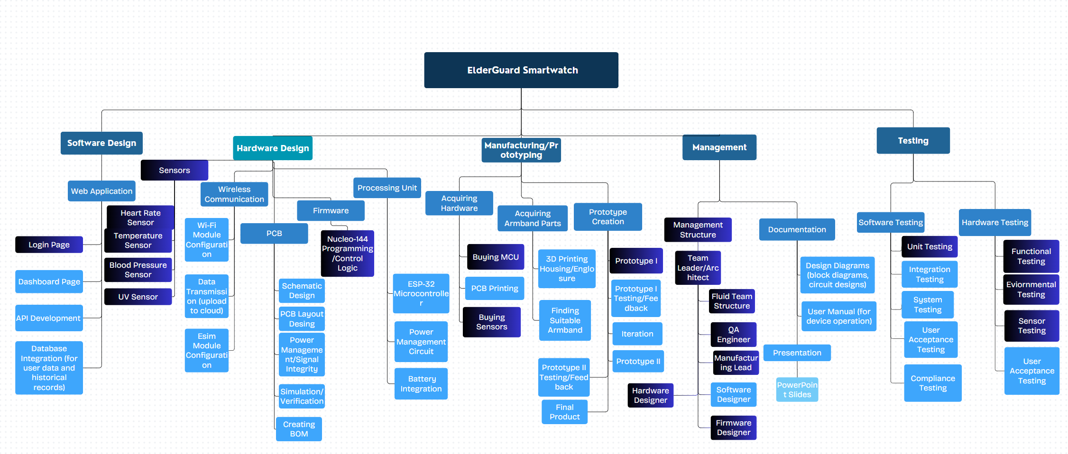
WBS

Slide 8
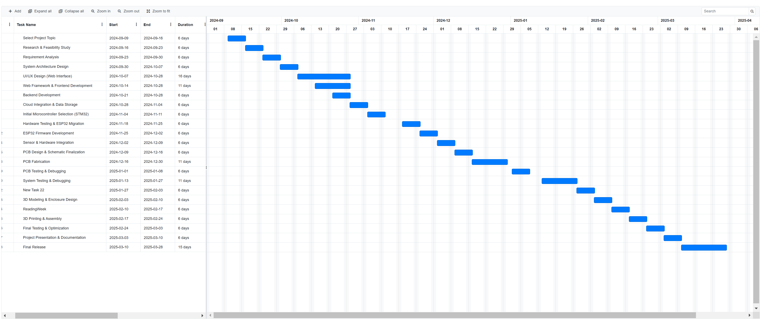
Gantt Chart

Slide 9
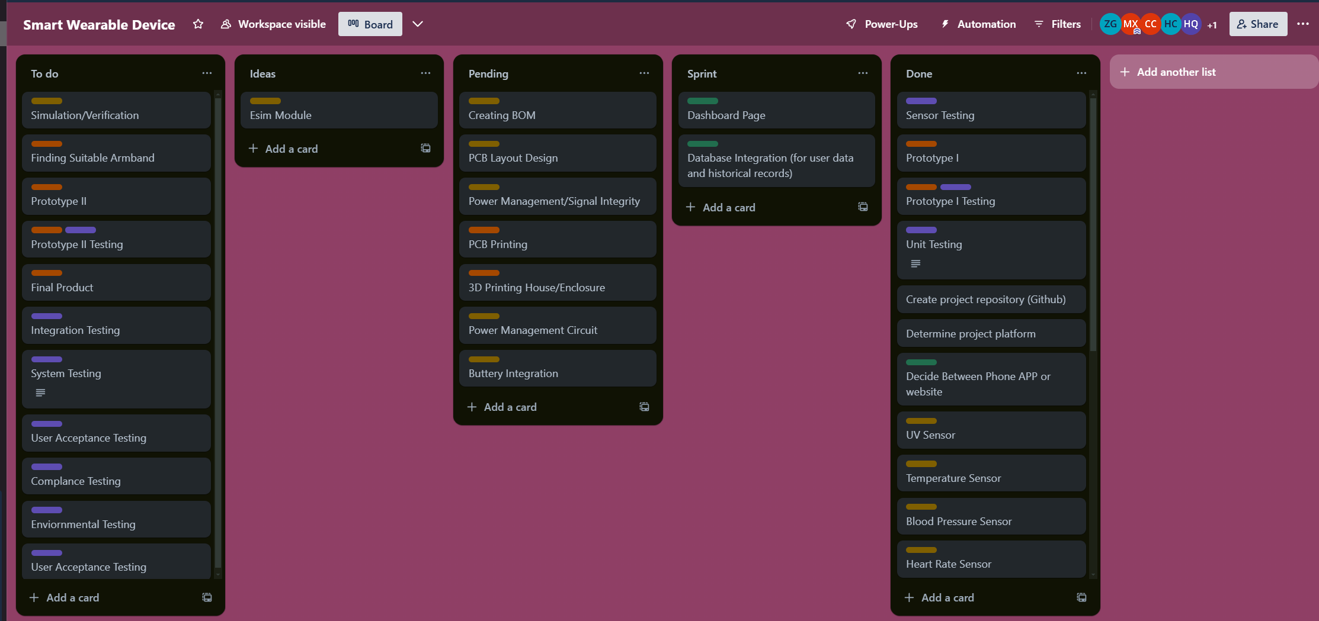
Trello Board

