Slide 1
Department of Computer Science and Engg.
Modeling Evolutionary Algorithms as Complex Networks
Group #4
Project Advisor (Guide): Dr. Shunmuga Velayutham C.
CB.EN.U4CSE13106 | Ananya Bahadur | B
CB.EN.U4CSE13113 | CH Srikant | B
CB.EN.U4CSE13152 | Sanjay Menon | B
CB.EN.U4CSE13157 | Sourav Jaiswal | B

Slide 2
PROBLEM STATEMENT
Modeling Evolutionary Algorithms as Complex Networks

Slide 3
Motivation
Large-scale networks, exhibiting complex patterns of interaction amongst vertices, exists in both natural and artificial systems and have been well studied.
It has been shown [Zelinka et.al] that EA dynamics exhibit CN properties and hence can be analyzed and visualized as CNs.
Analysis techniques of CNs can be applied to the modeled CN (EACN) to gain insights on EA dynamics.

Slide 4
Introduction
  Complex Networks have a high clustering coefficient and almost always a hierarchical structure.
  Evolutionary Algorithms also exhibit hierarchy and high clustering in the evolution process as parents produce “more fit” offspring.
  We wish to devise a general method to model a few classes of GAs as CNs and validate it by comparing insights obtained from CN analysis with already known characteristics of the GA.

Slide 5
Complex Networks
  High clustering coefficient
  Hierarchical or community structure (almost always)
  Not Lattice
  @sanjay (my topic. You just mention. Spend all your time on explaining typical EA construction and terminology)

Slide 6
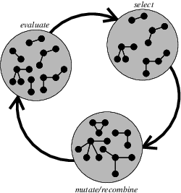
Creation of CNs (Me)
Select four individuals (three randomly selected a
one regularly selected)
2. Create an off-spring (individual) vertex
3. If the off-spring at the new position has better
fitness, then it is a successful vertex that
increases the number of incoming edges by 3
4. If the fitness is worse, then the number of
incoming and outgoing edges will not be
changed
This is one of the strategies (Zelinka et. al.)

Slide 7
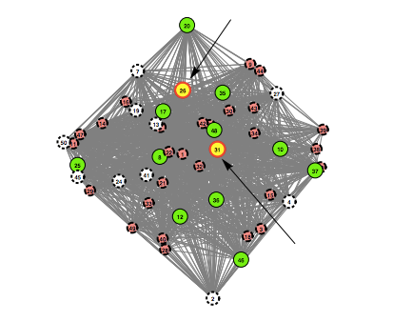
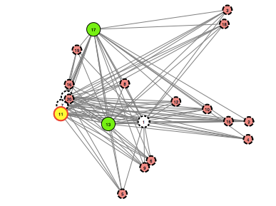
Visualization of CNs
Generation 10
Generation 20

Slide 8
Work Flow
Take known Evolutionary Algorithms like DERandBin1, knapsack problem as test-beds.
Implement the CN generation as described in [1] and [2].
Analyse the generated CNs and find insights into GA function / dynamics.
@me my last slides talk about this. Our roadmap.

Slide 9
Proposed System (Sourav)
DEAP Distributed Evolutionary Algorithms in Python
[Beagle (C++), pyEvolove, JAGA (Java)]
Helper classes, fitness functions, ALL possible selector functions
Distributed evolution phase
Automated statistics
Open Source

Slide 10
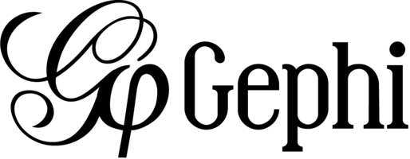
Proposed System
Gephi Graph Manipulation GUI
[GraphViz]
Supports multiple graph formats
All kinds of graph analysis inbuilt, implemented efficiently

Slide 11
Proposed System
DEAP
Gephi
Individual (attributes)
Update / Store
Initial Population
Callbacks
Evolution
Calculate Fitness
Crossover
Mutation
Filter
@sourav all this is old!

Slide 12
Challenges
Large amounts of data!
Improving DEAP, to include callbacks (via ZeroMQ or equivalent) for distributed evolution.
One large graph, or many small ones?

Slide 13
Literature Survey
I. Zelinka, D. Davendra, “Do Evolutionary Algorithm Dynamics create Complex Network Structures?”
  The article shows that EA dynamics can be modeled as Complex Networks, subject to a few presumptions. It also discusses the criteria that determine the quality of the generated CN.

Slide 14
REFERENCES
[1] I. Zelinka, D. Davendra, “Do Evolutionary Algorithm Dynamics create Complex Network Structures?”
[2] I. Zelinka, “Real-Time Deterministic Chaos Control by Means of Selected
Evolutionary Algorithms,” Engineering Applications of Artificial
Intelligence, 22(2), 2008. doi:10.1016/j.engappai.2008.07.008.

