Slide 1
Department of Computer Science and Engg.
Modeling Evolutionary Algorithms as Complex Networks
Group Number : 4
Project Advisor (Guide): Dr. Shunmuga Velayutham C
CB.EN.U4CSE13106 | Ananya Bahadur | B
CB.EN.U4CSE13113 | Chinta Sai Srikant | B
CB.EN.U4CSE13127 | Kasturi Rangan | B
CB.EN.U4CSE13168 | S. Thandayuthapani | B

Slide 2
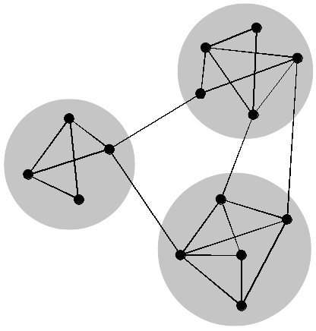
Complex Networks
Complex network is a graph with non-trivial topological features and often occur in graph modeling of real systems.

Slide 3
Complex Networks
What separates a CN from a normal graph?
High clustering coefficient : In graph theory, a clustering coefficient is a measure of the degree to which nodes in a graph tend to cluster together. Two versions of this measure exist: the global and the local.
Nodes with high in-degree
High Betweenness centrality : It is an indicator of a node's centrality in a network. It is equal to the number of shortest paths from all vertices to all others that pass through that node.
Follows Power law

Slide 4
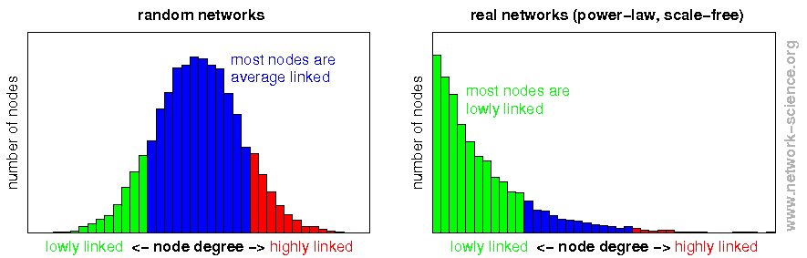
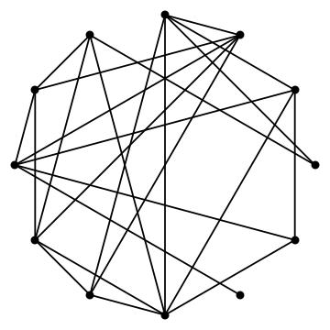
Complex Networks
Random Graph

Slide 5
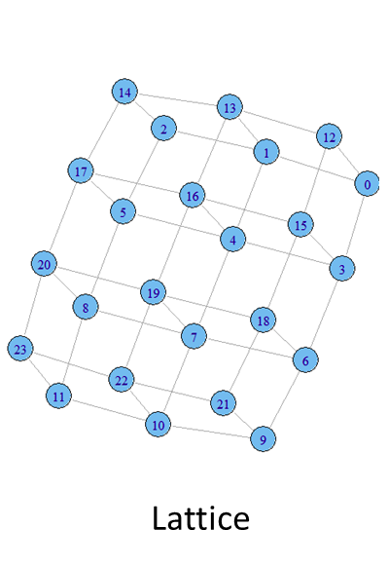
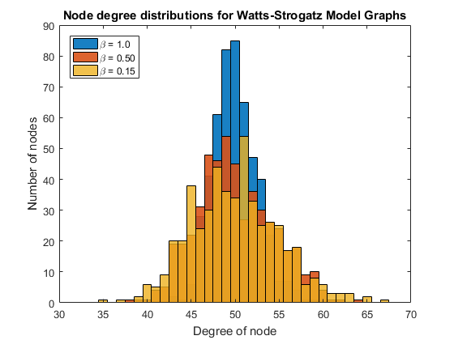
Complex Networks
Lattice graph
\

Slide 6
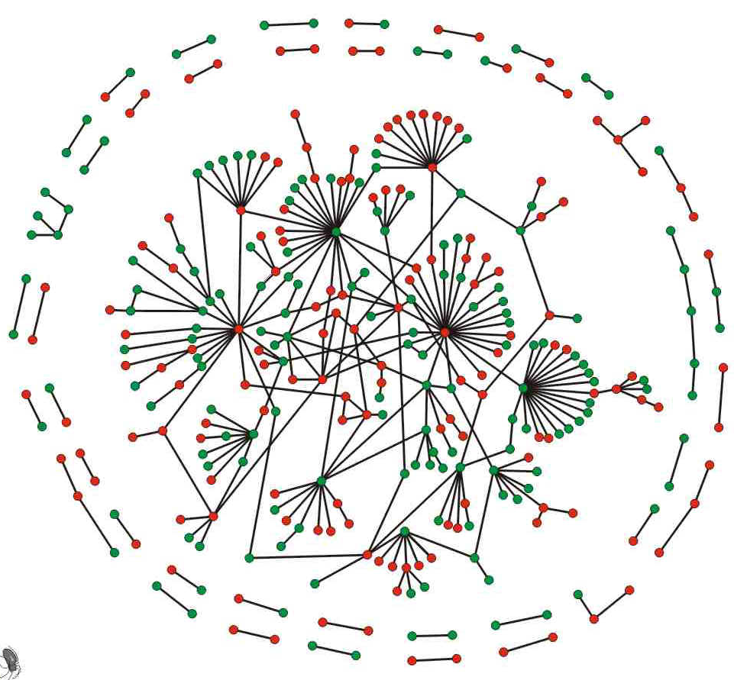
Complex Networks

Slide 7
Complex Networks

Slide 8
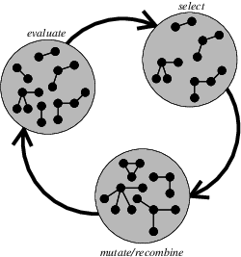
EA to CN
Is it even possible?
“Does evolution create a CN?”
Yes
Zelinka et. al.

Slide 9
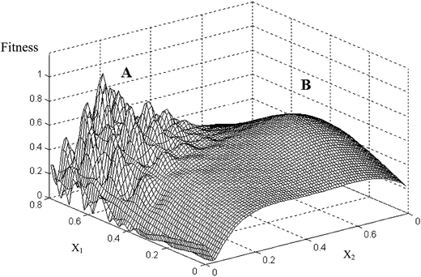
EA to CN
Individuals are nodes
Individuals move to better positions in (search space)

Slide 10
EA to CN
Individuals are never removed.
Add incoming edges to contributors from improved individual.

Slide 11
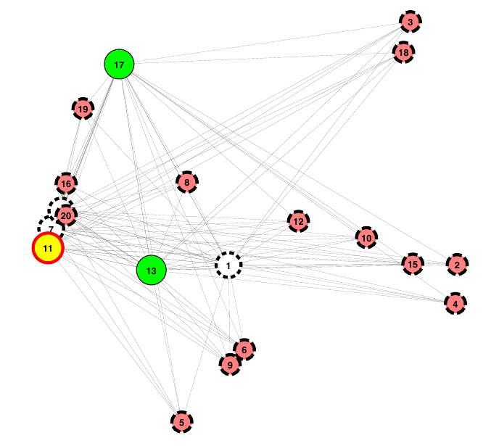
EA to CN
DERand1Bin
Not all EA dynamics
generate
Complex structure
SOMA

Slide 12
EA to CN
Nodes with high in-degree.
Betweenness - ?
Centrality - ?
Closeness - ?
Clustering - ?
Can we establish termination criteria?

