Slide 1
Department of Computer Science and Engg.
Modeling Evolutionary Algorithms as Complex Networks
Group #4
Project Advisor (Guide): Dr. Shunmuga Velayutham C.
CB.EN.U4CSE13106 | Ananya Bahadur | B
CB.EN.U4CSE13113 | CH Srikanth | B
CB.EN.U4CSE13127 | Kasturi Rangan | B
CB.EN.U4CSE13168 | S. Thandayuthapani | B

Slide 2
Context
Complex Networks
DEAP, Gephi, GraphStream
Trackers

Slide 3
Implementation
DEAP
Gephi
Plugin

Slide 4
DEAP
Distributed Evolutionary Algorithms in Python
Features:
Parallelization with SCOOP
Multi-Objective Optimisation
Pre-built, ready-to-use evolution strategies
Rapid prototyping

Slide 5

Graph manipulation package
Features
Supports multiple file formats
All kinds of graph analysis inbuilt, implemented efficiently

Slide 6
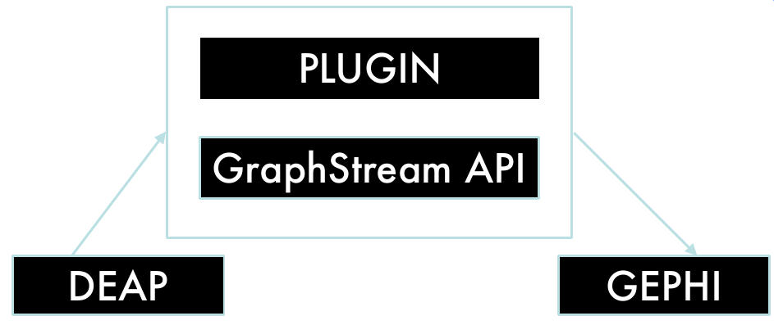
Architecture

Slide 7
DEAP Sample-1
Define Individual and parameters
creator.create("FitnessMax", base.Fitness, weights=(1.0,))
creator.create("Individual", list, fitness=creator.FitnessMax)

Slide 8
DEAP Sample-2
Define and register
evaluate mutate
mate select
def evalOneMax(individual):
return sum(individual),
toolbox.register("evaluate", evalOneMax)
toolbox.register("mate", tools.cxTwoPoint)
toolbox.register("mutate", tools.mutFlipBit, indpb=0.05)
toolbox.register("select", tools.selTournament, tournsize=3)

Slide 9
DEAP Sample-3
Create population
For each iteration:
Select parents
Mate, mutate to obtain off-spring
Re-evaluate new population
PEAviz.Tracker

Slide 10
DEAP Sample-4
import peaviz
trackerHub = peaviz.TrackerHub()
creator.create("tracker", peaviz.Tracker, hub=trackerHub, size=20)
creator.create("Individual", list, fitness=deap.creator.maximize, tracker=deap.creator.tracker)
def evalOneMax(individual):
fitness = (sum(individual),)
individual.tracker.setFitness(fitness)
return fitness
individual.tracker.deploy()

Slide 11
Roadmap
Implement DEAP – Gephi pipeline
Use known Evolutionary Algorithms (knapsack, DERand1Bin) as test-beds.
Analyse generated CNs.
Develop insight into EA dynamics.
Implement Gephi – DEAP pipeline
[Optional] Develop better CN models

Slide 12
References
I. Zelinka, D. Davendra, “Do Evolutionary Algorithm Dynamics create Complex Network Structures?”
  The article shows that EA dynamics can be modeled as Complex Networks, subject to a few presumptions. It also discusses the criteria that determine the quality of the generated CN.
Dynamical processes in complex networks. Alain Barrat, Marc Barthelemy, and Alessandro Vespignani, 2008.
Scale-Free Networks: Complex Webs in Nature and Technology. Guido Caldarelli, 2007. [ chapter1.pdf ]
I. Zelinka, “Real-Time Deterministic Chaos Control by Means of Selected Evolutionary Algorithms,” Engineering Applications of Artificial Intelligence, 22(2), 2008. doi:10.1016/j.engappai.2008.07.008.

Slide 13
References
R. Senkerik, M. Pluhacek, A. Viktorin, “On the application of Complex Network Analysis for meta-heuristics”

