Slide 1
Department of Computer Science and Engg.
Modeling Evolutionary Algorithms as Complex Networks
Group #4
Project Advisor (Guide): Dr. Shunmuga Velayutham C.
CB.EN.U4CSE13106 | Ananya Bahadur | B
CB.EN.U4CSE13113 | CH Sai Srikanth | B
CB.EN.U4CSE13127 | Kasturi Rangan | B
CB.EN.U4CSE13168 | S. Thandayuthapani | B

Slide 2
GENETIC ALGORITHM
A General Evolutionary algorithm consists of following concepts:
  Mutation
  Crossover
  Fitness Function
  Selection
Date: 09-Feb-2017
In-House Project Group No: 01

Slide 3
FITNESS FUNCTION
Gives score to each indivdual.
Based on score computed selects subset of candidates for
  mutation
  crossover

Slide 4
SELECTION
Fitness values are sorted.
A random value ‘R’ is chosen between 0 and 1 based on a particular distribution.
The selected candidate is determined by R.
Individual can be selected more than ONCE.
Date: 09-Feb-2017
In-House Project Group No: 01

Slide 5
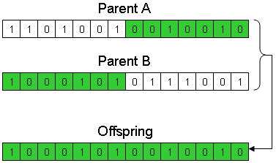
CROSSOVER
2 or more parent individuals produce a child individual.
Date: 09-Feb-2017
In-House Project Group No: 01

Slide 6
MUTATION
Maintains genetic diversity from one generation of population to the next.
Alters a property of candidate.
Also defined by a Mutation Probability.
Date: 09-Feb-2017
In-House Project Group No: 01

