Slide 1
Department of Computer Science and Engg.
Modeling Evolutionary Algorithms as Complex Networks
Group #4
Project Advisor (Guide): Dr. Shunmuga Velayutham C.
CB.EN.U4CSE13106 | Ananya Bahadur | B
CB.EN.U4CSE13113 | CH Srikant | B
CB.EN.U4CSE13152 | Sanjay Menon | B
CB.EN.U4CSE13157 | Sourav Jaiswal | B

Slide 2
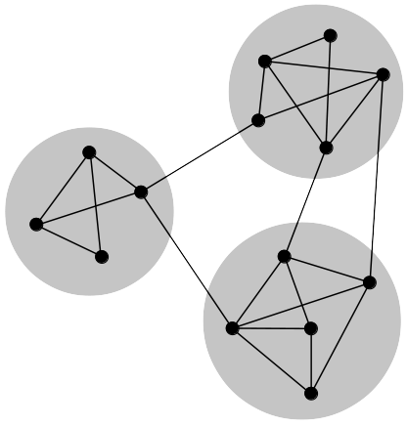
Complex Networks
Complex network is a graph with
non-trivial topological features
often occur in graphs modelling of real systems.
Creation based on
Power-law distributions
High clustering coefficient
Short (avg.) path length
By j_ham3 - Own work, CC BY-SA 3.0, https://commons.wikimedia.org/w/index.php?curid=17125894

Slide 3
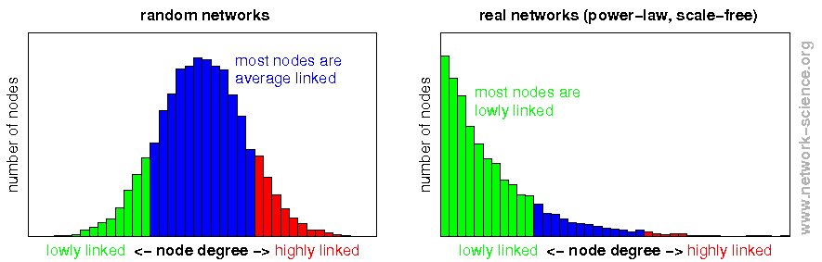
Complex Networks

Slide 4
Complex Networks

Slide 5
Complex Networks
Mathematics
Biology
Physics
Epidemology
Computer Science
Sociology

Slide 6
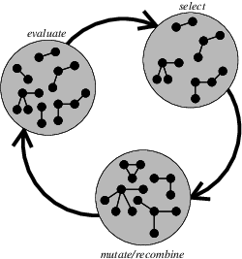
EA to CN
Is it even possible?
“Does evolution create a CN?”
Yes
Zelinka et. al.

Slide 7
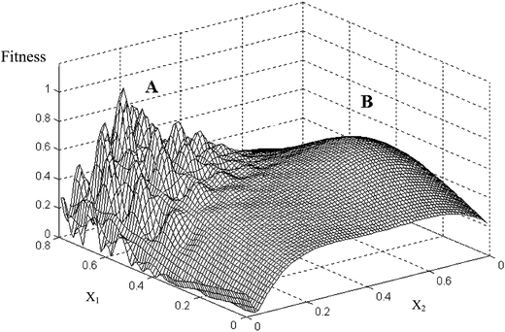
EA to CN
Individuals are nodes
Individuals move to better positions in (search space)

Slide 8
EA to CN
Individuals are never removed.
Add incoming edges to contributors from improved individual.

Slide 9
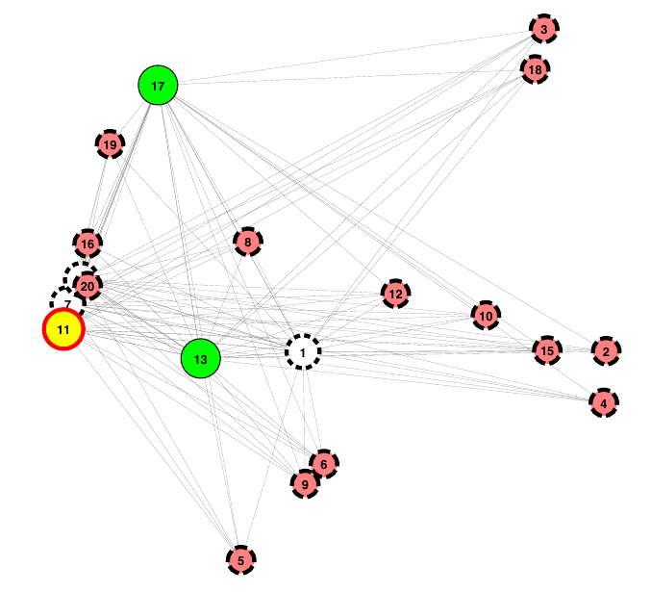
EA to CN
DERand1Bin
Not all EA dynamics
generate
Complex structure
SOMA

Slide 10
EA to CN
Nodes with high in-degree.
Betweenness - ?
Centrality - ?
Closeness - ?
Clustering - ?
Can we establish termination criteria?

Slide 11
Roadmap
Use known Evolutionary Algorithms (knapsack, DERand1Bin) as test-beds.
Implement DEAP – Gephi pipeline
Analyse generated CNs.
Develop insight into EA dynamics.
[Optional] Develop better CN models

Slide 12
References
I. Zelinka, D. Davendra, “Do Evolutionary Algorithm Dynamics create Complex Network Structures?”
  The article shows that EA dynamics can be modeled as Complex Networks, subject to a few presumptions. It also discusses the criteria that determine the quality of the generated CN.
Dynamical processes in complex networks. Alain Barrat, Marc Barthelemy, and Alessandro Vespignani, 2008.
Scale-Free Networks: Complex Webs in Nature and Technology. Guido Caldarelli, 2007. [ chapter1.pdf ]
I. Zelinka, “Real-Time Deterministic Chaos Control by Means of Selected Evolutionary Algorithms,” Engineering Applications of Artificial Intelligence, 22(2), 2008. doi:10.1016/j.engappai.2008.07.008.

