Slide 1
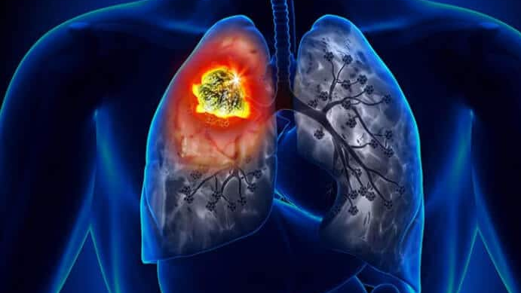
Machine learning prediction of lung cancer https://github.com/oyebolakolapo/Lung_cancer_prediction
Kolapo Oyebola
Data Science
9th November 2023

Slide 2
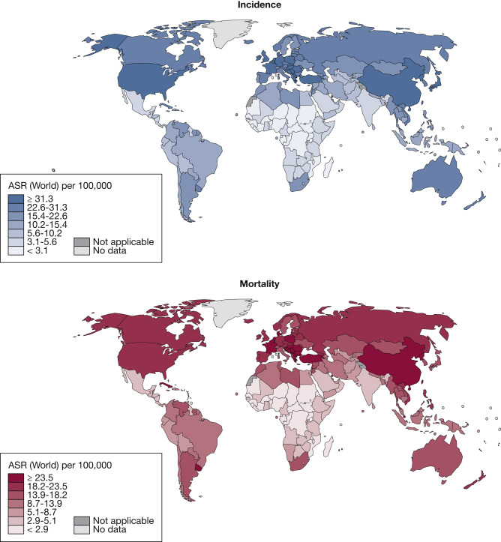
The burden of lung cancer
Lung cancer is characterized by the development of malignant tumors within lung tissues.
Lung cancer is a leading cause of cancer-related deaths worldwide, impacting individuals across various demographics
Figure 1. Global burden of lung cancer in 2020, both sexes, all ages. ASR = age-standardized rate

Slide 3
Project goal
Develop a machine learning model for lung cancer risk assessment
1. Library installation and
importation
Data cleaning: nulls, duplicates, outliers etc
3. Prepare data for ML modelling
4. Evaluating ML classifiers
2. Exploratory Data Analysis (EDA)
Data visualization
Transform/scale data
Train : test data (80:20)
Random Forest, Decision Tree, Extra Trees, Logistic Regression, Multilayer Perceptron, ADABoost, XGboost
5. Model comparison
6. Feature importance/selection
Hyperparameter tuning

Slide 4
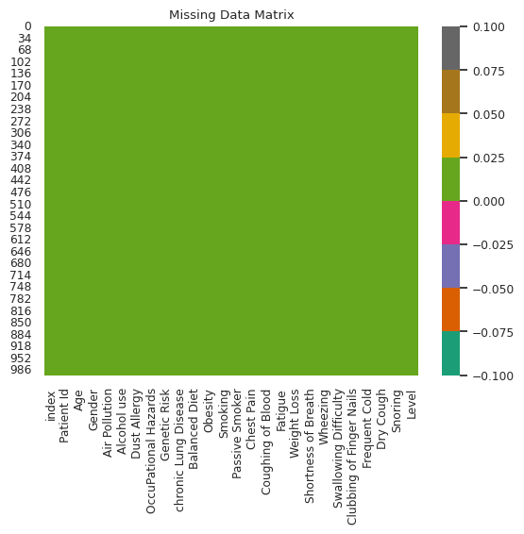
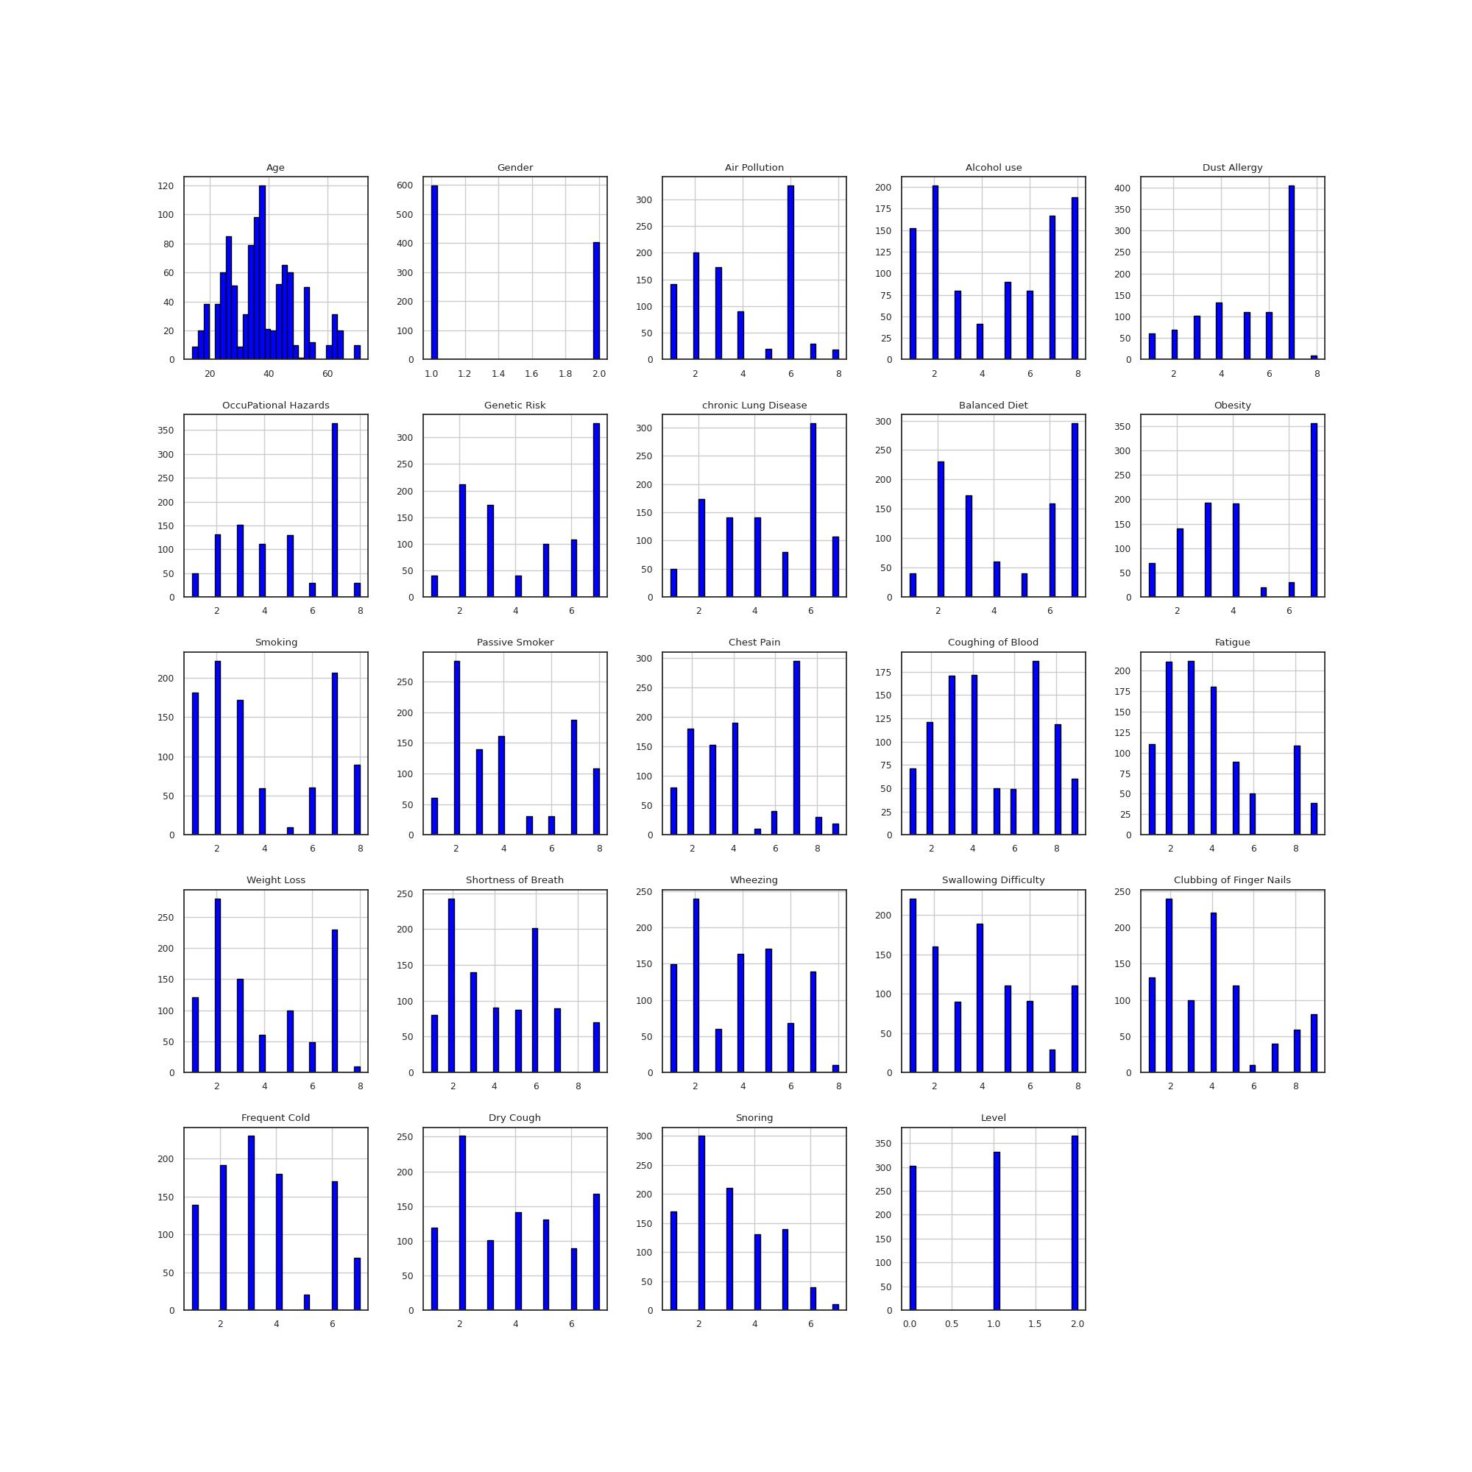
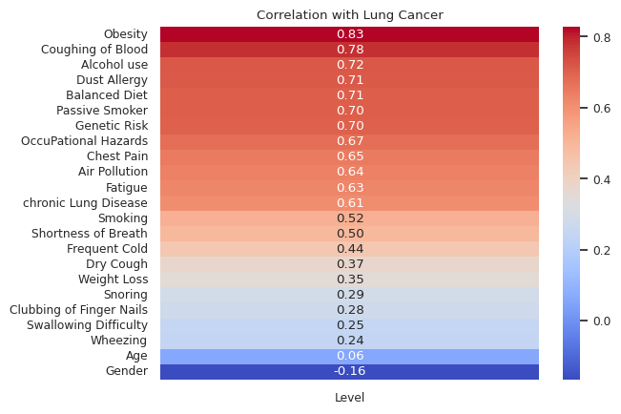
Data Exploration
Figure 2. No missing values
Figure 3: Correlation of features with target variable
Figure 4: Normalized distribution of feature values following outlier handling

Slide 5
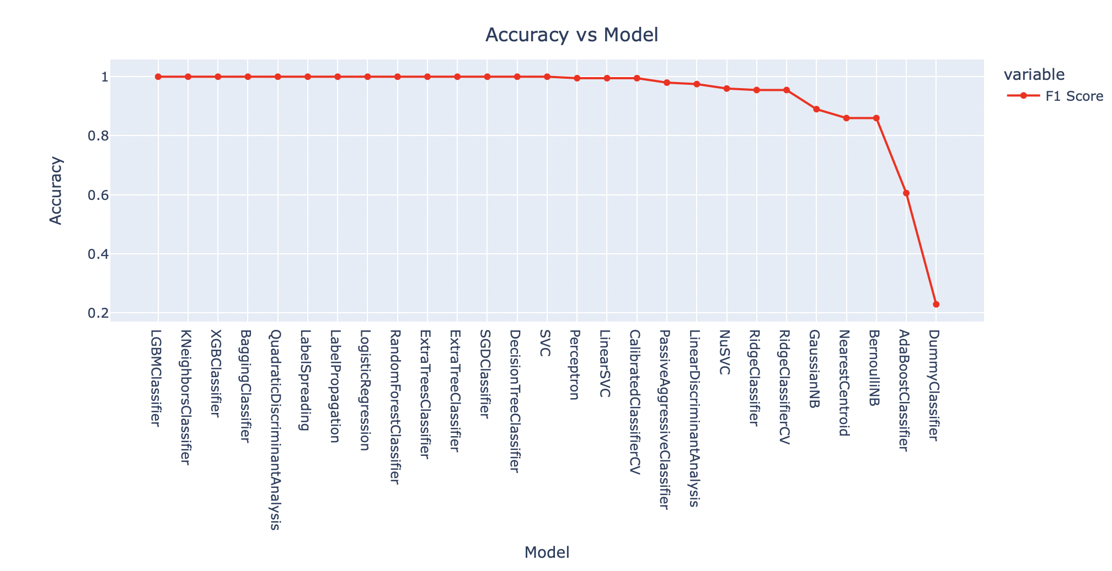
Model performance
Figure 5: F1 score comparison of machine learning classifers

Slide 6
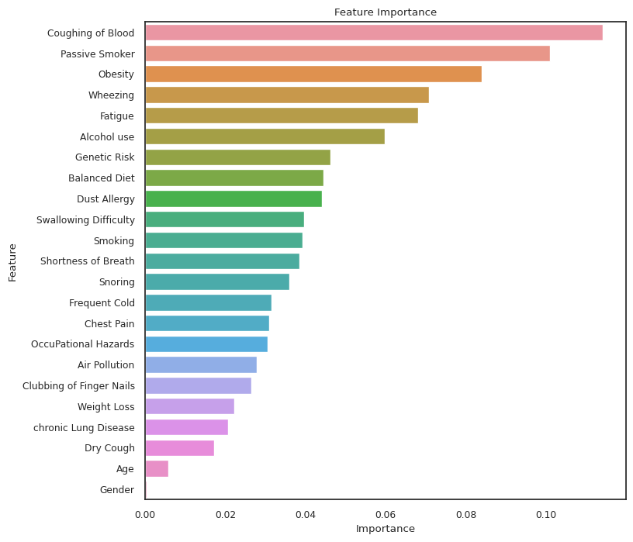
Feature selection
The random forest model shows that coughing of blood is the most important feature in lung cancer followed by passive smoking, obesity and wheezing.
Caveats:
The importance of a feature doesn’t necessarily mean a causal relationship
Results are specific to this model and dataset
Low importance doesn’t mean feature is unimportant in predicting lung cancer in general.
Figure 6: Lung cancer risk predictors

Slide 7
Thank you LHL!

