Slide 1


Social Experiment in Heterogeneous Mixed Reality Environments
Wole Oyekoya
Anthony Steed
University College London
Joseph Newman
University of Cambridge
Enrique Martinez
Ulysses Bernardet
Universitat Pompeu Fabra

Slide 2
Outline
Introduction
Objectives
System Architecture
Experiment
Initial Results
Future Work

Slide 3
Objectives
Experiment on social interaction within three heterogeneous mixed reality systems based at three separate locations.
  Test the architecture and compare different mixed or virtual reality systems
  Explore user experience within each system

Slide 4
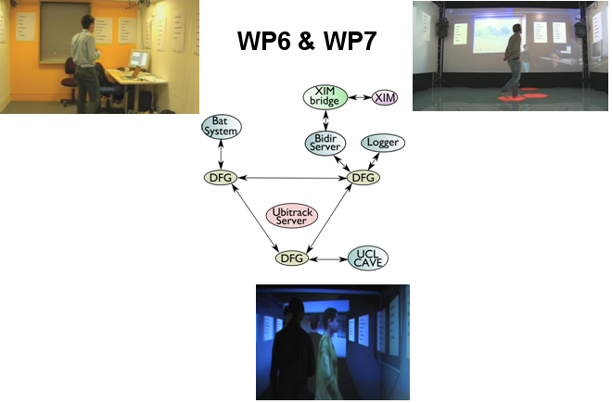
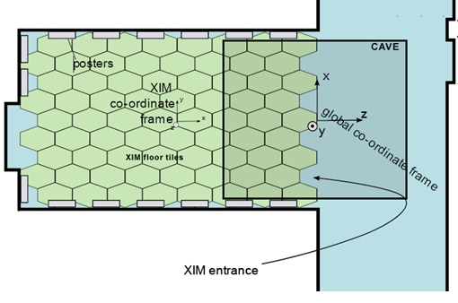
System Architecture
Based on the Ubitrack Framework
Real-world setup (BatSystem tracking)
XIM Setup
Mapping of Co-ordinate Systems
CAVE™-like IPT setup

Slide 5

Experiment
5 groups with 3 participants in each group
Average of 20 minutes duration
Questionnaire
Video observations
Log files (positions and orientation)
video

Slide 6
Initial Results
Questions on each user’s experience indicates participant’s ability to perform the task successfully
Leadership Question based on peer assessments
 | _{Age} |  |  | _{English Fluency} |  |  | _{User Experience}
 | _{Min} | _{Max} | _{Mean} | _{Min} | _{Max} | _{Mean} | _{Min} | _{Max} | _{Mean} | _{Std. Dev.}
_{CAVE} | ₂₄ | ₂₇ | _{25.4} | ₈₀ | ₁₀₀ | ₉₄ | ₁ | ₇ | _{5.13} | _{1.83}
_{DTG} | ₂₃ | ₂₇ | _{24.6} | ₇₅ | ₁₀₀ | _{92.8} | ₁ | ₇ | _{4.18} | _{2.20}
_{XIM} | ₂₄ | ₃₂ | _{27.6} | ₅₀ | ₁₀₀ | _{81.6} | ₁ | ₇ | _{4.31} | _{1.79}
 | CAVE | DTG | XIM
CAVE |  | 46 | 51.67
DTG | 84.17 |  | 63.33
XIM | 51.67 | 32

Slide 7
Future Work
Further analysis is planned on datasets acquired:
  Task performance
  Space utilisation
  Questionnaire analysis
  Video observations

Slide 8
Acknowledgements
University College London, UK
University of Cambridge, UK
Universitat Pompeu Fabra, Spain
Funding
Presenccia, funded under EU FP6, Contract Number 27731.

Slide 9

Thank you
Wole Oyekoya
University College London
http://vecg.cs.ucl.ac.uk/
http://www.presenccia.org/

