Slide 1
Proof of edge-critical strongly-connected digraph generator algorithm
version 1.4

Slide 2
Index
Definition
Graph
Strongly-connected digraph
edge-critical strongly-connected digraph
Summary
Problem Statement
Objective
Existing tools
Prime digraph generation
Example and Motivation
Algorithm I - Find all prime digraphs
Results

Slide 3
Index
Proof of prime generator algorithm
Correctness of prime_generator
Completeness of prime_generator
Construction of BFS tree
Three cases
Case I – Two or more out-edges only
Case II – Two or more in-edges
Case III – One in-edge and at least one out-edge
Conclusion
Conclusion
Further study
Reference

Slide 4
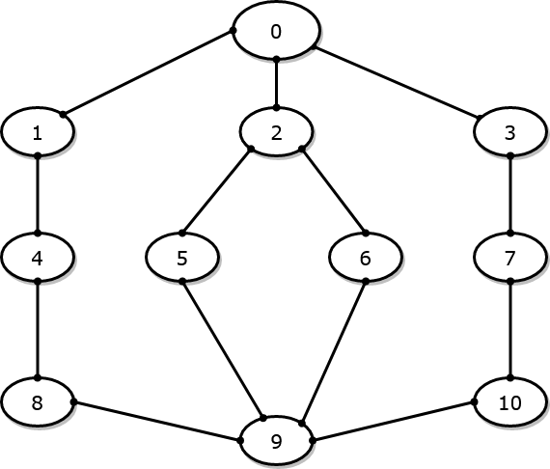
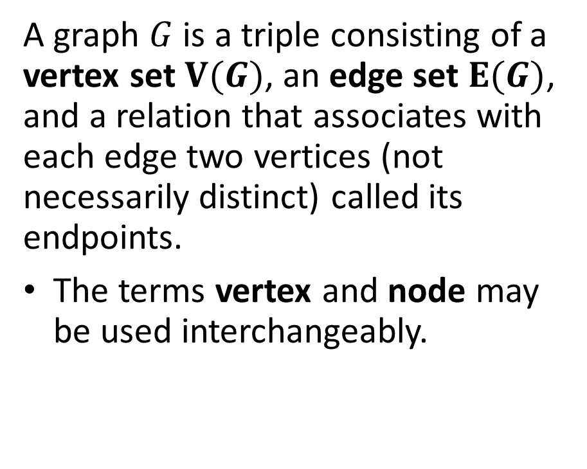

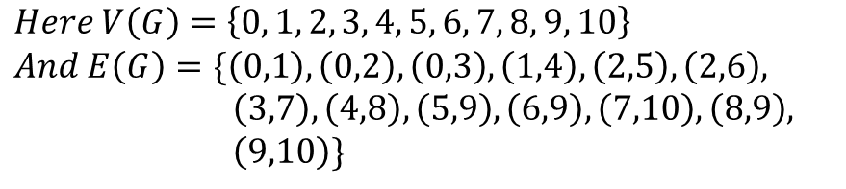
Graph^{[1]}
$$G$$
A graph $G$ is a triple consisting of a vertex set $V(G)$, an edge set $E(G)$, and a relation that associates with each edge two vertices (not necessarily distinct) called its endpoints.
The terms vertex and node may be used interchangeably.
$$Here V\left(G\right)=\left\{0, 1, 2, 3, 4, 5, 6, 7, 8, 9, 10\right\}$$
$$And E\left(G\right)=\{\left(0,1\right), \left(0,2\right), \left(0,3\right), \left(1,4\right), \left(2,5\right), \left(2,6\right),$$
$\left(3,7\right), \left(4,8\right), \left(5,9\right), \left(6,9\right), \left(7,10\right), \left(8,9\right),$
$\left(9,10\right)\}$

Slide 5
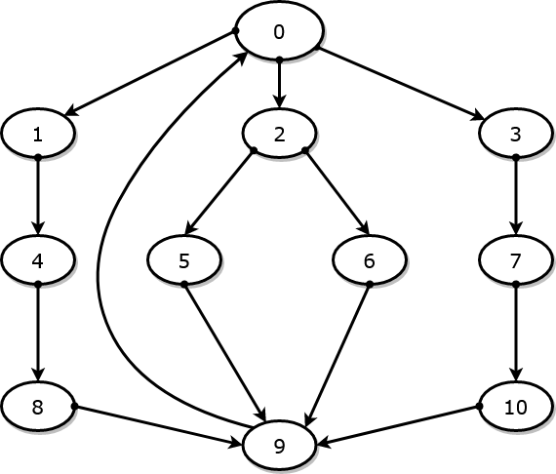
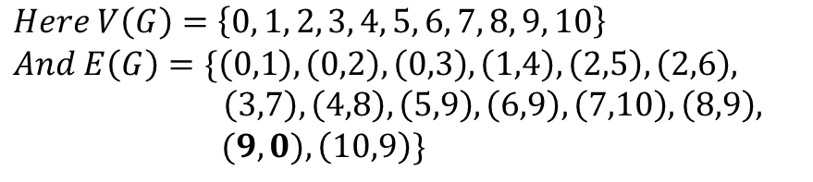


strongly-connected digraph ^{[3]}
$$G$$
A digraph is strongly connected or strong if for each ordered pair $u, v$ of vertices, there is a path from $u to v$.
$$Here V\left(G\right)=\left\{0, 1, 2, 3, 4, 5, 6, 7, 8, 9, 10\right\}$$
$$And E\left(G\right)=\{\left(0,1\right), \left(0,2\right), \left(0,3\right), \left(1,4\right), \left(2,5\right), \left(2,6\right),$$
$\left(3,7\right), \left(4,8\right), \left(5,9\right), \left(6,9\right), \left(7,10\right), \left(8,9\right),$
$(9, 0),\left(10,9\right)\}$

Slide 6
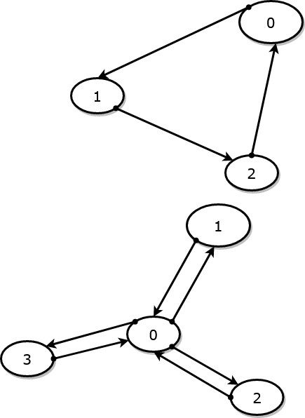


edge-critical strongly-connected digraph
A strongly-connected digraph that ceases to be strongly-connected if any of its edge is removed is called edge-critical strongly-connected digraph.
Note: In the codebase ^{[5]}, an edge-critical strongly-connected digraph is called prime digraph. We may use the terms interchangeably.
$$G$$
$$H$$
G and H are prime digraphs.
Note: All edge-critical graphs are 1-edge-connected graphs but not necessarily vice versa.

Slide 7
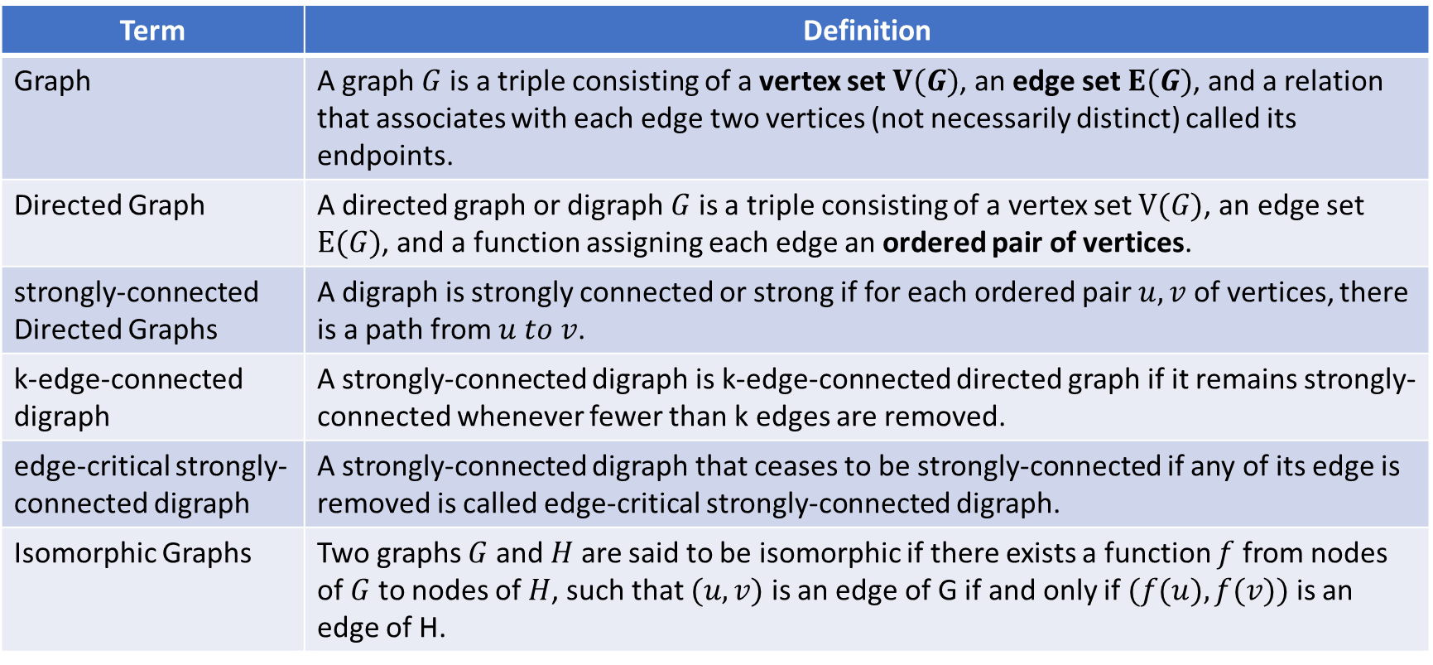
Definitions-Summary
Term | Definition
Graph | A graph $G$ is a triple consisting of a vertex set $V(G)$, an edge set $E(G)$, and a relation that associates with each edge two vertices (not necessarily distinct) called its endpoints.
Directed Graph | A directed graph or digraph $G$ is a triple consisting of a vertex set $V(G)$, an edge set $E(G)$, and a function assigning each edge an ordered pair of vertices.
strongly-connected Directed Graphs | A digraph is strongly connected or strong if for each ordered pair $u, v$ of vertices, there is a path from $u to v$.
k-edge-connected digraph | A strongly-connected digraph is k-edge-connected directed graph if it remains strongly-connected whenever fewer than k edges are removed.
edge-critical strongly-connected digraph | A strongly-connected digraph that ceases to be strongly-connected if any of its edge is removed is called edge-critical strongly-connected digraph.
Isomorphic Graphs | Two graphs $G$ and $H$ are said to be isomorphic if there exists a function $f$ from nodes of $G$ to nodes of $H$, such that $(u,v)$ is an edge of G if and only if $(f(u),f(v))$ is an edge of H.

Slide 8

Objective
Find an algorithm to generate all prime (edge-critical strongly-connected) directed graphs of $n+1$ nodes given a set of all prime digraphs of $n$ nodes.
Prove the algorithm’s correctness and completeness.

Slide 9
Tools at hand
Following algorithms/tools that have been studied in detail is assumed to be present at hand for achieving the mentioned objectives.
strong-connection test^{[9,10]}: An algorithm that tests whether the given graph is strongly-connected or not. It does so by finding the strongly connected components using Depth First Search algorithm. It is referred as is_strongly_connected(digraph)
Prime test ^{[5]}: An algorithm that tests whether given graph is edge-critical strongly-connected or not. It does so by removing an edge and checking for strong-connectedness. This is done for all edges. It is referred as is_prime(digraph)
Note: is_strongly_connected is available in the networkx package while is_prime is available on link mentioned in reference.
Further Work: Find a better algorithm to conclude primality of directed graph.

Slide 10
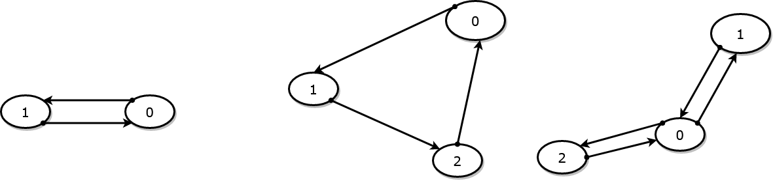
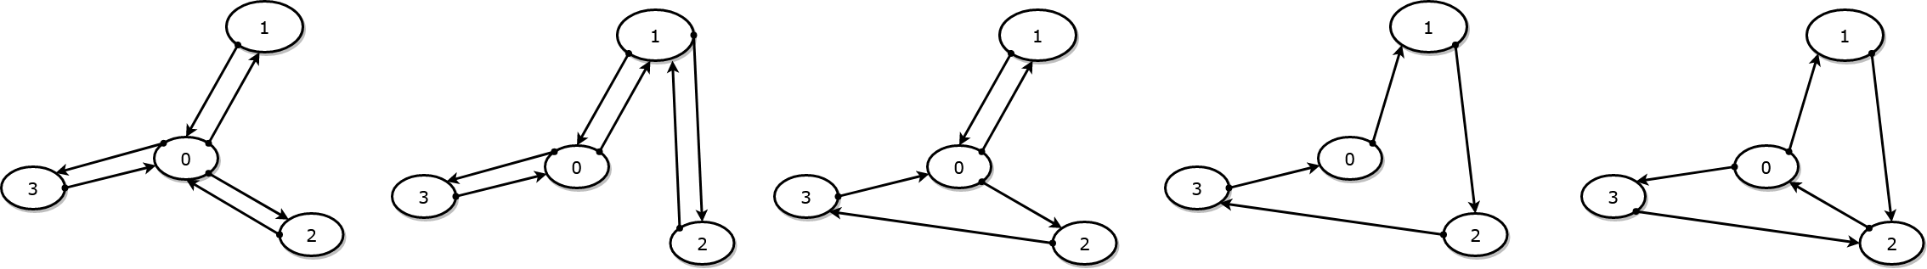
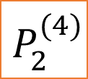
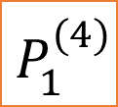
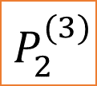
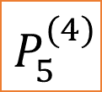
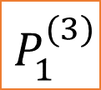
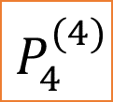
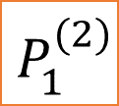
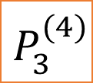
All prime digraphs of 2,3, and 4 nodes
$$P_{1}^{(2)}$$
$$P_{1}^{(3)}$$
$$P_{2}^{(3)}$$
$$P_{1}^{(4)}$$
$$P_{2}^{(4)}$$
$$P_{3}^{(4)}$$
$$P_{4}^{(4)}$$
$$P_{5}^{(4)}$$

Slide 11
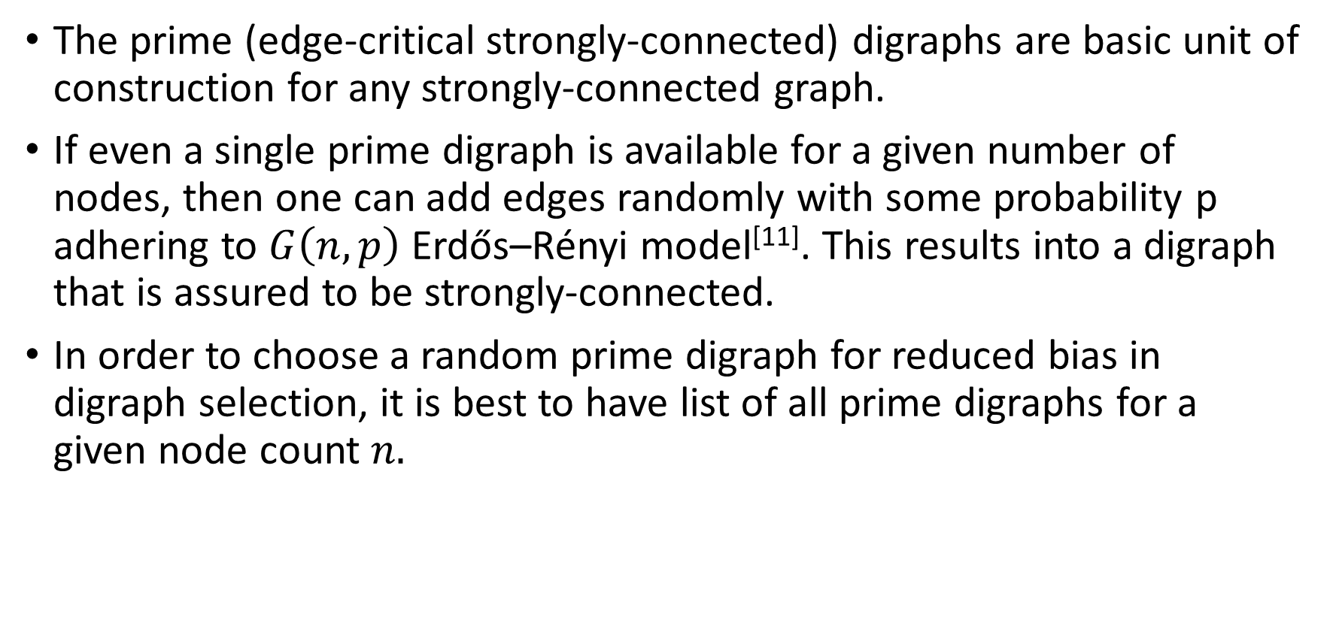
Motivation of Prime digraphs
The prime (edge-critical strongly-connected) digraphs are basic unit of construction for any strongly-connected graph.
If even a single prime digraph is available for a given number of nodes, then one can add edges randomly with some probability p adhering to $G\left(n,p\right)$ Erdős–Rényi model^{[11]}. This results into a digraph that is assured to be strongly-connected.
In order to choose a random prime digraph for reduced bias in digraph selection, it is best to have list of all prime digraphs for a given node count $n.$

Slide 12
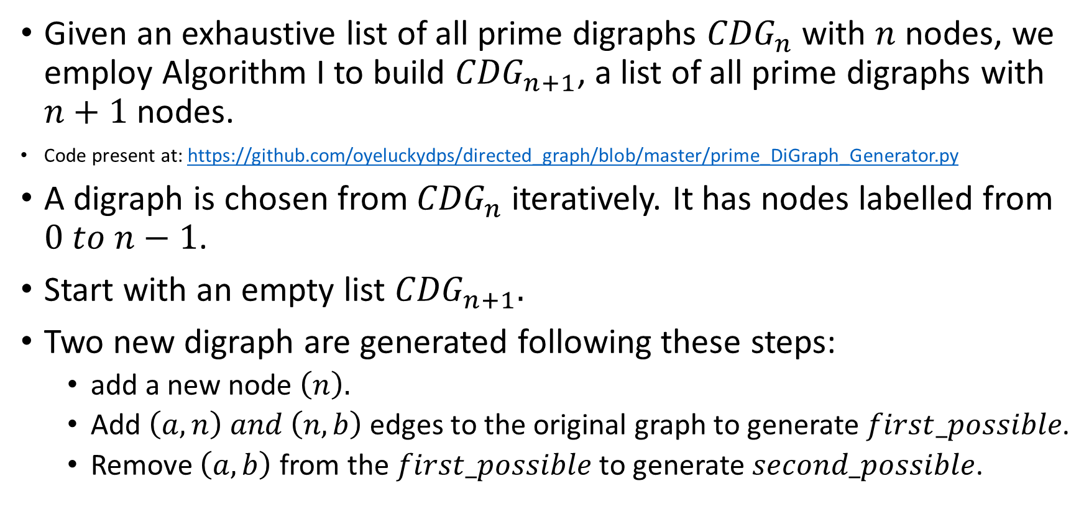
Algorithm I – Find all prime digraphs
Given an exhaustive list of all prime digraphs ${CDG}_{n}$ with $n$ nodes, we employ Algorithm I to build ${CDG}_{n+1}$, a list of all prime digraphs with $n+1$ nodes.
Code present at: https://github.com/oyeluckydps/directed_graph/blob/master/prime_DiGraph_Generator.py
A digraph is chosen from ${CDG}_{n}$ iteratively. It has nodes labelled from $0 to n−1$.
Start with an empty list ${CDG}_{n+1}.$
Two new digraph are generated following these steps:
add a new node $\left(n\right).$
Add $\left(a, n\right) and \left(n,b\right)$ edges to the original graph to generate $first_possible$.
Remove $\left(a,b\right)$ from the $first_possible$ to generate $second_possible$.

Slide 13
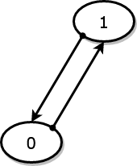
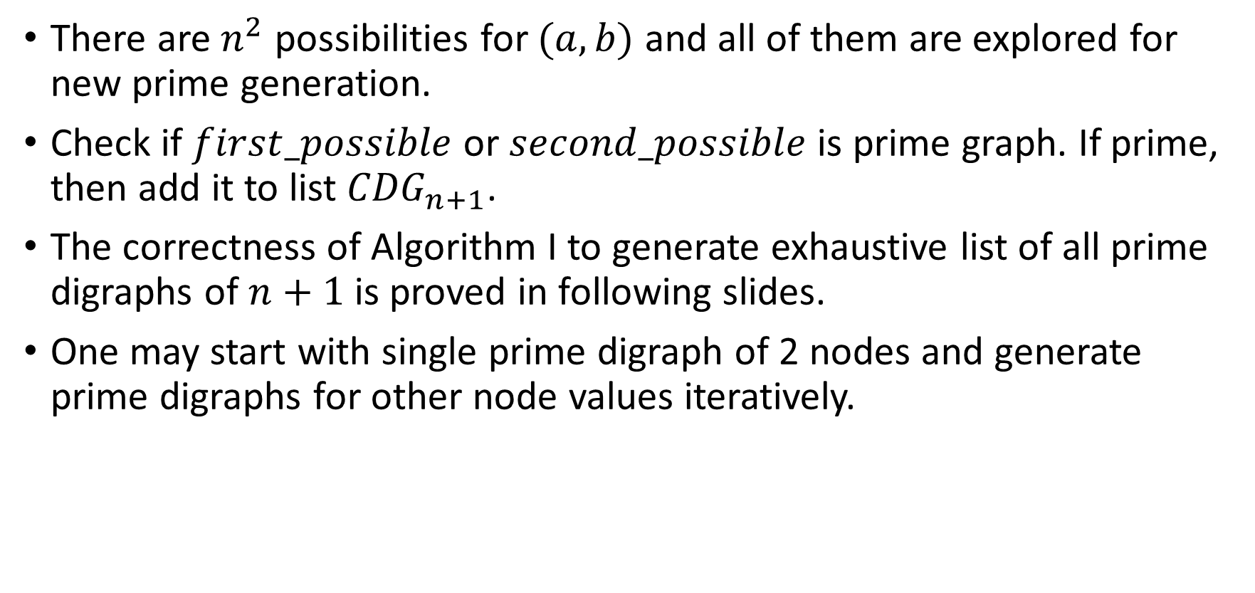

Algorithm I – Find all prime digraphs
There are $n^{2}$ possibilities for $(a,b)$ and all of them are explored for new prime generation.
Check if $first_possible$ or $second_possible$is prime graph. If prime, then add it to list ${CDG}_{n+1}$.
The correctness of Algorithm I to generate exhaustive list of all prime digraphs of $n+1$ is proved in following slides.
One may start with single prime digraph of 2 nodes and generate prime digraphs for other node values iteratively.
$$P_{1}^{(2)}$$

Slide 14
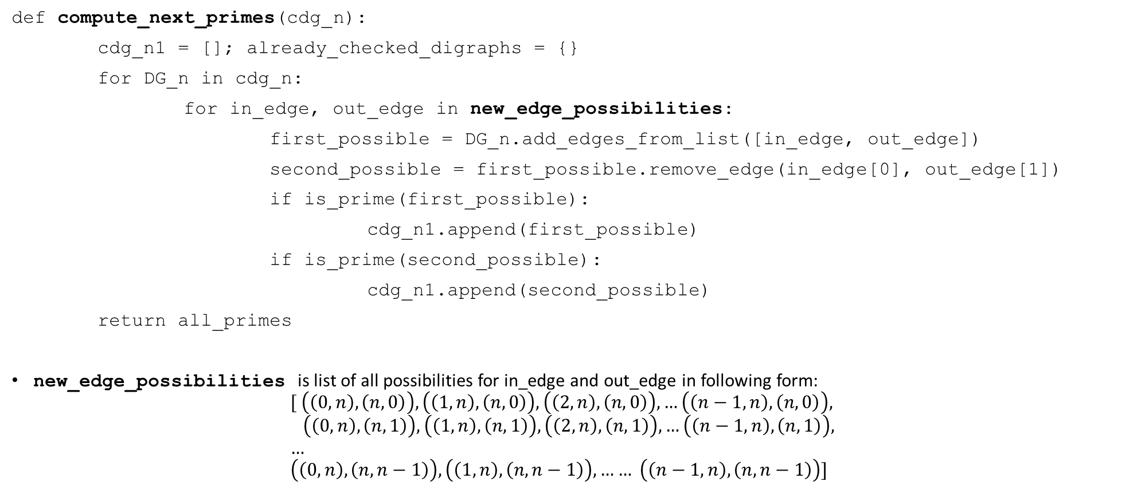
Algorithm I – Find all prime digraphs
def compute_next_primes(cdg_n):
cdg_n1 = []; already_checked_digraphs = {}
for DG_n in cdg_n:
for in_edge, out_edge in new_edge_possibilities:
first_possible = DG_n.add_edges_from_list([in_edge, out_edge])
second_possible = first_possible.remove_edge(in_edge[0], out_edge[1])
if is_prime(first_possible):
cdg_n1.append(first_possible)
if is_prime(second_possible):
cdg_n1.append(second_possible)
return all_primes
new_edge_possibilities is list of all possibilities for in_edge and out_edge in following form:
$$[ \left(\left(0,n\right), \left(n,0\right)\right),\left(\left(1,n\right), \left(n,0\right)\right),\left(\left(2,n\right), \left(n,0\right)\right), …\left(\left(n−1,n\right), \left(n,0\right)\right), \\ \left(\left(0,n\right), \left(n,1\right)\right),\left(\left(1,n\right), \left(n,1\right)\right),\left(\left(2,n\right), \left(n,1\right)\right), …\left(\left(n−1,n\right), \left(n,1\right)\right), \\ … \\ \left(\left(0,n\right), \left(n,n−1\right)\right),\left(\left(1,n\right), \left(n,n−1\right)\right), …… \left(\left(n−1,n\right), \left(n,n−1\right)\right)]$$

Slide 15
Result: Find all prime digraphs
Algorithm I was used to generate all prime digraphs for 2 to 10 nodes. It can be found at: https://github.com/oyeluckydps/directed_graph/blob/master/using_isomorphic_hashCDG.csv
Count of prime digraphs for given number of nodes is:
Number of nodes | Total Prime Digraphs
2 | 1
3 | 2
4 | 5
5 | 15
6 | 63
7 | 288
8 | 1526
9 | 8627
10 | 52021

Slide 16
Correctness of prime generator
RTP: The prime generator algorithm outputs a set of graphs and each graph is a prime graph.
A graph (either first_possible or second_possible) is only added to the CDG_n1 if it is prime i.e. if it passes the is_prime test thus each graph in the CDG_n1 is prime.

Slide 17
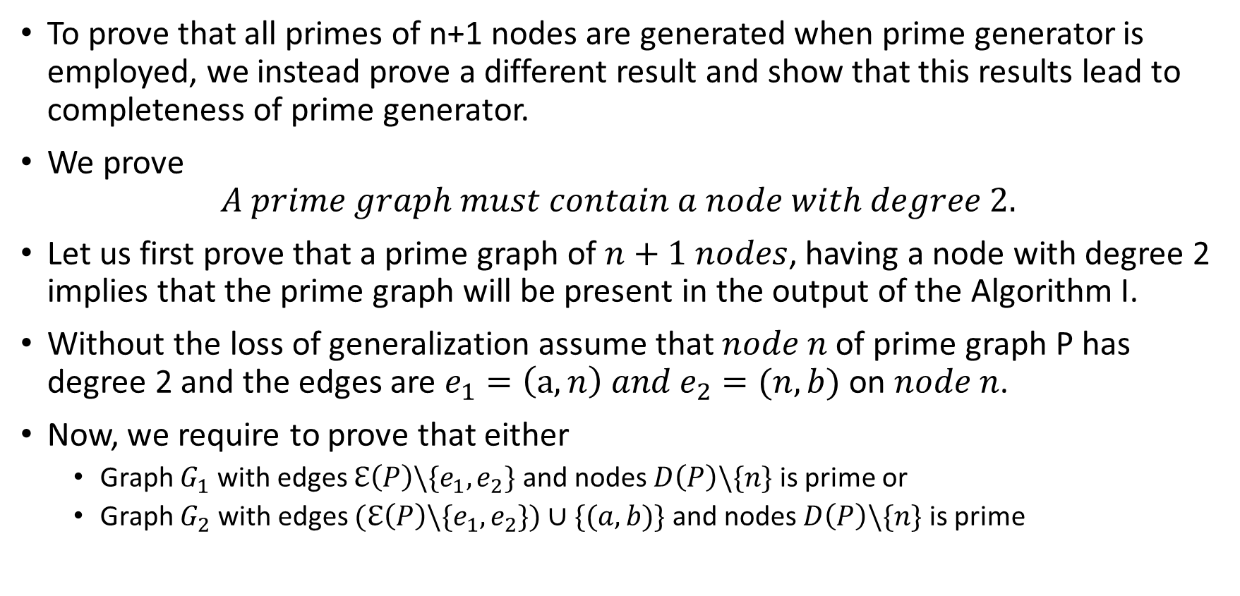
Completeness of prime generator
To prove that all primes of n+1 nodes are generated when prime generator is employed, we instead prove a different result and show that this results lead to completeness of prime generator.
We prove
$$A prime graph must contain a node with degree 2.$$
Let us first prove that a prime graph of $n+1 nodes$, having a node with degree 2 implies that the prime graph will be present in the output of the Algorithm I.
Without the loss of generalization assume that $node n$ of prime graph P has degree 2 and the edges are $e_{1}=\left(a, n\right) and e_{2}=(n, b)$ on $node n$.
Now, we require to prove that either
Graph $G_{1}$with edges $ℇ\left(P\right)\backslash \{e_{1},e_{2}\}$ and nodes $D\left(P\right)\backslash \{n\}$ is prime or
Graph $G_{2}$with edges $(ℇ\left(P\right)\backslash \{e_{1},e_{2}\})∪\{(a,b)\}$ and nodes $D\left(P\right)\backslash \{n\}$ is prime

Slide 18
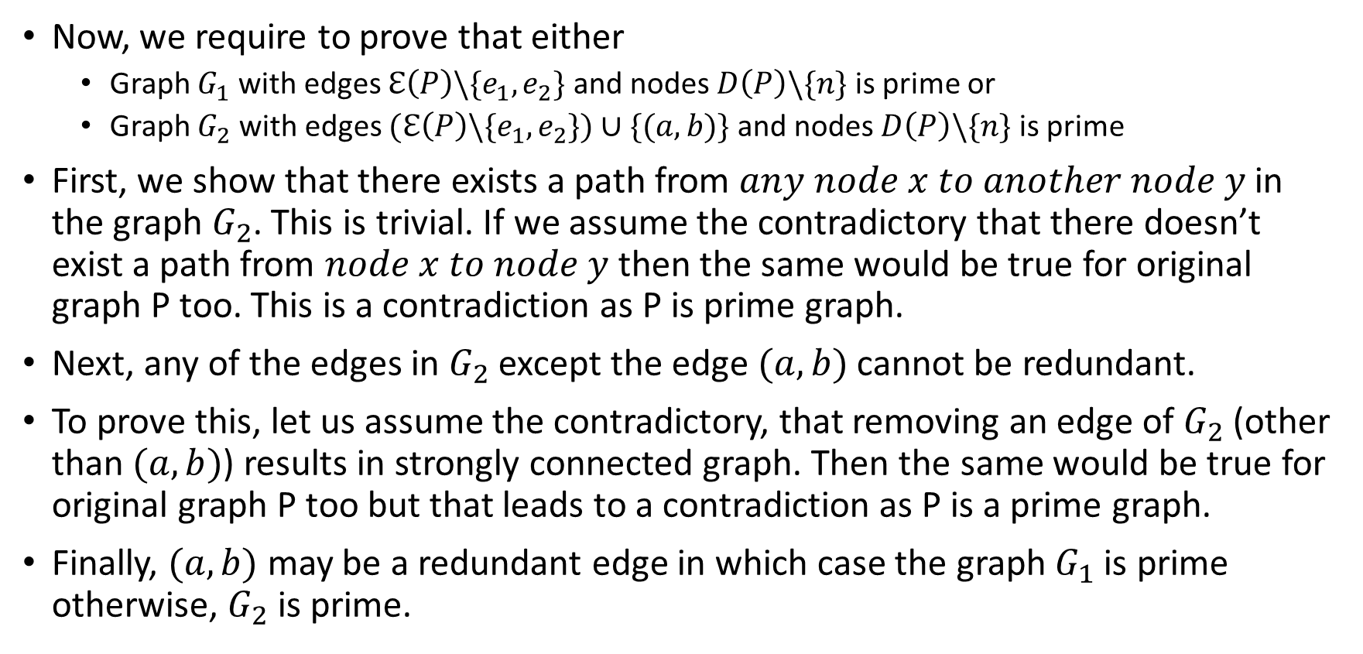
Completeness of prime generator
Now, we require to prove that either
Graph $G_{1}$with edges $ℇ\left(P\right)\backslash \{e_{1},e_{2}\}$ and nodes $D\left(P\right)\backslash \{n\}$ is prime or
Graph $G_{2}$with edges $(ℇ\left(P\right)\backslash \{e_{1},e_{2}\})∪\{(a,b)\}$ and nodes $D\left(P\right)\backslash \{n\}$ is prime
First, we show that there exists a path from $any node x to another node y$ in the graph $G_{2}$. This is trivial. If we assume the contradictory that there doesn’t exist a path from $node x to node y$ then the same would be true for original graph P too. This is a contradiction as P is prime graph.
Next, any of the edges in $G_{2}$ except the edge $(a,b)$ cannot be redundant.
To prove this, let us assume the contradictory, that removing an edge of $G_{2}$ (other than $(a,b)$) results in strongly connected graph. Then the same would be true for original graph P too but that leads to a contradiction as P is a prime graph.
Finally, $(a,b)$ may be a redundant edge in which case the graph $G_{1}$ is prime otherwise, $G_{2}$ is prime.

Slide 19
Completeness of prime generator
This proves that a prime graph of n+1 nodes with a node having two edges can always be found from a prime graph of n nodes by either
Adding a new node ‘n’ and adding an in-edge and out-edge from two nodes say a and b, OR
Removing an edge (a, b) followed by addition of node n and edges (a, n) and (n, b).
Now, we shall prove that any prime graph has at least one node with two edges.

Slide 20
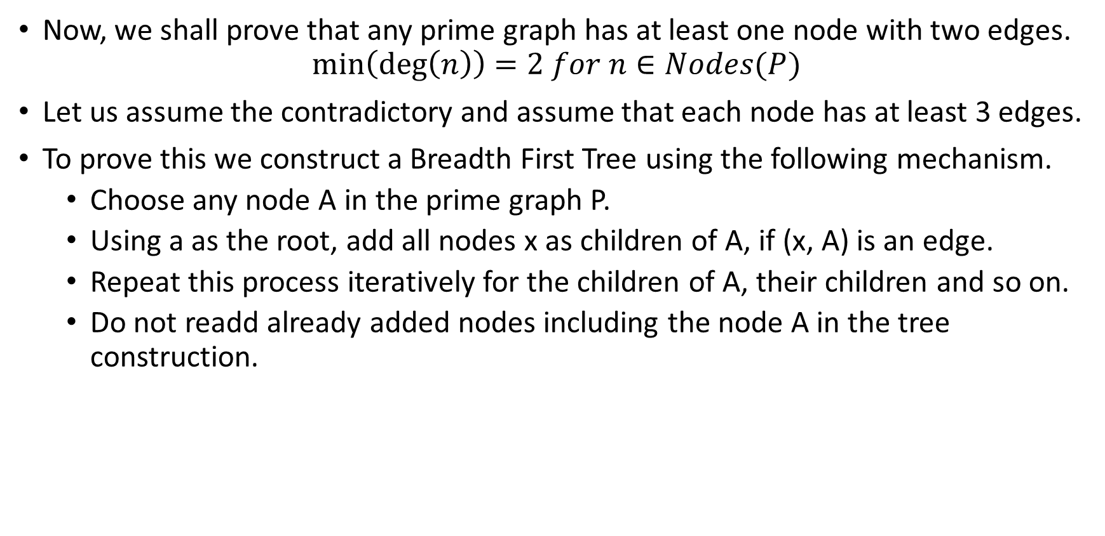
Construction of BFS tree
Now, we shall prove that any prime graph has at least one node with two edges.
$$\min\left(\deg\left(n\right)\right)=2 for n∈Nodes(P)$$
Let us assume the contradictory and assume that each node has at least 3 edges.
To prove this we construct a Breadth First Tree using the following mechanism.
Choose any node A in the prime graph P.
Using a as the root, add all nodes x as children of A, if (x, A) is an edge.
Repeat this process iteratively for the children of A, their children and so on.
Do not readd already added nodes including the node A in the tree construction.

Slide 21
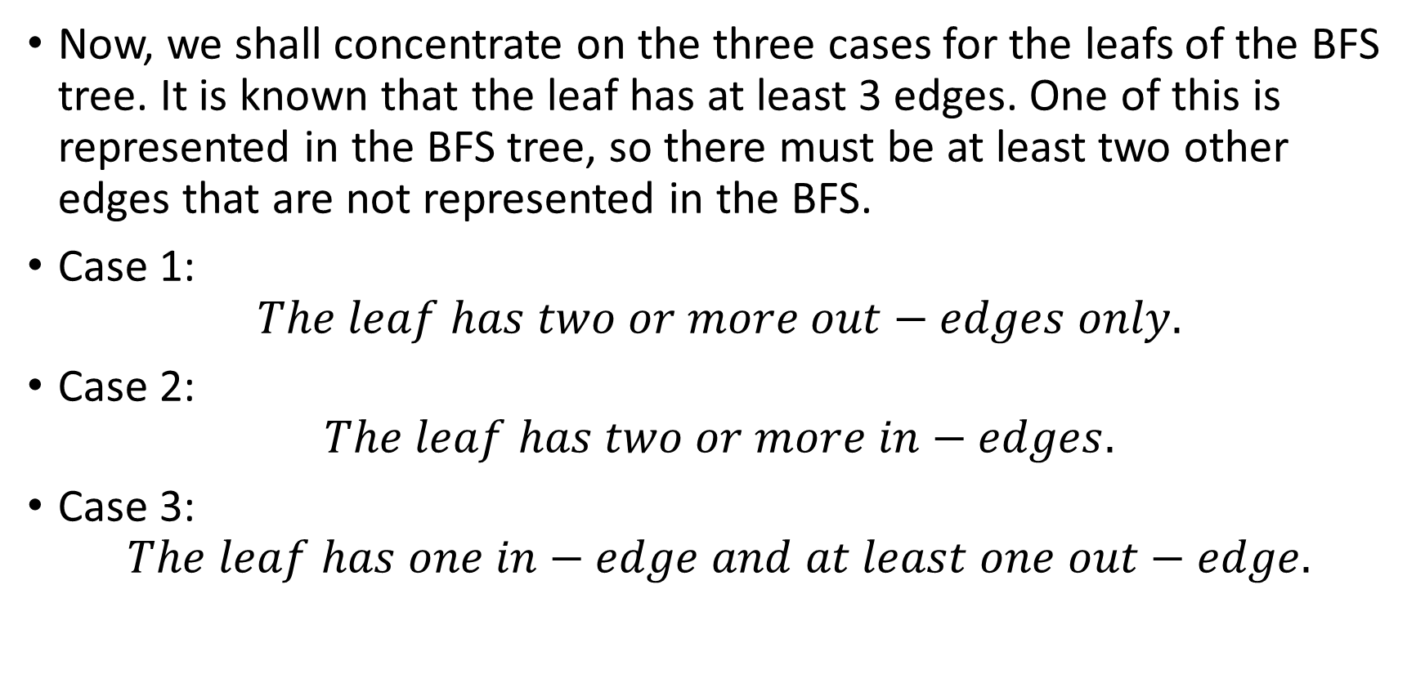
Three cases
Now, we shall concentrate on the three cases for the leafs of the BFS tree. It is known that the leaf has at least 3 edges. One of this is represented in the BFS tree, so there must be at least two other edges that are not represented in the BFS.
Case 1:
$$The leaf has two or more out−edges only.$$
Case 2:
$$The leaf has two or more in−edges.$$
Case 3:
$$The leaf has one in−edge and at least one out−edge.$$

Slide 22

Two or more out-edges only
$$Case 1: The leaf has two or more out−edges only$$
If the node has only out-edges (as the edge on the BFS tree is also an out-edge), then there does not exist a path from any other node to this node. So clearly, case 1 leads to contradiction.

Slide 23
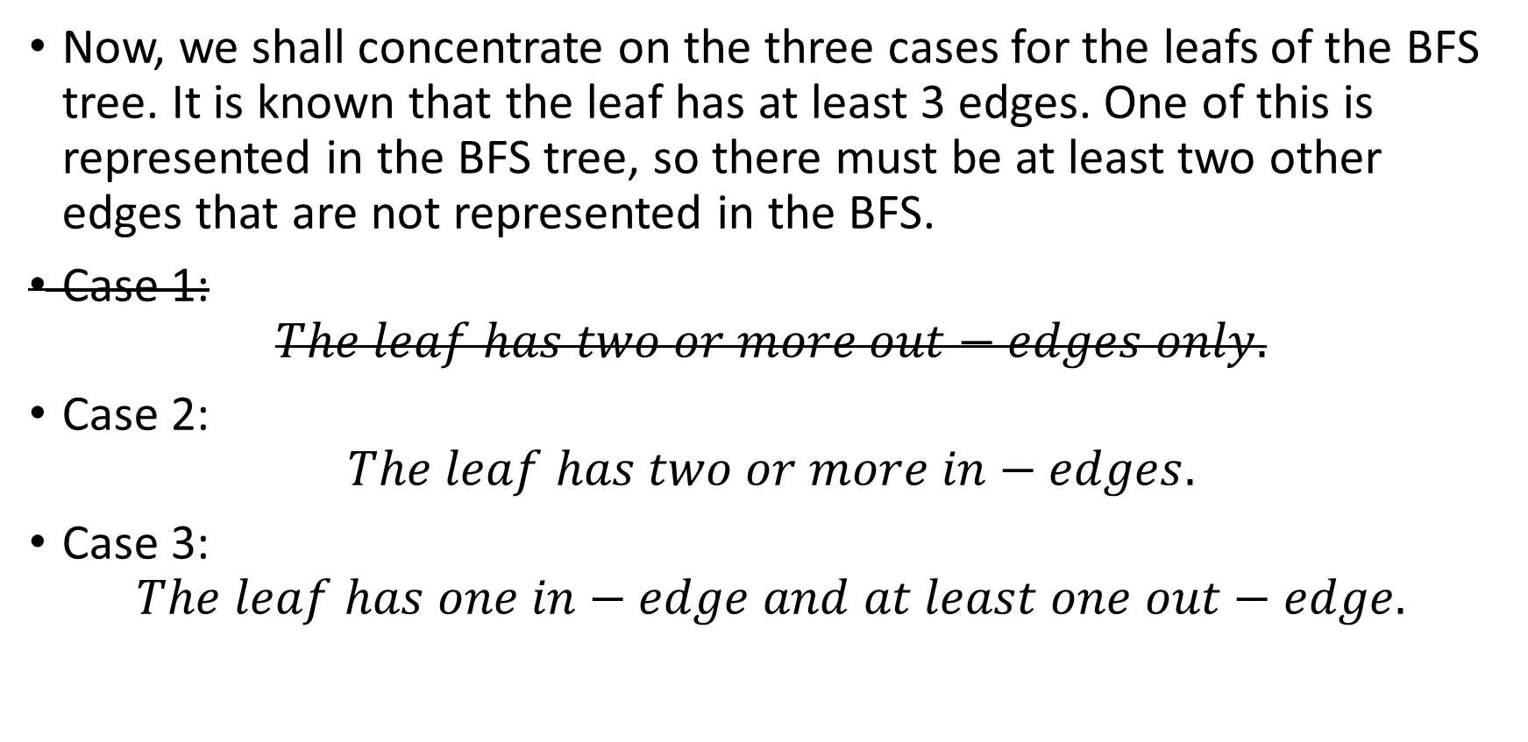
Three cases
Now, we shall concentrate on the three cases for the leafs of the BFS tree. It is known that the leaf has at least 3 edges. One of this is represented in the BFS tree, so there must be at least two other edges that are not represented in the BFS.
Case 1:
$$The leaf has two or more out−edges only.$$
Case 2:
$$The leaf has two or more in−edges.$$
Case 3:
$$The leaf has one in−edge and at least one out−edge.$$

Slide 24
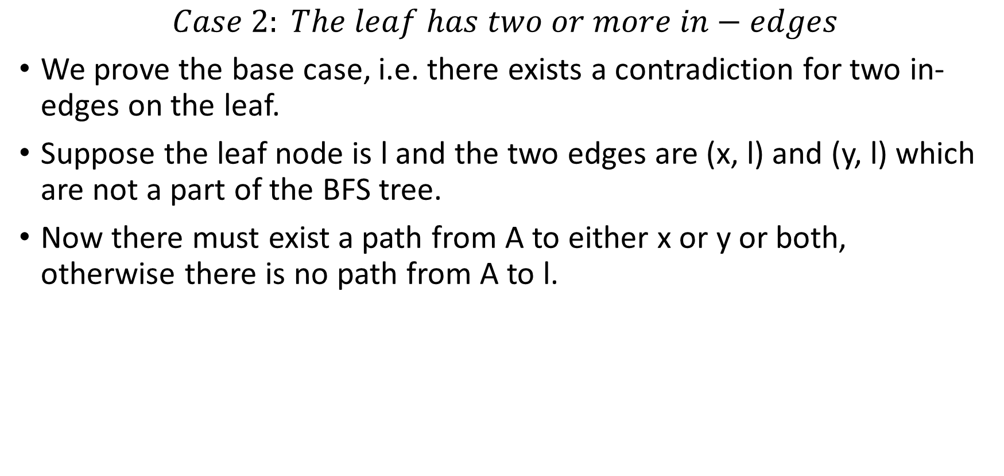
Two or more in-edges
$$Case 2: The leaf has two or more in−edges$$
We prove the base case, i.e. there exists a contradiction for two in-edges on the leaf.
Suppose the leaf node is l and the two edges are (x, l) and (y, l) which are not a part of the BFS tree.
Now there must exist a path from A to either x or y or both, otherwise there is no path from A to l.

Slide 25
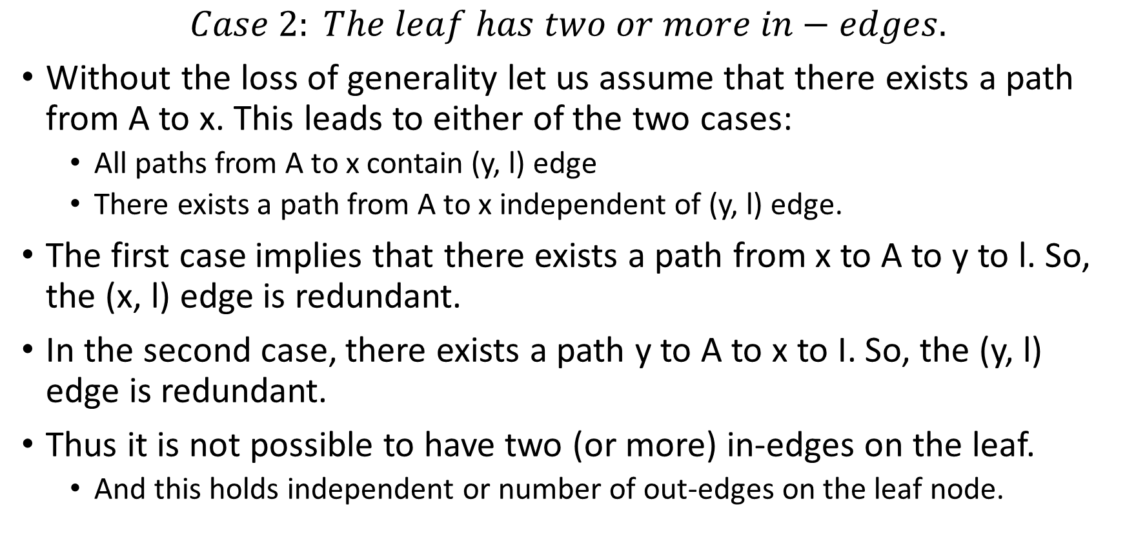
Two or more in-edges
$$Case 2: The leaf has two or more in−edges.$$
Without the loss of generality let us assume that there exists a path from A to x. This leads to either of the two cases:
All paths from A to x contain (y, l) edge
There exists a path from A to x independent of (y, l) edge.
The first case implies that there exists a path from x to A to y to l. So, the (x, l) edge is redundant.
In the second case, there exists a path y to A to x to I. So, the (y, l) edge is redundant.
Thus it is not possible to have two (or more) in-edges on the leaf.
And this holds independent or number of out-edges on the leaf node.

Slide 26
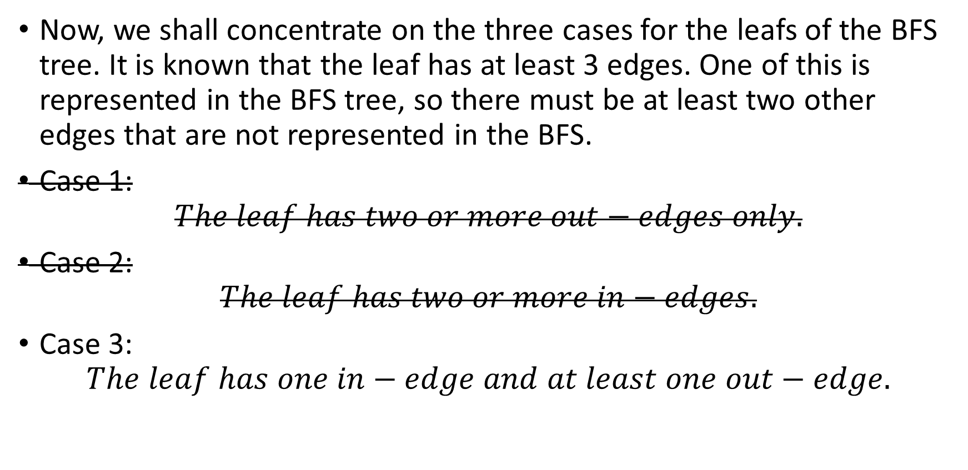
Three cases
Now, we shall concentrate on the three cases for the leafs of the BFS tree. It is known that the leaf has at least 3 edges. One of this is represented in the BFS tree, so there must be at least two other edges that are not represented in the BFS.
Case 1:
$$The leaf has two or more out−edges only.$$
Case 2:
$$The leaf has two or more in−edges.$$
Case 3:
$$The leaf has one in−edge and at least one out−edge.$$

Slide 27
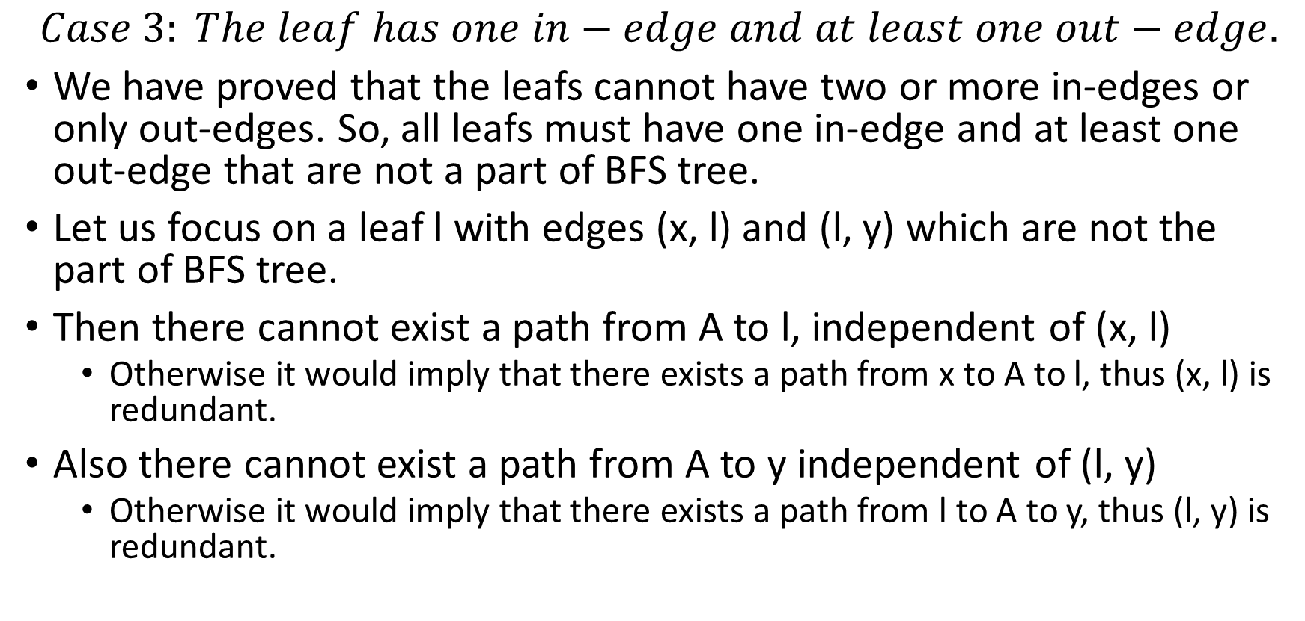
1 in-edge and at least 1 out-edge
$$Case 3: The leaf has one in−edge and at least one out−edge.$$
We have proved that the leafs cannot have two or more in-edges or only out-edges. So, all leafs must have one in-edge and at least one out-edge that are not a part of BFS tree.
Let us focus on a leaf l with edges (x, l) and (l, y) which are not the part of BFS tree.
Then there cannot exist a path from A to l, independent of (x, l)
Otherwise it would imply that there exists a path from x to A to l, thus (x, l) is redundant.
Also there cannot exist a path from A to y independent of (l, y)
Otherwise it would imply that there exists a path from l to A to y, thus (l, y) is redundant.

Slide 28
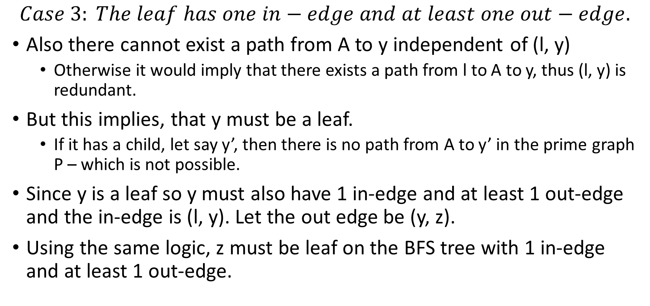
1 in-edge and at least 1 out-edge
$$Case 3: The leaf has one in−edge and at least one out−edge.$$
Also there cannot exist a path from A to y independent of (l, y)
Otherwise it would imply that there exists a path from l to A to y, thus (l, y) is redundant.
But this implies, that y must be a leaf.
If it has a child, let say y’, then there is no path from A to y’ in the prime graph P – which is not possible.
Since y is a leaf so y must also have 1 in-edge and at least 1 out-edge and the in-edge is (l, y). Let the out edge be (y, z).
Using the same logic, z must be leaf on the BFS tree with 1 in-edge and at least 1 out-edge.

Slide 29
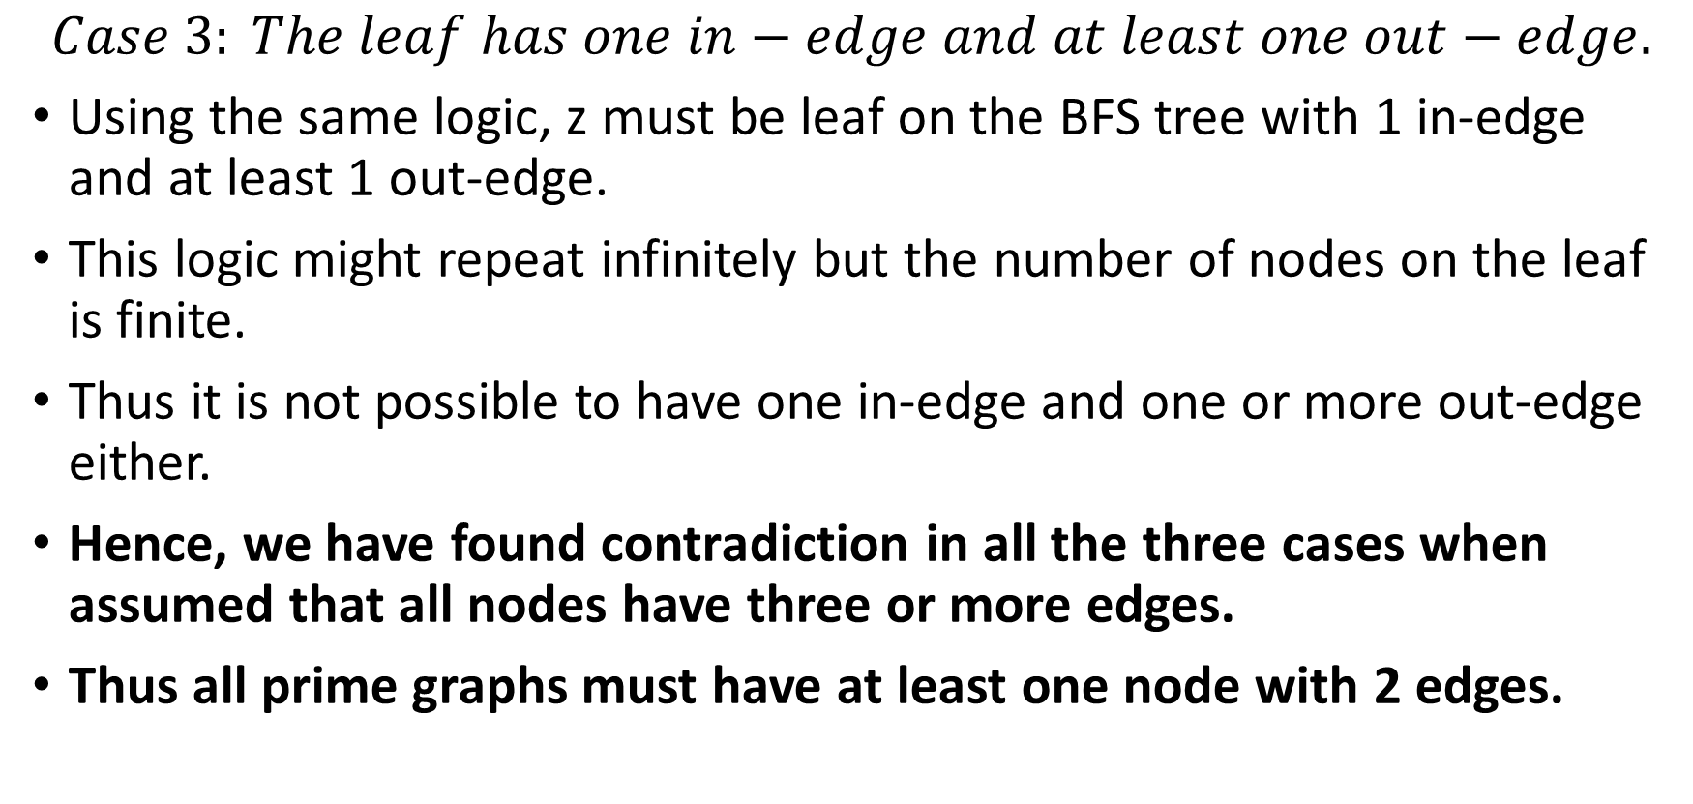
1 in-edge and at least 1 out-edge
$$Case 3: The leaf has one in−edge and at least one out−edge.$$
Using the same logic, z must be leaf on the BFS tree with 1 in-edge and at least 1 out-edge.
This logic might repeat infinitely but the number of nodes on the leaf is finite.
Thus it is not possible to have one in-edge and one or more out-edge either.
Hence, we have found contradiction in all the three cases when assumed that all nodes have three or more edges.
Thus all prime graphs must have at least one node with 2 edges.

Slide 30

Conclusion
A algorithm to find the set of all prime (edge-critical strongly-connected) digraphs for any given number of nodes is found. The algorithm is iterative in nature.
A theoretical proof for correctness and completeness of Alorithm I to generate exhaustive list of all prime digraphs of $n+1$ nodes is established.

Slide 31
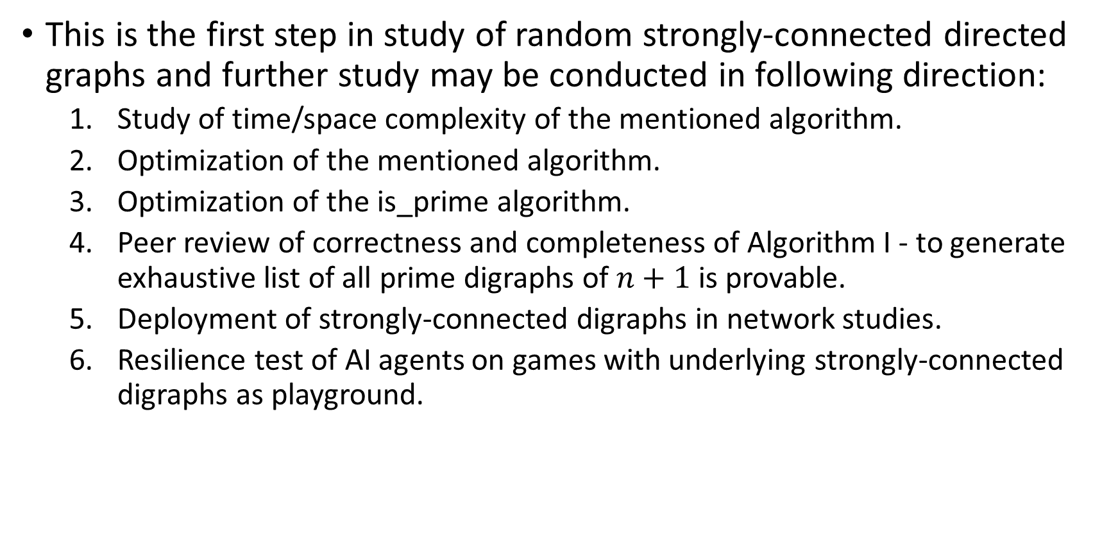
Further study
This is the first step in study of random strongly-connected directed graphs and further study may be conducted in following direction:
Study of time/space complexity of the mentioned algorithm.
Optimization of the mentioned algorithm.
Optimization of the is_prime algorithm.
Peer review of correctness and completeness of Algorithm I - to generate exhaustive list of all prime digraphs of $n+1$ is provable.
Deployment of strongly-connected digraphs in network studies.
Resilience test of AI agents on games with underlying strongly-connected digraphs as playground.

Slide 32
Reference
Douglas B West (2001). 1.1.2 Introduction to Graph Theory. Pearson Education, Inc
Douglas B West (2001). 1.4.2 Introduction to Graph Theory. Pearson Education, Inc
Douglas B West (2001). 1.4.12 Introduction to Graph Theory. Pearson Education, Inc
Wikipedia contributors (2022a, June 25). K-edge-connected graph. https://en.wikipedia.org/wiki/K-edge-connected_graph
Verma, A. Kumar (2022, December 11). Directed Graph and analysis. GitHub. https://github.com/oyeluckydps/directed_graph
Wikipedia contributors (2022c, November 28). Graph isomorphism. Wikipedia. https://en.wikipedia.org/wiki/Graph_isomorphism
L. P. Cordella, P. Foggia, C. Sansone, M. Vento (2001). “An Improved Algorithm for Matching Large Graphs”, 3rd IAPR-TC15 Workshop on Graph-based Representations in Pattern Recognition, Cuen, pp. 149-159. https://citeseerx.ist.psu.edu/viewdoc/summary?doi=10.1.1.101.5342
Shervashidze, Nino, Pascal Schweitzer, Erik Jan Van Leeuwen, Kurt Mehlhorn, and Karsten M. Borgwardt (2011). Weisfeiler Lehman Graph Kernels. Journal of Machine Learning Research. http://www.jmlr.org/papers/volume12/shervashidze11a/shervashidze11a.pdf

Slide 33
Reference
R. Tarjan (1972). Depth-first search and linear graph algorithms. SIAM Journal of Computing 1(2):146-160.
E. Nuutila and E. Soisalon-Soinen (1994). On finding the strongly connected components in a directed graph. Information Processing Letters 49(1): 9-14
Erdős, P.; Rényi, A. (1959). "On Random Graphs. I" (PDF). Publications Mathematicae. 6: 290–297.

