Slide 1
Generation of random strongly-connected Directed Graphs

Slide 2
Index
Definition
Graph
Directed Graph
strongly-connected digraph
k-edge-connected digraph
edge-critical strongly-connected digraph
Isomorphic Graphs
Summary
Problem Statement
Objective
Existing tools
Prime digraph generation
Example and Motivation
Algorithm I – Reduce to primes
Algorithm II - Find all prime digraphs
Results

Slide 3
Index
Random strongly-connected digraph
Algorithm III – Random strongly-connected digraph
Algorithm IV – Random prime generator
Conclusion
Conclusion
Further study
Reference

Slide 4
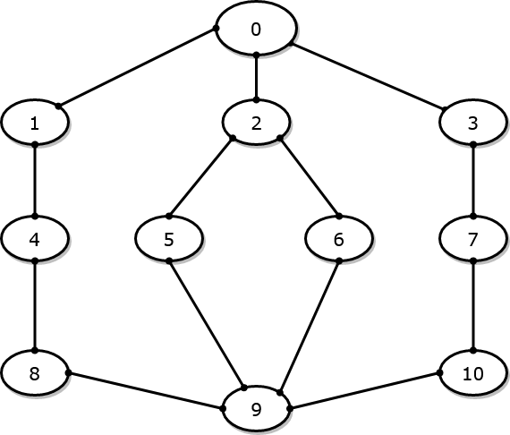
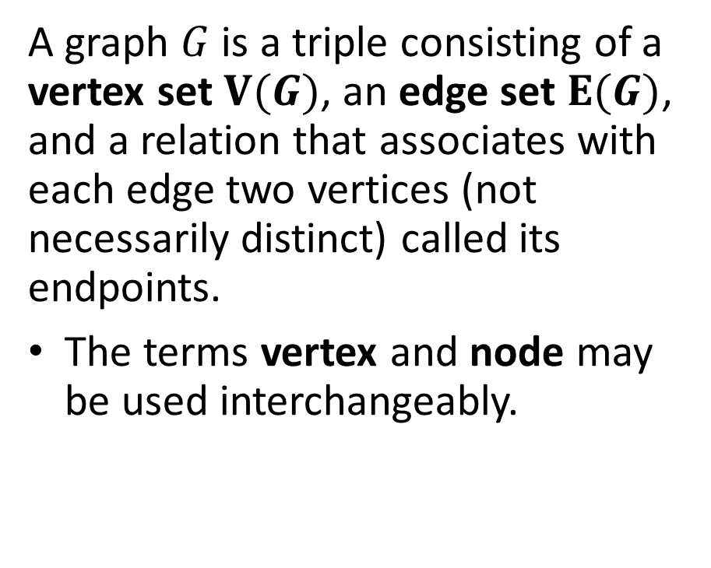

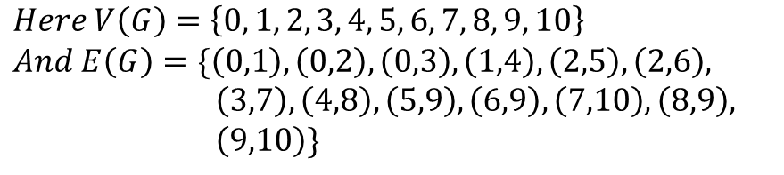
Graph^{[1]}
$$G$$
A graph $G$ is a triple consisting of a vertex set $V(G)$, an edge set $E(G)$, and a relation that associates with each edge two vertices (not necessarily distinct) called its endpoints.
The terms vertex and node may be used interchangeably.
$$Here V\left(G\right)=\left\{0, 1, 2, 3, 4, 5, 6, 7, 8, 9, 10\right\}$$
$$And E\left(G\right)=\{\left(0,1\right), \left(0,2\right), \left(0,3\right), \left(1,4\right), \left(2,5\right), \left(2,6\right),$$
$\left(3,7\right), \left(4,8\right), \left(5,9\right), \left(6,9\right), \left(7,10\right), \left(8,9\right),$
$\left(9,10\right)\}$

Slide 5
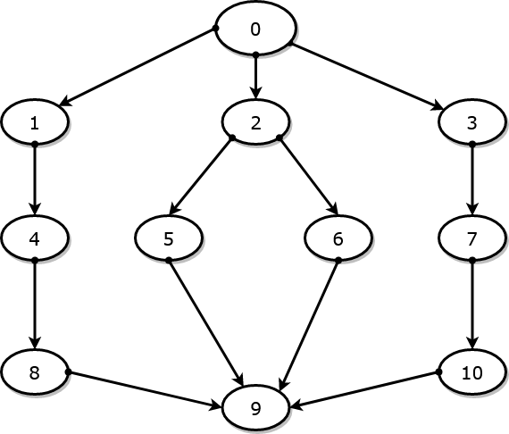
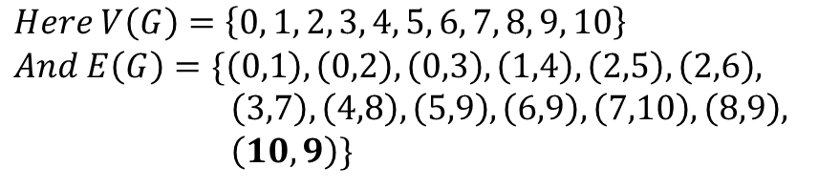
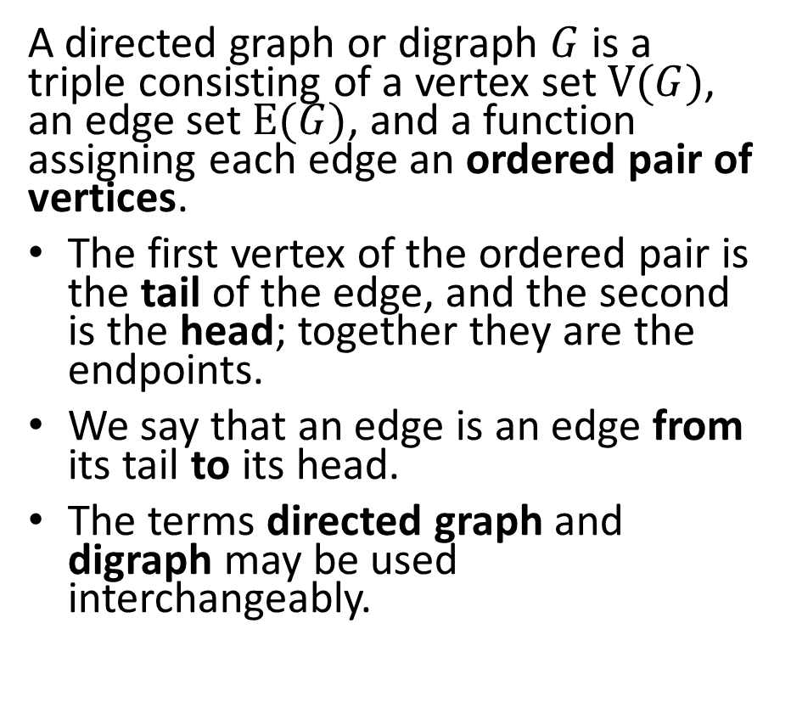
Directed Graph ^{[2]}
$$G$$
A directed graph or digraph $G$ is a triple consisting of a vertex set $V(G)$, an edge set $E(G)$, and a function assigning each edge an ordered pair of vertices.
The first vertex of the ordered pair is the tail of the edge, and the second is the head; together they are the endpoints.
We say that an edge is an edge from its tail to its head.
The terms directed graph and digraph may be used interchangeably.
$$Here V\left(G\right)=\left\{0, 1, 2, 3, 4, 5, 6, 7, 8, 9, 10\right\}$$
$$And E\left(G\right)=\{\left(0,1\right), \left(0,2\right), \left(0,3\right), \left(1,4\right), \left(2,5\right), \left(2,6\right),$$
$\left(3,7\right), \left(4,8\right), \left(5,9\right), \left(6,9\right), \left(7,10\right), \left(8,9\right),$
$\left(10,9\right)\}$

Slide 6
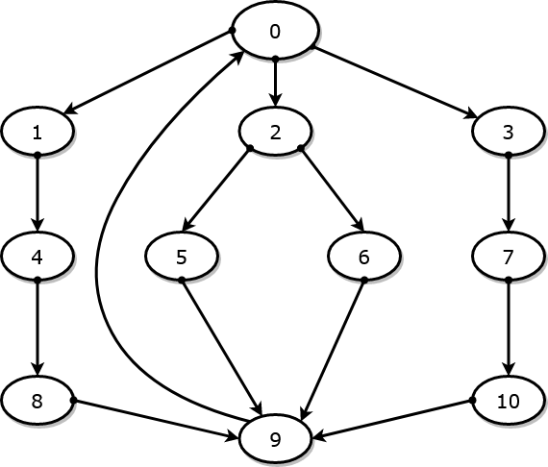
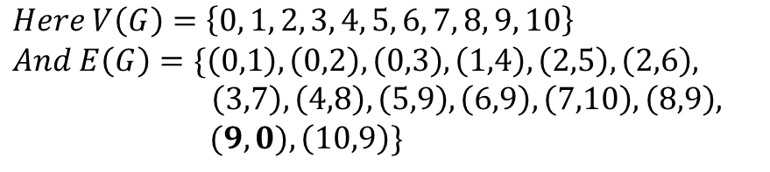


strongly-connected digraph ^{[3]}
$$G$$
A digraph is strongly connected or strong if for each ordered pair $u, v$ of vertices, there is a path from $u to v$.
$$Here V\left(G\right)=\left\{0, 1, 2, 3, 4, 5, 6, 7, 8, 9, 10\right\}$$
$$And E\left(G\right)=\{\left(0,1\right), \left(0,2\right), \left(0,3\right), \left(1,4\right), \left(2,5\right), \left(2,6\right),$$
$\left(3,7\right), \left(4,8\right), \left(5,9\right), \left(6,9\right), \left(7,10\right), \left(8,9\right),$
$(9, 0),\left(10,9\right)\}$

Slide 7
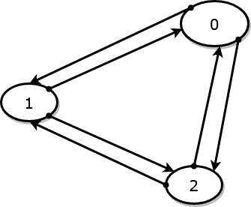

k-edge-connected digraph ^{[4]}
A strongly-connected digraph is k-edge-connected directed graph if it remains strongly-connected whenever fewer than k edges are removed.
Note: This is a natural extension of k-edge-connected graph for directed graphs.
$$G$$
G is a 2-edge-connected digraph as one must remove at least three edges to make this digraph non-strongly-connected.

Slide 8
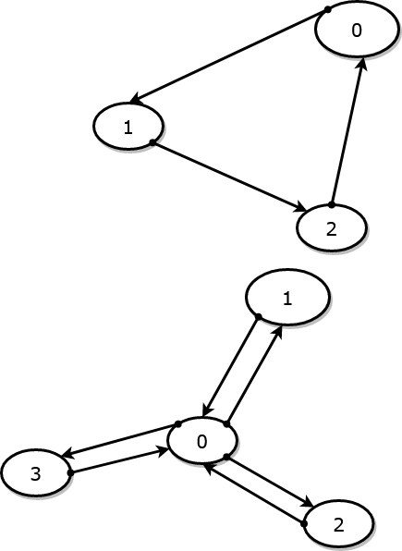


edge-critical strongly-connected digraph
A strongly-connected digraph that ceases to be strongly-connected if any of its edge is removed is called edge-critical strongly-connected digraph.
Note: In the codebase ^{[5]}, an edge-critical strongly-connected digraph is called prime digraph. We may use the terms interchangeably.
$$G$$
$$H$$
G and H are prime digraphs.
Note: All edge-critical graphs are 1-edge-connected graphs but not necessarily vice versa.

Slide 9
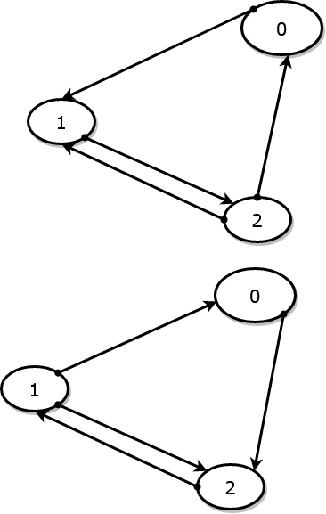
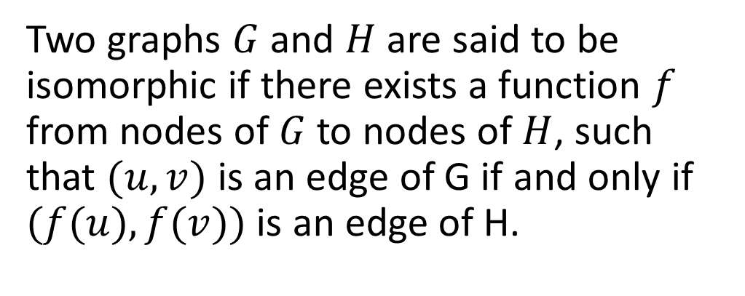
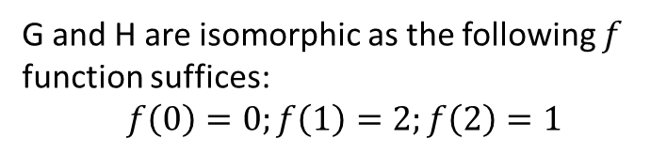


Isomorphic Graphs ^{[6]}
Note the difference in tail and head of edge
$$G$$
Two graphs $G$ and $H$ are said to be isomorphic if there exists a function $f$ from nodes of $G$ to nodes of $H$, such that $(u,v)$ is an edge of G if and only if $(f(u),f(v))$ is an edge of H.
$$H$$
G and H are isomorphic as the following $f$ function suffices:
$$f\left(0\right)=0;f\left(1\right)=2;f\left(2\right)=1$$

Slide 10
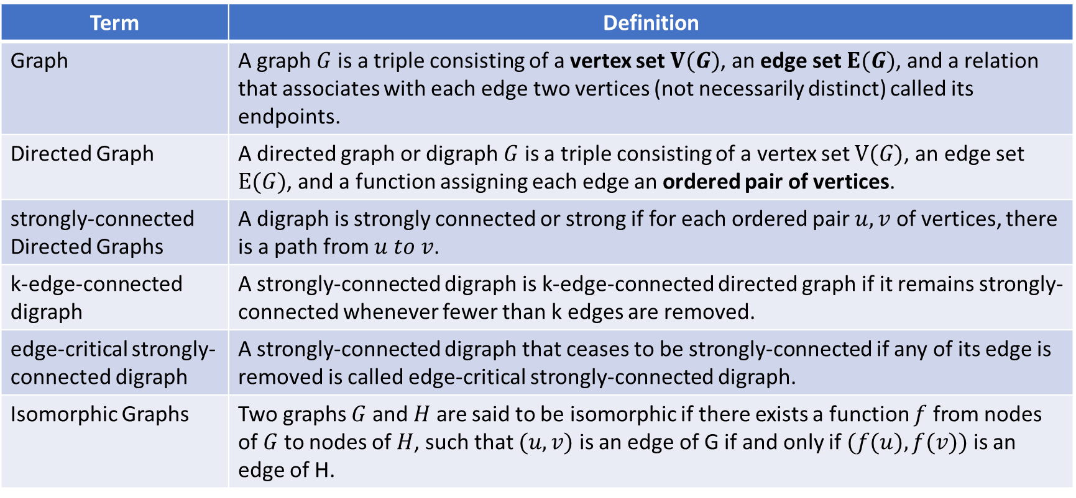
Definitions-Summary
Term | Definition
Graph | A graph $G$ is a triple consisting of a vertex set $V(G)$, an edge set $E(G)$, and a relation that associates with each edge two vertices (not necessarily distinct) called its endpoints.
Directed Graph | A directed graph or digraph $G$ is a triple consisting of a vertex set $V(G)$, an edge set $E(G)$, and a function assigning each edge an ordered pair of vertices.
strongly-connected Directed Graphs | A digraph is strongly connected or strong if for each ordered pair $u, v$ of vertices, there is a path from $u to v$.
k-edge-connected digraph | A strongly-connected digraph is k-edge-connected directed graph if it remains strongly-connected whenever fewer than k edges are removed.
edge-critical strongly-connected digraph | A strongly-connected digraph that ceases to be strongly-connected if any of its edge is removed is called edge-critical strongly-connected digraph.
Isomorphic Graphs | Two graphs $G$ and $H$ are said to be isomorphic if there exists a function $f$ from nodes of $G$ to nodes of $H$, such that $(u,v)$ is an edge of G if and only if $(f(u),f(v))$ is an edge of H.

Slide 11

Objective
Find an algorithm to generate all prime (edge-critical strongly-connected) directed graphs of $n+1$ nodes given a set of all prime digraphs of $n$ nodes.
Using the prime digraphs or otherwise generate a random strongly-connected directed graph for a given number of nodes.

Slide 12
Tools at hand
Following algorithms/tools that have been studied in detail is assumed to be present at hand for achieving the mentioned objectives.
Isomorphism test^{[7]}: An algorithm that tests whether the two input graphs are isomorphic to each other or not. It does so by finding all matching node candidates for a given node and then running isomorphism test on the remaining subgraph iteratively.
Weisfeiler Lehman Isomorphism hash^{[8]} – A hashing algorithm on graph such that different hash for two graphs implies non-isomorphism among the graphs with very high probability. However, the converse is not true i.e. two non-isomorphic graph can have same hash.

Slide 13
Tools at hand
strong-connection test^{[8,9]}: An algorithm that tests whether the given graph is strongly-connected or not. It does so by finding the strongly connected components using Depth First Search algorithm. It is referred as is_strongly_connected(digraph)
Prime test ^{[5]}: An algorithm that tests whether given graph is edge-critical strongly-connected or not. It does so by removing an edge and checking for strong-connectedness. This is done for all edges. It is referred as is_prime(digraph)
Note: Tools 1,2, and 3 are available in the networkx package. 4th tool is available on link mentioned in reference.

Slide 14
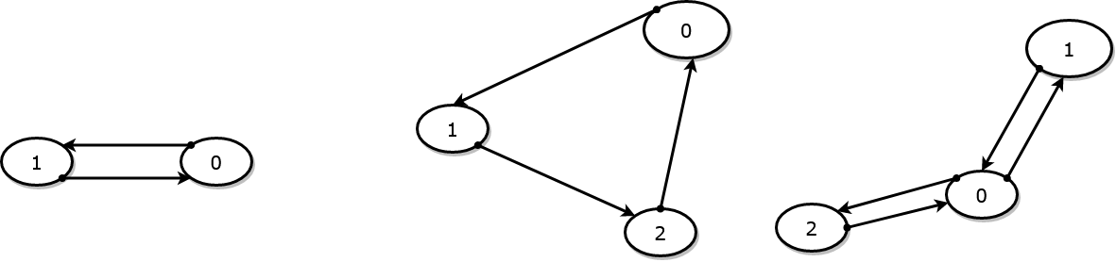
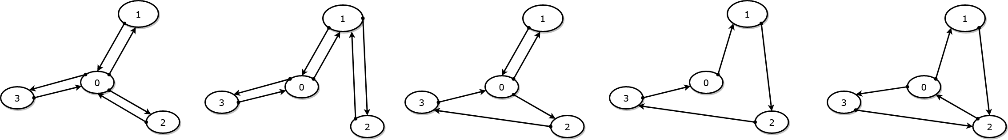
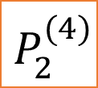
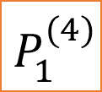
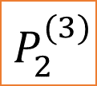
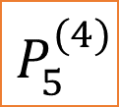
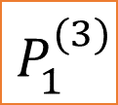
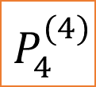
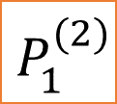
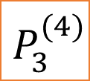
All prime digraphs of 2,3, and 4 nodes
$$P_{1}^{(2)}$$
$$P_{1}^{(3)}$$
$$P_{2}^{(3)}$$
$$P_{1}^{(4)}$$
$$P_{2}^{(4)}$$
$$P_{3}^{(4)}$$
$$P_{4}^{(4)}$$
$$P_{5}^{(4)}$$

Slide 15
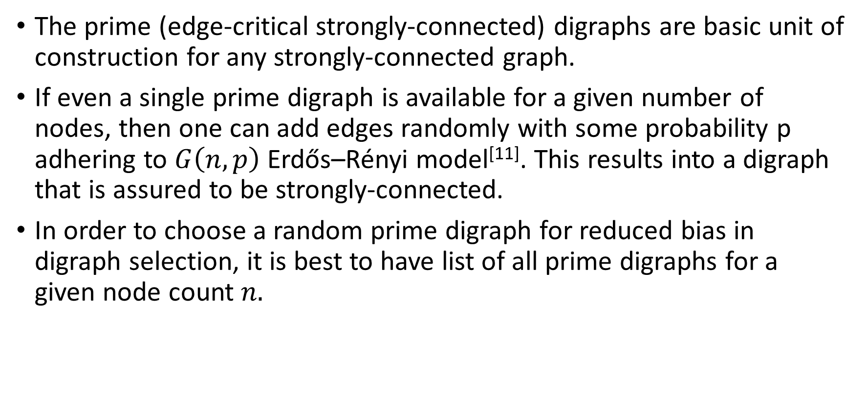
Motivation of Prime digraphs
The prime (edge-critical strongly-connected) digraphs are basic unit of construction for any strongly-connected graph.
If even a single prime digraph is available for a given number of nodes, then one can add edges randomly with some probability p adhering to $G\left(n,p\right)$ Erdős–Rényi model^{[11]}. This results into a digraph that is assured to be strongly-connected.
In order to choose a random prime digraph for reduced bias in digraph selection, it is best to have list of all prime digraphs for a given node count $n.$

Slide 16
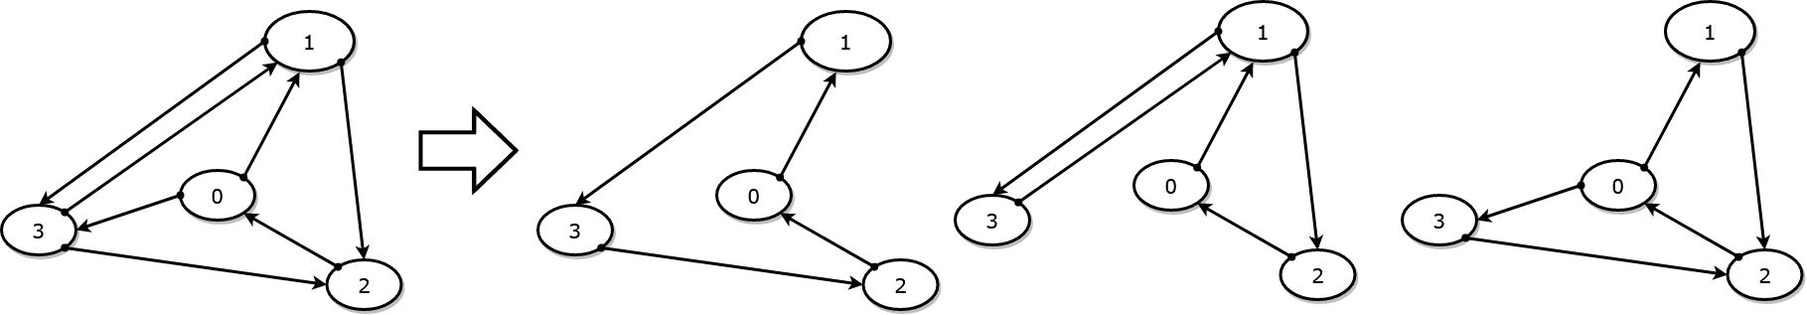





Algorithm I – Reduce to Primes
An algorithm “reduce_to_primes” is described below that finds all prime digraphs formed by removing one or more edges of the input digraph $G.$
Code present at: https://github.com/oyeluckydps/directed_graph/blob/master/prime_DiGraph_Generator.py in find_primes(DG, already_checked_cdg = None) function.
$$G$$
$$P_{4}^{(4)}$$
$$P_{3}^{(4)}$$
$$P_{5}^{(4)}$$

Slide 17
Algorithm I – Reduce to Primes
List of already checked digraphs
def reduce_to_primes(digraph, already_checked_digraphs):
if not is_strongly_connected(digraph):
return ([], already_checked_digraphs)
if isomorphic_graph_exists(already_checked_digraphs, digraph):
return ([], already_checked_digraphs)
else:
already_checked_digraphs.append(digraph)
if is_prime(digraph):
return ([digraph], already_checked_digraphs)
reduced_primes_on_this_digraph = []
for edge in digraph.edge_list:
digraph_temp = digraph.remove_edge(edge)
primes_for_this_edge_removal, already_checked_digraphs = reduce_to_primes(DG_temp, already_checked_digraphs)
reduced_primes_on_this_digraph.add_to_list(primes_for_this_edge_removal)
return (reduced_primes_on_this_digraph, already_checked_digraphs)
Return empty list if digraph is not strongly connected.
True if digraph (or its isomorph) is already checked, so present in list
Returns True if digraph is prime.

Slide 18
Algorithm I – Explanation
If the digraph is not strongly-connected or it has already been checked, an empty list is returned.
If the digraph is prime, return the digraph in a list.
The algorithm used Depth First Search to reduce input digraph into its prime if none of the above criteria is met.
It removes one edge at a time and calls itself (Algorithm I) with the digraph after edge removal. The output is concatenated to a list for all edges that are removed in iteration. The list is returned in output.
already_checked_digraphs may be implemented as a dict with key as the Weisfeiler Lehman hash and value being list of all graphs with given hash.

Slide 19
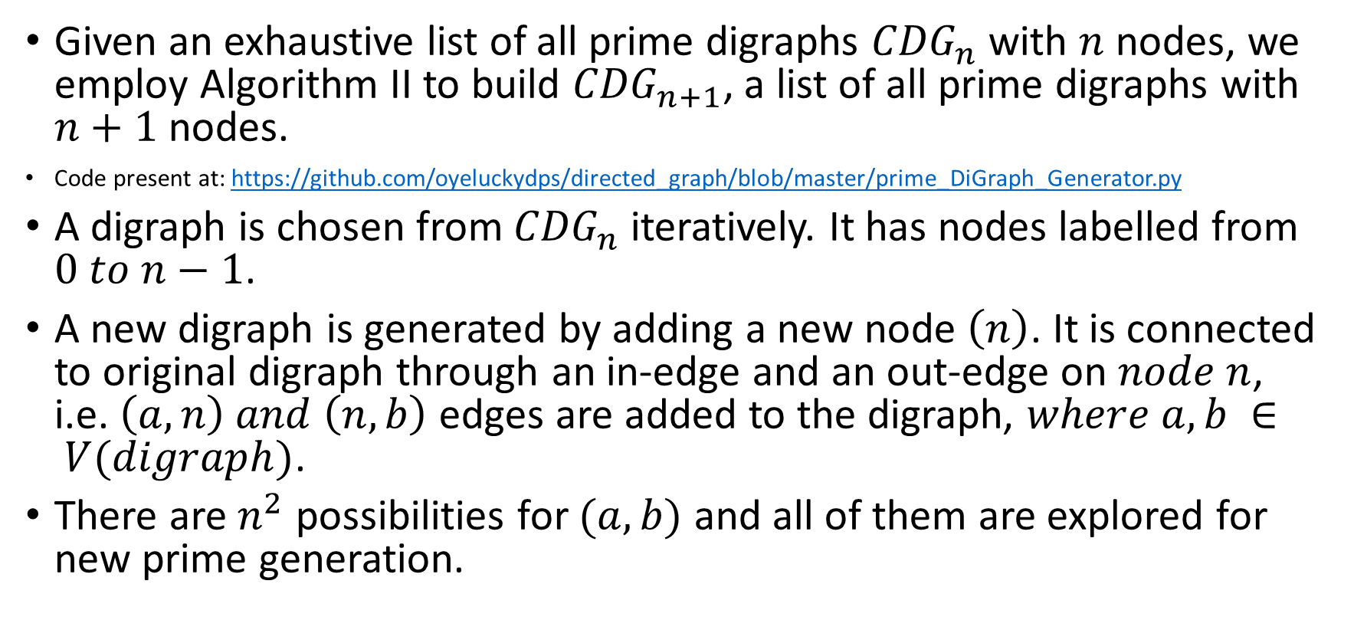
Algorithm II – Find all prime digraphs
Given an exhaustive list of all prime digraphs ${CDG}_{n}$ with $n$ nodes, we employ Algorithm II to build ${CDG}_{n+1}$, a list of all prime digraphs with $n+1$ nodes.
Code present at: https://github.com/oyeluckydps/directed_graph/blob/master/prime_DiGraph_Generator.py
A digraph is chosen from ${CDG}_{n}$ iteratively. It has nodes labelled from $0 to n−1$.
A new digraph is generated by adding a new node $\left(n\right)$. It is connected to original digraph through an in-edge and an out-edge on $node n$, i.e. $\left(a, n\right) and \left(n,b\right)$ edges are added to the digraph, $where a,b ∈ V(digraph)$.
There are $n^{2}$ possibilities for $(a,b)$ and all of them are explored for new prime generation.

Slide 20
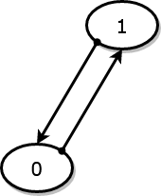
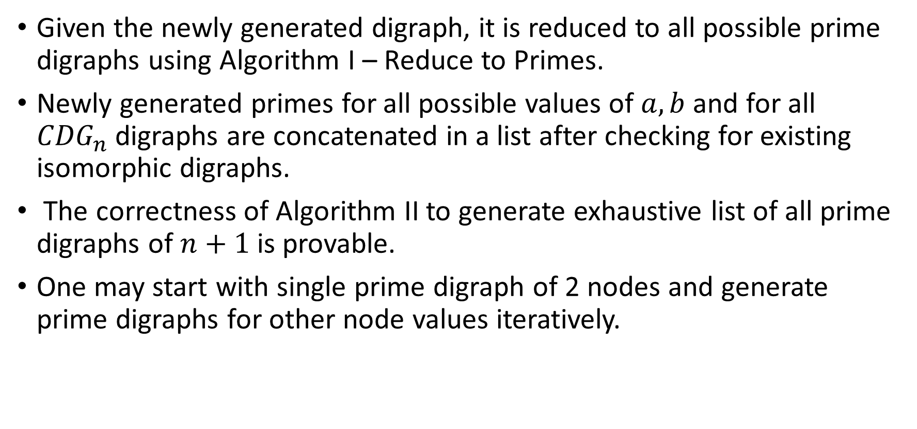

Algorithm II – Find all prime digraphs
Given the newly generated digraph, it is reduced to all possible prime digraphs using Algorithm I – Reduce to Primes.
Newly generated primes for all possible values of $a, b$ and for all ${CDG}_{n}$ digraphs are concatenated in a list after checking for existing isomorphic digraphs.
The correctness of Algorithm II to generate exhaustive list of all prime digraphs of $n+1$ is provable.
One may start with single prime digraph of 2 nodes and generate prime digraphs for other node values iteratively.
$$P_{1}^{(2)}$$

Slide 21
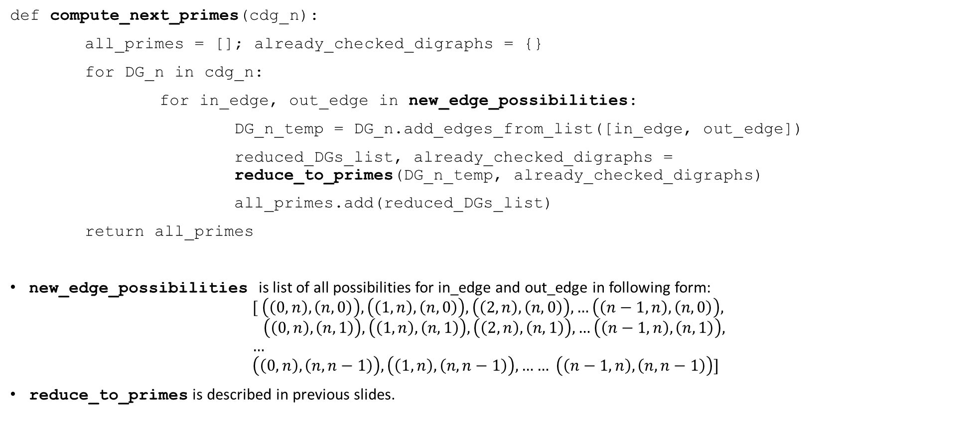
Algorithm II – Find all prime digraphs
def compute_next_primes(cdg_n):
all_primes = []; already_checked_digraphs = {}
for DG_n in cdg_n:
for in_edge, out_edge in new_edge_possibilities:
DG_n_temp = DG_n.add_edges_from_list([in_edge, out_edge])
reduced_DGs_list, already_checked_digraphs = reduce_to_primes(DG_n_temp, already_checked_digraphs)
all_primes.add(reduced_DGs_list)
return all_primes
new_edge_possibilities is list of all possibilities for in_edge and out_edge in following form:
$$[ \left(\left(0,n\right), \left(n,0\right)\right),\left(\left(1,n\right), \left(n,0\right)\right),\left(\left(2,n\right), \left(n,0\right)\right), …\left(\left(n−1,n\right), \left(n,0\right)\right), \\ \left(\left(0,n\right), \left(n,1\right)\right),\left(\left(1,n\right), \left(n,1\right)\right),\left(\left(2,n\right), \left(n,1\right)\right), …\left(\left(n−1,n\right), \left(n,1\right)\right), \\ … \\ \left(\left(0,n\right), \left(n,n−1\right)\right),\left(\left(1,n\right), \left(n,n−1\right)\right), …… \left(\left(n−1,n\right), \left(n,n−1\right)\right)]$$
reduce_to_primes is described in previous slides.

Slide 22
Result: Find all prime digraphs
Algorithm II was used to generate all prime digraphs for 2 to 10 nodes. It can be found at: https://github.com/oyeluckydps/directed_graph/blob/master/using_isomorphic_hashCDG.csv
Count of prime digraphs for given number of nodes is:
Number of nodes | Total Prime Digraphs
2 | 1
3 | 2
4 | 5
5 | 15
6 | 63
7 | 288
8 | 1526
9 | 8627
10 | 52021

Slide 23
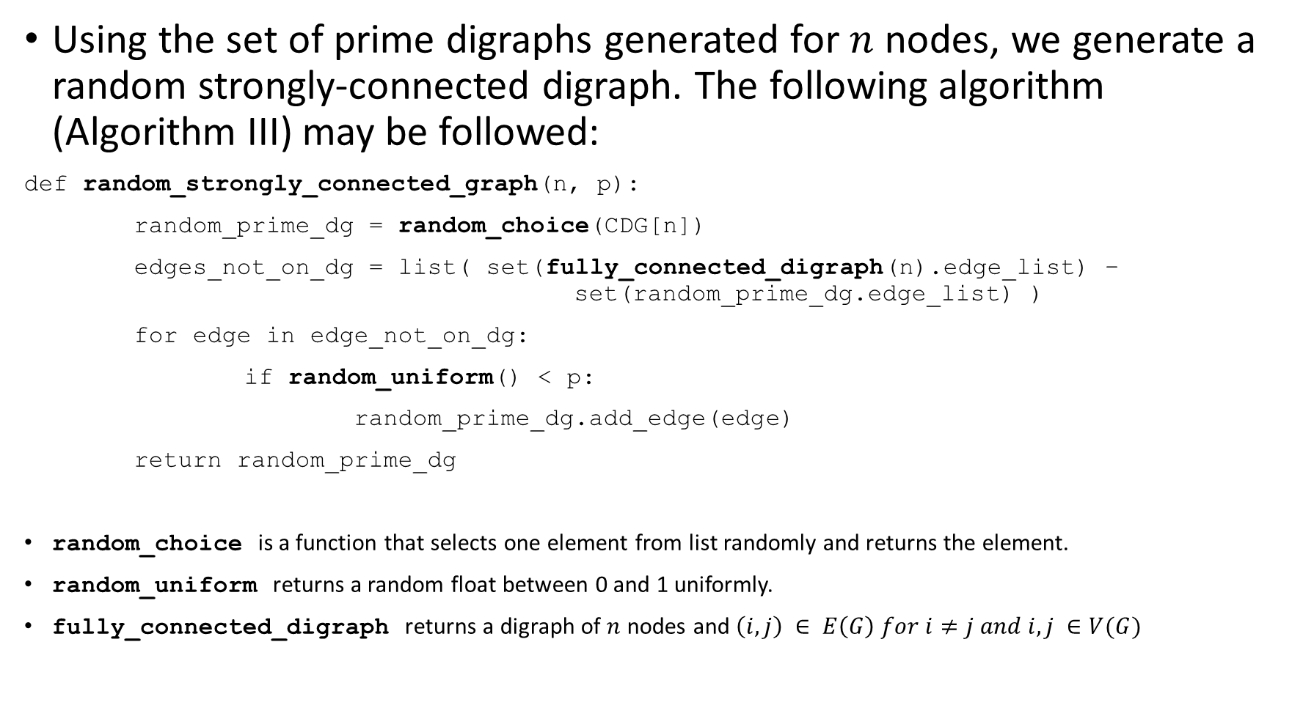
Algorithm III - Random strongly-connected digraph
Using the set of prime digraphs generated for $n$ nodes, we generate a random strongly-connected digraph. The following algorithm (Algorithm III) may be followed:
def random_strongly_connected_graph(n, p):
random_prime_dg = random_choice(CDG[n])
edges_not_on_dg = list( set(fully_connected_digraph(n).edge_list) – set(random_prime_dg.edge_list) )
for edge in edge_not_on_dg:
if random_uniform() < p:
random_prime_dg.add_edge(edge)
return random_prime_dg
random_choice is a function that selects one element from list randomly and returns the element.
random_uniform returns a random float between 0 and 1 uniformly.
fully_connected_digraph returns a digraph of $n$ nodes and $\left(i,j\right) ∈ E\left(G\right) for i≠j and i,j ∈V(G)$

Slide 24
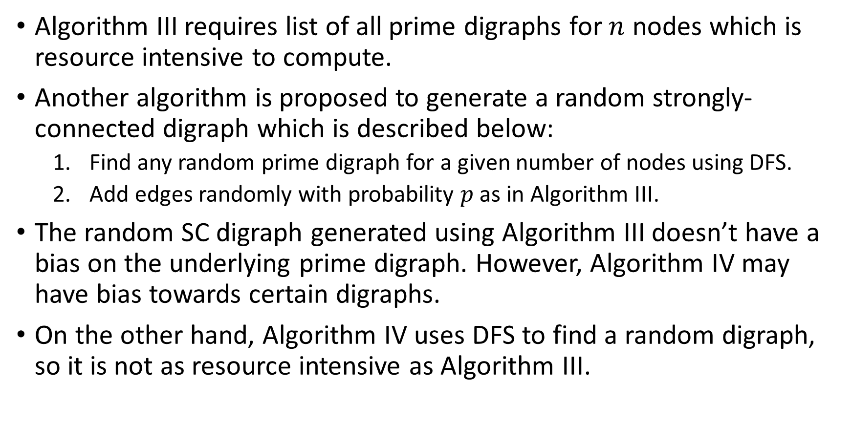
Algorithm III/IV
Algorithm III requires list of all prime digraphs for $n$ nodes which is resource intensive to compute.
Another algorithm is proposed to generate a random strongly-connected digraph which is described below:
Find any random prime digraph for a given number of nodes using DFS.
Add edges randomly with probability $p$ as in Algorithm III.
The random SC digraph generated using Algorithm III doesn’t have a bias on the underlying prime digraph. However, Algorithm IV may have bias towards certain digraphs.
On the other hand, Algorithm IV uses DFS to find a random digraph, so it is not as resource intensive as Algorithm III.

Slide 25
Algorithm IV - Random prime generator
def random_prime_generator(digraph):
if not is_strongly_connected(digraph):
return None
if is_prime(digraph):
return digraph
edge_list = set(digraph.edge_list); already_removed_edge = set()
not_tested_edges = edge_list - already_removed_edge
while len(not_tested_edges) > 0:
edge_to_remove = random_choice(list(not_tested_edges))
digraph_temp = digraph.remove_edge(edge_to_remove)
not_tested_edges = not_tested_edges.remove_edge(edge_to_remove)
prime_digraph = random_prime_generator(digraph_temp)
if prime_digraph is not None:
return prime_digraph
return None
All highlighted functions have already been discussed in previous slides.

Slide 26
Algorithm IV - Random prime generator
At first glance Algorithm IV seems very similar to Algorithm I. The key difference between the two being
Algorithm I – Reduce to Prime Digraphs returns a list of all primes the may can form the input digraph while Algorithm IV return only one prime after reduction of the input digraph.
Algorithm I iterates over all edges of input digraph and it must check all possible digraphs in the search tree, however, Algorithm IV returns the first prime that it is able to find during search on the tree.
Algorithm I is deterministic in nature and will always return same collection of prime digraphs for a given input, while Algorithm IV is probabilistic in nature.
An implementation of Algorithm IV may be found at: https://github.com/oyeluckydps/directed_graph/blob/master/random_DiGraph_generator.py

Slide 27
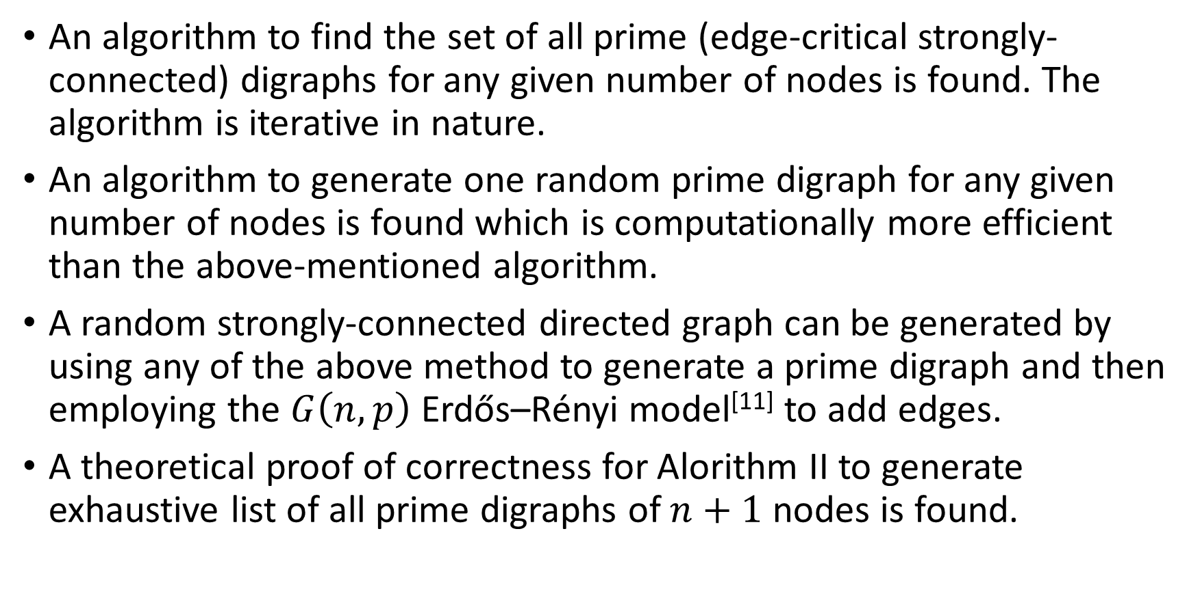
Conclusion
An algorithm to find the set of all prime (edge-critical strongly-connected) digraphs for any given number of nodes is found. The algorithm is iterative in nature.
An algorithm to generate one random prime digraph for any given number of nodes is found which is computationally more efficient than the above-mentioned algorithm.
A random strongly-connected directed graph can be generated by using any of the above method to generate a prime digraph and then employing the $G\left(n,p\right)$ Erdős–Rényi model^{[11]} to add edges.
A theoretical proof of correctness for Alorithm II to generate exhaustive list of all prime digraphs of $n+1$ nodes is found.

Slide 28
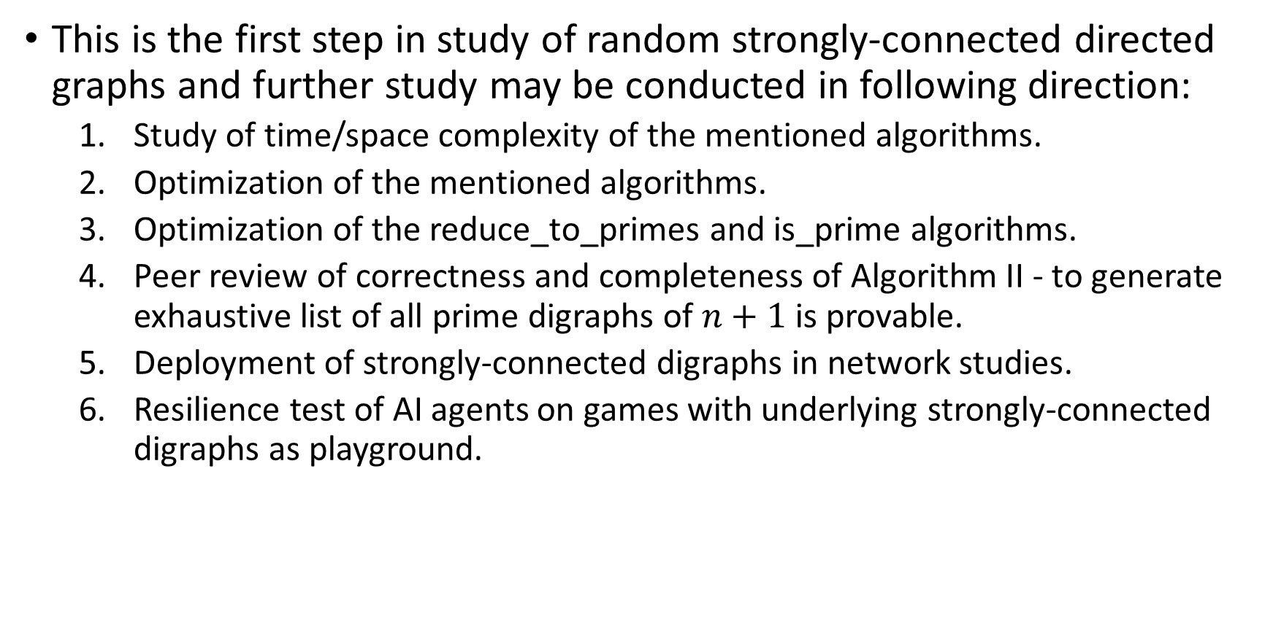
Further study
This is the first step in study of random strongly-connected directed graphs and further study may be conducted in following direction:
Study of time/space complexity of the mentioned algorithms.
Optimization of the mentioned algorithms.
Optimization of the reduce_to_primes and is_prime algorithms.
Peer review of correctness and completeness of Algorithm II - to generate exhaustive list of all prime digraphs of $n+1$ is provable.
Deployment of strongly-connected digraphs in network studies.
Resilience test of AI agents on games with underlying strongly-connected digraphs as playground.

Slide 29
Reference
Douglas B West (2001). 1.1.2 Introduction to Graph Theory. Pearson Education, Inc
Douglas B West (2001). 1.4.2 Introduction to Graph Theory. Pearson Education, Inc
Douglas B West (2001). 1.4.12 Introduction to Graph Theory. Pearson Education, Inc
Wikipedia contributors (2022a, June 25). K-edge-connected graph. https://en.wikipedia.org/wiki/K-edge-connected_graph
Verma, A. Kumar (2022, December 11). Directed Graph and analysis. GitHub. https://github.com/oyeluckydps/directed_graph
Wikipedia contributors (2022c, November 28). Graph isomorphism. Wikipedia. https://en.wikipedia.org/wiki/Graph_isomorphism
L. P. Cordella, P. Foggia, C. Sansone, M. Vento (2001). “An Improved Algorithm for Matching Large Graphs”, 3rd IAPR-TC15 Workshop on Graph-based Representations in Pattern Recognition, Cuen, pp. 149-159. https://citeseerx.ist.psu.edu/viewdoc/summary?doi=10.1.1.101.5342
Shervashidze, Nino, Pascal Schweitzer, Erik Jan Van Leeuwen, Kurt Mehlhorn, and Karsten M. Borgwardt (2011). Weisfeiler Lehman Graph Kernels. Journal of Machine Learning Research. http://www.jmlr.org/papers/volume12/shervashidze11a/shervashidze11a.pdf

Slide 30
Reference
R. Tarjan (1972). Depth-first search and linear graph algorithms. SIAM Journal of Computing 1(2):146-160.
E. Nuutila and E. Soisalon-Soinen (1994). On finding the strongly connected components in a directed graph. Information Processing Letters 49(1): 9-14
Erdős, P.; Rényi, A. (1959). "On Random Graphs. I" (PDF). Publications Mathematicae. 6: 290–297.

