Slide 1
Miniature Rheostat
Team Flux

Slide 2
Objective:
To develop a rheostat that has range of 0.1Ω to 10^6 Ω and can be employed in Robotics, PCB, and testing of circuits (breadboards).

Slide 3
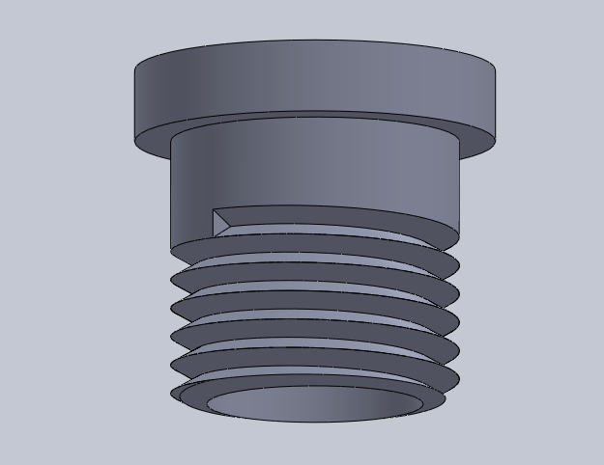
Methodology:
We intend to develop the rheostat in parts.
1.) Cap part: Plastic cast that has pointer.

Slide 4
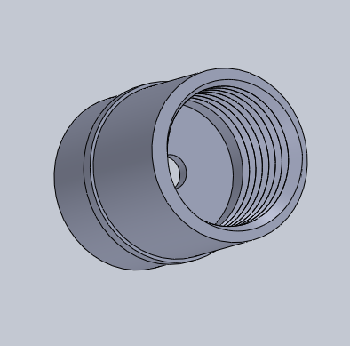
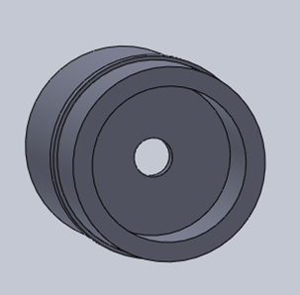
2.) Side part: It has grooves and base and it finally gets attached to base part. It also has the neck through which pointer is held.

Slide 5
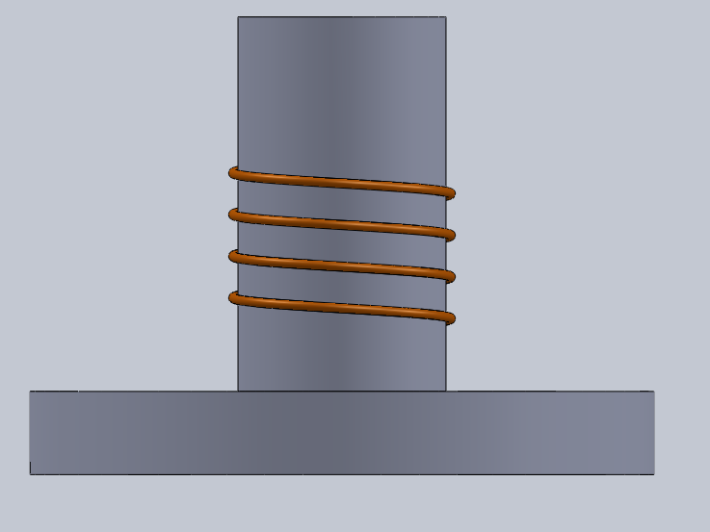
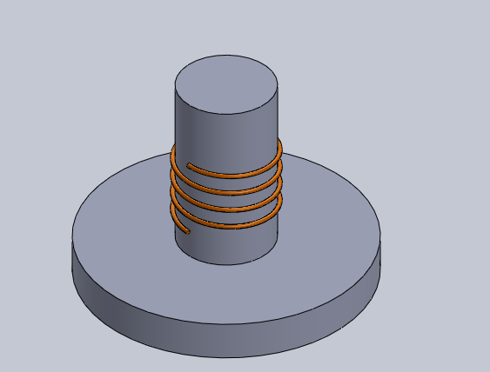
3.) Base part: It has different material wires wrapped on screw groove. This works as the wire on rheostat. It also has the terminals.

Slide 6
Details of Design and Materials and other features
CORE
The basic design consists of a core with a composite wire made of wires with different resistivity wound on it. The core can be made of porcelain or ceramic, when in production finally but initially we use ABS, PLA, PET etc that can be 3-D printed from the facility already available in our institute.

Slide 8
Then after initial testings with thermoplastics, we also test ULTEM 1010 which can be bought from STRATASYS(Bangalore), an online website. This will result in:-
Glass Transition temperature of 215C.
Heat Deflection temperature at 264psi is 213C.
Volume resistivity is of order 10^14.
Dielectric constant 2.67

Slide 9
These materials are chosen for core because their hardness and toughness does not get affected much because of continuous absorbing and releasing of heat(especially ULTEM 1010).
This material also has high specific heat.

Slide 10
WIRES IN RHEOSTAT
As our rheostat works on a wide range so it has wires of different materials put on the core in helical style. The helix has the same pitch as that of cap so that the pointer which is attached to the cap remains in contact with the wire. The wires used for 1-10 ohm is constantan, for 10-100 ohm a is nichrome and for 100-1000 ohm is mangenese*.

Slide 12
We will be working on wires of diameter already available in market for early experiments and then if necessary for better precision drawing of wire is also considered.
The width of width is taken after calculations on helical path. Due to non-availability of all wire diameters we have also considered the possibility and changing the core diameter with height.

Slide 13
Pointer
The rheostat has a point that is attached to the cap part of the rheostat and it goes through a hole in the base part of rheostat to the wire on the core that is the rheostat wire.
The material for pointer will be copper (and some tests with aluminium too). To make the pointer we used a 22gauge/16oz copper sheet that has thickness of about 0.55mm, This is standard sheet and it is

Slide 14
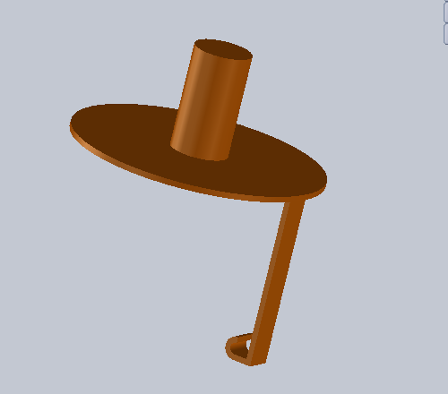
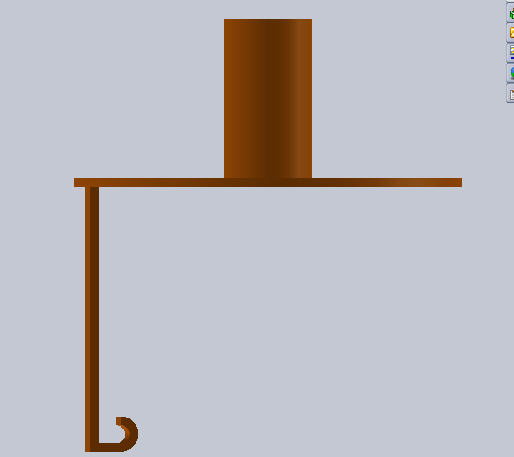

Slide 15
easily available online. It may also be available in local market. Same goes for aluminium sheet. We need two tools
>MULTITEC Palm Nipper Micro Shear
>AGRICART PROFESSIONAL HEDGE SHEAR STRAIGHT
For working on the plates to produce desirable chips.

Slide 16
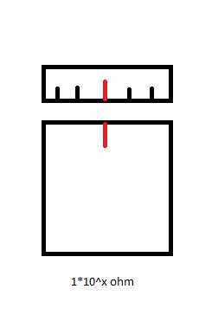
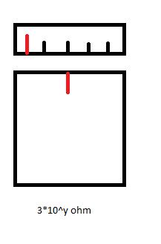
Scale on Rheostat
The cap of rheostat has marking that tell the current resistance offered by the rheostat. Each marking is at 40deg.

Slide 17
And then we decide the value of x and y that is the EXPONENT by number of colours visible on threads of body of rheostat. When the rheostat is rotated for first 360 degrees only one colour is visible and second colour is visible for the second round and so on.
The colours displayed with each turn are BLACK, BROWN, RED, ORANGE, YELLOW, GREEN, BLUE, VIOLET, GREY, WHITE.

Slide 18
Problems that we are still working on:-
We are still working on the following problems and trying to get their solution as soon as possible.
Finding a mentor: This has been a challenge for us because none of the faculty has complete expertise on this subject so people are a bit reluctant in joining us. There are many issues that needs to be handled.

Slide 19
Way to join the metal joins on helical path: This is a major issue and we have already contacted Assistant Professor. Jinu Paul of Mechanical Science department. He might help us with other manufacturing issues too.
Choice of material: Since we need material of different resistivity over a wide range, it is not easy to get all materials single-handedly so we are in contact with two faculty members of

Slide 20
Metallurgy and material science department.
Manufacturing challenges: There are many manufacturing challenges that needs to be addressed at earliest like improving the design of pointer so that it can be achieved easily and how the actual result will be manufactured etc. We are in Contact with Assistant Professor. Jinu Paul for that.

Slide 21
Timeline and Plan of activities.
We are almost ready with the prototype and dimensions of the rheostat and we are working on its manufacturing details.
First month we will be constructing a basic working model of the rheostat.
Second month we will focus on the size of rheostat. We will try to reduce it as much as possible by using all the different shapes of material strips that offer the resistance.

Slide 22
Third month efforts will be made to increase the efficiency and accuracy of the instrument.
By the end of fourth month we will come up with the final and fully completed rheostat.

Slide 23
Team members and role:
Abhinav Kumar Verma: The work will be mainly to keep team on track. He will supervise the team and work mainly on product development.
Omkar Gabhale: He will be the person developing the product and doing AUTO CAD for 3D printers.

Slide 24
Anukul Kumar: He will be overlooking all the presentations and other relations along with the final product design. He will also take care of manufacturing details.
Vatte Vineeth Reddy: He work is mainly to look into materials and their properties and decide the suitable ones for the rheostat.

Slide 25
Deliverable:
A rheostat of size at maximum (2.5cm in length and 2cm in diameter) and range 1-10^6 ohm that can be employed on PCBs, testing of circuits(breadboards) and robotics.

Slide 26
How is our rheostat beneficial over other product
There are very few or none miniature rheostat that vary resistance exponentially in market. This results in a very large range of operation from 1-10^6ohm. There are rheostats of 1Mega-ohm available in market but You can’t use them over any other range. On the other hand You can use this rheostat for a range of 10ohm, 500ohm, 1000ohm or for whatever range You wish.

Slide 27
There are again some or none rheostats with graduated markings for hinting actual value of resistance on which the rheostat is set. Our rheostat achieves this easily by markings on the cap and different colours used on the threads of body and cap

Slide 28
What we need for this project
We would be requiring access to following facilities already available in Institute
>3-D printing facility in STEP.
>Metal sheet cutting facility.
>Other facilities as and when required from material science department.

Slide 29
We would be requiring these products for routine activity.
>Copper and aluminium Sheet
>Metal shears
>Vernier Caliper
>Micrometer
>Multimeter
>Nichrome, constantan, Magnin and mangenese wire of different guages.
>Soldering Kit

Slide 30
Thank You!

