Slide 1
Session -02
Index
Installation
AEM Instances – Author, Publish and Dispatcher
Run Modes
Demo - AEM Folder Structure
Demo - Modes of AEM – Classic vs Touch
Demo - Authoring and Publish
Question and Answers

Slide 2
Installation
For Installation of AEM follow the user guide provided for this session.

Slide 3
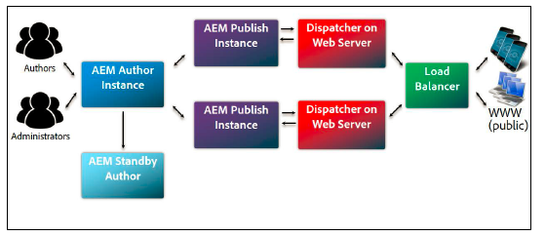
AEM Instances – Author, Publish and Dispatcher
Author -:
Publish -:
Dispatcher -:
An AEM instance used to create, upload and edit content, and administer the website. After content is ready to go live, it is replicated to the Publish instance.
Inside the organization's firewall.
It provides an easy GUI for the tasks and uses the port 4502 by default.
An AEM instance that serves the published content to the public.
The default port used by the instance is 4503
A Static web server augmented with the AEM.
It caches webpages produced by the publish instance to improve performance.
It can also handles security and load balancing.
The author and publish instances are the same software stack but two different run modes.

Slide 4
Run Modes
Installation Run Modes -:
author
publish
samplecontent
nosamplecontent
Custom Run Modes -:
Any name can be provided example -: dev, qa, uat, prod, yourname etc.

Slide 5
Demo - AEM Folder Structure
In this demo familiarize yourself with the repository. Different sections (apps, dam, libs, conf etc.) of the repository.

Slide 6
Demo - Modes of AEM, Classic vs Touch
In this demo understand the what is classing UI and what is touch UI.
Note -: Support for classing UI interface has been stopped.

Slide 7
Demo - Authoring and Publish
In this demo how authoring is performed on a page and then publish the authored page to see it reflecting on the publish instance.

Slide 8
Question and Answers

