Slide 1
Session -1
Index
Content Management System
Overview of AEM
Features of Adobe Experience Manager
Role based pre-requisites for AEM
AEM Architecture Overview
AEM Technology Stack – Basics
Granite Introduction
OSGi Introduction
JCR Introduction
Apache Sling Introduction
Functional Building Blocks of AEM
Demo – Various AEM Consoles
Demo – walkthrough over various application modules
Demo – walkthrough over various consoles
Questions and Answers

Slide 2
Content Management System
What is a Content Management System ?
CMS is a software application or set of related programs that are used to create and manage digital content. Typically two CMS comes in our mind
1. Enterprise content management (ECM) -: An ECM facilitates collaboration in the workplace by integrating document management, digital asset management and records retention functionalities, and providing end users with role-based access to the organization's digital assets.
Examples -: DocuSign, OpenText, Oracle WebCenter, IBM FileNet, Doc Send, M Files. Etc.
2. Web content management (WCM) -: A WCM facilitates collaborative authoring for websites. Where content of website is updated frequently.
Examples -: WordPress, Drupal, Sitecore, Joomla, SharePoint, AEM etc.

Slide 3
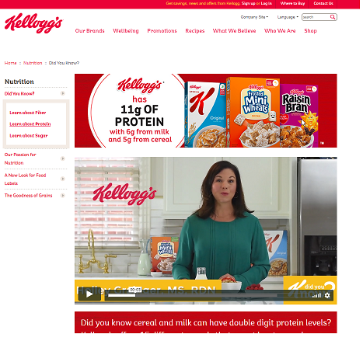
Content Management System
It provides website authoring, collaboration, and administration tools that helps users with little knowledge of web programming languages or mark-up languages create and manage website content. Site content can be of any type from text, images, videos, pdfs etc.
Text
Image
Video

Slide 4
Adobe Experience Manager - Overview
AEM is highly capable content management system. Also, One of the leading digital experience management solution for marketers and IT to design, anticipate and deliver quickly adaptable experiences across web, mobile, in store and any end point in the customer journey.
AEM is based on Components and templates
Allows java base development
Any One can author and update sites. No development knowledge required.
Easy Maintenance
Easy publish data to production
Easy integration with third party applications

Slide 5

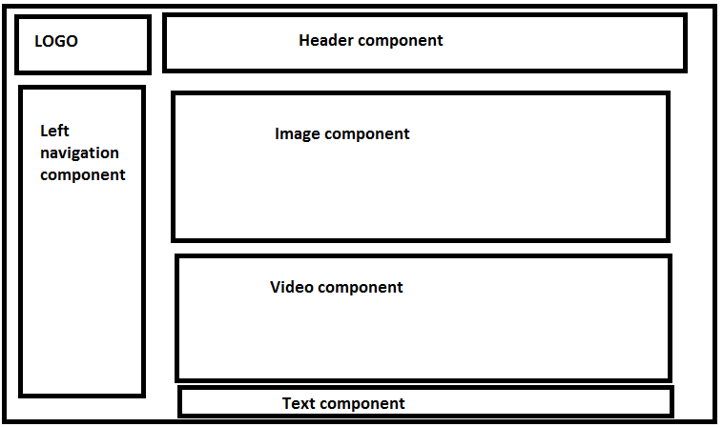
How Website developed in AEM
A web page after adding different component on a page created using a template
AEM Template – A skeleton to create multiple pages using different component.

Slide 6



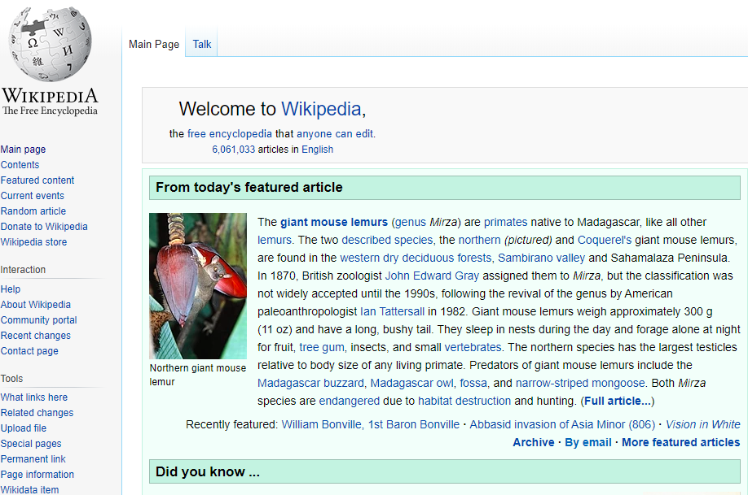
Website development process in AEM
Developers
Content authors
Content approvers
Live site
Note -: Other than website development there are many other features which makes AEM market leader. Let’s see them.

Slide 7
Features of Adobe Experience Manager
Few of the features which makes AEM as one of the topmost content management system are
Out of the box components for rapid development
Content editing features even from distributed locations
Multisite management for any locale
Easy integration with third party applications
Authoring enabled from mobile and tablets
Digital asset management
Integration within the Adobe marketing cloud
Personalization features
Workflows & schedulers
Marketing campaigns
Securities in all level
Best product support
AEM as cloud
Cloud manager integration to help different cycles of project development (CI, CD etc.)
AEM as headless CMS
Single page application support

Slide 8
Role based pre-requisites for AEM
Note -: For any role basic understanding of any Content management System
Developer -:
  Frontend/UI developer
    JavaScript
    HTML, CSS/Bootstrap/Responsive Design
    HTL/slightly- understanding
    Java-understanding
  Backend/Services/Integration Developer
    Java
    JSP/Servlets
    HTL/slightly - understanding
    HTML, CSS, JavaScript -understanding
Tools for developer -:
Setup
JDK
AEM Quick start jar file
Development
Eclipse/IntelliJ,
Maven,
GIT or any source control
Jenkins or any CI/CD tool
Additional
Artifactory,
Apache web server,
Analytics,
Target,
Lucene
Tomcat/Jboss.

Slide 9
Role based pre-requisites for AEM
Note -: For any role basic understanding of any Content management System
QA -:
  Good to have knowledge on
    Jenkins or CI/CD tool
    JIRA or any other document tool
    Basic understanding of web development cycle
Marketing/Sales People -:
  Good to have knowledge on
    Campaign
    Analytics
    Target/Personalization
Quick reference to understand Adobe marketing cloud
https://www.youtube.com/watch?v=hxbADwtWtcY

Slide 10
AEM Architecture Overview
AEM is a content management system for building websites, content services, and forms. It is a web-based client-server system made up of number of infrastructure-level and application-level functions. You can use these infrastructure and application-level building blocks to create customized solutions by building the required applications.
Infrastructure-Level Functions -:
Web Application Server : You can deploy AEM in standalone mode or as a web application within a third-party application server, such as WebLogic and WebSphere. The standalone mode includes an integrated Jetty web server.
Web Application Framework : AEM has a Sling web application framework that helps simplify the writing of REST, content-oriented web applications.
Content Repository : AEM includes a Java Content Repository (JCR), a type of hierarchical database designed specifically for unstructured and semi-structured data.
Application-Level Functions -:
Websites
Content Services
Forms
Digital Assets
Communities
Online Commerce

Slide 11
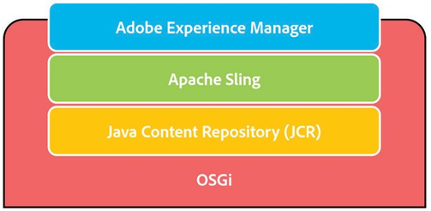
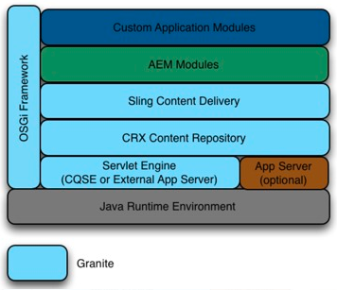
AEM Technology Stack - Basics
AEM is a java web application and is based on technologies such as Open Service Gateway Initiative (OSGI), Java Content repository (JCR), and Apache Sling.
The following diagram is a high-level view of the architecture stack.
Granite Platform -: Granite is Adobe’s open web stack and AEM is built on the Granite Platform.

Slide 12
AEM Technology Stack – Granite platform
Granite is a general-purpose platform for building robust scalable applications. It supports an “open architecture”, which is based on both “open standards” (JCR and OSGi) and “open source” projects (Apache Sling and Apache Jackrabbit). AEM is built on the Granite platform.
Technically, at the core, Granite provides:
An application launcher : Quickstart for deployment in existing servlet containers or Application servers.
An OSGi Framework : into which everything is deployed.
A number of OSGi services to support building applications : Log Service, Http Service, Event Admin Service, Configuration Admin Service, Declarative Services, and Metatype Service.
A comprehensive Logging Framework providing various logging APIs: SLF4j, Log4F, Apache Commons Logging and OSGi Log Service.
The JCR API Specification, based on Apache Jackrabbit and OSGified for Granite.
The Apache Sling Web Framework.
NOTE -: Granite is a platform.

Slide 13
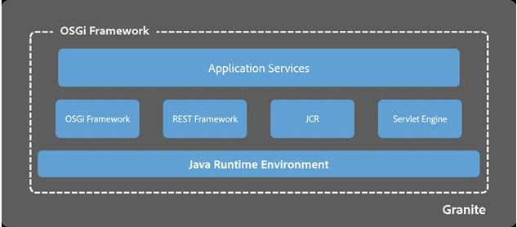
AEM Technology Stack – OSGi Framework
OSGi enables a collaborative and modular environment, where each application may be built and implemented as a small bundle. Each of these bundles is a collection of tightly coupled, dynamically loadable classes, JAR files, and configuration files that explicitly declare their external dependencies.
NOTE -: OSGi is a framework, its implementation is Felix which is what is used in AEM.

Slide 14
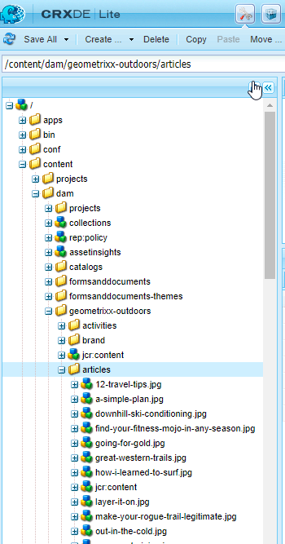
AEM Technology Stack – Java Content Repository (JCR)
The JCR, specifically JSR-283 (Java Specification Request-283), is a database that supports structured and unstructured content, versioning, and observation. All data pertaining to Adobe Experience Manager such as HTML, CSS, JS/Java, Images, and Videos are stored in the JCR object database.
The JCR, specifically JSR-283 (Java Specification Request-283), is a database that supports structured and unstructured content, versioning, and observation. All data pertaining to Adobe Experience Manager such as HTML, CSS, JS/Java, Images, and Videos are stored in the JCR object database.
NOTE -: Adobe implementation of JSR-283 is CRX(Content Repository extreme). CRX is phased out from version 6.0 and its updated version is called Apache Jackrabbit OAK.

Slide 15
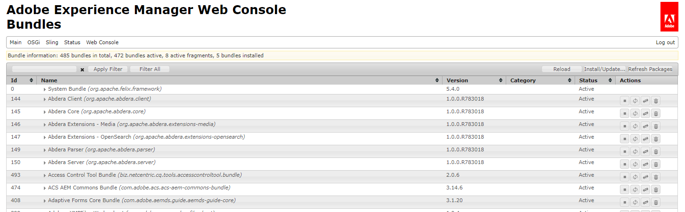
AEM Technology Stack – Apache Sling
Apache Sling is a web application framework for content-centric applications and uses a java Content Repository (such as Apache Jackrabbit Oak) to store and manage content. Apache Sling is based on Representational State Transfer (REST) principles and helps build applications as a series of OSGi bundles.
The embedded Apache Felix OSGi framework and console provides a dynamic runtime environment, where code and content bundles can be loaded, unloaded, and reconfigured at runtime.
Sling assumes “Everything is a Resource”. That is, Sling is resource-oriented, where the resource have URLs, and each resource is mapped into a JCR node. Example see this resource -: http://localhost:4502/content/dam/geometrixx-outdoors/articles/12-travel-tips.jpg
NOTE -: Resource resolution will be discussed in detail in future sessions.

Slide 16
Functional Building Blocks of AEM
AEM application modules such as Sites, Assets, Communities, Forms and Apps sit on top of the AEM shared framework.
This shared framework is known is Granite and includes all the application layer functionality such as multisite manager, workflow, taxonomy management, mobile functionality.
All of this is encapsulated within the OSGi container.

Slide 17
Demo – walkthrough over various application modules
Demo – walkthrough over various consoles.

Slide 18
Question and Answers

