Slide 1

Stackoverflow
Chris Birch, Sulaimon Oyeleye, Jacinto Mendoza

Slide 2
OUTLINE
Data Overview
Problem Analysis
Data Dictionary
Dashboard
Closing Remarks

Slide 3
Data Overview
2018 survey consisting of data such as the community's favorite technologies to their job preferences
30-minute survey taken in January 2018
98,855 responses recorded with 67,411 that completed the survey
Consists of two files:
surveyresultspublic – contains main results, w/one respondent per row
surveyresultsschema – contains each column name from the main results

Slide 4
Problem Analysis
Analyze the data based on:
Gender & sex by country
Job satisfaction based on years coding professionally
Salary based off years of experience
Satisfaction by salary
Gender analysis by category
Education by country and the major declared

Slide 5
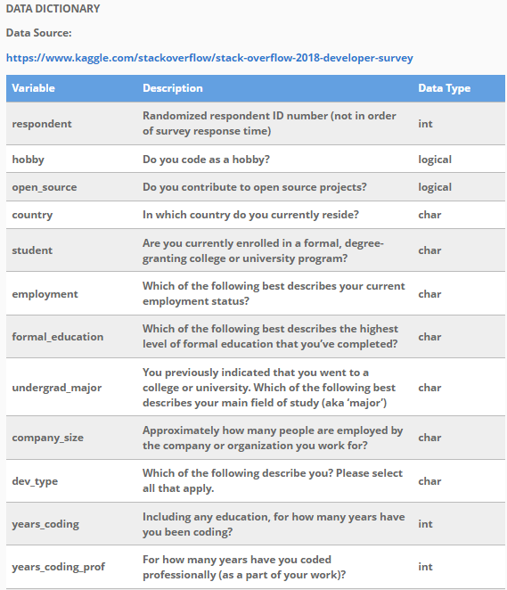
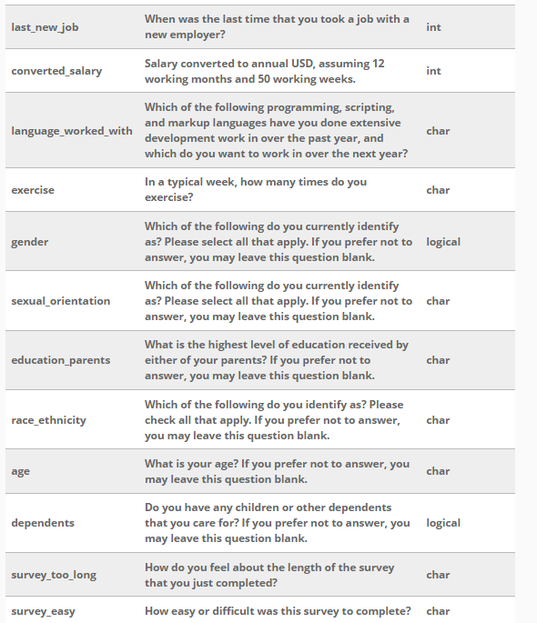
Data Dictionary

Slide 6
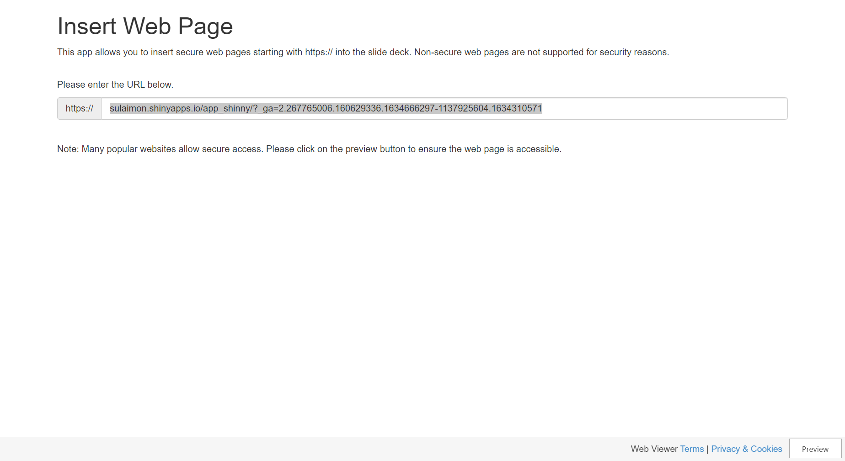

Slide 7

Closing Remarks
Data was cleaned to provide consistency and be prepared for data analysis
Created meaningful, visualized data with almost 100,000 rows of data
Data is based off cells that isn’t N/A which was filtered

Slide 8
Questions?

