Slide 1
Jenkins
DevOps

Slide 2
Learning outcomes
Understand Authorization and Authentication in Jenkins
Disable security
Configure Matrix based security and understand permissions
Understand how to configure LDAP in Jenkins

Slide 3
3. Security
User management
Various Security measures
Matrix-Based Security
Source code management using GitHub
LDAP Integration

Slide 4
Securing Jenkins
Securing Jenkins has two aspects to it
Access control, which ensures users are authenticated when accessing Jenkins and their activities are authorised
Protecting Jenkins against external threats

Slide 5
Access Control
Authentication - Protects Jenkins from the external threats , Locks the Jenkins UI. Only few people can access it.
Authorization - Those who have access to it , what they can access.

Slide 6
Access Control
This allows you to lock down the access to Jenkins UI so that Users are authenticated and appropriate set of permissions are given to them. This setting is controlled mainly by two axes:
Security Realm, which determines users and their passwords as well as what groups the users belong to.
Authorization Strategy, which determines who has access to what.
These axis are Orthogonal and has to be configured individually

Slide 7
Protect Jenkins from other threats
To be aware of these features
CSRF Protection — Prevents a remote attack against Jenkins running inside your premises.
Protects Jenkins master from malicious builds
Protect Jenkins master from malicious build agents

Slide 8
Disabling security
Accidentally set up a security realm / authorisation in such a way that you may no longer be able to reconfigure Jenkins
Stop Jenkins
In $Jenkins_Home find config.xml
Look up <useSecurity>true</useSecurity>
Replace true with false
Remove elements authorizationStrategy and securityRealm
If still not working try renaming or deleting config.xml

Slide 9
Matrix-based security
Matrix-based security is one of the authorization strategies available for securing Jenkins. It allows you to grant specific permissions to users and groups.

Slide 10
Available permissions
Overall
Slave
Job
Run
View
SCM

Slide 11
Overall
Permission | Description
Administer | Make system-wide configuration changes. Perform highly sensitive operations that amounts to full local system access (within the scope granted by the underlying OS).
Read | View almost all pages within Jenkins.
RunScripts | Run groovy scripts via the groovy console or groovy cli command.
UploadPlugins | Upload arbitrary plugins.
ConfigureUpdateCenter | Configure update sites and proxy settings.

Slide 12
Slave
Permission | Description
Configure | Configure existing slaves.
Delete | Delete existing slaves.
Create | Create new slaves.
Disconnect | Disconnect slaves or mark slaves as temporarily offline.
Connect | Connect slaves or mark slaves as online.

Slide 13
Job
Create | Create a new job.
Delete | Delete an existing job.
Configure | Update the configuration of an existing job.
Read | Grants read-only access to project configurations.
Discover | Redirect anonymous users to a login form rather than presenting an error message if they don't have permission to view jobs.
Build | Start a new build and cancel a running build.
Workspace | Retrieve the contents of a workspace that Jenkins has checked out for performing a build.
Cancel | Cancel a running build.

Slide 14
Run
Permission | Description
Delete | Delete specific builds from a build's history.
Update | Update the description and other properties of a build. (For example, to leave notes about the cause of a build failure.)

Slide 15
Permission | Description
Create | Create new views.
Delete | Delete existing views.
Configure | Update the configuration of existing views.
Read | See any existing views.

Slide 16
SCM
Permission | Description
Tag | Create a new tag in the source code repository for a given build.

Slide 17
LDAP Integration
https://wiki.jenkins.io/display/JENKINS/LDAP+Plugin
This plugin provides yet another way of authenticating users using LDAP. It can be used with LDAP servers like Active Directory or OpenLDAP among others.

Slide 18
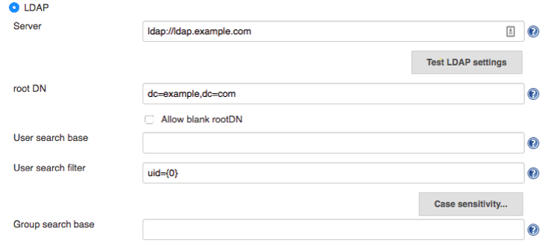
LDAP - Config

Slide 19
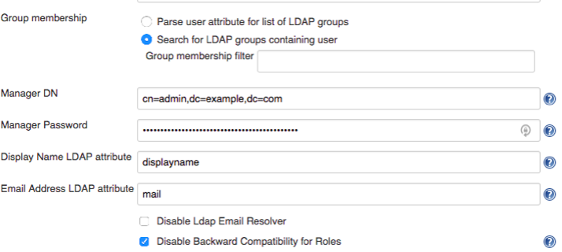
LDAP - Config

Slide 20
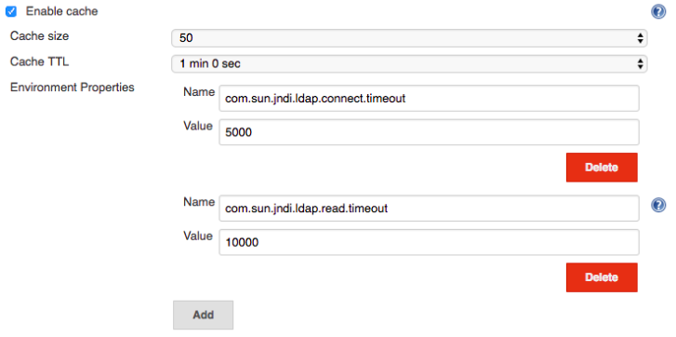
LDAP - Config

Slide 21
LDAP - Notes
It is strongly encouraged that you upgrade to at least version 1.15 of the LDAP plugin as that version includes the Test LDAP settings button which contains a number of important diagnostic checks to validate subtle issues with your LDAP configuration.

Slide 22
LDAP - Notes
Existing LDAP users are strongly encouraged to upgrade to this version and use the button to ensure that their existing configuration does not have subtle issues (most common subtle issues revolve around group resolution and user lookup and typically surface for users as issues with API token or Jenkins CLI access but can also appear with features such as the Authorize Project plugin or other plugins that require details of user permissions or group membership outside of a user's web session)

Slide 23
Authorize - LDAP
https://wiki.jenkins.io/display/JENKINS/Authorize+Project+plugin
Configure projects to run with specified authorization.
Provides following ways to specify authorization.

