Slide 1
Making Rocket Fuel on Mars
CHO301 CHEMICAL TECHNOLOGY
A Sabatier plant that turns Martian CO₂ and ice into liquid methane and oxygen
CO₂ + 4 H₂ → CH₄ + 2 H₂O
625
94.9%
480
kg CH₄ per day
CO₂ conversion
days to 300 t CH₄
Group 11 | IIT (BHU) Varanasi
Shikhar Ayush Tanishq Shivam Umair Junaid
chemical-technology-project.vercel.app
github.com/oyetanishq/chemical-technology-project
Notes:
Title slide. The deck has one two-slide section per team member, in the order reactor, hand calculations, simulation, literature, economics, sizing.

Slide 2
Design basis: 350 °C, 5 bar, nickel on alumina
1 Reaction Engineering and Reactor Design | Shikhar
Parameter | Value | Why
Temperature | 350 °C | Middle of the 300–400 °C window. Slow below it, CO forms above it
Pressure | 5 bar | Fewer moles of gas on the product side, so pressure helps conversion
Catalyst | Ni on Al₂O₃ | Cheap and robust. Ru is more active at low T but costs more
H₂:CO₂ feed | 4 : 1 | Stoichiometric, so neither feed is wasted. Tuned to 3.99 in the plant
Water by-product | 2 mol per CH₄ | Returned to the electrolyser, which halves the water demand
Sabatier reaction
CO₂ + 4 H₂ → CH₄ + 2 H₂O
−165
−130.8
kJ/mol, ΔH: heat must be removed
kJ/mol, ΔG: strongly favourable
The design tension
Thermodynamics prefers low temperature, since the reaction is exothermic and loses gas volume. Kinetics needs enough heat to get going on nickel. 300–400 °C is the practical compromise.
Notes:
Parameters come from the Month 1 reaction engineering work. 350 °C and 5 bar are a justified design point inside the window, not a proven optimum: that needs verified kinetics and plant sweeps.

Slide 3
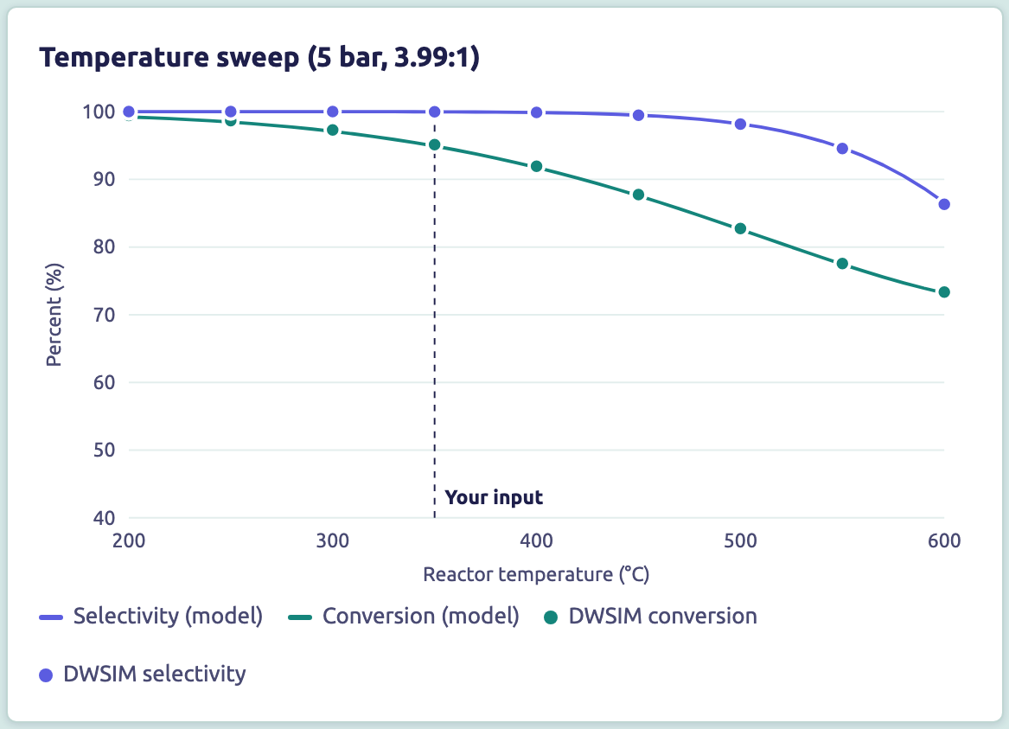
Selectivity stays near 100% up to 400 °C
1 Reaction Engineering and Reactor Design | Shikhar
95.1%
99.98%
conversion, single pass at 4:1
CH₄ selectivity at 350 °C
Above 500 °C
Reverse water-gas shift takes over: selectivity is down to 86.3% at 600 °C. Across 300–400 °C it never fell below 99.22%.
Kinetics check
LHHW rate law reaches 92.6% with 1.5 kg catalyst. Its constants still need checking against the paper.
Notes:
Screenshot: website Reactor tab; lines are the website model and dots are the DWSIM Gibbs sweep, single pass at 5 bar. The kinetic and heat-duty comparisons come from the Month 2 kinetics dashboard. The −42 and −43.44 kW values are proof-of-concept scale (4 kmol/h H₂); the full plant duty is −81.1 kW. Koschany constants are still flagged draft in the task tracker.

Slide 4
Stoichiometry sets the size of the whole plant
2 Mass and Energy Balance (Hand Calculations) | Ayush
CO₂ + 2 H₂O → CH₄ + 2 O₂ net reaction, once Sabatier water returns to the electrolyser
300 t
823 t
674 t
1,197 t
CH₄ to make, from 1,350 t of propellant at 3.5:1
CO₂ from the atmosphere (2.74 kg per kg CH₄)
net water from ice (2.25 kg per kg CH₄)
O₂ co-produced (3.99 kg per kg CH₄), 147 t surplus
From 39.4 kWh/kg H₂ to the plant’s power demand
39.4
60.6
30.5
793
kWh/kg H₂
kWh/kg H₂
kWh/kg CH₄
kW
theoretical (HHV)
at 65% efficiency
at 0.503 kg H₂ per kg CH₄
at 625 kg CH₄/day
Notes:
Propellant target is 1,350 t split at the 3.5:1 engine ratio, which gives 300 t CH₄. Electrolysis chain: 39.4 ÷ 0.65 = 60.6 kWh/kg H₂; 0.503 kg H₂ per kg CH₄ gives 30.5 kWh/kg CH₄; 30.5 × 625 ÷ 24 = 793 kW. The Month 1 deck printed 772 kW, but its own 9,142 MWh and 0.79 yield both correspond to about 793 kW, so 793 is used here.

Slide 5
Hand calculations agree with two independent models
2 Mass and Energy Balance (Hand Calculations) | Ayush
Metric | Hand calc | Cantera | Month 2 DWSIM | Final DWSIM
CO₂ conversion (%) | 100 | 95.07 | 95.00 (typed) | 95.12
CH₄ selectivity (%) | 100 | 99.97 | 100 | 99.98
Sabatier heat (kW) | 78.3 | 81.04 | 81.13 | 81.20
Carbon balance (out/in) | 1.0000 | 1.0000 | 1.00001 | 1.00000
Hydrogen balance (out/in) | 1.0000 | 1.00002 | 1.00000 | 1.00000
Plant mass closure | n/a | n/a | 0.00005% | 0.00003%
Fuel yield, kg CH₄ per kW per day, depends on what is counted
0.79
0.75
0.66
Still open
Choosing 65% or 70% electrolyser efficiency moves yield by about 7%.
hand calc: electrolysis only
final plant: adds compressors and heaters
estimate: also adds refrigeration at 30% of Carnot
Notes:
The final conversion, selectivity and heat values are single-pass at 4:1. Balances and closure are for the full recycled plant. Hand-calc assumes full conversion, so it sets the ideal limit. Yield boundaries differ: 0.79 counts electrolysis only, 0.75 adds compressors and heaters, and 0.66 is an estimate that adds refrigeration at 30% of Carnot (website model).

Slide 6
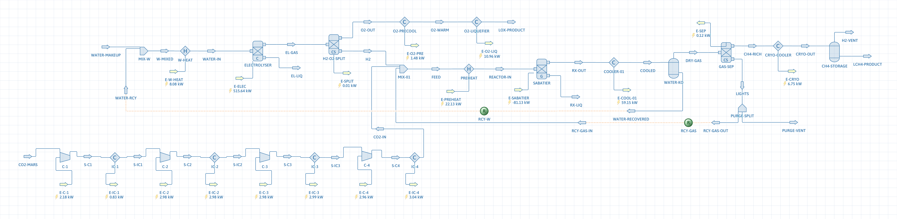
The final DWSIM flowsheet connects every unit
3 Process Simulation | Tanishq
−81.1 kW
11.1 kW
11.0 kW
2 recycles
Sabatier heat removed at full plant scale
4-stage CO₂ compressor shaft power, 75% efficient
heat removed in the O₂ liquefier, down to −170 °C
water and unreacted gas, with a 2% purge
Peng-Robinson, pure CO₂ feed, ideal gas separator (99% H₂, 99.95% CO₂), zero pressure drop, no solid CO₂ phase
Notes:
Solved in DWSIM with Peng-Robinson. Recycles converge to a tolerance of 1e-8. Assumptions: pure CO₂ feed, ideal gas separator, zero pressure drop, no solid CO₂ phase.

Slide 7
The mass balance closes and Month 2 gaps are gone
3 Process Simulation | Tanishq
Plant boundary
Month 2 to final model
Stream | T (°C) | P (bar) | kg/h
CO₂ from Mars (in) | −60 | 0.0065 | 71.52
Water make-up (in) | 25 | 5 | 58.68
Liquid CH₄ (out) | −170 | 5 | 26.05
Liquid O₂ (out) | −170 | 5 | 104.05
Purge vent (out) | 25 | 5 | 0.10
Total in = total out |  |  | 130.20
Item | Month 2 | Final
Conversion | 95%, typed in | 94.9%, computed
Throughput | About 610 kg/day | 625 kg/day, on target
Gas losses | About 5% vented | Recycled, about 0.1% purged
Water make-up | 123.1 kg/h | 58.7 kg/h with recycle
Missing units | CO₂ compressor, O₂ liquefier | Both added and solved
O₂:CH₄ ratio | About 4.3, unexplained | 4.0, matches stoichiometry
0.00003%
0.007 wt%
plant mass-balance error
CO₂ left in the methane, so it will not freeze out
Notes:
Values from ts2_streams_v2.csv. Mass closure 0.00003%. The final model replaced the typed conversion with a Gibbs reactor and added the two loads that were missing in Month 2.

Slide 8
Flight hardware and published studies anchor the design
4 Literature and Benchmarking | Shivam
NASA MOXIE
SpaceX Raptor
ESA ISRU strategy
Perseverance rover, 2021–23
Starship methalox engine
Space Resources Strategy, 2019
12 g O₂/h
3.6 : 1
2030
peak rate at ≥98% purity
LOX:CH₄ burn ratio by mass
target for demonstrated ISRU technology
122 g O₂ across 16 runs
About 100 W, limited by power rather than chemistry
Proves CO₂ conversion works on Mars
350 bar chamber pressure (Raptor 3)
Isp 327 s at sea level, 350 s in vacuum
Sets the propellant our plant must deliver
Runs through 2030
Sustained Moon presence by 2040
23 activities funded in the 2019 call
4 orders
Our plant makes 104 kg O₂/h against MOXIE’s 12 g/h, about 8,700 times more. MOXIE shows the principle; this scale-up is the main technology risk.
Notes:
MOXIE figures: 12 g/h peak, at least 98% purity, 122 g across 16 runs. Our plant makes 104 kg/h O₂, about 8,700 times the MOXIE rate, or about 4 orders of magnitude. The Raptor thrust figure is left out because earlier decks disagree (D10 in the discrepancy register).

Slide 9
Our 1,350 t target is a Starship-class plant
4 Literature and Benchmarking | Shivam
Propellant load by architecture
 | This project | NASA JSC 2024
Plant size | 300 t CH₄ over 480 days | 30 and 300 t/yr cases
O₂:CH₄ | 4.0 : 1 natural output | 3.5 : 1 fixed target
Electrolysis share | About 95% of electric load | 53–62% of plant power
Scope | Reaction to liquid storage | Also ice mining and CO₂ capture
Architecture | Propellant (t)
NASA DRA 5.0 / EMC | 30
Mars Direct ERV | 96
SpaceX Starship | 1,200
This project | 1,350
42.8×
26×
What this means
Our target matches a reusable Starship-class vehicle and is far above small-capsule ascent vehicle studies, so the vehicle class must always be stated.
scale-up in CH₄ rate over the NASA reference plant of 14.6 kg/day
scale-up in power over the same plant’s 30 kW, the same order as the rate
Notes:
Propellant loads from the Month 1 benchmark slide. NASA EMC reference: 14.6 kg CH₄/day, 412 kg, 30 kW. JSC comparison: NTRS 20240014064. The earlier "out-produces NASA by 4x" wording is dropped because the scope differs and the task tracker asks for CH₄-only output over 480 days.

Slide 10
Three transport scenarios replace a single $1–2B claim
5 Techno-Economic Analysis | Umair
Scenario | Basis | $/kg to Mars surface | Savings on 1,350 t
Optimistic | Published Starship Mars-surface projections | $150–600 | About $0.5B
Realistic | Back-solved from the original claim | $700–1,700 | About $1.6B
Conservative | Falcon 9 cost to LEO × gear ratio of 3.5–5 | $10,500–15,000 | About $17B
Transport cost
Savings per mission
C(Mars) = C(LEO) × GR
S = M(propellant) × C(Mars)
GR between 3.5 and 5 covers injection, orbit insertion and landing
Avoided cost per kg times propellant no longer shipped
Hardware cost (AMCM)
Payback in missions
C(dev) ∝ Q^0.59 × M^0.66
n = CapEx ÷ (S − Ops)
NASA cost model calibrated on 260 aerospace programs
Ops per mission uses the 2.2-year synodic period
Notes:
Propellant basis 1,350 t. Only the conservative case is a direct use of the gear-ratio formula; the optimistic case uses Starship projections and the realistic case is back-solved from the original claim. AMCM: Guerra and Shishko, 2000.

Slide 11
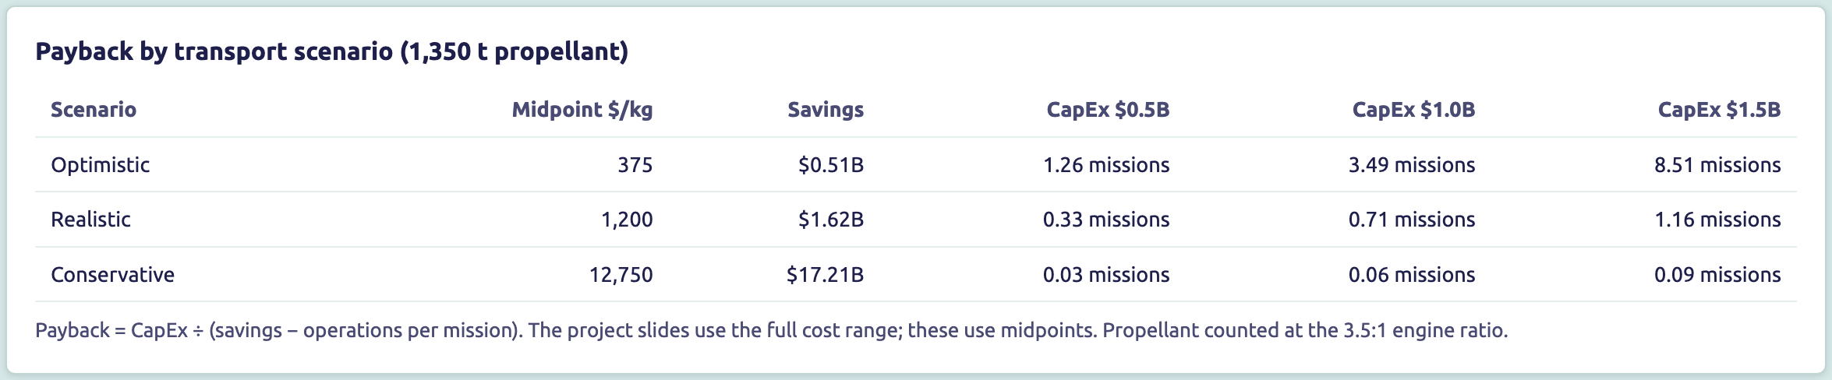
The realistic case pays back in about one mission
5 Techno-Economic Analysis | Umair
$0.5–1.5B
$50–150M
Stated plainly
If Starship pricing is optimistic, one mission does not cover the plant even at low CapEx: payback is 1.26 missions at best. CapEx must still be rebuilt from the corrected sizing.
plant CapEx, first-of-a-kind, AMCM-based
operations per year, about 10% of development cost
Notes:
Screenshot: website Sizing & Economics tab at midpoint transport costs. Ops are 10% of CapEx per year over 2.2 years. The earlier decks quote 0.3–1.2 missions for the realistic case, which matches this table. CapEx is not yet based on the corrected equipment sizing.

Slide 12
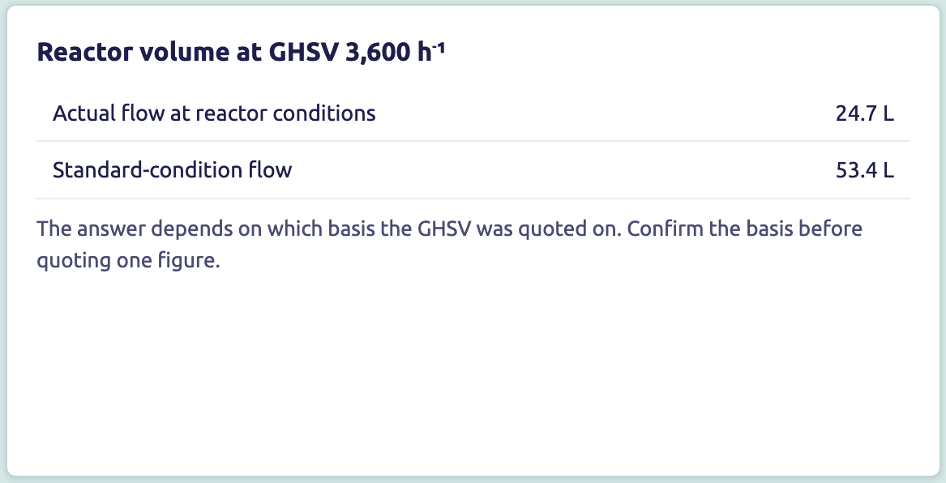
Correcting the basis cuts the reactor from 262 L to 25 L
6 Equipment Sizing | Junaid
Method
V = (n R T / P) ÷ GHSV
Reactor feed of 8.57 kmol/h, taken at the real 350 °C and 5 bar, with GHSV of 3,600 h⁻¹.
Basis | Volume
Month 2 script: 550 K, 10 bar basis | 261.8 L
Actual flow at 350 °C, 5 bar | 24.7 L
If GHSV is on standard conditions | 53.4 L
Before quoting one figure
The answer depends on which basis the GHSV was quoted on. The corrected sizing script is the controlling figure once it is verified.
Notes:
Month 2 script: 261.8 L at 550 K and 10 bar. Discrepancy D4 records the unit slip and product-stream flow. Corrected first pass: 8.57 kmol/h × R × 623 K ÷ 5 bar = 88.8 m³/h, and 88.8 ÷ 3,600 h⁻¹ gives 24.7 L. If GHSV is defined at standard conditions it gives 53 L. The corrected script (task JN-1) is the controlling figure once verified.

Slide 13
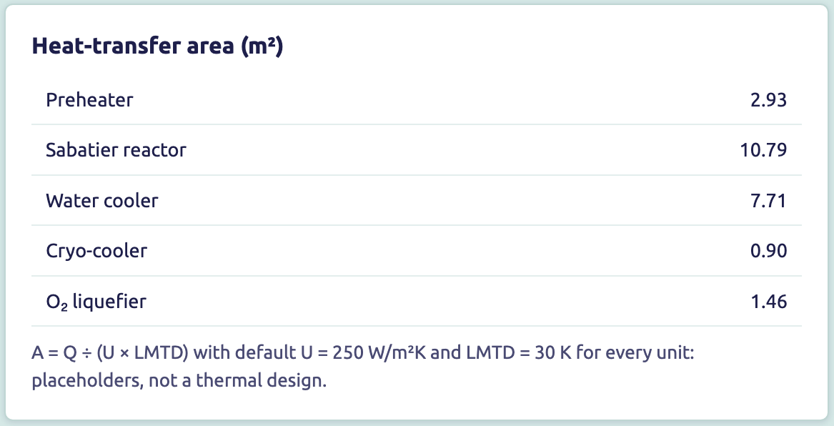
Reactor cooling needs the largest exchanger surface
6 Equipment Sizing | Junaid
CO₂ compressor train, 6.5 mbar to 5 bar
Stage | Outlet (bar) | Outlet (°C) | Power (kW)
1 | 0.034 | 74 | 2.18
2 | 0.180 | 189 | 2.98
3 | 0.949 | 189 | 2.98
4 | 5.000 | 189 | 2.96
Total |  |  | 11.10
Limits of this first pass
10.8 m²
7.7 m²
U = 250 W/m²K and LMTD = 30 K are defaults, not a thermal design. The electrolyser, gas separator and storage tanks are not sized yet, and they will drive the hardware mass.
Sabatier reactor, the largest surface
water cooler ahead of the knock-out
Notes:
Areas use A = Q ÷ (U × LMTD) with U = 250 W/m²K and LMTD = 30 K using the website model duties, within about 2% of DWSIM. These are first-pass defaults and not a thermal design. Compressor data from the DWSIM stream and duty tables. The electrolyser, gas separator and storage tanks are not sized yet.

Slide 14
Project timeline and review gates
Gantt chart
G1 decisions
G2 freeze
G3 analysis
G4 draft
G5 sign-off
Wk 1
Wk 2
Wk 3
Wk 4
Wk 5
Wk 6
Wk 7
Wk 8
Shikhar
Reaction Engineering
Ayush
Mass and Energy
Tanishq
Simulation
Shivam
Literature
Umair
Techno-Economic
Junaid
Equipment Sizing
Notes:
Same week ranges and gates as the concluding presentation.

Slide 15
Sources
References
1. NASA JPL/MIT: MOXIE, Perseverance rover results (2021–2023)
2. Andersen et al. (2024): NASA JSC ISRU trade study, NTRS 20240014064, ASCEND 2024
3. NASA NTRS 20170005179: ISRU propellant production system for a Mars Ascent Vehicle
4. Polsgrove, T. et al. (2017): AIAA 2017-0423
5. NASA NTRS 20160006324: Sustaining human presence on Mars using ISRU and a reusable lander
6. SpaceX: Raptor and Starship documentation
7. ESA: Space Resources Strategy (2019)
8. Guerra, L. and Shishko, R. (2000): Advanced Missions Cost Model
9. Koschany, F. et al. (2016): LHHW kinetics for Ni CO₂ methanation; Xu and Froment (1989)
10. Sabatier, P. and Senderens, J.B. (1902): Comptes Rendus Acad. Sci. 82
11. Goodwin, D. G. et al.: Cantera 3.2.0
12. Bell, I. H. et al. (2014): CoolProp, Ind. Eng. Chem. Res.
13. NIST Chemistry WebBook; IUPAC standard atomic weights
14. Tsiolkovsky, K.: rocket equation and interplanetary mass budgets
15. DWSIM open-source process simulator: documentation, Peng-Robinson package
16. Hu, J. et al. (2007); Strucks, P. et al. (2021): Ni methanation kinetics reviews
Plant simulator website
GitHub repository
https://chemical-technology-project.vercel.app
https://github.com/oyetanishq/chemical-technology-project
Notes:
Same reference list as the final presentation, plus links to the deployed website and the GitHub repository.

