Slide 1
Analysis of accessible food services to low income households
IBM Data Science Capstone project

Slide 2
Problem Description
- Problem:
Singapore lockdown due to COVID-19, circuit breaker implementations
Low income families with low access to budget food services affected
High living expenses, insufficient financial support
- Objective:
Identify planning areas with clusters of low income households with limited budget food services in their vicinity
Insights for charity entities to prioritised planning areas for food charity handouts to maximise the effectiveness of a community support initiative.

Slide 3
Data
- 2015 population data of Singapore residents by planning area and income bracket
- By Singapore Ministry of Trade and Industry - Department of Statistics
https://data.gov.sg/dataset/resident-working-persons-aged-15-years-over-by-planning-area-gross-monthly-income-from-work-2015

Slide 4
Approach
- Identify population number in each income bracket for each planning area
- Using Fourspace API, search for recommended budget food services in a 2.5km radius vicinity
- Group population and cluster planning area, according to income bracket and number of available food services available in vicinity
- Identify similar planning areas which are on top priority for food charity handouts
(criteria: low income + lack of food services nearby)

Slide 5
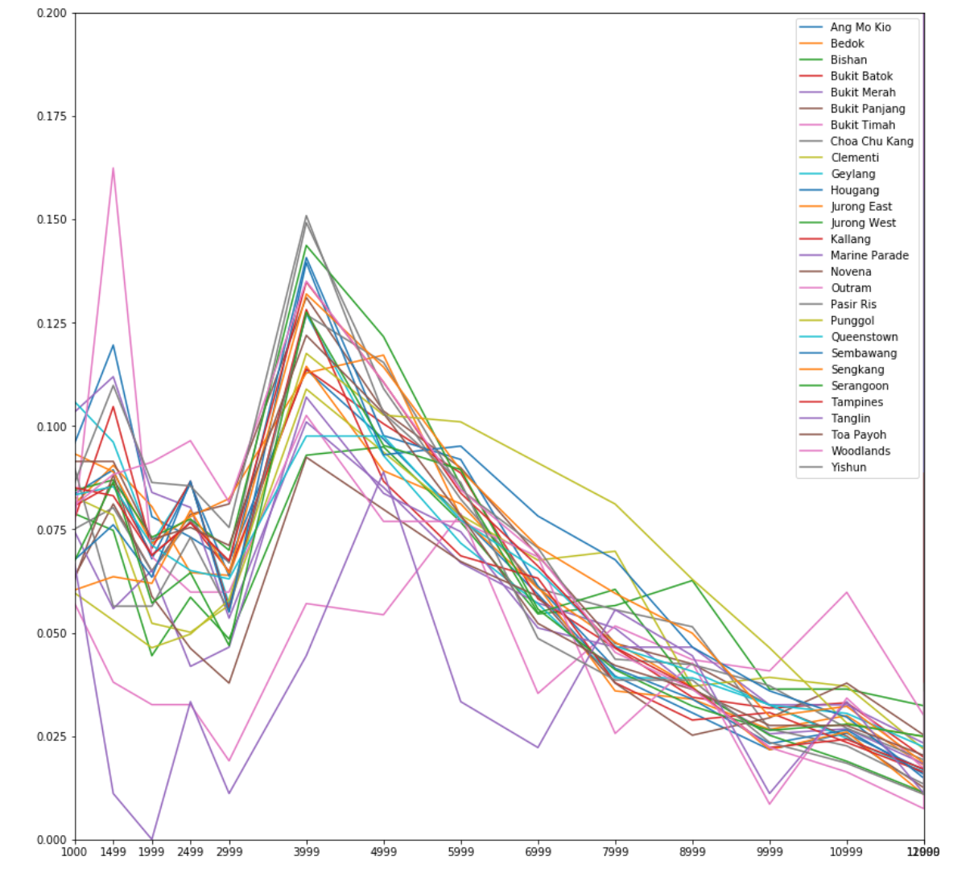
Exploratory Analysis
- Proportion of each income bracket against income bracket

Slide 6
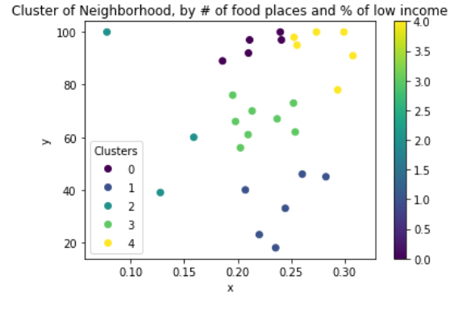
K-means Clustering
- Cluster 1

Slide 7
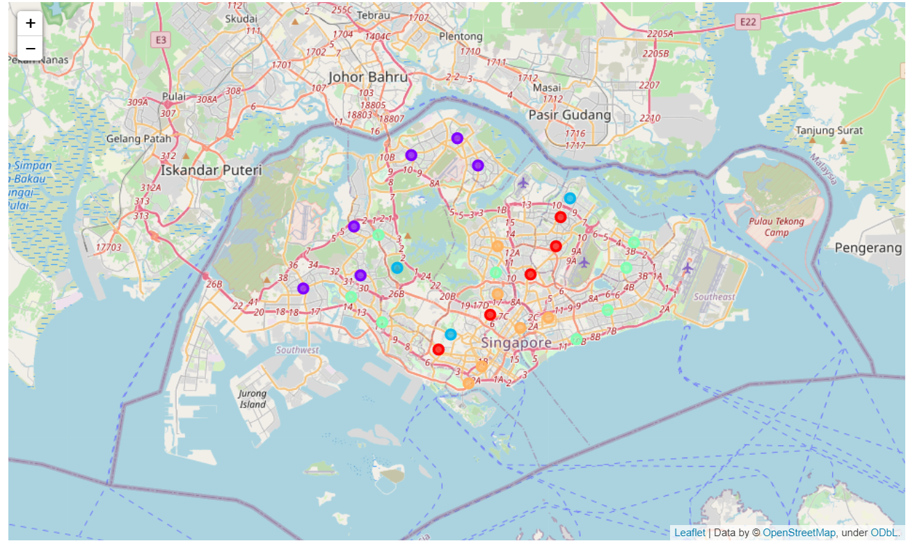
Map

