Slide 1




$$y_{b}$$
$$x_{b}$$
Lander (body)
Camera
$$y_{c}$$
$$z_{c}$$
Lunar Surface

Slide 2
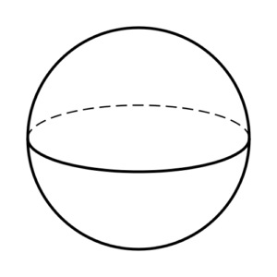







$$z_{i }z_{m }$$
$$r$$
$$x_{i}$$
$$y_{m }$$
ϒ
$$θ$$
$$y_{i}$$
$$x_{m }$$

Slide 3





Feature
$${𝓵^{c}}_{ }$$
$${r_{f/m}^{m}}_{ }$$
$${r_{b/i}^{i}}_{ }$$
$$z_{m }$$
$$x_{m }$$

