Slide 1
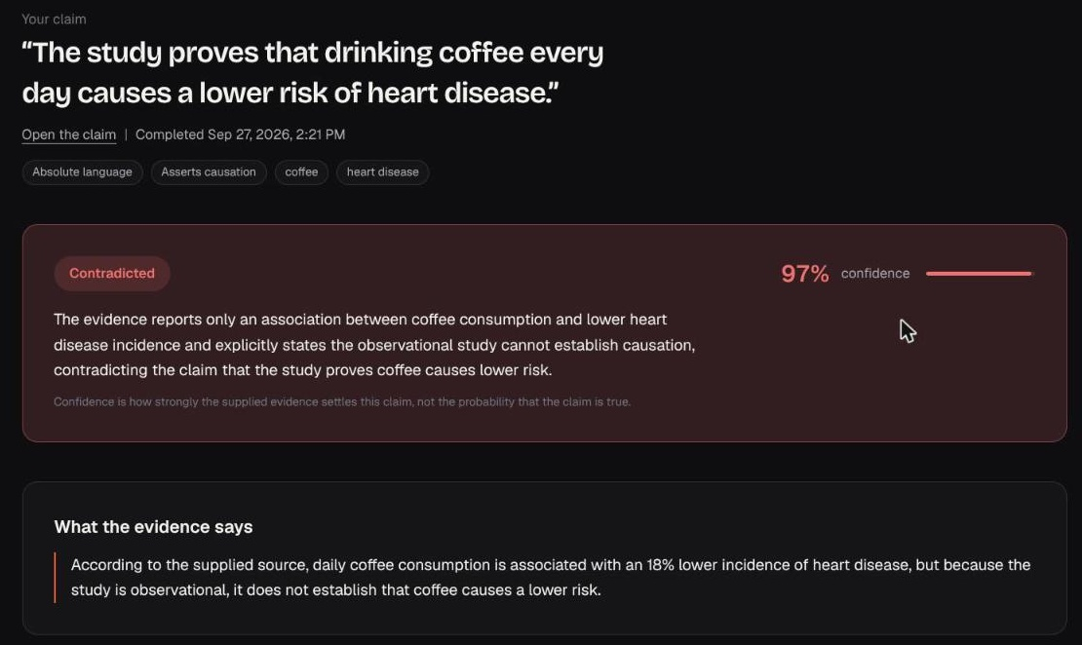
ProofLens
Check what your evidence actually supports.
Evidence-grounded claim verification. Enter a claim, add your documents, and get a verdict that explains itself and points back to the page it came from.
Real result screen · live run, 27 Sep 2026
GOMYCODE NIGERIA · COME BUILD WITH AI HACKATHON 2026
Notes:
ProofLens answers one narrow question: does the evidence I supplied actually support the claim I am making?
You give it a claim and your source documents. It gives back a verdict, an explanation of what the source does and does not establish, and the exact passage and page it relied on.
Everything on these slides comes from the running product and the repository. The screenshot on the right is a real result from a live run today.

Slide 2
ProofLens
02 / 10
THE PROBLEM
A source can be real and still not say what the claim says.
THE CLAIM
THE SOURCE · PAGE 2 AND PAGE 3
“The study proves that drinking coffee every day causes a lower risk of heart disease.”
“Daily coffee consumption was associated with a lower risk of heart disease.”
“…the findings do not establish that coffee causes a lower risk.”
The gap is easy to miss when reading quickly:
Stronger language than the source
A different number, date or name
A negation read as agreement
Notes:
The problem is not fake sources. It is real sources being stretched.
A study finds an association, and the claim says it proves causation. A report says 1,200 participants and the claim says 10,000. A sentence says something is not established, and it gets quoted as if it were.
The source exists, the citation looks fine, and the claim still is not supported. Checking that by hand means reading closely every time.
The example here is the one we will run live: a sample document written for the demo.

Slide 3
ProofLens
03 / 10
THE PRODUCT
Claim + evidence in. An explained verdict out.
ProofLens tests a claim against the documents you supply and explains what that evidence establishes.
Your claim
Verdict + confidence
One of four outcomes
One plain statement
ProofLens
checks + reasoning
+
Explanation
What the source says, why it does or does not match, what it does not establish
Your evidence
Source evidence
PDF, TXT, MD or CSV · passage + page
The exact quote, document and page: “Show me why”
THE FOUR VERDICTS
Supported
Partially supported
Contradicted
Insufficient evidence
Notes:
ProofLens is not a chatbot and not a web search. It only reasons over the evidence you attach.
The label is the least interesting part. The explanation is the product: what the source actually says, why the claim does or does not match it, what the source does not establish, and a link to the exact passage.
There are four verdicts. Insufficient evidence is its own outcome, so "the source does not cover this" is never confused with "the source says the opposite".

Slide 4
ProofLens
04 / 10
HOW IT WORKS
Deterministic checks and AI reasoning, with the backend owning the verdict.
01
02
03
04
05
06
Claim analysed
Evidence extracted
Rule-based checks
AI reasoning
Backend validation
Show me why
Strength of language, causal wording, numbers, dates, names
PDF text pulled per page in an isolated subprocess; you pick the passage and page
Number, date, entity, negation and causation-vs-association comparisons
Model sees only the supplied passages and must answer in a strict JSON schema
Output parsed with Pydantic; references must match a supplied passage; hard conflicts override the model
Verdict with quotes, document and page, linked to the highlighted passage
If every AI model fails, ProofLens returns the deterministic result only when the checks are decisive; otherwise it says reasoning is unavailable and stores nothing.
Notes:
This pipeline is what the code actually does.
First the claim is analysed: is it absolute or hedged, does it assert causation, what numbers, dates and names does it contain.
Then deterministic checks compare those against the evidence directly, without any model.
The AI model then reasons over the supplied passages only, and has to answer in a strict JSON schema.
The backend validates that answer. References to passages that were not supplied are dropped. Quotes have to appear verbatim in the stored passage. And a hard conflict found by the checks, such as a number mismatch, overrides a model that says supported.
If the AI is unavailable, the user sees an unavailable state. We never show an invented verdict.

Slide 5
ProofLens
05 / 10
THE IMPORTANT DIFFERENCE
Not just a label. What the source establishes, and why.
YOUR CLAIM
WHAT THE EVIDENCE SAYS
WHY IT DOES NOT FULLY MATCH
WHAT YOU CAN CONCLUDE
“The study proves that drinking coffee every day causes a lower risk of heart disease.”
Daily coffee consumption is associated with an 18% lower incidence of heart disease, but because the study is observational, it does not establish that coffee causes a lower risk.
The source describes an association and notes the observational design prevents establishing causation, whereas the claim asserts proven causal effect.
Coffee consumption is linked to a lower risk of heart disease, but the study does not prove that coffee causes this reduction.
SHOW ME WHY · coffee-heart-study-sample.pdf · page 3 · Limitations
“Because this was an observational study, the findings do not establish that coffee causes a lower risk of heart disease.”
Contradicted · 97%
Notes:
This is the actual output from the live run, word for word. Model wording varies from run to run, but these fields are always there.
A plain label would just say contradicted. ProofLens explains the gap: the source found an association, the claim says the study proves causation.
It also says what you can honestly conclude from this source, which is the useful part for the person writing the claim.
And Show me why points to the exact sentence on page 3 that the verdict rests on.
The deterministic checks flagged the same thing independently: stronger language than the source, causation versus associated.
The document is a sample written for this demo, and it is labelled as fictional data on page 1.

Slide 6
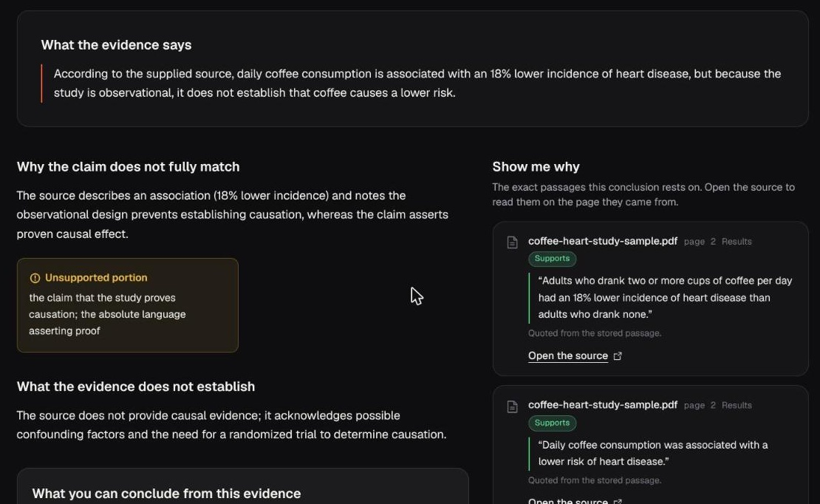
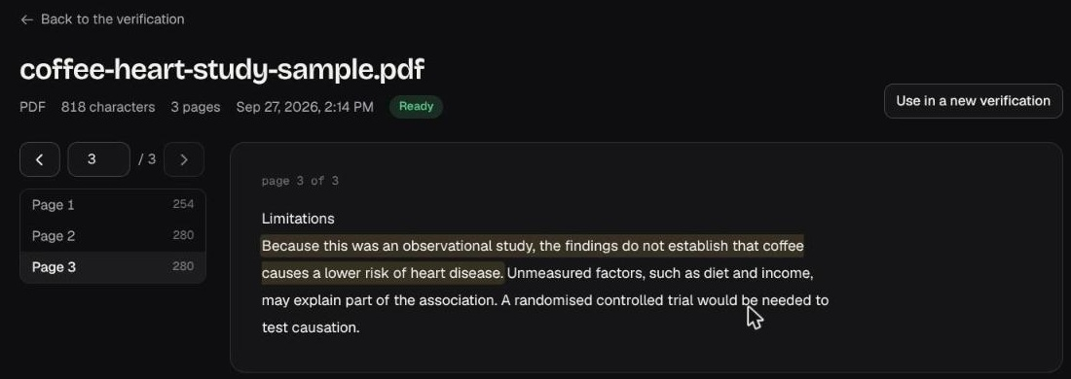
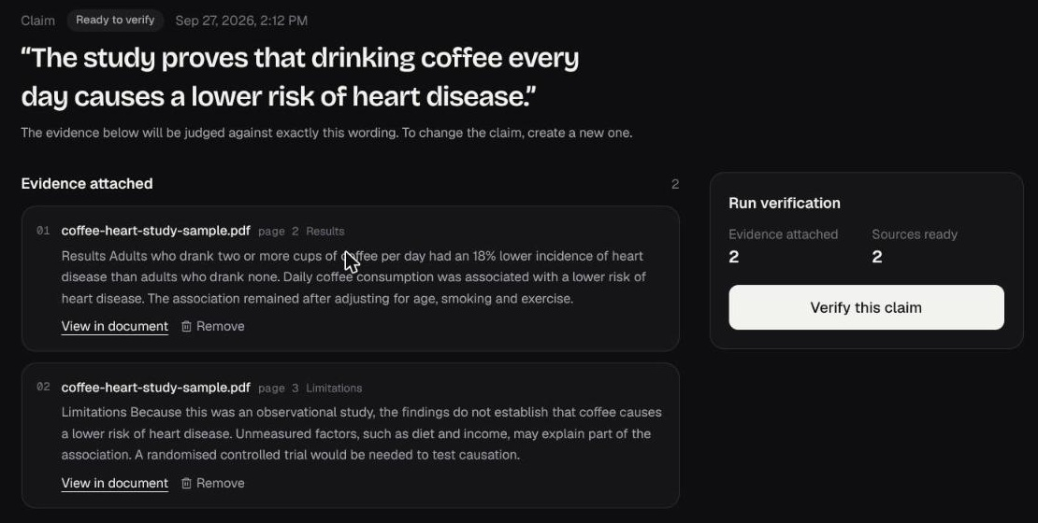
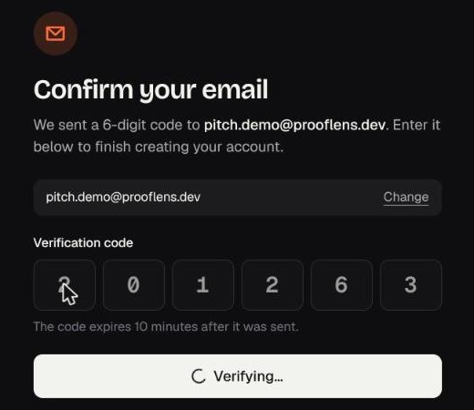
ProofLens
06 / 10
THE REAL PRODUCT
The running web app, captured today.
Open the source: the cited sentence highlighted on page 3
Evidence by page · 6-digit email code
Result: why it does not match · Show me why, with roles and page numbers
Notes:
These are real screenshots from the web app running locally today, not mock-ups.
Large on the left: the result page. Why the claim does not fully match, the unsupported portion, and the Show me why column, where each cited passage has a role, supports or conflicts, and a page number.
Top right: clicking open the source takes you to the document viewer on that page with the cited sentence highlighted.
Bottom right: evidence is attached by page and passage, and accounts are confirmed with a 6-digit email code.
There is also an Expo mobile app with the same flow; we have not captured it on a device, so it is not shown here.

Slide 7
ProofLens
07 / 10
TECHNICAL FOUNDATION
A full-stack product, not a prompt wrapper.
BACKEND
CLIENTS
AI LAYER
SECURITY
• FastAPI · Python
• PostgreSQL · async SQLAlchemy 2
• Alembic migrations (10 revisions)
• PyMuPDF text extraction in a sandboxed subprocess
• Next.js 16 · React 19 web app
• Expo SDK 57 mobile app
• Neither client calls an AI provider or holds verification logic
• One provider interface: Gemini, NVIDIA NIM, Groq, Ollama
• Chosen by configuration, with ordered fallback models
• Strict JSON-schema output, validated with Pydantic
• Argon2id passwords · SHA-256 hashed session tokens
• Revocation, 5-session cap, 24h expiry
• Rate limits on login, signup, OTP · owner checks on every resource
• Request body caps · security headers
Notes:
Under the hood this is a real product. The FastAPI backend owns the verdict. PostgreSQL stores claims, documents, pages, evidence and every verification with a snapshot of the evidence it used.
PDFs are parsed in a separate subprocess with a timeout and memory limit, so a hostile PDF cannot take the server down.
The AI layer is one interface with four providers behind it. Which one runs is configuration only, and each provider can have backup models that are tried in order.
Security basics are done properly: Argon2id passwords, hashed tokens, revocation, rate limits on authentication and OTP, and ownership checks so one user can never read another user's claims or documents.

Slide 8
ProofLens
08 / 10
PROOF IT WORKS
Measured today, not estimated.
297
47
3 of 4
backend tests passing
security tests
AI providers verified live
186 unit · 111 integration against real PostgreSQL
cross-user access, token revocation, rate limits, body limits, lock and delete protection
Gemini, NVIDIA NIM and Groq returned validated verdicts; Ollama not run here
END-TO-END RUN IN THE WEB APP · 27 SEP 2026
Register
›
Email code
›
Claim
›
Upload PDF
›
Pick passages
›
Verify
›
Verdict
›
Show me why
Every step completed against the real backend. Result: Contradicted, 97%, 3 passages cited by page.
Notes:
Here is what we actually verified today.
297 backend tests pass: 186 unit tests and 111 integration tests that run against a real PostgreSQL database. 47 of those are security tests.
Three AI providers returned validated verdicts in live calls today: Gemini, NVIDIA NIM and Groq. Ollama is implemented but we did not run it.
And we ran the full user journey in the browser, from registration and the email code to the verdict and the highlighted source.
Being honest about gaps: the web and mobile apps have no automated tests yet, and there are no usage or accuracy figures because the product has not been benchmarked.

Slide 9
ProofLens
09 / 10
RESPONSIBLE AI
The model reasons. The backend decides.
Grounded in supplied evidence only
Prompt-injection guard
The prompt forbids outside knowledge; the model only sees the passages you attached.
Claim and evidence are wrapped as untrusted data; injected delimiter tags are stripped.
Structured, validated output
No invented citations
Strict JSON schema, parsed with Pydantic; malformed output is retried, then rejected.
References to unknown passages are dropped; quotes must appear verbatim in the stored passage.
Checks can overrule the model
Honest failure
A number, date or name conflict turns an AI “supported” into contradicted or partial.
Provider outage: deterministic result only if decisive, otherwise “unavailable”. No verdict is invented.
Notes:
AI does real work in ProofLens, but it does not get the last word.
The model only sees the passages you supplied, and the prompt tells it to treat them as untrusted data, so a document cannot instruct the model.
Its answer must match a strict schema. We validate it. Citations that point at passages we never gave it are dropped, and quotes have to appear verbatim.
When the deterministic checks find a hard conflict, like the wrong number, they overrule a model that says supported.
And when the AI is down, we say so. We would rather show "unavailable" than a verdict nobody can stand behind.
Confidence is shown as how strongly the evidence settles the claim, not the probability the claim is true, and the app says exactly that on screen.

Slide 10
ProofLens
10 / 10
NEXT STEP
From a working product to one people rely on.
WORKING TODAY
NEXT · NOT BUILT YET
• Claim → evidence → verdict → explanation → source, on web
• Four verdicts with deterministic checks + AI reasoning
• Page-level Show me why with highlighted passages
• Email-code accounts and verification history
• Suggest the relevant passages automatically (ranking code exists, not yet wired in)
• Check that a passage really appears on the page it cites
• Split multi-part claims and verify each part
• Web and mobile test suites · accuracy benchmark
ProofLens helps people say exactly what their evidence supports, and show the page that proves it.
Notes:
Today ProofLens does the full loop: a claim, your evidence, a verdict with an explanation, and the exact source passage.
Next, in order: suggest the relevant passages automatically, since the page-ranking code already exists but is not yet connected; confirm that a chosen passage really appears on the page it cites; split claims with several parts and check each one; and add tests for the web and mobile apps plus a proper accuracy benchmark.
The goal stays the same: help people say exactly what their evidence supports, and show the page that proves it. Thank you.

