Slide 1
Mesh Simplification
HZS5143
hzouyangjinbin@corp.netease.com

Slide 2
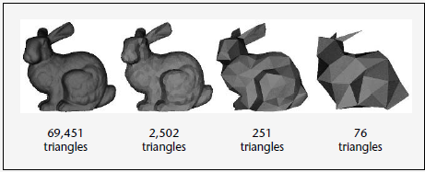
Task
The most common task in LOD:
Starting from a complex polygonal model, create a series or spectrum of simpler models that resemble the original but use fewer polygons.
Pictures references from the book《Level of Detail For 3d Graphics》

Slide 3
Geometry Simplification
Simplifying a polygonal surface reduce the number of vertices,changing the shape of the surface as a result.
In this step, we only consider the geometric coordinates but no other attributes as well.

Slide 4
Algorithms for Simplification
Polygon Merging
Vertex Removal
Edge Collapse
Triangle Collapse
Cell Collapse

Slide 5
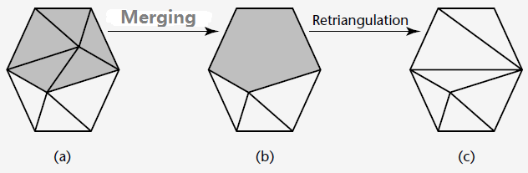
Polygon Merging
Merging nearly coplanar and adjacent polygons into lager polygons,which are then triangulated,as well as Vertex Removal.

Slide 6
Edge Collapse
Using the edge collapse operator,this operator collapse and edge (v_{a}, v_{b}) into a single vertex v_{new.}this new vertex maybe the subset of the (v_{a}, v_{b}) .
This causes the removal of the edge (v_{a}, v_{b}) as well as the triangles spanning that edge.

Slide 7
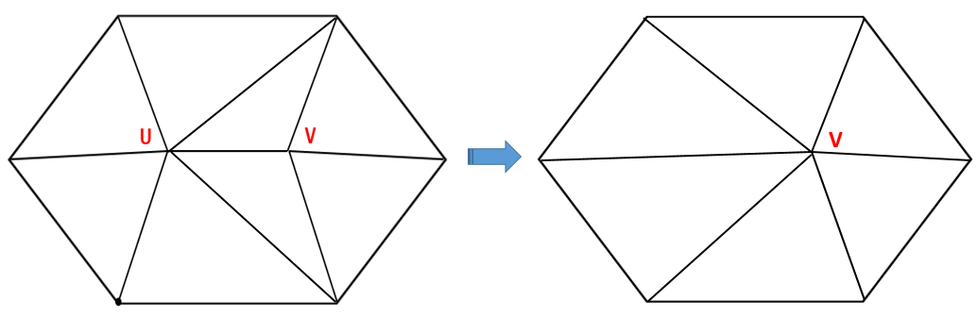
Edge Collapse
The edge collapse operator has been widely used in view-independent simplification

Slide 8
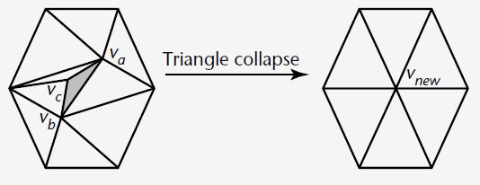
Triangle Collapse
A triangle collapse operator simplifies a mesh by collapsing a triangle (v_{a}, v_{b}, v_{c}) to a single vertex v_{new}
A triangle collapse is equivalent to two edge collapse

Slide 9
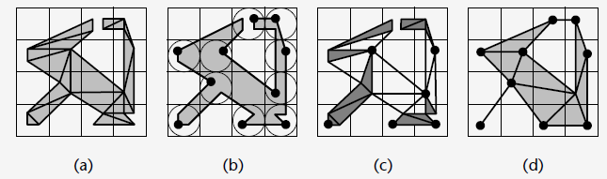
Cell Collapse
The cell collapse operator simplifies the input mesh by collapsing all the vertices in a certain volume, or cell, to a single vertex. The cell undergoing collapse could belong to a grid

Slide 10
Implementation for Vertex Removal
Compute the “Average Plane”:
Let X be the Vertex under consideration
Let Ti be a triangle in the fan of X
Let c_{i}, A_{i} and n_{i} be the center, area, normal vector of triangle T_{i}, respectively
The base point B and normal vector n of the average plane are calculated as follows:

Slide 11
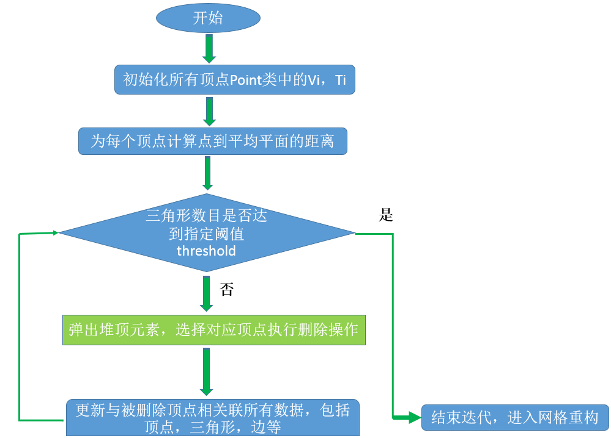
Flow chart

Slide 12
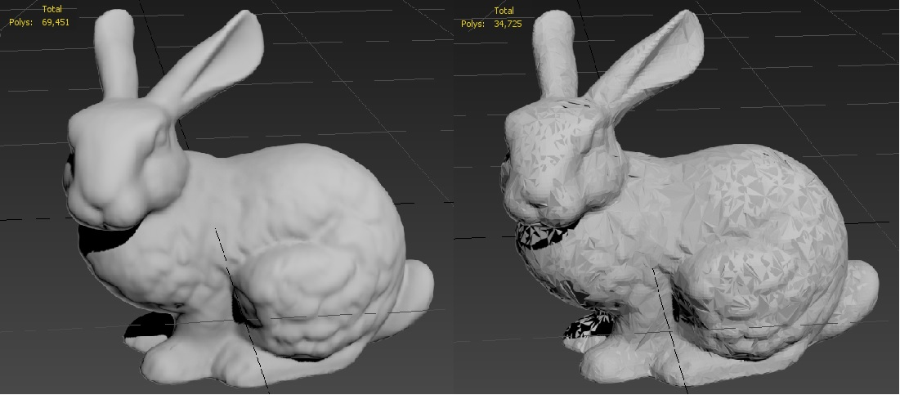
Result of Vertex Removal

Slide 13
Implementation for Edge Collapse
This operator collapses an edge (U, V) to a single vertex V, subset of the (U, V).

Slide 14
Compute the cost for edges
Define the cost of collapsing an edge as the length of the edge multiplied by a curvature term.
The curvature term for collapsing an edge uv is determined by comparing dot products of face normals in order to find the triangle adjacent to u that faces furthest away from the other triangles that are along uv.
Where Tu is the set of triangles that contain u and Tuv is the set of triangles that contain both u and v.

Slide 15
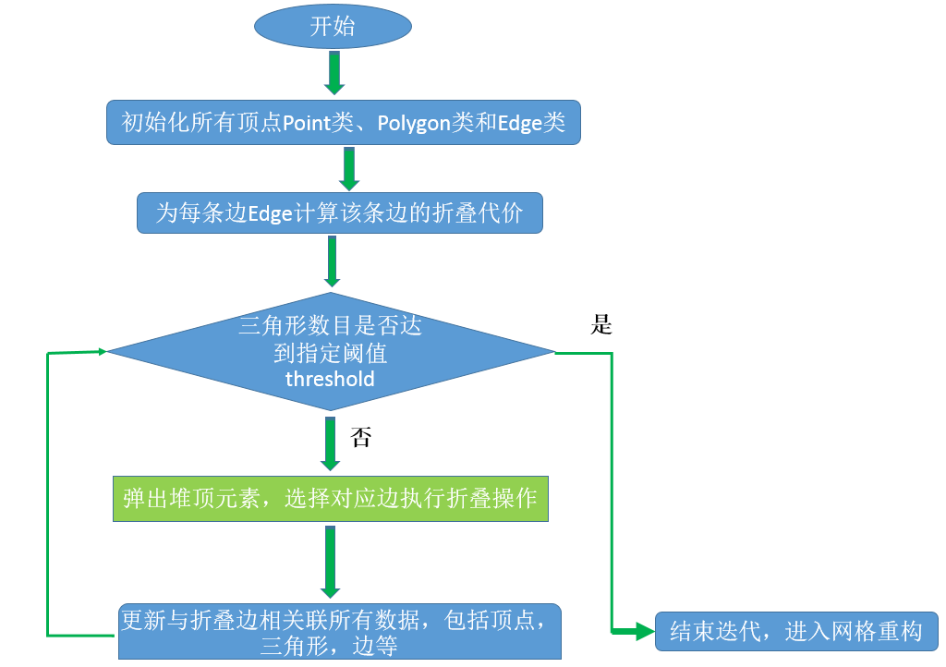
Flow chart

Slide 16
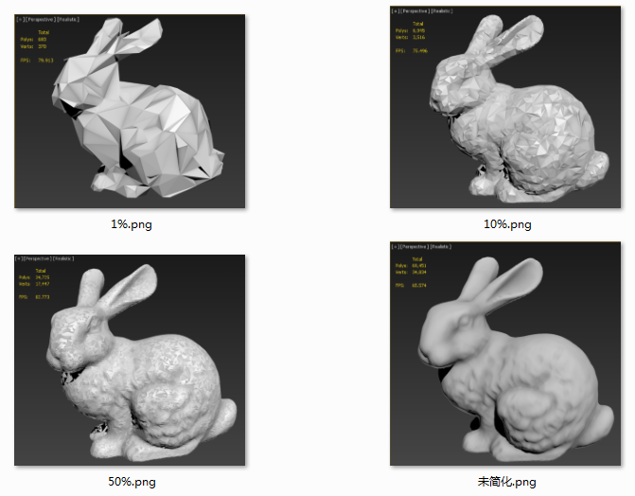
Result for Edge Collapse

Slide 17
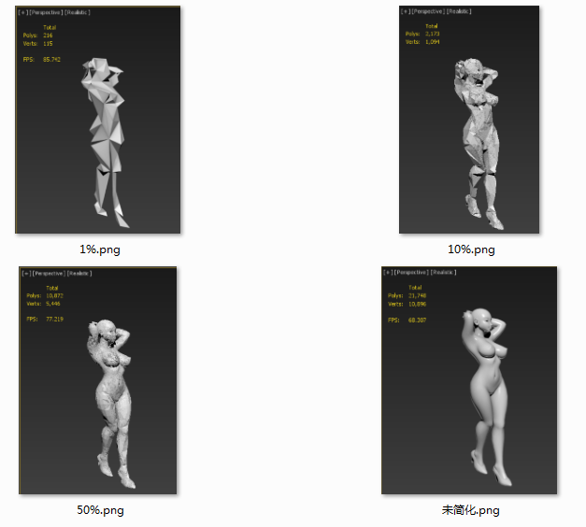
Result for Edge Collapse

Slide 18
Mesh Simplification with Atrributes
Many of today’s interesting polygonal models comprise not only geometric coordinates but other attributes as well.
Colors, normals, and texture coordinates are the most common attributes.

Slide 19
Colors
The colors of a polygonal model are typically stored as (r, g, b) triples with each value in the range [0, 1].
The most straightforward way to measure color error is to treat the RGB space (in which red, green, and blue form the orthogonal basis vectors of the coordinate system) as a Euclidean space and compute the RGB distance between corresponding points as:
$$d_{color}=\sqrt{{\left(r_{1}−r_{2}\right)}^{2}+{\left(g_{1}−g_{2}\right)}^{2}+{\left(b_{1}−b_{2}\right)}^{2}}$$

Slide 20
Texture Coordinates
Texture coordinates for polygonal surfaces are represented as (u, v) coordinate pairs that define a mapping of vertices to points in a 2D texture space.
As with the color space, this texture space generally uses values in the range [0,1].

Slide 21
Simplification with texture consideration
Unlike the color space, the u and v values should not be considered as totally independent. The difference here is that the texture coordinates are intended to describe a bijection (one-to-one and onto mapping) between the polygonal surface and the texture space.
The simplification process should take care to avoid creating folds in the texture space, causing the same texture space location to map to multiple locations on the surface.

Slide 22
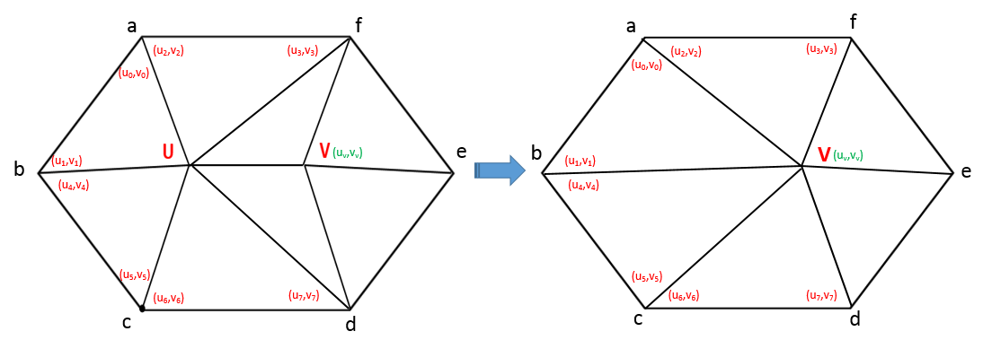
Implementation
triangle（a，b，v）：(u₀,v₀), (u₁,v₁),(u_{v}, v_{v})
triangle（a，f，v）：(u₂,v₂), (u₃,v₃),(u_{v}, v_{v})
triangle（b，c，v）：(u₄,v₄), (u₅,v₅),(u_{v}, v_{v})
triangle（c，d，v）：(u₆,v₆), (u₇,v₇),(u_{v}, v_{v})

Slide 23
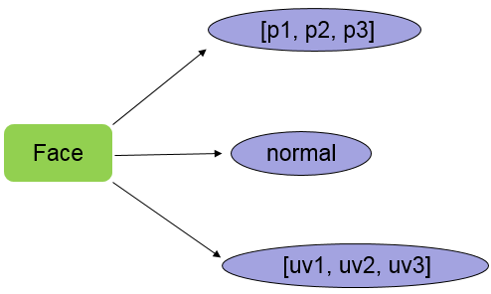
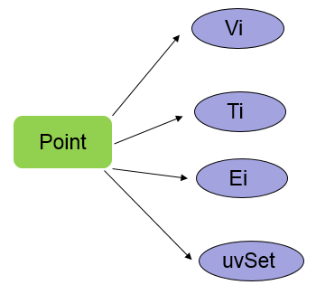
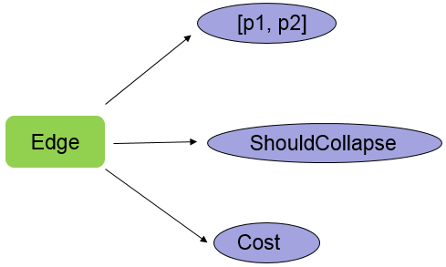
Data structures

Slide 24
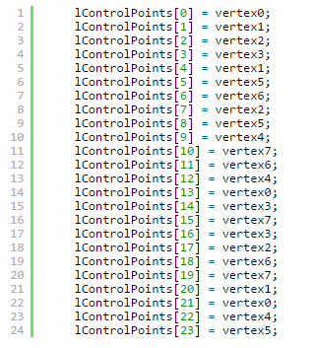
Eliminate redundant control points

Slide 25
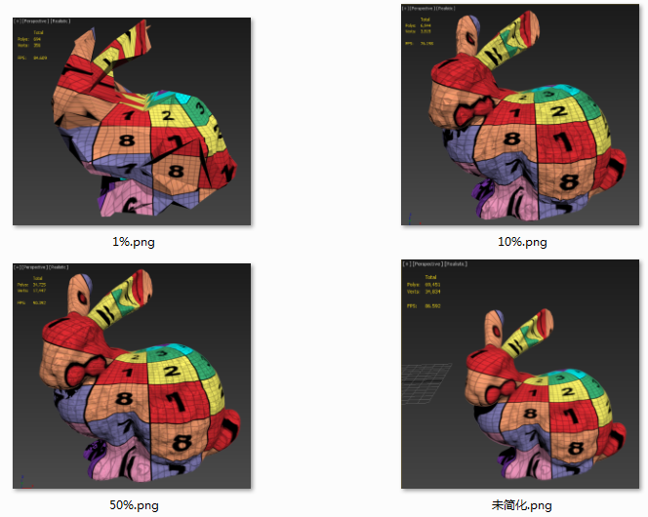
Result 1

Slide 26
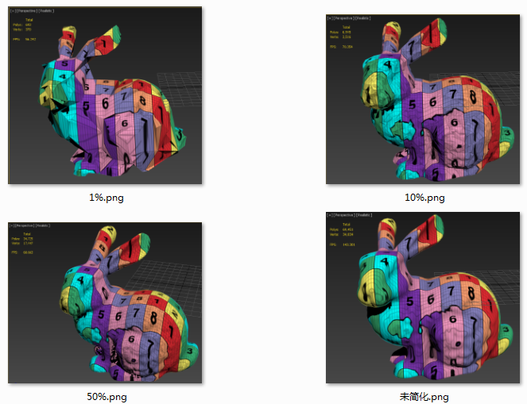
Result 2

Slide 27
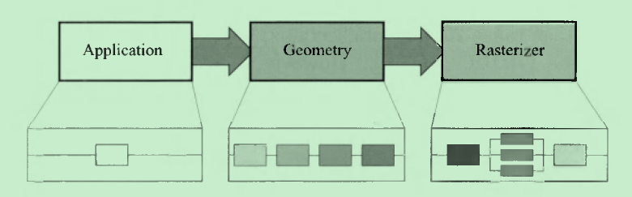
The Graphics Rendering Pipeline
The pictures reference from Real-Time Rendering.3rd.

Slide 28
The Application Stage
In this Stage,the developer has full control over what happens in the application stage.since it executes on the CPU.
Therefore,the developer can entirely determine the implementation and can later modify it in order to improve performance.

Slide 29

The Geometry Stage
The Geometry stage is respoinsible for the majority of the per-polygon and per-vertex operations.

Slide 30
The Rasterizer Stage
Given the transformed and projected vertices with their associated shadring data(all from the geometry stage),the goal of the rasterizer stage is to compute and set colors for the pixels covered by the object.

Slide 31
Model and View Transform
On its way to the screen, a model is transformed into several different spaces or coordinate systems.
Originally,a model resides in its own model space,which simply means that it has not been transformed at all.
Each model can be associated with a model transform so that it can be positioned and oriented. It is possible to have several model transforms associated with a single model,because it allows several copies(called instances)of the same model.

Slide 32
World Space
After the coordinates of an object in the model space transform has been applied to there coordinates, the model is to be located in world coordinates o in a world space.
World space is unique,and after the modes have been transfored with their model transforms, all models exist in the same space.

Slide 33
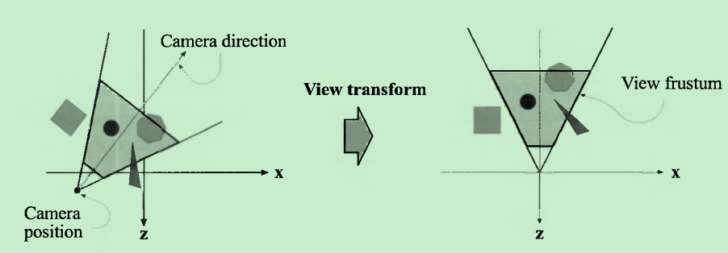
View Space
Only the models that the camera seens are rendered.

Slide 34
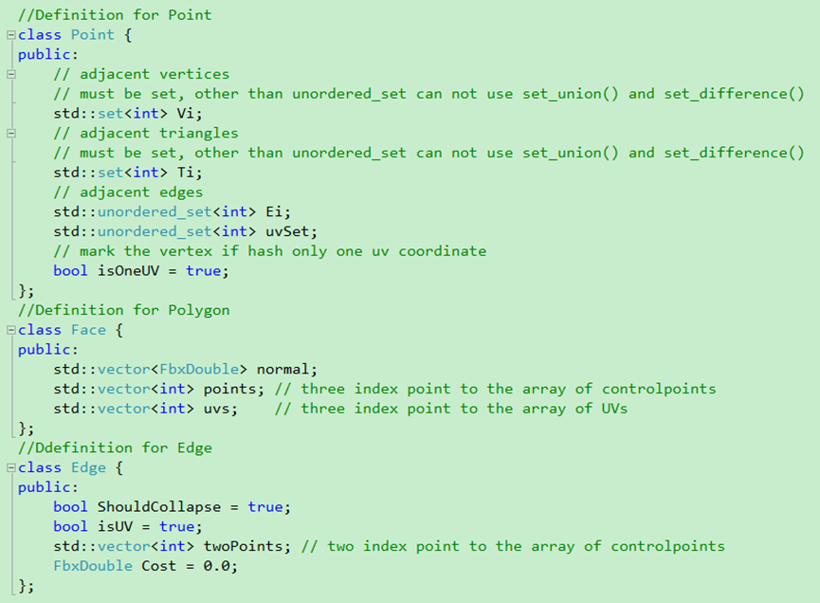
Generate LODs With C++

Slide 35
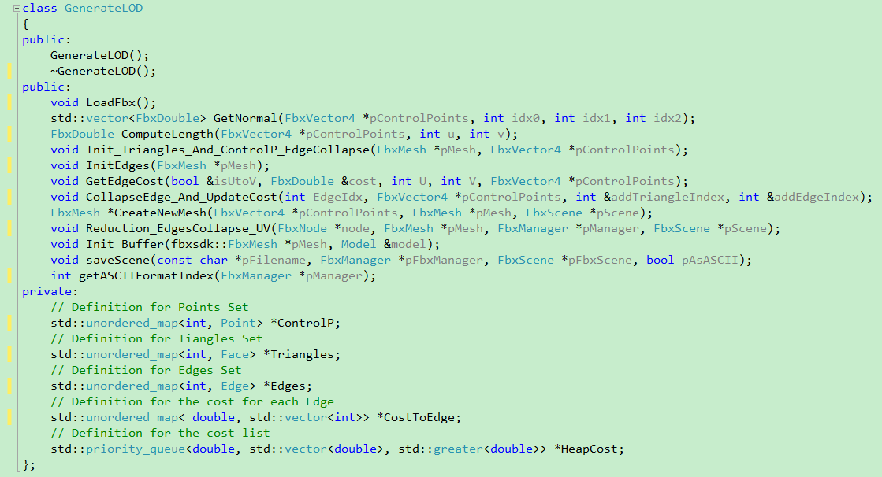
Algorithm Class

Slide 36
Data structures

Slide 37
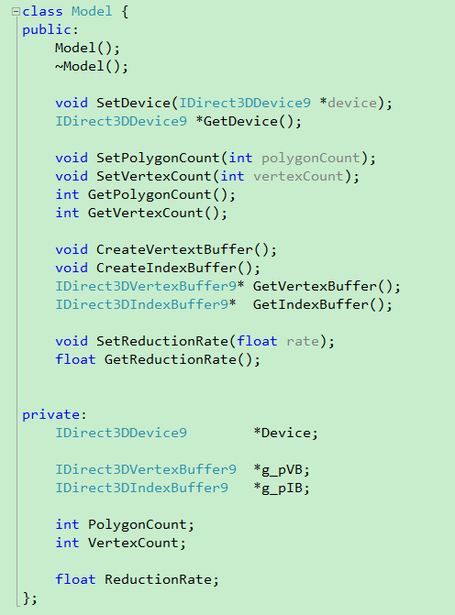
Model structure
g_pVB : vertex buffer
g_pIB : vertex index buffer
VertexCount
PolygonCount

Slide 38
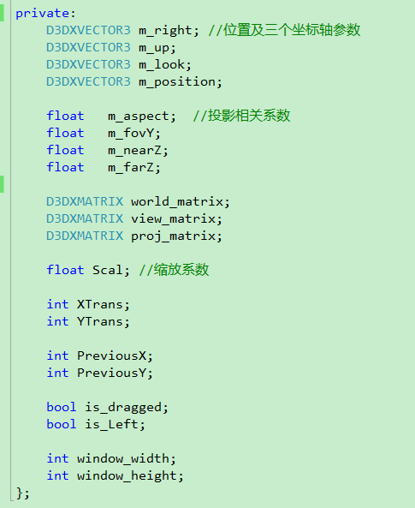
Camera
m_right
m_up
m_look
m_position

Slide 39
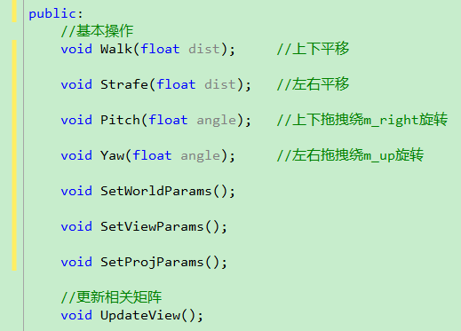
Translation/Rotation
Walk()
Strafe()
Pitch()
Yaw()

Slide 40
SetRenderState
To improve rendering performance, you can cull out (or remove) a primitive that faces away from the camera. For single-sided primitives, this saves rendering time because a back-face is not visible.
To enable culling, you need to know the winding order of the vertices (typically counter-clockwise).
D3DRS_CULLMODE:
D3DCULL_CCW (default)
D3DCULL_CW
D3DCULL_NONE

Slide 41
Main References
Level of Detail For 3d Graphics. (ps:book)
A Simple, Fast, and Effective Polygon Reduction Algorithm, November 98 Game Developer Magazine
P.Cignoni, C.Montani, R. Scopigno. Mesh Optimization
Michael Garland, Paul S. Heckbert. Surface Simplification Using Quadric Error Metrics
P. Cignoni, C. Montani, R. Scopigno. A comparison of mesh simplification algorithms
Real-Time Rendering.3rd.pdf
And some other Technology blog:
http://blog.csdn.net/dj0379/article/details/7903601
http://www.zwqxin.com/archives/opengl/model-fbx-dae-format-import-animation.html
http://www.cnblogs.com/clayman/archive/2010/12/10/1901779.html

Slide 42
The end
Thank you

