Slide 1
Group 4
gunnar
even
øyvind
øyvind

Slide 2
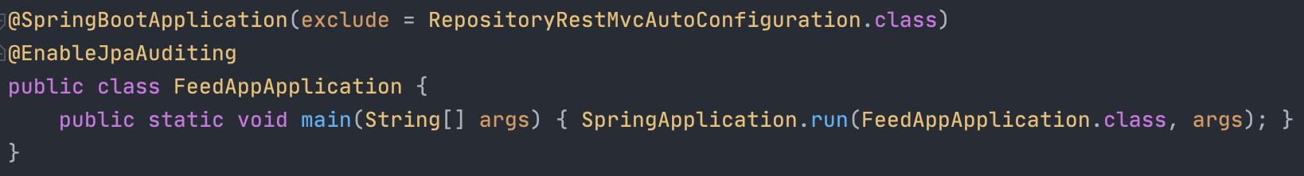
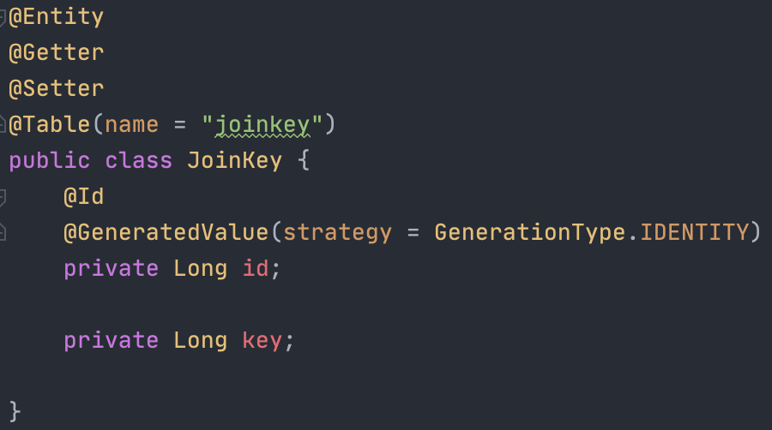
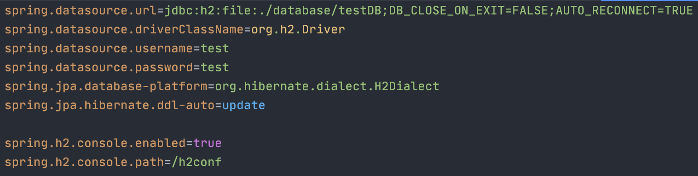
Design
Spring
Lombok
For getters and setters
H2
Database engine
Works well with Spring
Relation database

Slide 3
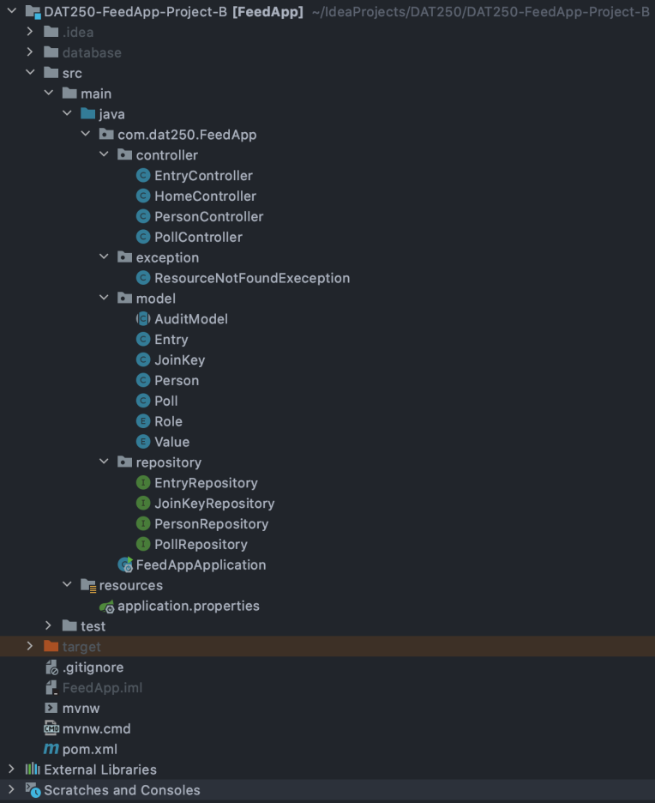
Implementation
Structure

Slide 4
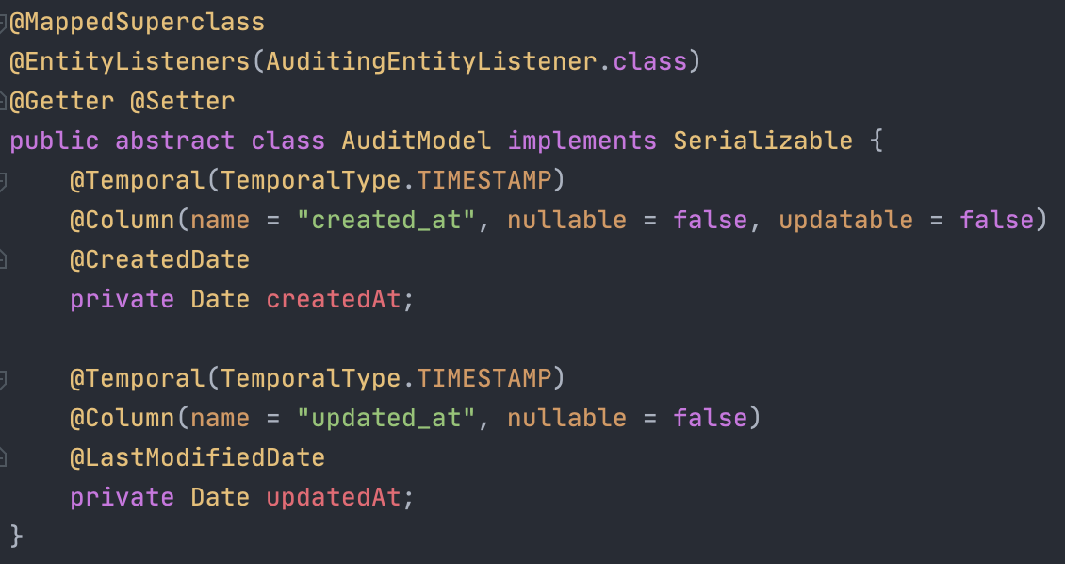
AuditModel

Slide 5
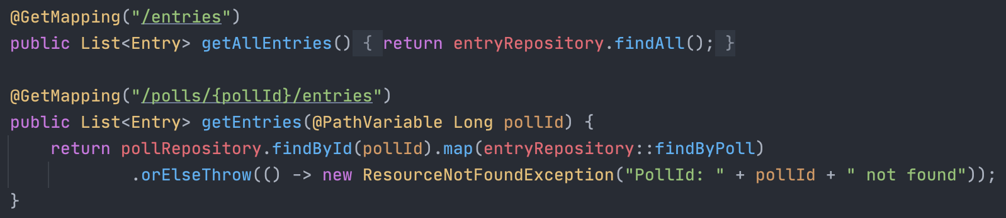
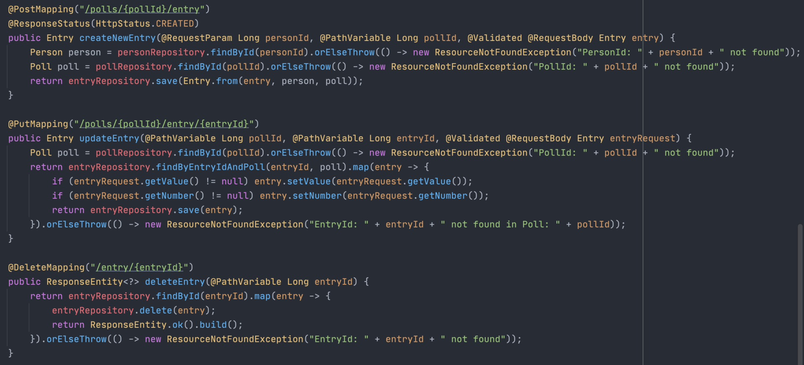
Controllers

Slide 6
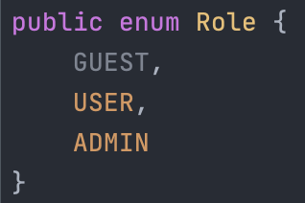
Roles

Slide 7
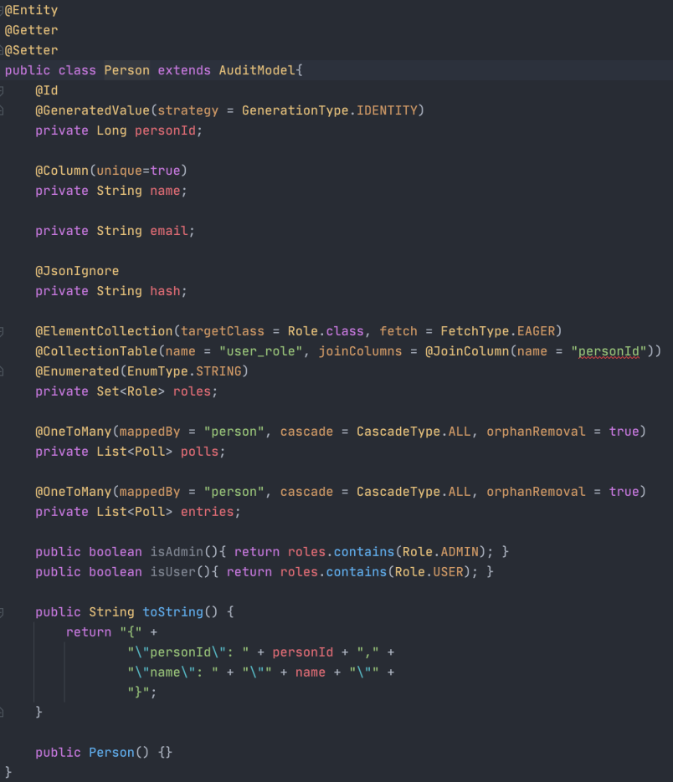
Entities

Slide 8
Repository

