Slide 1
Just CNN
(0.788, 0.134)
CNN + PPD
(0.415, 0.175)

Slide 2
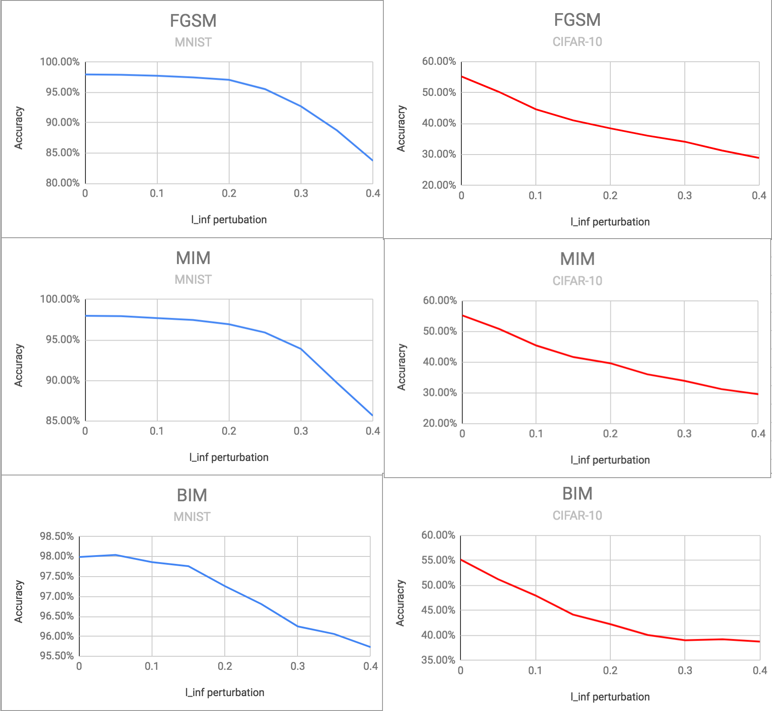

Slide 3
NOT Permuted Image
Permuted Image
0
Conv2D (3,3)
PhaseLayer
0
1
800
Conv2D (3,3)
2
1
PhaseLayer
MaxPool (2,2)
300
2
Dropout 0.25
10
Conv2D (3,3)
3
Conv2D (3,3)
4
MaxPool
Dropout
512
5
Dropout 0.5
10

