Slide 1
Introduction to C Programming
CSE115: Programming Language I

Slide 2
Semantics and Syntax
Semantics – the meaning of the language within a given context
String firstName = 23; // java example
Syntax - Syntax are the rules to join words
together in forming a correct expression or phrase.
int volume = 66 * 22 * 55; // C syntax
volume := 66 * 22 * 55 // Go syntax
He drinks rice (wrong semantic- meaningless, right syntax- grammar)
He drink water (right semantic- has meaning, wrong syntax- grammar)
In natural languages it is often possible to assemble a sentence in more than one correct ways.

Slide 3
C Programming Language
Why 'C' ?
Because based on 'B'; developed at Bell Laboratories
Developed by Dennis Ritchie at Bell Laboratories in the 1960s
In cooperation with Ken Thomson it was used for Unix systems
The C Language was only vaguely defined, not standardized, so that almost everyone had his own perception of it, to such an extend that an urgent need for a standard code was creeping up

Slide 4
A Simple Program in C
#include <stdio.h>
#include <stdlib.h>
int main()
{
printf("Hello world!\n");
return 0;
}
standard Library, input-output, header-file
Beginning of program
Start of Segment
Function for printing text
End of statement
Insert a new line
End of Segment

Slide 5
Preprocessor Directives
A C program begins with # which provides an instruction to the C preprocessor
It is executed before the actual compilation is done.
Two most common directives :
#include
#define
In our example (#include<stdio.h>) identifies the header file for standard input and output operations.

Slide 6
Function main()
Identify the start of the program
Every C program has a main( )
'main' is a C keyword. We must not use it for any other purpose.
4 common ways of main declaration
int main(void)
{
return 0;
}
void main(void)
{
}
main(void)
{
}
main( )
{
}

Slide 7
The curly braces { }
Identify a segment / body of a program
The start and end of a function
The start and end of the selection or repetition block.
Since the opening brace indicates the start of a segment with the closing brace indicating the end of a segment, there must be just as many opening braces as closing braces (this is a common mistake of beginners)

Slide 8
Statement
Specifying an action to be taken by the computer as the program executes.
Each statement in C needs to be terminated with semicolon (;)
Example:
#include <stdio.h>
int main()
{
printf(“I love programming\n”);
printf(“You will love it too once ”);
printf(“you know the trick\n”);
return 0;
}
statement
statement
statement
statement

Slide 9
Statement
Statement has two parts :
Declaration
The part of the program that tells the compiler the names of memory cells in a program
Executable statements
Program lines that are converted to machine language instructions and executed by the computer

Slide 10
An Example
/*
Converts distance in miles
to kilometres.
*/
#include <stdio.h> //printf, scanf definitions
#define KMS_PER_MILE 1.609 //conversion constant
int main(void) {
float miles, // input – distance in miles
kms; // output – distance in kilometres
miles = 10.5;
//Convert the distance to kilometres
kms = KMS_PER_MILE * miles;
//Display the distance in kilometres
printf("That equals %f km.\n", kms);
return 0;
}
Why scanf()
Programmer vs User

Slide 11
An Example
/*
Converts distance in miles
to kilometres.
*/
#include <stdio.h> //printf, scanf definitions
#define KMS_PER_MILE 1.609 //conversion constant
int main(void) {
float miles, // input – distance in miles
kms; // output – distance in kilometres
//Get the distance in miles
printf("Enter distance in miles: ");
scanf("%f", &miles);
//Convert the distance to kilometres
kms = KMS_PER_MILE * miles;
//Display the distance in kilometres
printf("That equals %f km.\n", kms);
return 0;
}

Slide 12
An Example
/*
Converts distance in miles
to kilometres.
*/
#include <stdio.h> //printf, scanf definitions
#define KMS_PER_MILE 1.609 //conversion constant
int main(void) {
float miles, // input – distance in miles
kms; // output – distance in kilometres
//Get the distance in miles
printf("Enter distance in miles: ");
scanf("%f", &miles);
//Convert the distance to kilometres
kms = KMS_PER_MILE * miles;
//Display the distance in kilometres
printf("That equals %f km.\n", kms);
return 0;
}
standard header file
preprocessor directives
constant
reserved words
variables
comments
functions
special symbols
punctuations

Slide 13
An Example
/*
Converts distance in miles
to kilometres.
*/
#include <stdio.h> //printf, scanf definitions
#define KMS_PER_MILE 1.609 //conversion constant
int main(void) {
float miles, // input – distance in miles
kms; // output – distance in kilometres
//Get the distance in miles
printf("Enter distance in miles: ");
scanf("%f", &miles);
//Convert the distance to kilometres
kms = KMS_PER_MILE * miles;
//Display the distance in kilometres
printf("That equals %f km.\n", kms);
return 0;
}
declarations
Executable statements

Slide 14
An Example
/*
Converts distance in miles
to kilometres.
*/
#include <stdio.h> //printf, scanf definitions
#define KMS_PER_MILE 1.609 //conversion constant
int main(void) {
float miles, // input – distance in miles
kms; // output – distance in kilometres
//Get the distance in miles
printf("Enter distance in miles: ");
scanf("%f", &miles);
//Convert the distance to kilometres
kms = KMS_PER_MILE * miles;
//Display the distance in kilometres
printf("That equals %f km.\n", kms);
return 0;
}
Sample Run
Enter distance in miles: 10.5
That equals 16.89 km.

Slide 15
An Example
What happens in the computer memory?
memory
memory
memory
MileToKm.exe
MileToKm.exe
MileToKm.exe
miles
miles
miles
?
10.5
10.5
kms
kms
kms
?
?
16.89
At the beginning
After user enters: 10.5 to
scanf("%f", &miles);
After this line is executed:
kms = KMS_PER_MILE * miles;
Do not assume that uninitialised variables contain zero! (Very common mistake.)

Slide 16
Variables
Variable → a name associated with a memory cell whose value can change
Variable Declaration: specifies the type of a variable
Example: int num;
Variable Definition: assigning a value to the declared variable
Example: num = 5;

Slide 17
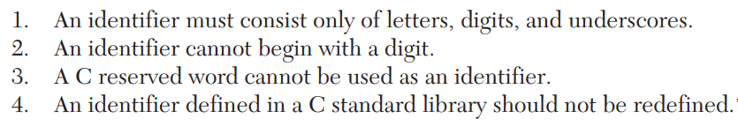
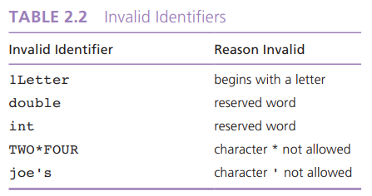
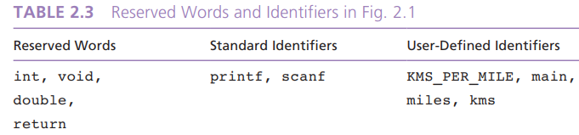
Identifiers

Slide 18
Basic Data Types
There are 4 basic data types :
int // 4 bytes
float // 4 bytes
double // 8 bytes
char // 1 bytes
int
used to declare numeric program variables of integer type
whole numbers, positive and negative
keyword: int
int number;
number = 12;
….
…
number = 7;

Slide 19
Basic Data Types
float
fractional parts, positive and negative
keyword: float
float height;
height = 1.72;
double
used to declare floating point variable of higher precision or higher range of numbers
exponential numbers, positive and negative
keyword: double
double valuebig;
valuebig = 12E-3; (is equal to 12X10⁻³)

Slide 20
Basic Data Types
char
A single symbol that can be typed using the keyboard
Example of characters:
Numeric digits: 0 - 9
Lowercase/uppercase letters: a - z and A - Z
Space (blank)
Special characters: , . ; ? “ / ( ) [ ] { } * & % ^ < > etc
single character
keyword: char
char d;
d = 128;
In addition, there are void, short, long, etc.
Extended ASCII (American Standard Code for Information Interchange) represents both control characters and printable characters.
The declared character must be enclosed within a single quote!

Slide 21
Data types (summary)
Type | Storage size | Value range | Precision
char | 1 byte | -128 to 127 or 0 to 255 | n/a
int | 4 bytes | -2,147,483,648 to 2,147,483,647 | n/a
unsigned int | 4 bytes | 0 to 4,294,967,295 | n/a
float | 4 byte | 1.2E-38 to 3.4E+38 | 6 decimal places
double | 8 byte | 2.3E-308 to 1.7E+308 | 15 decimal places
Here unsigned is a modifier; a modifier is a C keyword that can be used in front of a data type to modify the behavior of that data type

Slide 22
A closer look at variables
Memory

Slide 23
A closer look at variables
int a = 139, b = -5;
Memory

Slide 24
A closer look at variables
int a = 139, b = -5;
Memory
a
139
b
-5

Slide 25
A closer look at variables
int a = 139, b = -5;
Memory
a
139
b
-5
0 | 0 | 0 | 0 | 0 | 0 | 0 | 0 | 0 | 0 | 0 | 0 | 0 | 0 | 0 | 0 | 0 | 0 | 0 | 0 | 0 | 0 | 0 | 0 | 1 | 0 | 0 | 0 | 1 | 0 | 1 | 1
32 bits

Slide 26
A closer look at variables
int a = 139, b = -5;
Memory
a
139
b
-5
1 | 1 | 1 | 1 | 1 | 1 | 1 | 1 | 1 | 1 | 1 | 1 | 1 | 1 | 1 | 1 | 1 | 1 | 1 | 1 | 1 | 1 | 1 | 1 | 1 | 1 | 1 | 1 | 1 | 0 | 1 | 1
32 bits
← ------------------------------------ 2’s complement of 5 ------------------------→

Slide 27
A closer look at variables
char c = ‘H’;
0 | 1 | 0 | 0 | 1 | 0 | 0 | 0
8 bits

Slide 28
A closer look at variables
char c = ‘H’;
0 | 1 | 0 | 0 | 1 | 0 | 0 | 0
8 bits
?

Slide 29
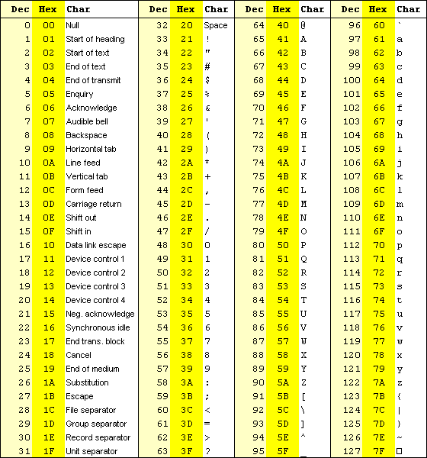

Slide 30
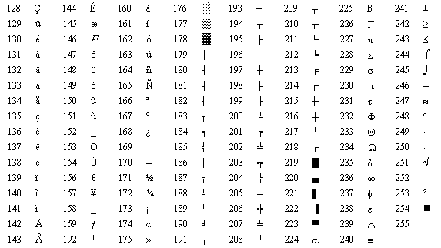

Slide 31
A closer look at variables
char c = 0x2A;//stores (00101010)₂=(2A)₁₆
1001000₂ = 72₁₀
0 | 1 | 0 | 0 | 1 | 0 | 0 | 0
8 bits
?

Slide 32
Input/Output Operations
Input operation
an instruction that copies data from an input device into memory
Output operation
an instruction that displays information stored in memory to the output devices (such as the monitor screen)

Slide 33
Input/Output Functions
A C function that performs an input or output operation
A few functions that are pre-defined in the header file stdio.h such as :
printf()
scanf()
getchar() & putchar()
#include <stdio.h>
int main () {
char c;
printf("Enter character: ");
c = getchar();
printf("Character entered: ");
putchar(c);
return(0);
}
Output:
Enter character: a
Character entered: a

Slide 34
The printf function
Used to send data to the standard output (usually the monitor) to be printed according to specific format.
General format:
printf(“string literal”);
A sequence of any number of characters surrounded by double quotation marks.
printf(“format string”, variables);
Format string is a combination of text, conversion specifier and escape sequence.

Slide 35
The printf function
Example:
printf(“Thank you”);
printf (“Total sum is: %d\n”, sum);
%d is a placeholder (conversion specifier)
marks the display position for a type integer variable
\n is an escape sequence
moves the cursor to the new line

Slide 36
Placeholder / Conversion Specifier
No | Conversion Specifier | Output Type | Output Example
1 | %d | Signed decimal integer | -76
2 | %i | Signed decimal integer | 76
3 | %o | Unsigned octal integer | 134
4 | %u | Unsigned decimal integer | 76
5 | %x | Unsigned hexadecimal (small letter) | 9c
6 | %X | Unsigned hexadecimal (capital letter) | 9C
7 | %f | Integer including decimal point | 76.0000
8 | %e | Signed floating point (using e notation) | 7.6000e+01
9 | %E | Signed floating point (using E notation) | 7.6000E+01
10 | %g | The shorter between %f and %e | 76
11 | %G | The shorter between %f and %E | 76
12 | %c | Character | ‘7’
13 | %s | String | “76”

Slide 37
Escape Sequence
Escape Sequence | Effect
\a | Beep sound
\b | Backspace
\n | New line
\t | Tab
\v | Vertical tab
\\ | Backslash
\” | “ sign

Slide 38
Formatting output
int meters = 21, feet = 68 , inches = 11;
printf("Results:%3d meters=%4d ft.%2d in.\n", meters, feet, inches);
printf("Results:%03d meters=%04d ft.%02d in.\n", meters, feet, inches);
R | e | s | u | l | t | s | : |  | 2 | 1 |  | m | e | t | e | r | s | = |  |  | 6 | 8 |  | f | t | . | 1 | 1 |  | i | n | .
R | e | s | u | l | t | s | : | 0 | 2 | 1 |  | m | e | t | e | r | s | = | 0 | 0 | 6 | 8 |  | f | t | . | 1 | 1 |  | i | n | .

Slide 39
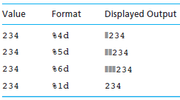
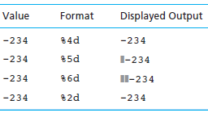
Formatting output

Slide 40
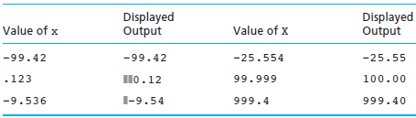
Formatting output
Displaying x Using Format String Placeholder %6.2f
printf(“%6.2f”,x);

Slide 41
The scanf function
Read data from the standard input device (usually keyboard) and store it in a variable.
General format:
scanf(“Format string”, &variable);
Notice ampersand (&) operator :
C address of operator
it passes the address of the variable instead of the variable itself
tells the scanf() where (in the RAM) to find the variable to store the new value

Slide 42
The scanf function
Example :
int age;
printf(“Enter your age: “);
scanf(“%d”, &age);
Common Conversion specifier used in printf and scanf functions.
 | printf | scanf
int | %d | %d
float | %f | %f
double | %lf | %lf
char | %c | %c
string | %s | %s

Slide 43
The scanf function
If you want the user to enter more than one value, you serialize the inputs.
Example:
float height, weight;
printf(“Please enter your height and weight:”);
scanf(“%f%f”, &height, &weight);

Slide 44
Expressions
An expression is any valid set of literals, variables, operators, operands and expressions that evaluates to a single value.
This value can be a number, a string or a logical value.
For instance a = b + c; denotes an expression in which there are 3 operands a, b, c and two operator + and =.
The number of operands of an operator is called its arity.
Based on arity, operators are classified as nullary (no operands), unary (1 operand), binary (2 operands), ternary (3 operands).

Slide 45
Arithmetic Operators
Operation | Operator | Example (a=5,b=3) | Value of expression
Addition | + | a+b | 8
Subtraction | - | b-a | -2
Multiplication | * | a*b | 15
Integer Division | / | a/b | 1
Modulus | % | a%b | 2
Division | / | a*1.0/b | 1.666666

Slide 46
Arithmetic Operators
If both of the operands are int types, then the result of the expression is an int too. If you want the result to be any other type, you have to use typecasting.
int a = 3, b = 5;
double c;
c = 1/5; //value of c is 0.0
c = 1.0/5; //value of c is 0.2
c = a/b; //value of c is 0.0
c = (double)a/b; //value of c is 0.6
modulus (%) operators works only when both of its operands are int variables/values.

Slide 47
Assignment Operators
Assignment operators are used to combine the '=' operator with one of the binary arithmetic operators
In the following table, assume that c = 9 for all the examples
Operator | Example | Equivalent Statement | Value of c is
+= | c += 7 | c = c + 7 | 16
-= | c -= 8 | c = c – 8 | 1
*= | c *= 10 | c = c * 10 | 90
/= | c /= 5 | c = c / 5 | 1
%= | c %= 5 | c = c % 5 | 4

Slide 48
Unary Operators
C Operation | Operator | Example
Positive | + | a = +3;
Negative | - | b = -a;
The first assigns positive 3 to a.
The second assigns the negative value of a to b.

Slide 49
Operator Precedence
When an expression contains more than one operator, the meaning of the expression may not be immediately clear:
Does i + j * k mean (i + j) * k or
i + (j * k) ?
In C, this potential ambiguity is resolved by operator precedence.
Precedence of the arithmetic operators:
Highest: + - (unary)
* / %
Lowest: + - (binary)

Slide 50
Operator Precedence
Examples:
i + j * k means i + (j * k)
-i * -j means (-i) * (-j)
+i + j / k means (+i) + (j / k)

Slide 51
Associativity
Operator precedence rules alone aren’t enough when an expression contains two or more operators at the same level of precedence. The associativity of the operators now comes into play.
The binary arithmetic operators are all left associative (they group from left to right); the unary operators are right associative.
Examples of associativity:
i - j - k means (i - j) - k
i * j / k means (i * j) / k
i - j * i + k means (i - (j * i)) + k
- - i means -(-i) right associative

Slide 52
Increment and Decrement Operators
The ++ and -- operators increment and decrement variables.
Both operators have the same precedence as negation.
Either operator can be prefix or postfix:
++i (same as i = i + 1)
i++ (same as i = i + 1)
--i (same as i = i - 1)
i-- (same as i = i - 1)
When used as a prefix operator, ++ increments the variable before its value is fetched:
i = 1;
printf("i is %d\n", ++i); /* prints "i is 2" */

Slide 53
Increment and Decrement Operators
When used as a postfix operator, ++ increments the variable after its value is fetched:
i = 1;
printf("i is %d\n", i++); /* prints "i is 1" */
printf("i is %d\n", i); /* prints "i is 2" */
The -- operator has similar properties:
i = 1;
printf("i is %d\n", --i); /* prints "i is 0" */
i = 1;
printf("i is %d\n", i--); /* prints "i is 1" */
printf("i is %d\n", i); /* prints "i is 0" */

Slide 54
Increment and Decrement Operators
int R = 10, count=10;
Statement | Equivalent Statements | R value | Count value
R = count++; | R = count; count = count + 1; | 10 | 11
R = ++count; | count = count + 1; R = count; | 11 | 11
R = count --; | R = count; count = count – 1; | 10 | 9
R = --count; | Count = count – 1; R = count; | 9 | 9

Slide 55
Partial List of C Operators
Precedence | Operator | Associativity
2 | ++ (prefix) -- (prefix) + (unary) - (unary) | Right
3 | * / % | Left
4 | + - | Left
5 | = *= /= %= += -= | Right
6 | ++ (postfix) -- (postfix) | Left

Slide 56
Programming Exercise
Try to predict the output of the following program and see if you can get it right.
#include <stdio.h>
int main()
{
int x = 3;
printf("%d\n", 3 -2 / 4);
printf("%f\n", 3 -2.0 / 4);
printf("%d\n", -27 / -5 + 4 / 3);
printf("%d\n", 16 % -5 + 7 * 6);
printf("%d\n", -12 * 3 % 5 * -23 / +6 - 5 * 2);
printf("%d\n", x-- * 2 + 5);
printf("%d\n", x);
printf("%d\n", --x * 2 + 5);
printf("%d\n", 3 % 5 / (5 % 3));
return 0;
}

Slide 57
Bitwise Operators
OR vs XOR
Students who have completed CSE115 or Mat116 can take CSE173.
Soup or salad comes with this entrée
& | bitwise AND
| | bitwise OR
^ | bitwise XOR Exclusive-OR
~ | 1’s compliment
<< | Shift left
>> | Shift right
All these operators (except ~) can be suffixed with =
For instance, a &= b; is the same as
a = a & b;

Slide 58
Bitwise Operators
Truth table
~a | a^b | a|b | a&b | b | a
1 | 0 | 0 | 0 | 0 | 0
1 | 1 | 1 | 0 | 1 | 0
0 | 1 | 1 | 0 | 0 | 1
0 | 0 | 1 | 1 | 1 | 1

Slide 59
Bitwise Operators
Examples
11010011
&
10001100
------------
10000000
11010011
|
10001100
------------
11011111
11010011
^
10001100
------------
01011111
~11010011
------------
00101100

Slide 60
Bitwise Operators
Examples: int a = 33333, b = -77777;
Expression | Representation | Value
a | 00000000 00000000 10000010 00110101 | 33333
b | 11111111 11111110 11010000 00101111 | -77777
a & b | 00000000 00000000 10000000 00100101 | 32805
a ^ b | 11111111 11111110 01010010 00011010 | -110054
a | b | 11111111 11111110 11010010 00111111 | -77249
~ ( a | b ) | 00000000 00000001 00101101 11000000 | 77248
~ a & ~ b | 00000000 00000001 00101101 11000000 | 77248

Slide 61
Bitwise Operators
Examples
(211)10
11010011>>3
------------
00011010
11010011<<3
------------
10011000
Right
left
211/2³=26
211x2³ = 1688 = 11010011000

Slide 62
Bitwise Operators
char c = 130;
unsigned int b = 1 << 31;
Expression | Representation | Action
c | 10111100 | unshifted
c << 4 | 11000000 | left shifted 4
c >> 4 | 00001011 | right shifted 4
b | 10000000 00000000 00000000 00000000 | unshifted
b >> 3 | 00010000 00000000 00000000 00000000 | right shifted 3

Slide 63
Suggested reading
Bitwise
https://www.guru99.com/c-bitwise-operators.html
https://www.programiz.com/c-programming/bitwise-operators
Book
Chapter 2
Problem Solving and Program Design in C-Addison-Wesley (Eight Edition)
Jeri R. Hanly, Elliot B. Koffman

Slide 64

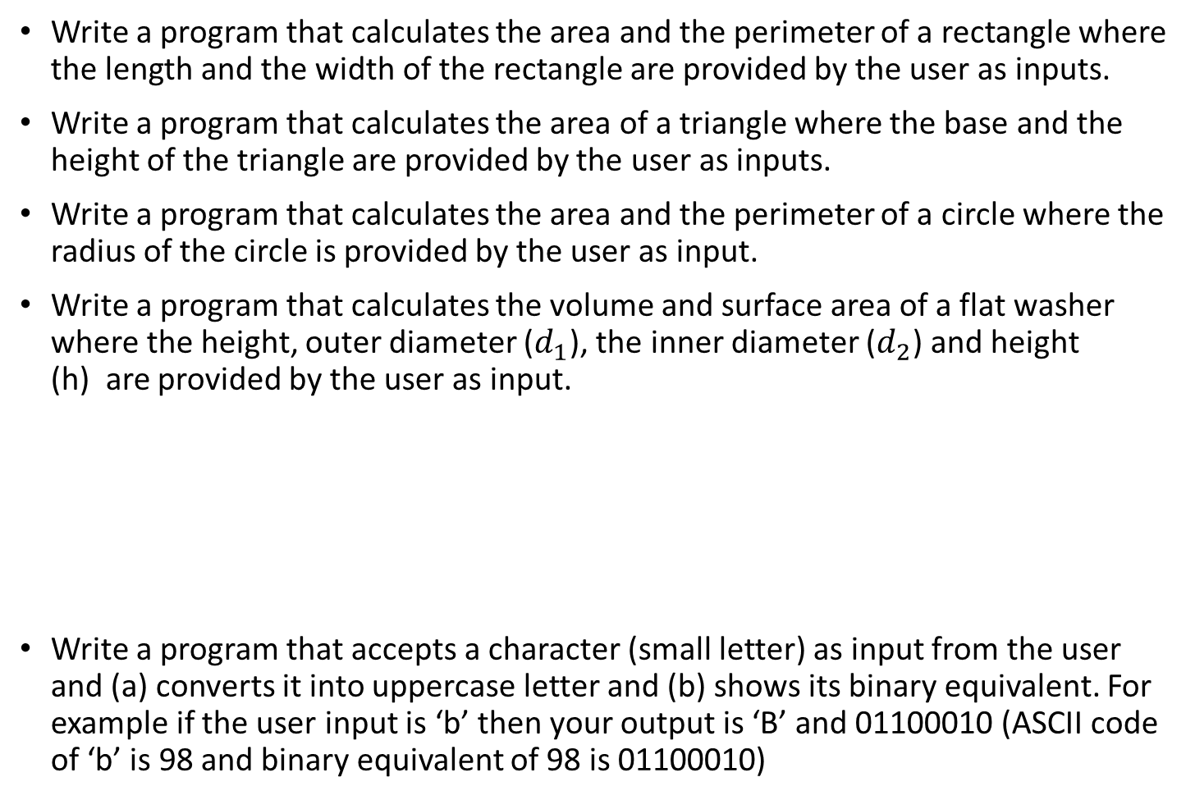

Practice
Write a program that calculates the area and the perimeter of a rectangle where the length and the width of the rectangle are provided by the user as inputs.
Write a program that calculates the area of a triangle where the base and the height of the triangle are provided by the user as inputs.
Write a program that calculates the area and the perimeter of a circle where the radius of the circle is provided by the user as input.
Write a program that calculates the volume and surface area of a flat washer where the height, outer diameter ($d_{1}$), the inner diameter ($d_{2}$) and height (h) are provided by the user as input.
Write a program that accepts a character (small letter) as input from the user and (a) converts it into uppercase letter and (b) shows its binary equivalent. For example if the user input is ‘b’ then your output is ‘B’ and 01100010 (ASCII code of ‘b’ is 98 and binary equivalent of 98 is 01100010)
$$d_{2}$$
$$d_{1}$$

