Slide 1
Overview of Programming
CSE115: Programming Language I

Slide 2
Introduction
Computer Programming
Computer cannot do anything by itself
Need to provide command (=set of instructions)
Now compare it with a calculator
Understanding Print
Integrated development environment (IDE)
https://en.wikipedia.org/wiki/Integrated_development_environment
Notepad is an IDE
We will use Code::Blocks as IDE
Compiler
Install codeblocks-20.03mingw-setup.exe
IDE
Compiler

Slide 3
Hello.c
Hello.o
Hello.exe

Slide 4
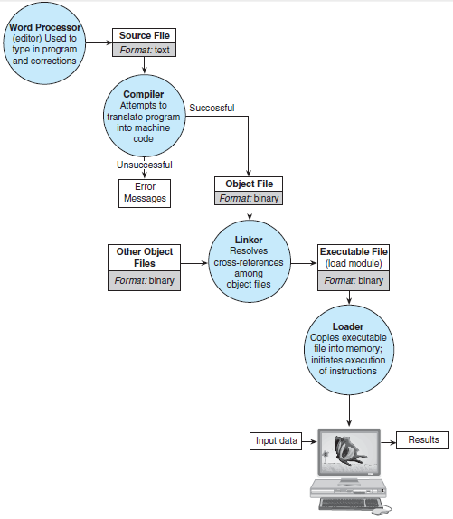
Steps of
programming
Integrated Development Environment (IDE) =
Editor + Compiler + Linker + Loader

Slide 5
Elements of Computer Systems
Two major categories:
1. Hardware
2. Software
• Hardware: Hardware is the equipment used to perform the necessary computations and includes the central processing unit (CPU), monitor, keyboard, mouse, printer, and speakers.
• Software: Software consists of the programs that enables us to solve problems with a computer by providing it with lists of instructions to perform.

Slide 6
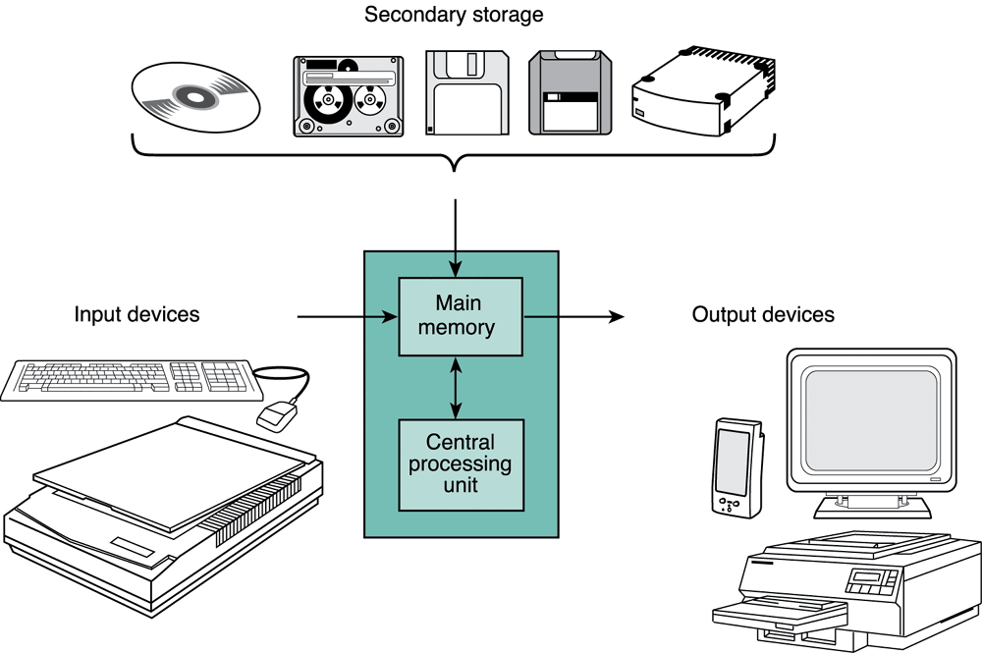
Computer Hardware Components
Components of a PC

Slide 7
Input / Output Devices
Input Devices
Accepts information from the user and transforms it to digital codes that the computer can process
Example: keyboard, mouse, scanner
Output Devices
An interface by which the computer conveys the output to the user
Example: monitor, printer

Slide 8
Storage Devices
A device used to store a large amount of information.
Store the instructions and/or data needed for the computer to execute its tasks.
Can be “read only” or “writable”.
Example: Solid State Drive (SDD), Hard drive (HDD), CD ROM, floppy disks

Slide 9
Main Memory
A semiconductor device which stores the information necessary for a program to run.
Two types:
ROM (Read Only Memory)
Contains information that is necessary for the computer to boot up
The information stays there permanently even when the computer is turned off.
RAM (Random Access Memory)
Contains instruction or data needed for a program to run
Gets erased when the computer is turned off.

Slide 10
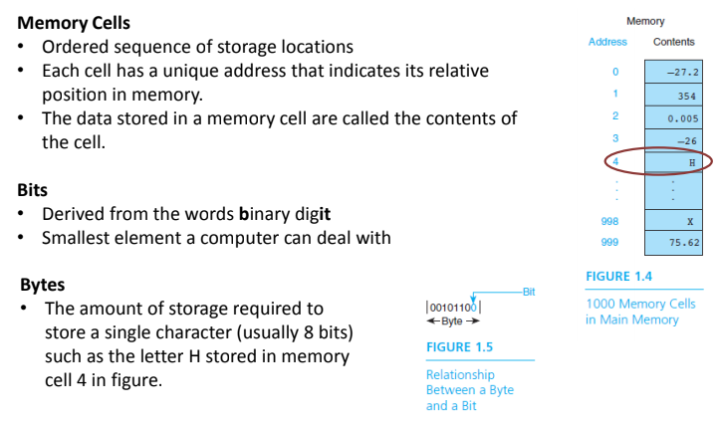
Anatomy of Memory

Slide 11
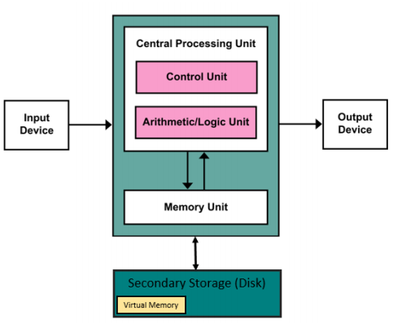
Central Processing Unit (CPU)
Does most of the work in executing a program
The CPU inside a PC is usually the microprocessor
3 main parts:
Control Unit: Fetch instructions from main memory and put them in the instruction register
ALU (Arithmetic Logic Unit): Execute arithmetic and logical operations
Registers: Temporarily store instructions or data fetched from memory
Von Neumann architecture

Slide 12
Computer Software
Two Types:
Operating System (OS): Software that controls interaction of user and computer hardware and that manages allocation of computer resources.
Application Software: Software used for a specific task such as word processing, accounting, or database management.
A software is a collection of related programs and associated data files.
A program is a sequence of instructions to solve a problem

Slide 13
Writing Computer Program
Computer needs our instructions in order to solve any problem. It can’t solve any problem by itself.
Programming is the task of writing a sequence of instructions for a computer to do something for you.
Programmer: who writes program
User: who runs program, gives input to it, and sees its output
But Computer doesn’t understand anything other than 0 and 1 (binary numbers).
So we have to either (i) learn computer’s own language (machine language) and then instruct it in that language or (ii) learn a programming language which is easier for humans to understand, write instructions in that language, and then translate (compile) the resulting program into a sequence of machine understandable (binary) instructions.

Slide 14
Hierarchies of Programming Languages
Machine Language (low level):
– Binary codes understood by a specific CPU
• Assembly Language (mid level):
– Mnemonic codes that correspond to machine language instructions
High-level language:
– Machine-independent programming language. Combines arithmetic expressions and English symbols. Easier to understand for humans.

Slide 15
Machine Language
The only language that the processor actually 'understands’
Consists of binary codes: 0 and 1
Example: 00010101
11010001
01001100
10011001
Each of the lines above corresponds to a specific task to be done by the processor.
Programming in machine code is difficult and slow since it is difficult to memorize all the instructions.
Mistakes can happen very easily.
Processor and Architecture dependent

Slide 16
Assembly Language
Enables machine code to be represented in words and numbers.
Example of a program in assembly language:
LOAD A, 9999
LOAD B, 8282
MOV C, A
DIV A, C
Easier to understand and memorize (called Mnemonics), compared to machine code but still quite difficult to use.
Processor and Architecture dependent

Slide 17
High-Level Language
Use more English words. They try to resemble English sentences. Therefore, it is easier to program in these languages.
The programming structure is problem oriented - does not need to know how the computer actually executes the instructions.
Processor independent - the same code can be run on different processors.
Examples of High-Level Languages: Fortran, Pascal, C, C++, Java,…
Example code written in C:
A = C;
A = A/C;
A high level language needs to be analyzed by the compiler and then compiled into machine code so that it can be understood and executed (i.e. performed) by the processor.

Slide 18
A Simple Program in C
#include <stdio.h>
#include <stdlib.h>
int main()
{
printf("Hello world!\n");
return 0;
}

Slide 19
A Simple Program in C
#include <stdio.h>
#include <stdlib.h>
int main()
{
printf("Hello world!\n");
return 0;
}
standard Library, input-output, header-file
Start of Segment
Beginning of program
Function for printing text
End of statement
Insert a new line
End of Segment

Slide 20
Output
Hello world!

Slide 21
Suggested reading
Book
Chapter 1
Problem Solving and Program Design in C-Addison-Wesley (Eight Edition)
Jeri R. Hanly, Elliot B. Koffman
Website: W3Schools
https://www.w3schools.com/c/c_getstarted.php

