Slide 1
Recursion
CSE115: Programming Language I

Slide 2
A Look Back at Functions
#include <stdio.h>
#include <math.h>
double distance(double x1, double y1, double x2, double y2)
{
double dist;
dist = sqrt((x1-x2)*(x1-x2)+(y1-y2)*(y1-y2));
return dist;
}
int main()
{
double milage = distance(0, 0, 3, 4);
printf("Milage: %lf\n",milage);
return 0;
}

Slide 3
A Look Back at Functions
#include <stdio.h>
#include <math.h>
double distance(double x1, double y1, double x2, double y2)
{
double dist;
dist = sqrt((x1-x2)*(x1-x2)+(y1-y2)*(y1-y2));
return dist;
}
int main()
{
double milage = distance(0, 0, 3, 4);
printf("Milage: %lf\n",milage);
return 0;
}
main

Slide 4
A Look Back at Functions
#include <stdio.h>
#include <math.h>
double distance(double x1, double y1, double x2, double y2)
{
double dist;
dist = sqrt((x1-x2)*(x1-x2)+(y1-y2)*(y1-y2));
return dist;
}
int main()
{
double milage = distance(0, 0, 3, 4);
printf("Milage: %lf\n",milage);
return 0;
}
main
distance
(0,0,3,4)

Slide 5
A Look Back at Functions
#include <stdio.h>
#include <math.h>
double distance(double x1, double y1, double x2, double y2)
{
double dist;
dist = sqrt((x1-x2)*(x1-x2)+(y1-y2)*(y1-y2));
return dist;
}
int main()
{
double milage = distance(0, 0, 3, 4);
printf("Milage: %lf\n",milage);
return 0;
}
main
distance
sqrt
(0,0,3,4)
(25)

Slide 6
A Look Back at Functions
#include <stdio.h>
#include <math.h>
double distance(double x1, double y1, double x2, double y2)
{
double dist;
dist = sqrt((x1-x2)*(x1-x2)+(y1-y2)*(y1-y2));
return dist;
}
int main()
{
double milage = distance(0, 0, 3, 4);
printf("Milage: %lf\n",milage);
return 0;
}
(5)
main
distance
sqrt
(0,0,3,4)
(25)

Slide 7
A Look Back at Functions
#include <stdio.h>
#include <math.h>
double distance(double x1, double y1, double x2, double y2)
{
double dist;
dist = sqrt((x1-x2)*(x1-x2)+(y1-y2)*(y1-y2));
return dist;
}
int main()
{
double milage = distance(0, 0, 3, 4);
printf("Milage: %lf\n",milage);
return 0;
}
(5)
main
distance
(0,0,3,4)

Slide 8
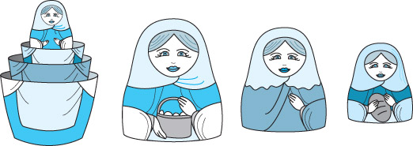
Recursion
Recursion is a technique that solves a problem by solving a smaller problem of the same type.
Recursion can be implemented using a recursive function (a function invoking itself, either directly or indirectly).
Recursion can be used as an alternative to iteration.
It is an important and powerful tool in problem solving and programming.
It is a programming technique that naturally implements the divide-and-conquer problem solving methodology.

Slide 9
Factorial – Iterative Definition
n! = n * (n-1) * (n-2) * … * 2 * 1 for any integer n>0
0! = 1
Iterative Definition in C:
fval = 1;
for (i = n; i >= 1; i--)
fval = fval * i;

Slide 10
Factorial – Recursive Definition
To define n! recursively, n! must be defined in terms of the factorial of a smaller number.
Observation (problem size is reduced):
n! = n * (n-1)!
Base case: 0! = 1
We can reach the base case, by subtracting 1 from n if n is a positive integer.
Recursive Definition:
n! = 1 if n = 0
n! = n*(n-1)! if n > 0

Slide 11
The Nature of Recursion
One or more simple cases of the problem (called the stopping cases or base case) have a simple non-recursive solution.
The other cases (general cases) of the problem can be reduced (using recursion) to problems that are closer to stopping cases.
Eventually the problem can be reduced to base cases only, which are relatively easy to solve.
In general:
if (base case)
solve it
else
reduce the problem using recursion // general case

Slide 12
Factorial of 4 (Recursive)
Calculate 4!
4! = 4 * (4-1)!
4! = 4 * 3!
4! = 4 * __

Slide 13
Factorial of 4 (Recursive)
Calculate 4!
4! = 4 * (4-1)!
4! = 4 * 3!
4! = 4 * __
Calculate 3!
3! = 3 * (3-1)!
3! = 3 * 2!
3! = 3 * __

Slide 14
Factorial of 4 (Recursive)
Calculate 4!
4! = 4 * (4-1)!
4! = 4 * 3!
4! = 4 * __
Calculate 3!
3! = 3 * (3-1)!
3! = 3 * 2!
3! = 3 * __
Calculate 2!
2! = 2 * (2-1)!
2! = 2 * 1!
2! = 2 * __

Slide 15
Factorial of 4 (Recursive)
Calculate 4!
4! = 4 * (4-1)!
4! = 4 * 3!
4! = 4 * __
Calculate 3!
3! = 3 * (3-1)!
3! = 3 * 2!
3! = 3 * __
Calculate 2!
2! = 2 * (2-1)!
2! = 2 * 1!
2! = 2 * __
Calculate 1!
1! = 1 * (1-1)!
1! = 1 * 0!
1! = 1 * __

Slide 16
Factorial of 4 (Recursive)
Calculate 4!
4! = 4 * (4-1)!
4! = 4 * 3!
4! = 4 * __
Calculate 3!
3! = 3 * (3-1)!
3! = 3 * 2!
3! = 3 * __
Calculate 2!
2! = 2 * (2-1)!
2! = 2 * 1!
2! = 2 * __
Calculate 1!
1! = 1 * (1-1)!
1! = 1 * 0!
1! = 1 * __
Calculate 0!
0! = 1

Slide 17
Factorial of 4 (Recursive)
Calculate 4!
4! = 4 * (4-1)!
4! = 4 * 3!
4! = 4 * __
Calculate 3!
3! = 3 * (3-1)!
3! = 3 * 2!
3! = 3 * __
Calculate 2!
2! = 2 * (2-1)!
2! = 2 * 1!
2! = 2 * __
Calculate 1!
1! = 1 * (1-1)!
1! = 1 * 0!
1! = 1 * 1
1! = 1

Slide 18
Factorial of 4 (Recursive)
Calculate 4!
4! = 4 * (4-1)!
4! = 4 * 3!
4! = 4 * __
Calculate 3!
3! = 3 * (3-1)!
3! = 3 * 2!
3! = 3 * __
Calculate 2!
2! = 2 * (2-1)!
2! = 2 * 1!
2! = 2 * 1
2! = 2

Slide 19
Factorial of 4 (Recursive)
Calculate 4!
4! = 4 * (4-1)!
4! = 4 * 3!
4! = 4 * __
Calculate 3!
3! = 3 * (3-1)!
3! = 3 * 2!
3! = 3 * 2
3! = 6

Slide 20
Factorial of 4 (Recursive)
Calculate 4!
4! = 4 * (4-1)!
4! = 4 * 3!
4! = 4 * 6
4! = 24

Slide 21
Recursive Factorial Function
// Computes the factorial of a nonnegative integer.
// Precondition: n must be greater than or equal to 0.
// Postcondition: Returns the factorial of n; n is unchanged.
int Factorial(int n)
{
if (n == 0) //base-case
return (1);
else //general-case
return (n * Factorial(n-1));
}

Slide 22
Tracing Factorial(4)
Factorial(4)

Slide 23
Tracing Factorial(4)
Factorial(4)
call
Factorial (4)

Slide 24
Tracing Factorial(4)
Factorial(4) = 4 * Factorial(3)
call
Factorial (4)
call
Factorial (3)

Slide 25
Tracing Factorial(4)
Factorial(4) = 4 * Factorial(3)
= 4 * (3 * Factorial(2))
call
Factorial (4)
call
Factorial (3)
call
Factorial (2)

Slide 26
Tracing Factorial(4)
Factorial(4) = 4 * Factorial(3)
= 4 * (3 * Factorial(2))
= 4 * (3 * (2 * Factorial(1)))
call
Factorial (4)
call
Factorial (3)
call
Factorial (2)
call
Factorial (1)

Slide 27
Tracing Factorial(4)
Factorial(4) = 4 * Factorial(3)
= 4 * (3 * Factorial(2))
= 4 * (3 * (2 * Factorial(1)))
= 4 * (3 * (2 * (1 * Factorial(0))))
call
Factorial (4)
call
Factorial (3)
call
Factorial (2)
call
Factorial (1)
call
Factorial (0)

Slide 28
Tracing Factorial(4)
Factorial(4) = 4 * Factorial(3)
= 4 * (3 * Factorial(2))
= 4 * (3 * (2 * Factorial(1)))
= 4 * (3 * (2 * (1 * Factorial(0))))
= 4 * (3 * (2 * (1 * 1)))
call
Factorial (4)
call
Factorial (3)
call
Factorial (2)
call
Factorial (1)
return
call
1
Factorial (0)

Slide 29
Tracing Factorial(4)
Factorial(4) = 4 * Factorial(3)
= 4 * (3 * Factorial(2))
= 4 * (3 * (2 * Factorial(1)))
= 4 * (3 * (2 * (1 * Factorial(0))))
= 4 * (3 * (2 * (1 * 1)))
= 4 * (3 * (2 * 1))
call
Factorial (4)
call
Factorial (3)
call
Factorial (2)
return
1
*
call
1
=
1
Factorial (1)
return
call
1
Factorial (0)

Slide 30
Tracing Factorial(4)
Factorial(4) = 4 * Factorial(3)
= 4 * (3 * Factorial(2))
= 4 * (3 * (2 * Factorial(1)))
= 4 * (3 * (2 * (1 * Factorial(0))))
= 4 * (3 * (2 * (1 * 1)))
= 4 * (3 * (2 * 1))
= 4 * (3 * 2)
call
Factorial (4)
call
Factorial (3)
return
2
*
call
1
=
2
Factorial (2)
return
1
*
call
1
=
1
Factorial (1)
return
call
1
Factorial (0)

Slide 31
Tracing Factorial(4)
Factorial(4) = 4 * Factorial(3)
= 4 * (3 * Factorial(2))
= 4 * (3 * (2 * Factorial(1)))
= 4 * (3 * (2 * (1 * Factorial(0))))
= 4 * (3 * (2 * (1 * 1)))
= 4 * (3 * (2 * 1))
= 4 * (3 * 2)
= 4 * 6
call
Factorial (4)
return
3
*
call
2
=
6
Factorial (3)
return
2
*
call
1
=
2
Factorial (2)
return
1
*
call
1
=
1
Factorial (1)
return
call
1
Factorial (0)

Slide 32
Tracing Factorial(4)
Factorial(4) = 4 * Factorial(3)
= 4 * (3 * Factorial(2))
= 4 * (3 * (2 * Factorial(1)))
= 4 * (3 * (2 * (1 * Factorial(0))))
= 4 * (3 * (2 * (1 * 1)))
= 4 * (3 * (2 * 1))
= 4 * (3 * 2)
= 4 * 6
= 24
return
4
*
call
6
=
24
final answer
Factorial (4)
return
3
*
call
2
=
6
Factorial (3)
return
2
*
call
1
=
2
Factorial (2)
return
1
*
call
1
=
1
Factorial (1)
return
call
1
Factorial (0)

Slide 33
A Couple of Things You Should Know
A stack is used to keep track of function calls.
Whenever a new function is called, all its parameters and local variables are pushed onto the stack along with the memory address of the calling statement (this gives the computer the return point after execution of the function)

Slide 34
Pitfalls of Recursion
If the recursion never reaches the base case, the recursive calls will continue until the computer runs out of memory and the program crashes. Experienced programmers try to examine the remains of a crash. The message “stack overflow error” or “heap storage exhaustion” indicates a possible runaway recursion.
When programming recursively, you need to make sure that the algorithm is moving toward the base case. Each successive call of the algorithm must be solving a simpler version of the problem.
Any recursive algorithm can be implemented iteratively, but sometimes only with great difficulty. However, a recursive solution will always run more slowly than an iterative one because of the overhead of opening and closing the recursive calls.

Slide 35
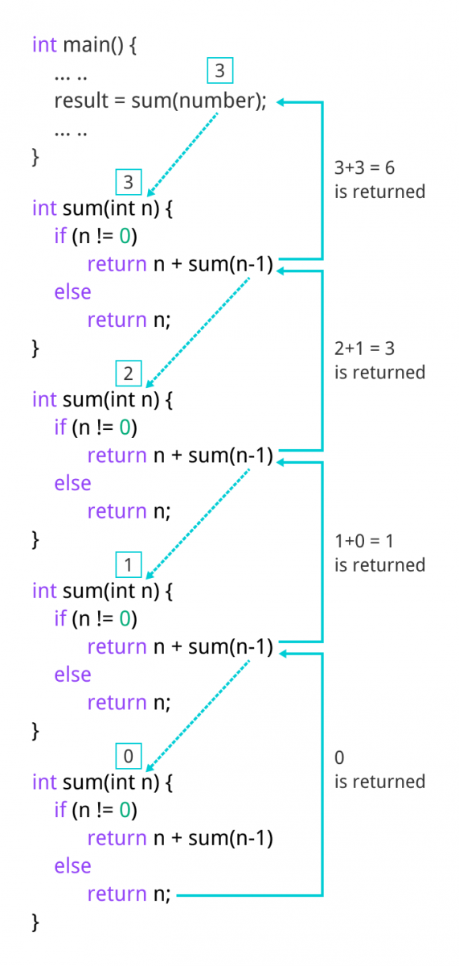

Slide 36
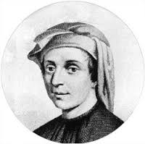
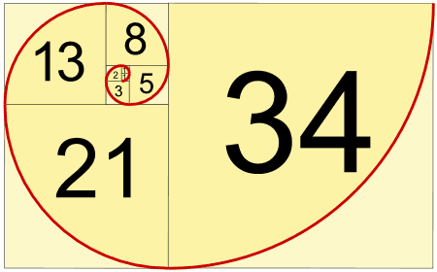
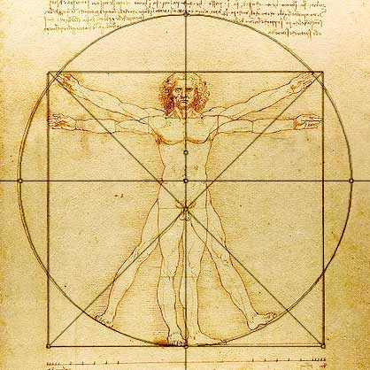
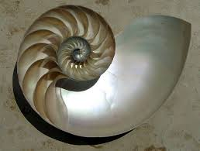
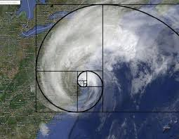
Fibonacci’s Problem
“Fibonacci” (Leonardo de Pisa) 1170-1240

Slide 37
Fibonacci Numbers
0, 1, 1, 2, 3, 5, 8, 13, 21, 34, ...
where each number is the sum of the preceding two.
Recursive definition:
F(0) = 0;
F(1) = 1;
F(number) = F(number-1)+ F(number-2);

Slide 38
Fibonacci Numbers
int Fibonacci(int n)
{
if(n == 0)
return 0;
else if (n == 1)
return 1;
else
return Fibonacci(n-1)+Fibonacci(n-2);
}
Base case
General
case

Slide 39
Tracing Fibonacci(5)
5
F(5)
Return F(4)+F(3)
3
2
F(4)
Return F(3)+F(2)
F(3)
Return F(2)+F(1)
2
1
1
1
F(3)
Return F(2)+F(1)
F(2)
Return F(1)+F(0)
F(2)
Return F(1)+F(0)
F(1)
Return 1
1
1
1
0
1
0
F(2)
Return F(1)+F(0)
F(1)
Return 1
F(1)
Return 1
F(0)
Return 0
F(1)
Return 1
F(0)
Return 0
1
0
F(1)
Return 1
F(0)
Return 0

Slide 40
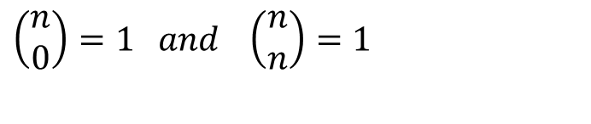
Another Example: n choose r (combinations)
Given n things, how many different sets of size k can be chosen?
with base cases:
$$\left(\begin{matrix}n \\ 0\end{matrix}\right)=1 and \left(\begin{matrix}n \\ n\end{matrix}\right)=1$$
C(n,r) = C(n-1, r-1) + C(n-1, r)
C(n,0) = 1 // r = 0
C(n,n) = 1 // r = n

Slide 41
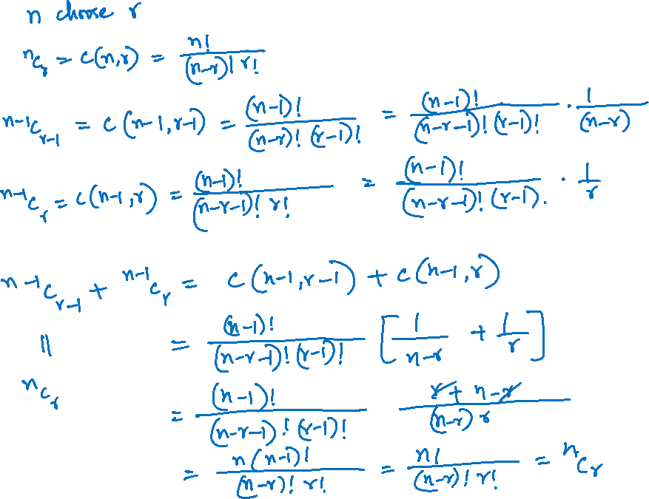

Slide 42
n choose r (Combinations)
int Combinations(int n, int r)
{
if(r == 0 || r == n) // base case
return 1;
else //general case
return(Combinations(n-1, r-1) + Combinations(n-1, r));
}

Slide 43
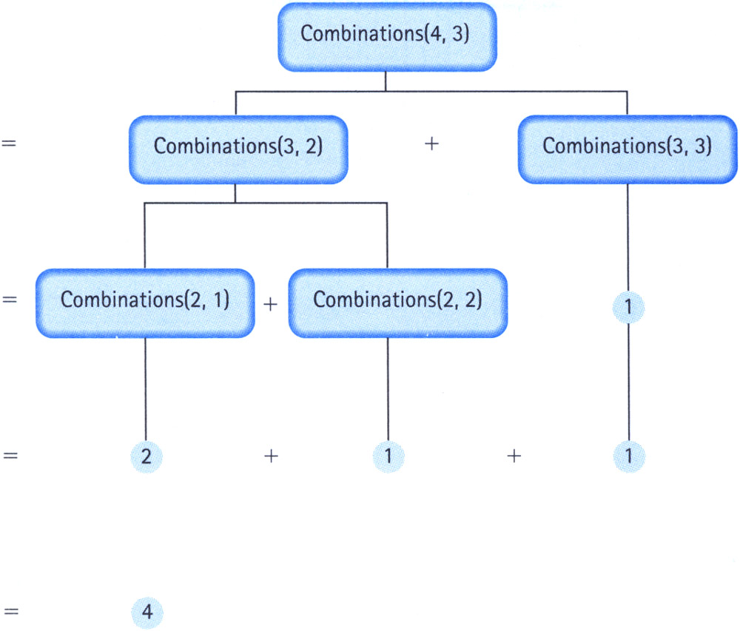
Tracing Combinations(4,3)

Slide 44
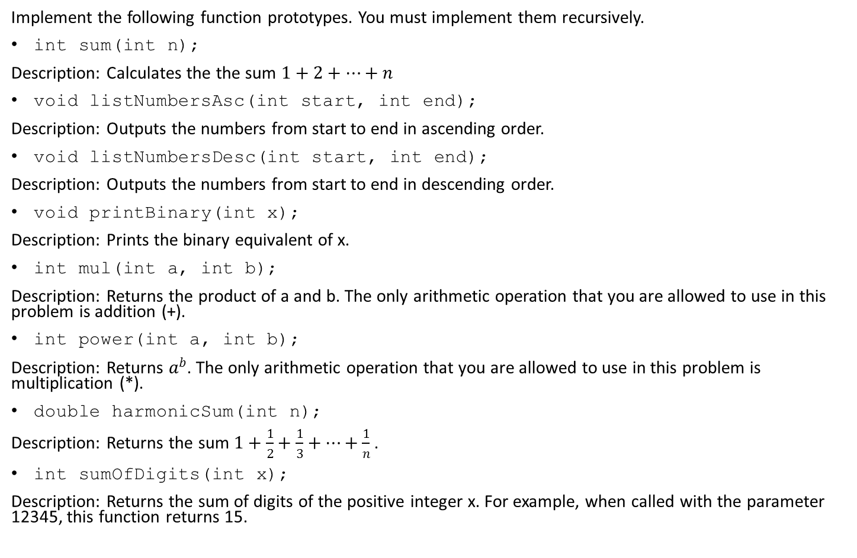
Home-works
Implement the following function prototypes. You must implement them recursively.
int sum(int n);
Description: Calculates the the sum $1+2+…+n$
void listNumbersAsc(int start, int end);
Description: Outputs the numbers from start to end in ascending order.
void listNumbersDesc(int start, int end);
Description: Outputs the numbers from start to end in descending order.
void printBinary(int x);
Description: Prints the binary equivalent of x.
int mul(int a, int b);
Description: Returns the product of a and b. The only arithmetic operation that you are allowed to use in this problem is addition (+).
int power(int a, int b);
Description: Returns $a^{b}$. The only arithmetic operation that you are allowed to use in this problem is multiplication (*).
double harmonicSum(int n);
Description: Returns the sum $1+\frac{1}{2}+\frac{1}{3}+…+\frac{1}{n}$ .
int sumOfDigits(int x);
Description: Returns the sum of digits of the positive integer x. For example, when called with the parameter 12345, this function returns 15.

Slide 45
Multiplication f(a,b)
F(a,b) = a + F(a,b-1)
F(a,0) = 0
a^{b}
f(a,b) = a * f(a,b-1)
f(a,0) = 1
Digit sum
F(n) = n%10 + F(n/10)
F(0) = 0

