Slide 1
Pointers - Dynamic Memory Allocation
CSE115: Programming Language I

Slide 2
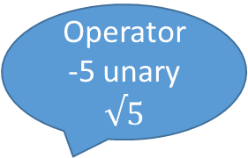
Operator
-5 unary
$$√5$$
sizeof(char) // 1
sizeof(int) // 4
sizeof(double) // 8
int n, *ptr;
size(n) // 4
sizeof(ptr) // 4
int arr[11];
sizeof(arr) // 11 x 4 = 44

Slide 3
Four Dynamic Memory Allocation Functions under stdlib.h
malloc(), calloc(), realloc()
free()
All returns void
char *ptr;
ptr = (char*)malloc(4 * sizeof(char));
int *ptr = (int*)malloc(5 * sizeof(int)); // memory not initialized
int *ptr = (int*)calloc(5, sizeof(int)); // default initialization with zero
// We may get to know about this 5 after long calculation
free(ptr); // ptr becomes null meaning memory deallocation

Slide 4
int *ptr = (int*)malloc(5 * sizeof(int)); // 5x4 = 20 Bytes
ptr = realloc(ptr, 10 * sizeof(int)); //10x4 = 40 Bytes
Already present value + new garbage value
If allocation is not done/successful
ptr == NULL

Slide 5
Dynamic Memory Allocation
Dynamic memory allocation is used to obtain and release memory during program execution. Up until this point we reserved memory at compile time using declarations.
You have to be careful with dynamic memory allocation. It operates at a low-level, you will often find yourself having to do a certain amount of work to manage the memory it gives you.
To use the functions discussed here, you must include the stdlib.h header file.
Four Dynamic Memory Allocation Functions:
Allocate memory - malloc(), calloc(), and realloc()
Free memory - free()
For more details:
https://www.geeksforgeeks.org/dynamic-memory-allocation-in-c-using-malloc-calloc-free-and-realloc/
https://www.geeksforgeeks.org/difference-between-malloc-and-calloc-with-examples/

Slide 6
malloc()
To allocate memory, use
void *malloc(size_t size);
Takes number of bytes to allocate as argument.
Use sizeof to determine the size of a type.
Returns pointer of type void *. A void pointer may be assigned to any pointer.
If no memory available, returns NULL.
e.g.
char *line;
int linelength = 100;
line = (char*)malloc(linelength);

Slide 7
malloc()
Prototype: void *malloc(size_t size);
function searches memory for size contiguous free bytes
function returns the address of the first byte
programmers responsibility to not lose the pointer
programmers responsibility to not write into area past the last byte allocated
Example:
Key
previously allocated
char *ptr;
ptr = (char*) malloc(4); // new allocation
new allocation
10
ptr
0
1
2
3
4
5
6
7
8
9
10
11
12
13
14
15
16
Memory

Slide 8
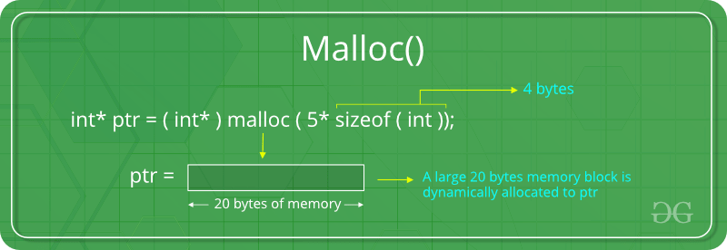
The “malloc” or “memory allocation” method in C is used to dynamically allocate a single large block of memory with the specified size.
It returns a pointer of type void which can be cast into a pointer of any form.
It doesn’t Initialize memory at execution time so that it has initialized each block with the default garbage value initially.

Slide 9
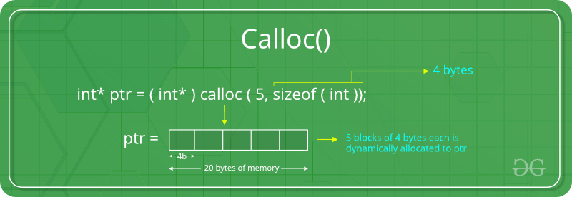
“calloc” or “contiguous allocation” method in C is used to dynamically allocate the specified number of blocks of memory of the specified type. it is very much similar to malloc() but has two different points and these are:
It initializes each block with a default value ‘0’.
It has two parameters or arguments as compare to malloc().

Slide 10
free()
Prototype: void free(void *ptr);
releases the area pointed to by ptr
ptr must not be null
trying to free the same area twice will generate an error
Example:
free(p1);
Key
allocated memory
2
5
p2
free memory
p1
initial memory
0
1
2
3
4
5
6
7
2
null
p2
p1
after free
0
1
2
3
4
5
6
7

Slide 11
Example
#include <stdio.h>
#include <stdlib.h>
int main()
{
char *str;
/* Memory allocation */
str = (char *) malloc(15);
strcpy(str, "KungFu");
printf("String = %s\n", str);
strcat(str, "Panda");
printf("String = %s\n", str);
/* Memory deallocation */
free(str);
return(0);
}

Slide 12
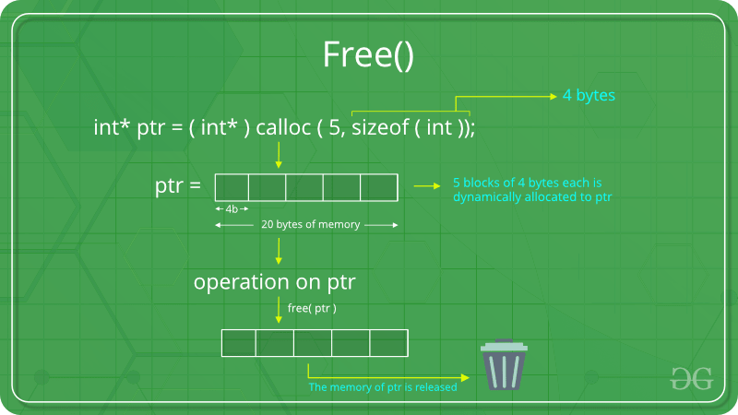
“free” method in C is used to dynamically de-allocate the memory. The memory allocated using functions malloc() and calloc() is not de-allocated on their own. Hence the free() method is used, whenever the dynamic memory allocation takes place. It helps to reduce wastage of memory by freeing it.

Slide 13
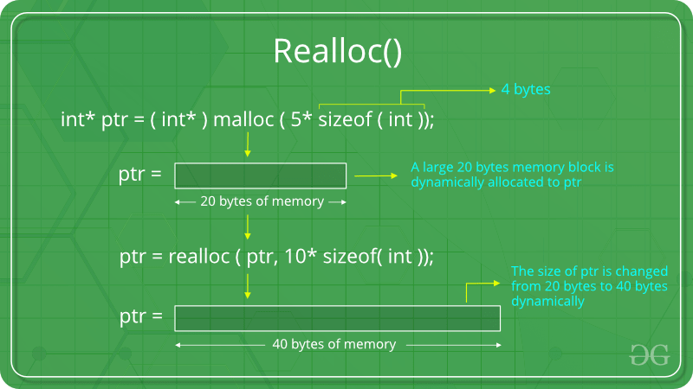
“realloc” or “re-allocation” method in C is used to dynamically change the memory allocation of a previously allocated memory. In other words, if the memory previously allocated with the help of malloc or calloc is insufficient, realloc can be used to dynamically re-allocate memory. re-allocation of memory maintains the already present value and new blocks will be initialized with the default garbage value.

Slide 14
Call by reference of the structure to the function
It is also possible to use pointers and pass the reference of the structure to the function. This way, any changes inside the function will change the actual structure as well.
To pass a structure variable as a reference, the Read( ) function can be written this way:
void Read(struct student *s1); /* function prototype */
Read(&student1); /* function call */
where student1 is a variable of type struct student.

Slide 15
Call by reference
Take note that when a structure is declared as a pointer, the elements in the structure cannot be referred to using the ‘.’ operator anymore. Instead, they need to be accessed using the ‘->’ operator (indirect component selection operator).
For example:
void Read(struct student *s1)
{
s1->studentID = 10179;
scanf(“%s”, s1->name);
}

Slide 16
Example Using Structure: Call by reference
#include <stdio.h>
#include <string.h>
struct student
{
char name[20];
int id;
};
void Read (struct student *s1)
{
printf("Enter name:");
gets(s1->name);
printf("Enter ID:");
scanf("%d",&s1->id);
}
void main(void)
{
struct student student1;
Read(&student1);
printf("Name: %s", student1.name);
printf("\nID: %d\n", student1.id);
}

Slide 17
void listEvenNumAscending(int start, int end)
{
if (end < start)
return;
else
// printf("%d\n",n);
listEvenNumAscending(start, end-1);
if (end%2 == 0)
printf("%d\n",end);
return;
}

