Slide 1
Miscellaneous Topics
CSE115: Programming Language I

Slide 2
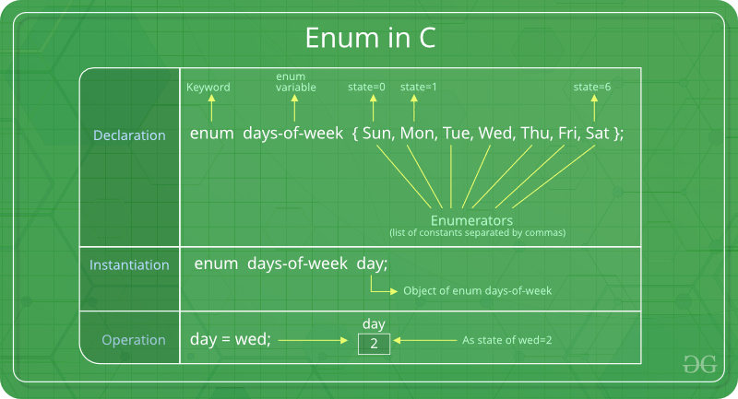
Enumeration (or enum) in C
Enumeration or Enum is a special kind of data type defined by the user.
It consists of constant integrals or integers that are given names by a user.
The use of enum in C to name the integer values makes the entire program easy to learn, understand, and maintain by the same or even different programmer.
We use enums for constants, i.e., when we want a variable to have only a specific set of values. For instance, for weekdays enum, there can be only seven values as there are only seven days in a week.

Slide 3
Macros in C
Macro in C programming is known as the piece of code defined with the help of the #define directive.
Macros in C are very useful at multiple places to replace the piece of code with a single value of the macro

Slide 4
#define
#include <stdio.h> #define INCREMENT(x) ++x int main() { char* ptr = "GeeksQuiz"; int x = 10; printf("%s ", INCREMENT(ptr)); printf("%d", INCREMENT(x)); return 0; } Output: eeksQuiz 11
#include <stdio.h> #define MULTIPLY(a, b) a* b int main() { // The macro is expanded as 2 + 3 * 3 + 5, not as 5*8 printf("%d", MULTIPLY(2 + 3, 3 + 5)); return 0; } // Output: 16
#include <stdio.h>
// here, instead of writing a*a we write (a)*(b)
#define MULTIPLY(a, b) (a) * (b)
int main()
{
// The macro is expanded as (2 + 3) * (3 + 5), as 5*8
printf("%d", MULTIPLY(2 + 3, 3 + 5));
return 0;
}
Output: 40
#include <stdio.h> #define merge(a, b) a##b int main() { printf("%d ", merge(12, 34)); } Output: 1234
#include <stdio.h>
#define get(a) #a
int main()
{
// GeeksQuiz is changed to "GeeksQuiz"
printf("%s", get(GeeksQuiz));
}

Slide 5
#include <stdio.h>
#define PRINT(i, limit) \
while (i < limit) { \
printf("GeeksQuiz "); \
i++; \
}
int main()
{
int i = 0;
PRINT(i, 3);
return 0;
}
Output: GeeksQuiz GeeksQuiz GeeksQuiz
#include <stdio.h>
#define square(x) x* x
int main()
{
// Expanded as 36/6*6
int x = 36 / square(6);
printf("%d", x); //36
return 0;
}
#include <stdio.h>
#define square(x) (x * x)
int main()
{
// Expanded as 36/(6*6)
int x = 36 / square(6);
printf("%d", x); // 1
return 0;
}

Slide 6
Linear search
Linear search in C to find whether a number is present in an array.
If it's present, then at what location it occurs.
It is also known as a sequential search.
It is straightforward and works as follows: we compare each element with the element to search until we find it or the list ends.

Slide 7
Binary Search
Key
List
8
1 | 2 | 3 | 4 | 6 | 7 | 8 | 9
8
1 | 2 | 3 | 4 | 6 | 7 | 8 | 9
8
1 | 2 | 3 | 4 | 6 | 7 | 8 | 9
Binary Search is a searching algorithm for finding an element's position in a sorted array.
In this approach, the element is always searched in the middle of a portion of an array.

Slide 9
Binary Search, cont.

Slide 10
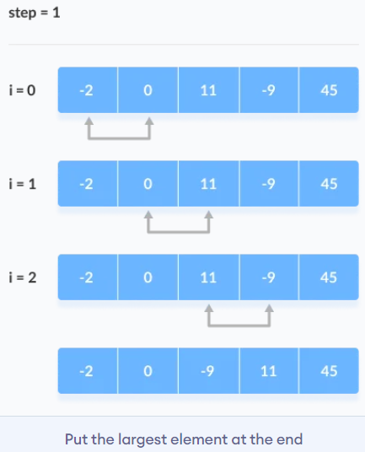
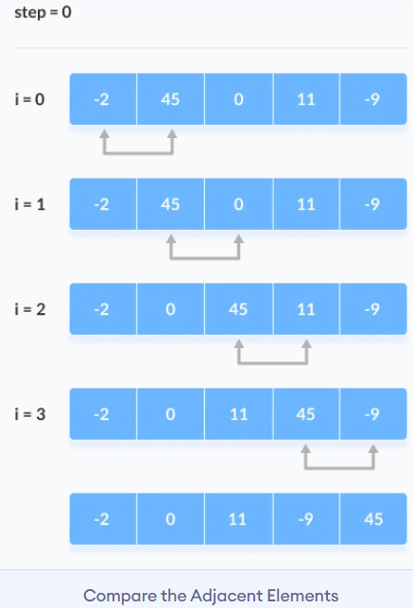
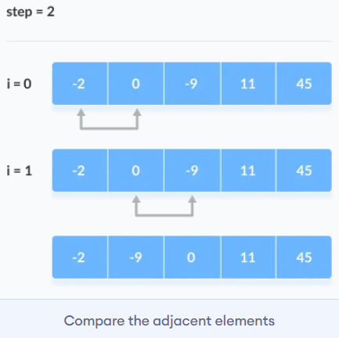
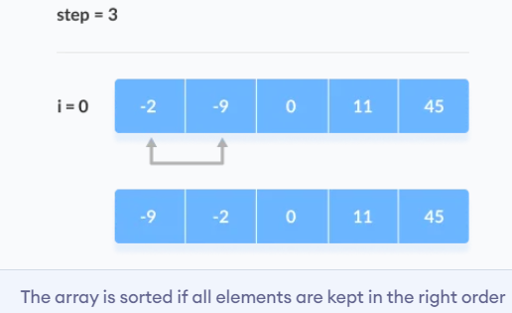
Bubble Sort
bubbleSort(array)
for i <- 1 to indexOfLastUnsortedElement-1
if leftElement > rightElement
swap leftElement and rightElement
end bubbleSort

Slide 11
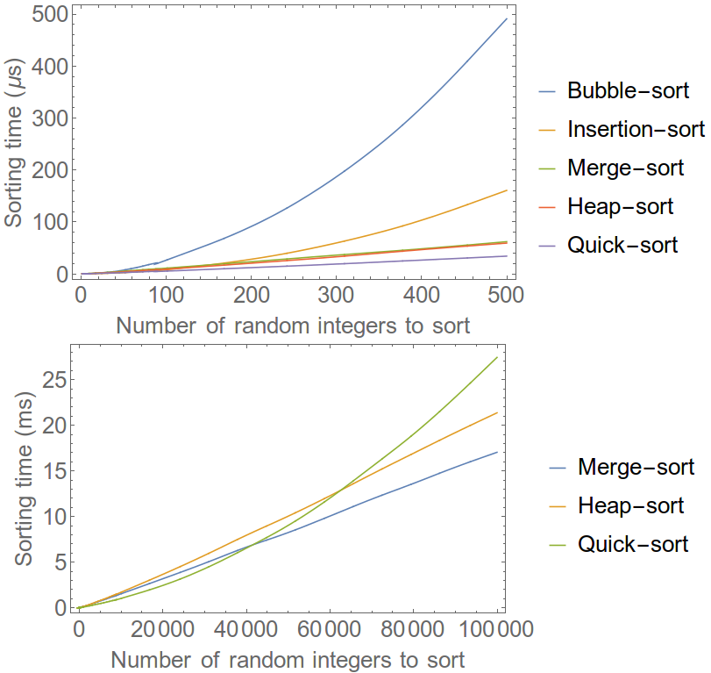
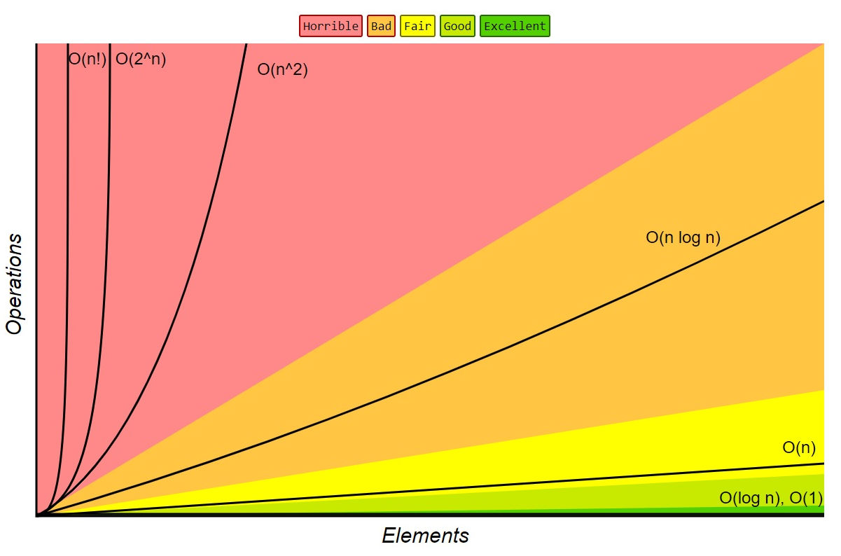
Time complexity (optional)
Further reading:
https://www.simplilearn.com/tutorials/data-structure-tutorial/time-and-space-complexity

