Slide 1
Strings
CSE115: Programming Language I

Slide 2
Fundamentals of Characters and Strings
Characters in C consist of any printable or nonprintable character in the computer’s character set including lowercase letters, uppercase letters, decimal digits, special characters and escape sequences.
A character is usually stored in the computer as an 8-bits (1 byte) integer.
The integer value stored for a character depends on the character set used by the computer on which the program is running.
Typically ASCII character set is used.

Slide 3
Difference Between an Integer Digit and a Character Digit
char num = 1 and char num = ‘1’ are not the same.
char num = 1 is represented in the computer as 00000001.
char num = ‘1’ on the other hand is number 49 according to the ASCII character set. Therefore, it is represented in the computer as (00110001)₂ = (31)₁₆.

Slide 4
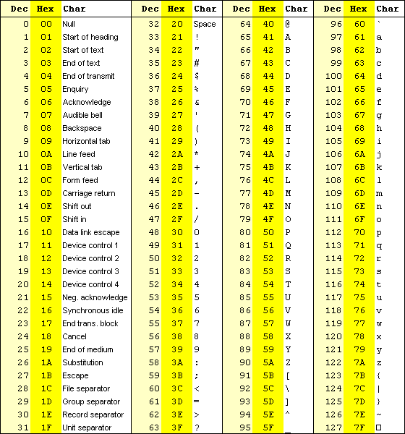

Slide 5
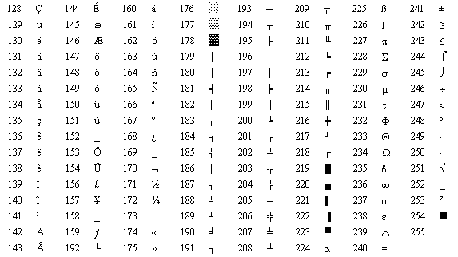

Slide 6
Example: ASCII Character
#include <stdio.h>
void main(void)
{
char my_A = 'A';
char my_Z = 'Z';
char my_a = 'a';
char my_z = 'z';
printf("\nASCII value for A is %d", my_A);
printf("\nASCII value for Z is %d",my_Z);
printf("\nASCII value for a is %d", my_a);
printf("\nASCII value for z is %d",my_z);
printf("\n");
printf("\n65 in ASCII represents %c",65);
printf("\n90 in ASCII represents %c",90);
printf("\n97 in ASCII represents %c",97);
printf("\n122 in ASCII represents %c",122);
}

Slide 7
Sample Output
ASCII value for A is 65
ASCII value for Z is 90
ASCII value for a is 97
ASCII value for z is 122
65 in ASCII represents A
90 in ASCII represents Z
97 in ASCII represents a
122 in ASCII represents z

Slide 8
Example
#include <stdio.h>
int main()
{
char ch;
printf("enter a character: ");
scanf("%c", &ch);
if (ch >= ‘A’ && ch <= ‘Z’)
printf("\ncapital letter\n");
return 0;
}
equivalent to
#include <stdio.h>
int main()
{
char ch;
printf("enter a character: ");
scanf("%c", &ch);
if (ch >= 65 && ch <= 90)
printf("\ncapital letter\n");
return 0;
}

Slide 9
String Declaration and Initialization
A string in C is an array of characters ending with the null character (‘\0’). It is written inside a double quotation mark (“ ”)
A string can be assigned (in a declaration) to a char array:
char color[6] = “green”;
0 | 1 | 2 | 3 | 4 | 5
‘g’ | ‘r’ | ‘e’ | ‘e’ | ‘n’ | ‘\0’
color

Slide 10
String Declaration and Initialization
A string can also be defined by specifying the individual characters:
char color[ ] = {‘g’, ‘r’, ‘e’, ‘e’, ‘n’, ‘\0’};
0 | 1 | 2 | 3 | 4 | 5
‘g’ | ‘r’ | ‘e’ | ‘e’ | ‘n’ | ‘\0’
color

Slide 11
String Declaration and Initialization
Notice that even though there are only five characters in the word ‘green’, six characters are stored in the computer. The last character, the character ‘\0’, is the NULL character which indicates the end of the string.
Therefore, if an array of characters is to be used to store a string, the array must be large enough to store the string and its terminating NULL character.

Slide 12
String Declaration and Initialization
If we happen to declare a string like this:
char my_drink[3] = “tea”;
We will get the following syntax error:
error C2117: 'tea' : array bounds overflow
Instead, we need to at least declare the array with (the size of the string + 1) to accommodate the null terminating character ‘\0’.
char my_drink[4] = “tea”;

Slide 13
String Declaration and Initialization
We can initialize string variables at compile time such as;
char name[10] = “Arris”;
This initialization creates the following spaces in storage :
name
0 | 1 | 2 | 3 | 4 | 5 | 6 | 7 | 8 | 9
‘A’ | ‘r’ | ‘r’ | ‘i’ | ‘s’ | ‘\0’ | ‘\0’ | ‘\0’ | ‘\0’ | ‘\0’

Slide 14
Example: String and ‘\0’
#include <stdio.h>
void main()
{
char sentence[] = "I love Bangladesh";
int i, count = 0;
for (i = 0; sentence[i] != '\0'; i++)
count++;
printf(“%s has %d characters including the whitespace", sentence, count);
}
Sample output:
I love Bangladesh has 17 characters including the whitespace

Slide 15
String Input/Output Functions
Standard Functions Input
scanf( ) // no whitespace character
gets( ) // embedded whitespace
Standard Functions Output
printf( )
puts( )
Use scanf function together with the format specifier %s for interactive input string. (no whitespace character)
If the string to be read as an input has embedded whitespace characters, use standard gets function.

Slide 16
Example: gets, puts, scanf and printf
#include <stdio.h>
int main()
{
char string1[50];
char string2[50];
printf("Enter a string less than 50 characters with spaces: \n");
gets(string1);
printf("\nYou have entered: ");
puts(string1);
printf("\nTry entering a string less than 50 characters, with spaces: \n");
scanf("%s", string2);
printf("\nYou have entered: %s\n", string2);
return 0;
}

Slide 17
Example: gets, puts, scanf and printf
Sample output
Enter a string less than 50 characters with spaces: hello world You have entered: hello world Try entering a string less than 50 characters, with spaces: hello world You have entered: hello

Slide 18
String Conversion Functions
These functions convert strings of digits to integer and floating-point values.
To use these functions, the general utilities library <stdlib.h>, needs to be included.
Example:
atoi: string to int
atof: string to double

Slide 19
Example
/*1. Converting a String Into an int Using atoi. */
#include <stdio.h>
#include <stdlib.h>
int main()
{
char str1[ ] = "124z3yu87";
char str2[ ] = "-3.4";
char str3[ ] = "e24";
int i1 = atoi(str1), i2 = atoi(str2), i3 = atoi(str3);
printf("i1: %d\n", i1);
printf("i2: %d\n", i2);
printf("i3: %d\n", i3);
return 0;
}
Output:
i1: 124 i2: -3 i3: 0

