Slide 1
Selection Structures
CSE115: Programming Language I

Slide 2
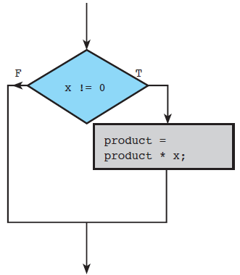
The if Statement – One Alternative

Slide 3
The if Statement – One Alternative
if Statement (One Alternative)
FORM: if( condition )
statement T ;
INTERPRETATION: If condition evaluates to true (a nonzero value), then statement T is executed; otherwise, statement T is skipped.
EXAMPLE:
if (x != 0)
product = product * x;

Slide 4
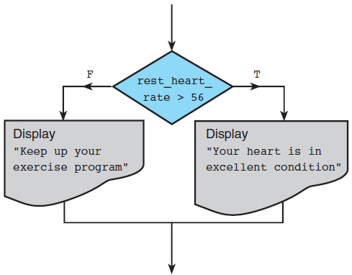
The if Statement – Two Alternatives

Slide 5
The if Statement – Two Alternatives
if Statement (Two Alternatives)
FORM: if( condition )
statement T ;
else
statement F ;
INTERPRETATION: If condition evaluates to true ( a nonzero value), then statement T is executed and statement F is kipped; otherwise, statement T is skipped and statement F is executed.
EXAMPLE:
if (rest_heart_rate > 56)
printf("Keep up your exercise program!\n");
else
printf("Your heart is in excellent health!\n");

Slide 6
The if Statement – Two Alternatives
#include <stdio.h>
int main()
{
int pulse; /* resting pulse rate for 10 secs */
int rest_heart_rate; /* resting heart rate for 1 minute */
/* Enter your resting pulse rate */
printf("Take your resting pulse for 10 seconds.\n");
printf("Enter your pulse rate and press return> ");
scanf("%d", &pulse);
/* Calculate resting heart rate for minute */
rest_heart_rate = pulse * 6;
printf("Your resting heart rate is %d.\n", rest_heart_rate);
/* Display message based on resting heart rate */
if (rest_heart_rate > 56)
printf("Keep up your exercise program!\n");
else
printf("Your heart is in excellent health!\n");
return 0;
}

Slide 7
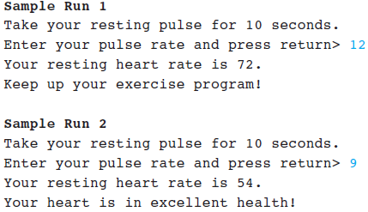
The if Statement – Two Alternatives

Slide 8
Look for Bugs!!!
If the variable item is even, print “It’s an even number”, otherwise print “It’s an odd number”
if item % 2 == 1
printf("It’s an odd number");
printf("It’s an even number");
compilation
error
if (item % 2 == 1);
printf("It’s an odd number");
printf("It’s an even number");
logical
error/bug
if (item % 2 == 1)
printf("It’s an odd number");
printf("It’s an even number");
logical
error/bug
if (item % 2 == 1)
printf("It’s an odd number");
else
printf("It’s an even number");
correct
code

Slide 9
if Statements with Compound True or False Statements
Enclose a compound statement that is a true task or a false task in braces.
Placement of the braces is a matter of personal preference.
if ( condition )
{
true task
}
else
{
false task
}

Slide 10
if Statements with Compound True or False Statements
if (pop_today > pop_yesterday)
{
growth = pop_today - pop_yesterday;
growth_pct = 100.0 * growth / pop_yesterday;
printf("The growth percentage is %.2f\n", growth_pct);
}
if (ctri <= MAX_SAFE_CTRI)
{
printf("Car #%d: safe\n", auto_id);
safe = safe + 1;
}
else
{
printf("Car #%d: unsafe\n", auto_id);
unsafe = unsafe + 1;
}

Slide 11
Indentation Style
In computer programming languages, indentation is used to format program source code to improve readability.
Not mandatory in C/C++/Java, but mandatory in Python
In code block: select > right click > format
Acceptable
Not acceptable
if (cond) {
statements;
}
else {
statements;
}
if (cond)
{
statements;
}
else
{
statements;
}
if (cond)
{
statements;
}
else
{
statements;
}
No indentation!
if (cond) {
statements;
} else {
statements;
}
if (cond) {
statements; }
else {
statements; }
Closing braces not aligned with if/else keyword.

Slide 12
Conditions
Boolean values: true / false.
Condition:
An expression that evaluates to a Boolean value (also called relational expression)
It is composed of expressions combined with relational or equality operators.
Examples: ( a <= 10 ), ( count > max ), ( value != -9 )
There is no boolean type in ANSI C. Instead, we use integers:
0 to represent false
Any other value to represent true (1 is used as the representative value for true in output)

Slide 13
Conditions
Relational and Equality Operators
Relational Operator | Meaning | Type
< | is less than | relational
<= | is less than or equal to | relational
> | is greater than | relational
>= | is greater than or equal to | relational
== | is equal to | equality
!= | is not equal to | equality

Slide 14
Truth Values
Example:
int a = (2 > 3);
int b = (3 > 2);
printf("a = %d; b = %d\n", a, b);
a = 0; b = 1

Slide 15
Truth Values
Be careful of the value returned/evaluated by a relational operation.
Since the values 0 and 1 are the returned values for false and true respectively, we can have codes like these:
int a = 12 + (5 >= 2); // 13 assigned to a
int b = (4 > 5) < (3 > 2) * 6; // 1 assigned to b
int c = ( (4 > 5) < (3 > 2) ) * 6; // 6 assigned to c
You are certainly not encouraged to write such convoluted codes!

Slide 16
Logical Operators
Complex conditions: combine two or more boolean expressions.
Examples:
If temperature is greater than 40C or blood pressure is greater than 200, go to A&E immediately.
If all the three subject scores (English, Maths and Science) are greater than 85 and mother tongue score is at least 80, recommend taking Higher Mother Tongue.
Logical operators are needed: && (and), || (or), ! (not).
A | B | A && B | A || B | !A
nonzero (true) | nonzero (true) | 1(true) | 1(true) | 0 (false)
nonzero (true) | 0 (false) | 0 (false) | 1(true) | 0 (false)
0 (false) | nonzero (true) | 0 (false) | 1(true) | 1(true)
0 (false) | 0 (false) | 0 (false) | 0 (false) | 1(true)
Notes:
rue

Slide 17
Operator Precedence
Operators
Function calls
! + − (unary operators)
*, /, %
+, -
==, >=, <=, >, <, !=
&&
||
=

Slide 18
Evaluation of Boolean Expressions
The evaluation of a boolean expression proceeds according to the precedence and associativity of the operators.
Example #1: What is the value of x?
Example #2: What is the value of x?
int x, a = 4, b = -2, c = 0;
x = (a > b && b > c || a == b);
x = ((a > b) && !(b > c));

Slide 19
English Conditions as C Expressions
x = 3.0 , y = 4.0 , and z = 2.0
English Condition | Logical Expression | Evaluation
x and y are greater than z | x > z && y > z | 1 && 1 is 1 (true)
x is equal to 1.0 or 3.0 | x == 1.0 || x == 3.0 | 0 || 1 is 1 (true)
x is in the range z to y , inclusive | z <= x && x <= y | 1 && 1 is 1 (true)
x is outside the range z to y | !(z <= x && x <= y) z > x || x > y | !(1 && 1) is 0 (false) 0 || 0 is 0 (false)

Slide 20
Short-circuit Evaluation
Does the following code give an error if a is zero?
if ((a != 0) && (b/a > 3))
printf(. . .);
Short-circuit evaluation uses the following facts:
expr1 || expr2 : If expr1 is true, skip evaluating expr2, as the result will always be true.
expr1 && expr2: If expr1 is false, skip evaluating expr2, as the result will always be false.

Slide 21
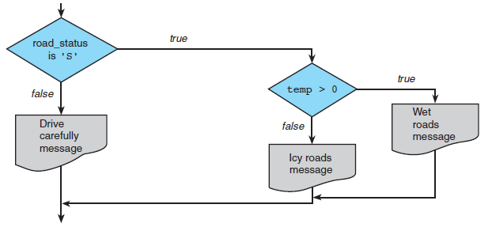
Nested if Statements
An if statement with another if statement as its true task or its false task

Slide 22
Nested if Statements
if (road_status == 'S')
if (temp > 0)
printf("Wet roads ahead\n");
else
printf("Icy roads ahead\n");

Slide 23
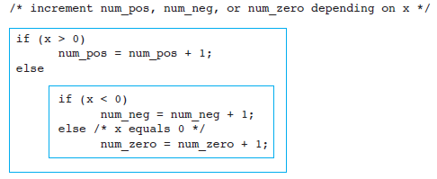
Nested if Statements

Slide 24
Multiple-Alternative Decision Form of Nested if
SYNTAX:
if ( condition 1 )
statement 1
else if ( condition 2 )
statement 2
.
.
.
else if ( condition n )
statement n
else
statement e

Slide 25
Multiple-Alternative Decision Form of Nested if
EXAMPLE: /* increment num_pos, num_neg, or num_zero depending on x */
if (x > 0)
num_pos = num_pos + 1;
else if (x < 0)
num_neg = num_neg + 1;
else /* x equals 0 */
num_zero = num_zero + 1;

Slide 26
The switch Multiple-Selection Structure
switch ( integer expression )
{
case constant₁ :
statement(s)
break ;
case constant₂ :
statement(s)
break ;
. . .
default:
statement(s)
break ;
}

Slide 27
switch Statement Details
The last statement of each case in the switch should almost always be a break.
The break causes program control to jump to the closing brace of the switch structure.
Without the break, the code flows into the next case. This is almost never what you want.
A switch statement will compile without a default case, but always consider using one.

Slide 28
Good Programming Practices
Include a default case to catch invalid data.
Inform the user of the type of error that has occurred (e.g., “Error - invalid day.”).
If appropriate, display the invalid value.
If appropriate, terminate program execution

Slide 29
switch Example
int day; scanf(“%d”, &day);
switch ( day )
{
case 0: printf (“Sunday\n”) ;
break ;
case 1: printf (“Monday\n”) ;
break ;
case 2: printf (“Tuesday\n”) ;
break ;
case 3: printf (“Wednesday\n”) ;
break ;
case 4: printf (“Thursday\n”) ;
break ;
case 5: printf (“Friday\n”) ;
break ;
case 6: printf (“Saturday\n”) ;
break ;
default: printf (“Error -- invalid day.\n”) ;
break ;
}

Slide 30
Why Use a switch Statement?
A nested if-else structure is just as efficient as a switch statement.
However, a switch statement may be easier to read.
Also, it is easier to add new cases to a switch statement than to a nested if-else structure.

Slide 31
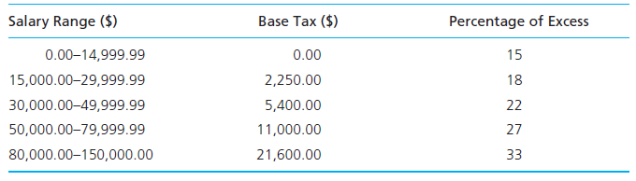
Practice
1. Write a C program that prompts the user to input three integer values and find the greatest and smallest of those three values.
2. Write a program that determines a student’s grade. The program will read three scores and determine the grade based on the following rules.
if the average score is equal to or above 90%, grade = A
if the average score is between 70% and 89.99%, grade = B
if the average score is between 50% and 69.99%, grade = C
if the average score is below 50%, grade = F
3. Calculate tax.

Slide 32
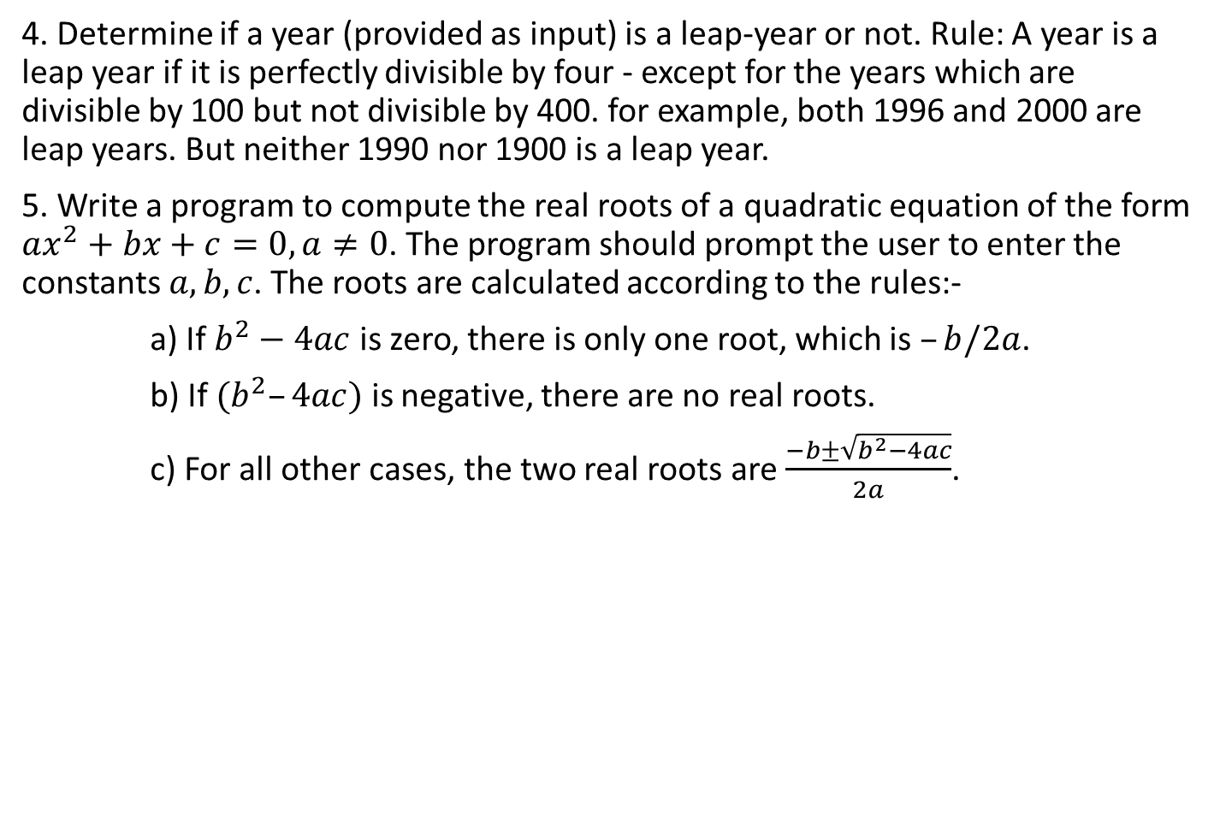
Practice
4. Determine if a year (provided as input) is a leap-year or not. Rule: A year is a leap year if it is perfectly divisible by four - except for the years which are divisible by 100 but not divisible by 400. for example, both 1996 and 2000 are leap years. But neither 1990 nor 1900 is a leap year.
5. Write a program to compute the real roots of a quadratic equation of the form $ax^{2}+bx+c=0, a≠0$. The program should prompt the user to enter the constants $a, b, c$. The roots are calculated according to the rules:-
a) If $b^{2}−4ac$ is zero, there is only one root, which is $–b/2a$.
b) If $(b^{2}–4ac)$ is negative, there are no real roots.
c) For all other cases, the two real roots are $\frac{−b±\sqrt{b^{2}−4ac}}{2a}$.

