Slide 1
Repetition Structures
CSE115: Programming Language I

Slide 2
An Example Problem
Read in 10 integers and output their sum

Slide 3
An Example Problem
Read in 10 integers and output their sum
#include <stdio.h>
int main()
{
int a, sum = 0;
printf("Enter a number: ");
scanf("%d",&a);
sum += a;
printf("Enter a number: ");
scanf("%d",&a);
sum += a;
printf("Enter a number: ");
scanf("%d",&a);
sum += a;
printf("Enter a number: ");
scanf("%d",&a);
sum += a;
printf("Enter a number: ");
scanf("%d",&a);
sum += a;
printf("Enter a number: ");
scanf("%d",&a);
sum += a;
printf("Enter a number: ");
scanf("%d",&a);
sum += a;
printf("Enter a number: ");
scanf("%d",&a);
sum += a;
printf("Enter a number: ");
scanf("%d",&a);
sum += a;
printf("Enter a number: ");
scanf("%d",&a);
sum += a;
printf("Total is %d\n", sum);
return 0;
}

Slide 4
Repetition Structure (Loop)
Executes a number of statements more than one time without having to write the statements multiple times.
Two designs of loop :
To execute a number of instructions from the program for a finite, pre-determined number of time (Counter-controlled loop)
To execute a number of instructions indefinitely until the user tells it to stop or a special condition is met (Sentinel-controlled loop)

Slide 5
Repetition Structure (Loop)
Loop condition
cond?
false
Each round of the loop is called an iteration.
true
Some
statement(s)
loop body

Slide 6
Repetition Structure (Loop)
There are 3 types of loops in C:
while
for
do while

Slide 7
Repetition : while Loop
Syntax :
while (condition)
statement;
As long as the condition is met (the condition expression is true), the statement inside the while loop (also called loop body) will get executed.
When the condition is no longer met (the condition expression is false), the program will continue on with the next instruction (the one after the while loop).
Example:
Similar as in the if statement, the condition is an expression that can return true or false.
cond?
false
int i = 0;
while (i < 5)
{
printf(“i = %d\n”, i);
i++;
}
printf(“Done”);
true
Loop body

Slide 8
Repetition : while Loop
In this example :
(i < 5) is known as loop repetition condition (counter-controlled) .
i is the loop counter variable.
In this case, this loop will keep on looping until the counter variable is equal to 4. Once i = 5, the loop will terminate.
The printf() statement will get executed as long as the variable i is less than 5. Since the variable i is incremented each time the loop is executed, the loop will stop after the 5th output.
Output:
i = 0
i = 1
i = 2
i = 3
i = 4
Done

Slide 9
Sum of 10 Integers
#include <stdio.h>
int main()
{
int i, a, sum;
sum = 0;
i = 0;
while(i < 10)
{
printf("Enter a number: ");
scanf("%d", &a);
sum = sum + a;
i++;
}
printf("Total is %d\n", sum);
return 0;
}
Initialization
Loop condition
Increment/decrement
Loop body

Slide 10
Repetition : for Loop
Syntax :
for (expression1; expression2; expression3)
statement;
expression1: initialize variables including the loop counter variable
expression2: the loop condition
expression3: changes the value of loop counter variable after each iteration (one cycle of the loop)
Note that each expression is separated by a semicolon (;)

Slide 11
Sum of 10 Integers
#include <stdio.h>
int main()
{
int i, a, sum;
sum = 0;
for(i = 0; i < 10; i++)
{
printf("Enter a number: ");
scanf("%d",&a);
sum += a;
}
printf("Total is %d\n", sum);
return 0;
}
Initialization
Loop condition
Increment/decrement
Loop body

Slide 12
Repetition : for Loop
Notice that the output is the same as the one for the while loop example. In fact, the two examples are exactly equivalent. Using a for loop is just another way of writing a while loop that uses a controlling variable.

Slide 13
Repetition : for Loop
It is also possible to omit one or more of the for loop expressions. In such a case, we just put the semicolon without the expression.
#include <stdio.h>
int main()
{
int i, a, sum;
sum = 0;
i = 0;
for(; i < 10; i++)
{
printf("Enter a number: ");
scanf("%d",&a);
sum += a;
}
printf("Total is %d\n", sum);
return 0;
}

Slide 14
Repetition : for Loop
It is also possible to have multiple initializations/increment/decrement statements separated by comma.
#include <stdio.h>
int main()
{
int i, a, sum;
for(i = 0, sum = 0; i < 10; i++)
{
printf("Enter a number: ");
scanf("%d",&a);
sum += a;
}
printf("Total is %d\n", sum);
return 0;
}

Slide 15
Loop Until User Inputs 100
#include <stdio.h>
int main()
{
int a, sum = 0;
printf("Enter a number: ");
scanf("%d",&a);
sum += a;
while(a != 100)
{
printf("Enter a number: ");
scanf("%d",&a);
sum += a;
}
printf("%d",sum);
return 0;
}

Slide 16
Repetition : do while Loop
Syntax
do
{
statement;
} while(condition);
A do while loop is pretty much the same as the while loop except that the condition is checked after the iteration is complete.
When there is a do while loop, the statement(s) inside it will be executed once no matter what. Only after that, the condition will be checked to decide whether the loop should be executed again or just continue with the rest of the program.

Slide 17
Repetition : do while Loop
#include <stdio.h>
int main()
{
int a = 0, sum = 0;
do
{
printf("Enter a number: ");
scanf("%d",&a);
sum += a;
}
while(a != 100);
printf("%d",sum);
return 0;
}

Slide 18
Repetition : do while Loop
Print the digits of an integer number in reverse order. For example if the input is 45718, your program should output 81754.

Slide 19
Repetition : do while Loop
Print the digits of an integer number in reverse order. For example if the input is 45718, your program should output 81754.
#include <stdio.h>
int main()
{
int number, digit;
printf(“Enter a number: ");
scanf("%d", &number);
while(number > 0)
{
digit = number % 10;
printf("%d", digit);
number = number / 10;
}
return 0;
}

Slide 20
Repetition : do while Loop
Sample run 1:
Enter a number: 2145
5412
Sample run 2:
Enter a number: 9
9
Sample run 3:
Enter a number: 0
Sample run 4:
Enter a number: 8711541
1451178

Slide 21
Repetition : do while Loop
Print the digits of an integer number in reverse order. For example if the input is 45718, your program should output 81754.
#include <stdio.h>
int main()
{
int number, digit;
scanf("%d", &number);
do
{
digit = number % 10;
printf("%d", digit);
number = number / 10;
}while(number > 0);
return 0;
}

Slide 22
Infinite Loop
#include <stdio.h>
int main()
{
int i;
for(i = 0; i != 9; i+=2)
printf("i = %d\n", i);
return 0;
}
How many times will the loop iterate?

Slide 23
Infinite Loop
If somehow the program never goes out of the loop, the program is said to be stuck in an infinite loop.
The infinite loop error happens because the condition expression of the while loop always return a true.
If an infinite loop occurs, the program would never terminate and the user would have to terminate the program by force.
Anything non-zero
for(;;)
{
printf("Hello javatpoint");
}
while(1)
{
i++;
printf("i is :%d",i);
}
do
{
// body of the loop..
}while(1);

Slide 24

Example
Calculate the sum of the following series ($x$ and $m$ are user inputs).
$$x^{0}+x^{1}+x^{2}+x^{3}+⋯+x^{m}$$

Slide 25
Example
Calculate the sum of the following series ($x$ and $m$ are user inputs).
$$x^{0}+x^{1}+x^{2}+x^{3}+⋯+x^{m}$$
#include <stdio.h>
int main()
{
int x, m, term = 1, sum = 1;
scanf("%d%d", &x, &m);
for(i=1; i<=m; i++)
{
term = term * x;
sum = sum + term;
}
printf("Sum = %d", sum);
return 0;
}

Slide 26

Example
Calculate the sum of the following series ($n$ is user input).
$$\frac{1}{1}+\frac{1}{2}+\frac{1}{3}+⋯+\frac{1}{n}$$

Slide 27

Example
Calculate the sum of the following series ($n$ is user input).
$$\frac{1}{1}−\frac{1}{2}+\frac{1}{3}−\frac{1}{4}+\frac{1}{5}−\frac{1}{6}+\frac{1}{7}−⋯±\frac{1}{n}$$

Slide 28
Example
Calculate the sum of the following series ($n$ is user input).
$$\frac{1}{1}−\frac{1}{2}+\frac{1}{3}−\frac{1}{4}+\frac{1}{5}−\frac{1}{6}+\frac{1}{7}−⋯±\frac{1}{n}$$
#include <stdio.h>
int main()
{
int n, i;
double term, sum = 0;
scanf("%d", &n);
for(i=1; i<=n; i++)
{
term = 1.0 / i;
if(i%2 == 0)
sum = sum - term;
else
sum = sum + term;
}
printf("Sum = %lf", sum);
return 0;
}

Slide 29
Selection Inside Loop
Read a positive integer and determine if it is a prime number.
Pseudo-code:
Read integer and store it in number
Set flag to 1
For i = 2 to (number-1)
If number is divisible by i then
Set flag to 0
If flag equals 1, then the number is a prime number, otherwise not

Slide 30
Selection Inside Loop
Read a positive integer and determine if it is a prime number.
#include <stdio.h>
int main()
{
int number, i, flag = 1;
scanf("%d", &number);
for(i=2; i<number; i++)
{
if(number % i == 0)
flag = 0;
}
if(flag == 1)
printf("%d is a prime number",number);
else printf("%d is not a prime number",number);
return 0;
}

Slide 31
Using break Inside Loop
In the prime number example, we do not need to continue the loop till the end once the value of flag is set to zero.
#include <stdio.h>
int main()
{
int number, i, flag = 1;
scanf("%d", &number);
for(i=2; i<number; i++)
{
if(number % i == 0)
{
flag = 0;
break;
}
}
if(flag == 1)
printf("%d is a prime number",number);
else printf("%d is not a prime number",number);
return 0;
}
The break statement makes the loop terminate prematurely.

Slide 32
Using continue Inside Loop
Read 10 integers from the user and calculate the sum of the positive numbers.
#include <stdio.h>
int main()
{
int number, i, sum = 0;
for(i=0; i<10; i++)
{
printf("Enter a number: ");
scanf("%d", &number);
if(number < 0)
continue;
sum = sum + number;
printf("%d is added\n", number);
}
printf("Total = %d",sum);
return 0;
}
The continue statement forces next iteration of the loop, skipping any remaining statements in the loop

Slide 33
Using continue Inside Loop
Read 10 integers from the user and calculate the sum of the positive numbers.
Output:
Enter a number: 1
1 is added
Enter a number: 2
2 is added
Enter a number: 3
3 is added
Enter a number: -4
Enter a number: -5
Enter a number: 6
6 is added
Enter a number: 7
7 is added
Enter a number: 8
8 is added
Enter a number: -9
Enter a number: 10
10 is added
Total = 37
#include <stdio.h>
int main()
{
int number, i, sum = 0;
for(i=0; i<10; i++)
{
printf("Enter a number: ");
scanf("%d", &number);
if(number < 0)
continue;
sum = sum + number;
printf("%d is added\n", number);
}
printf("Total = %d",sum);
return 0;
}

Slide 34
Example: A Travelling Man
Suppose a man (say, A) stands at (0, 0) and waits for user to give him the direction and distance to go.
User may enter N E W S for north, east, west, south, and any value for distance.
When user enters 0 as direction, stop and print out the location where the man stopped
N
W
E
S

Slide 35
float x=0, y=0;
char dir;
float mile;
while (1) {
printf("Please input the direction as N,S,E,W (0 to exit): ");
scanf("%c", &dir); fflush(stdin);
if (dir=='0'){ /*stop input, get out of the loop */
break;
}
if (dir!='N' && dir!='S' && dir!='E' && dir!='W') {
printf("Invalid direction, re-enter \n");
continue;
}
printf("Please input the mile in %c direction: ", dir);
scanf ("%f",&mile); fflush(stdin);
if (dir == 'N'){ /*in north, compute the y*/
y+=mile;
} else if (dir == 'E'){ /*in east, compute the x*/
x+=mile;
} else if (dir == 'W'){ /*in west, compute the x*/
x-=mile;
} else if (dir == 'S'){ /*in south, compute the y*/
y-=mile;
}
}
printf("\nCurrent position of A: (%4.2f,%4.2f)\n",x,y); // output

Slide 36
Nested Loop
What is the output of the following program?
for (i=1; i<=5; i++)
{
for (j=1; j<=4; j++)
{
printf("*");
}
printf("\n");
}

Slide 37
Nested Loop
What is the output of the following program?
Output
****
****
****
****
****
for (i=1; i<=5; i++)
{
for (j=1; j<=4; j++)
{
printf("*");
}
printf("\n");
}

Slide 38
Nested Loop
What is the output of the following program?
for (i=1; i<=5; i++)
{
for (j=1; j<=i; j++)
{
printf("*");
}
printf("\n");
}

Slide 39
Nested Loop
What is the output of the following program?
Output
*
**
***
****
*****
for (i=1; i<=5; i++)
{
for (j=1; j<=i; j++)
{
printf("*");
}
printf("\n");
}

Slide 40
Nested Loop
Write a program that generates the following pattern.
Output
*
++
***
++++
*****

Slide 41
Nested Loop
Write a program that generates the following pattern.
Output
*
++
***
++++
*****
int i, j;
for(i=1; i<=5; i++)
{
for(j=1; j<=i; j++)
{
if (i % 2 == 0)
printf("+");
else
printf("*");
}
printf("\n");
}

Slide 42
Nested Loop
Write a program that generates the following pattern.
Output
*
*+
*+*
*+*+
*+*+*
int i, j;
for(i=1; i<=5; i++)
{
for(j=1; j<=i; j++)
{
if (j % 2 == 0)
printf("+");
else
printf("*");
}
printf("\n");
}

Slide 43
Nested Loop
Write a program that generates the following pattern.
Output
*
**
***
****
*****

Slide 44
Nested Loop
Write a program that generates the following pattern.
Output (for n=5)
*
**
***
****
*****
scanf(“%d”, &n);
for(i=1; i<=n; i++)
{
for(j=1; j<=n-i; j++)
printf(" ");
for(j=1; j<=i; j++)
printf("*");
printf("\n");
}

Slide 45
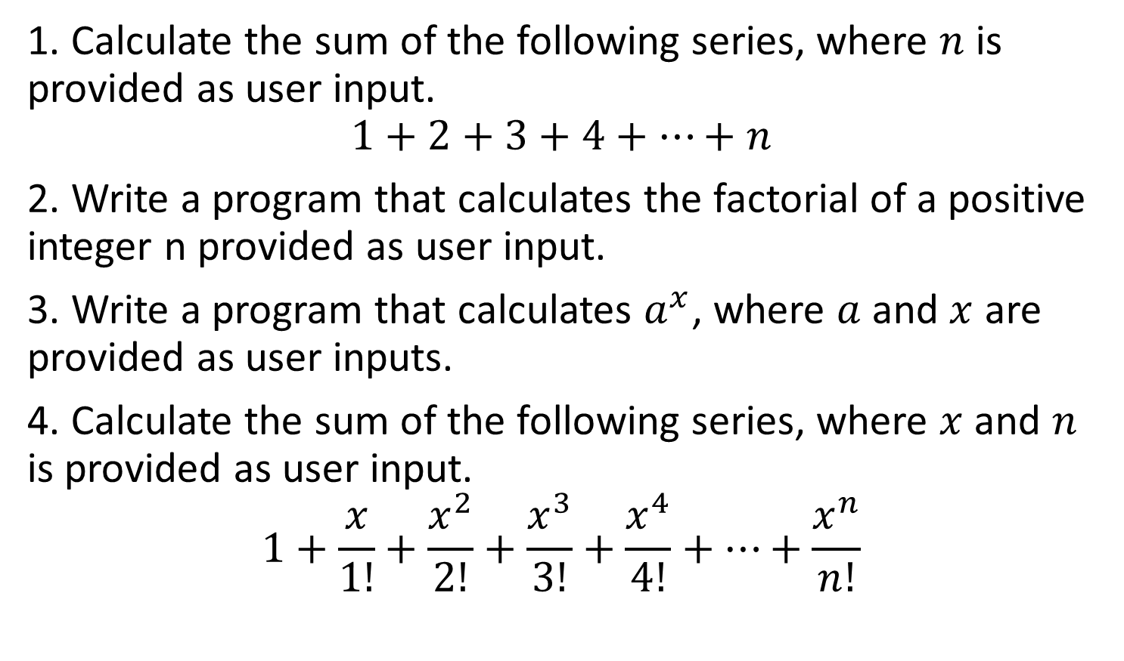
Practice
1. Calculate the sum of the following series, where $n$ is provided as user input.
$$1+2+3+4+…+n$$
2. Write a program that calculates the factorial of a positive integer n provided as user input.
3. Write a program that calculates $a^{x}$, where $a$ and $x$ are provided as user inputs.
4. Calculate the sum of the following series, where $x$ and $n$ is provided as user input.
$$1+\frac{x}{1!}+\frac{x^{2}}{2!}+\frac{x^{3}}{3!}+\frac{x^{4}}{4!}+⋯+\frac{x^{n}}{n!}$$

Slide 46
Practice
5. Write programs that generate the following patterns. In each case, the number of lines is the input.
*****
****
***
**
*
*
***
*****
*******
*********
*********
*******
*****
***
*
**********
**** ****
*** ***
** **
* *
** **
*** ***
**** ****
**********
*
* *
* *
* *
* *
* *
* *
* *
*
*
**
***
****
*****
****
***
**
*

