Slide 1
Functions
CSE115: Programming Language I

Slide 2
Introduction
A function is a block of code which is used to perform a specific task.
It can be written once and can be reused for a different program without having to rewrite that piece of code.
Functions can be put in a library. If another program would like to use them, it will just need to include the appropriate header file at the beginning of the program and link to the correct library while compiling.

Slide 3
Introduction
Functions can be divided into two categories :
Predefined functions (standard functions)
Built-in functions provided by C that are used by programmers without having to write any code for them. i.e: printf( ), scanf( ), etc
User-Defined functions
Functions that are written by the programmers themselves to carry out various individual tasks.

Slide 4
Standard Functions
Standard functions are functions that have been pre-defined by C and put into standard C libraries.
Example: printf(), scanf(), pow(), ceil(), rand(), etc.
What we need to do to use them is to include the appropriate header files.
Example: #include <stdio.h>, #include <math.h>
What contained in the header files are the prototypes of the standard functions. The function definitions (the body of the functions) has been compiled and put into a standard C library which will be linked by the compiler during compilation.

Slide 5
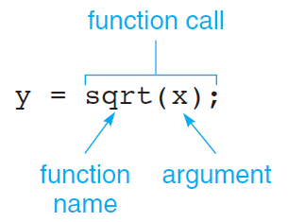
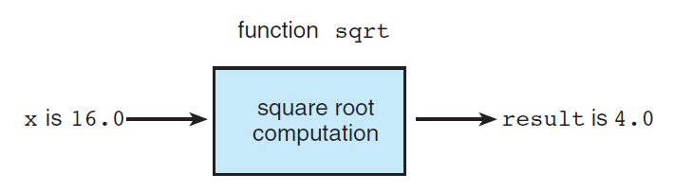
C Library Functions
Benefit of functions:
Avoid errors due to repetition of code
Reusability of code
C’s standard math library defines a function named sqrt - performs the square root computation

Slide 6
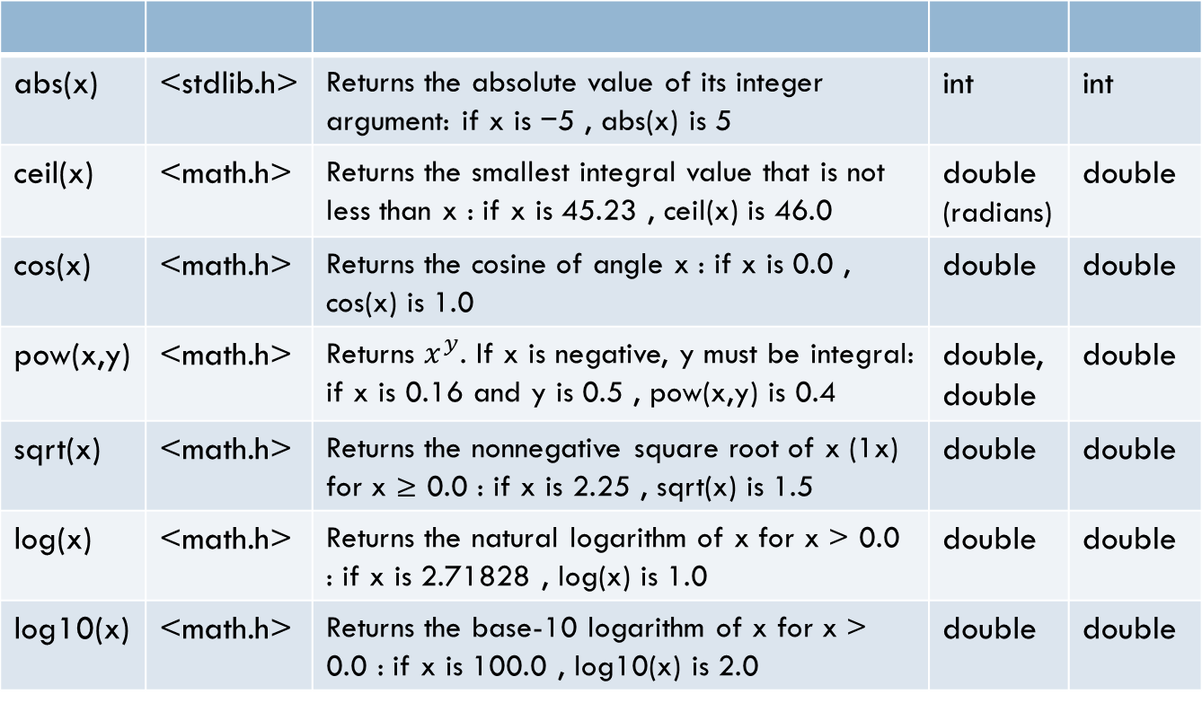
C Library Functions
Function | Header | Purpose: Example | Argument(s) | Result
abs(x) | <stdlib.h> | Returns the absolute value of its integer argument: if x is −5 , abs(x) is 5 | int | int
ceil(x) | <math.h> | Returns the smallest integral value that is not less than x : if x is 45.23 , ceil(x) is 46.0 | double | double
cos(x) | <math.h> | Returns the cosine of angle x : if x is 0.0 , cos(x) is 1.0 | double (radians) | double
pow(x,y) | <math.h> |  | double, double | double
sqrt(x) | <math.h> | Returns the nonnegative square root of x (1x) for x ≥ 0.0 : if x is 2.25 , sqrt(x) is 1.5 | double | double
log(x) | <math.h> | Returns the natural logarithm of x for x > 0.0 : if x is 2.71828 , log(x) is 1.0 | double | double
log10(x) | <math.h> | Returns the base-10 logarithm of x for x > 0.0 : if x is 100.0 , log10(x) is 2.0 | double | double
Check the complete list here:
https://en.cppreference.com/w/c/header
https://devdocs.io/c/

Slide 7
Character Handling Library
Character handling library includes several function that perform useful tests and manipulation of character data.
Each function receives a character, represented as an int or EOF, as an argument.
When using functions from the character handling library, the header file <ctype.h> needs to be included.
Characters in these functions are manipulated as integers (since a character is basically a 1 byte integer).

Slide 8
Functions in <ctype.h>
Prototype | Function Descriptions
int isdigit(int c) | Returns a true if value c is a digit, and 0 (false) otherwise.
int isalpha(int c) | Returns a true if value c is a letter, and 0 otherwise.
int isalnum(int c) | Returns a true if value c is a digit or a letter, and 0 otherwise.
int isxdigit(int c) | Returns a true value if c is a hexadecimal digit character, and 0 otherwise.
int islower(int c) | Returns a true value if c is a lowercase letter, and 0 otherwise.
int isupper(int c) | Returns a true value if c is an uppercase letter, and 0 otherwise.
int tolower(int c) | If c is an uppercase letter, tolower returns c as a lowercase letter. Otherwise, tolower returns the argument unchanged.
int toupper(int c) | If c is a lowercase letter, toupper returns c as an uppercase letter. Otherwise toupper returns the argument unchanged.
int isspace(int c) | Returns true if c is a white space character – newline (‘\n’), space (‘ ’), form feed (‘\f’), carriage return (‘\r’), horizontal tab (‘\t’) or vertical tab (‘\v’) – and 0 otherwise.
int iscntrl(int c) | Returns a true if c is a control character, and 0 otherwise.
int ispunct(int c) | Returns a true if c is a printing character other than a space, a digit or a letter, and 0 otherwise.
int isprint(int c) | Returns a true value if c is a printing character including space (‘ ’), and 0 otherwise.
int isgraph(int c) | Returns a true value if c is a printing character other than space (‘ ’), and 0 otherwise.

Slide 9
User Defined Functions
A programmer can create his/her own function(s).
It is easier to plan and write our program if we divide it into several functions instead of writing a long piece of code inside the main function.
A function is reusable and therefore prevents us (programmers) from having to unnecessarily rewrite what we have written before.
In order to write and use our own function, we need to do the following:
create a function prototype (declare the function)
define the function somewhere in the program (implementation)
call the function whenever it needs to be used

Slide 10

An Example
Lets find the value of $NCR$, where the values of N and R will be provided by the user.
FYI, $NCR$= $\frac{n!}{r!×\left(n−r\right)!}$

Slide 11
An Example
#include <stdio.h>
int main()
{
int N, R;
int factN = 1, factR = 1, factN_R = 1;
int result;
int i;
printf("Enter N and R\n");
scanf("%d%d",&N,&R);
for(i=1;i<=N;i++)
factN *= i;
for(i=1;i<=R;i++)
factR *= i;
for(i=1;i<=(N-R);i++)
factN_R *= i;
result = factN/(factR*factN_R);
printf("%d combination %d = %d",N,R,result);
return 0;
}
You are implementing same logic over and over

Slide 12
An Example
int factorial(int x)
{
int fact = 1, i;
for(i=1;i<=x;i++)
fact *= i;
return fact;
}

Slide 13
An Example
Function name
int factorial(int x)
{
int fact = 1, i;
for(i=1;i<=x;i++)
fact *= i;
return fact;
}

Slide 14
An Example
Type and name of
Input to the function (parameters)
int factorial(int x)
{
int fact = 1, i;
for(i=1;i<=x;i++)
fact *= i;
return fact;
}

Slide 15
An Example
Type of output value (return type) (void if no output)
int factorial(int x)
{
int fact = 1, i;
for(i=1;i<=x;i++)
fact *= i;
return fact;
}

Slide 16
An Example
int factorial(int x)
{
int fact = 1, i;
for(i=1;i<=x;i++)
fact *= i;
return fact;
}
Body of the function

Slide 17
An Example
#include <stdio.h>
int factorial(int x);
int main()
{
int N, R;
int result;
int i;
printf("Enter N and R\n");
scanf("%d%d",&N,&R);
result = factorial(N)/(factorial(R)*factorial(N-R));
printf("%d combination %d = %d",N,R,result);
return 0;
}
int factorial(int x)
{
int fact = 1, i;
for(i=1;i<=x;i++)
fact *= i;
return fact;
}

Slide 18
An Example
#include <stdio.h>
int factorial(int x);
int main()
{
int N, R;
int result;
int i;
printf("Enter N and R\n");
scanf("%d%d",&N,&R);
result = factorial(N)/(factorial(R)*factorial(N-R));
printf("%d combination %d = %d",N,R,result);
return 0;
}
int factorial(int x)
{
int fact = 1, i;
for(i=1;i<=x;i++)
fact *= i;
return fact;
}
Function prototype
Calling the function
Function implementation

Slide 19
An Example
#include <stdio.h>
int factorial(int x)
{
int fact = 1, i;
for(i=1;i<=x;i++)
fact *= i;
return fact;
}
int main()
{
int N, R;
int result;
int i;
printf("Enter N and R\n");
scanf("%d%d",&N,&R);
result = factorial(N)/(factorial(R)*factorial(N-R));
printf("%d combination %d = %d",N,R,result);
return 0;
}

Slide 20
Top Down Design
Analyze the problem
Break it into smaller sub-problems
Solve the smaller problems as Functions
Put them together in the main() function

Slide 21



A Simple Drawing Program
Problem:
Write a program DrawFigures.c to draw a rocket ship (which is a triangle over a rectangle, over an inverted V), a male stick figure (a circle over a rectangle over an inverted V), and a female stick figure (a circle over a triangle over an inverted V)
rocket
male
female
Analysis:
No particular input needed, just draw the needed 3 figures
There are common shapes shared by the 3 figures
Design:
Algorithm:
Draw Rocket ship
Draw Male stick figure (below Rocket ship)
Draw Female stick figure (below Male stick figure)

Slide 22
A Simple Drawing Program
Design (Structure Chart):
Draw 3 Figures
Draw Rocket Ship
Draw Male Stick Figure
Draw Circle
Draw Female Stick Figure
Draw Circle
Draw Triangle
Draw Rectangle
Draw Inverted V
Draw Rectangle
Draw Inverted V
Draw Triangle
Draw Inverted V
rocket
male
female

Slide 23
A Simple Drawing Program
#include <stdio.h>
void draw_rocket_ship();
void draw_male_stick_figure();
void draw_female_stick_figure();
void draw_circle();
void draw_rectangle();
void draw_triangle();
void draw_intersect_line();
int main(void) {
draw_rocket_ship();
printf("\n\n");
draw_male_stick_figure();
printf("\n\n");
draw_female_stick_figure();
printf("\n\n");
return 0;
}
void draw_rocket_ship()
{
draw_triangle();
draw_rectangle();
draw_intersect_line();
}
void draw_male_stick_figure()
{
draw_circle();
draw_rectangle();
draw_intersect_line();
}
void draw_female_stick_figure()
{
draw_circle();
draw_triangle();
draw_intersect_line();
}

Slide 24
A Simple Drawing Program
void draw_circle() {
printf(" ** \n");
printf(" * * \n");
printf(" * * \n");
printf(" ** \n");
}
void draw_rectangle() {
printf(" ****** \n");
printf(" * * \n");
printf(" * * \n");
printf(" * * \n");
printf(" ****** \n");
}
void draw_triangle() {
printf(" * \n");
printf(" * * \n");
printf(" * * \n");
printf("********\n");
}
void draw_intersect_line()
{
printf(" * \n");
printf(" * * \n");
printf(" * * \n");
printf("* *\n");
}

Slide 25
Functions with Multiple Parameter
A function can have any number of parameters (zero or more)
We have seen functions with no parameter (recall draw)
void draw_rectangle()
{
printf(" ****** \n");
printf(" * * \n");
printf(" * * \n");
printf(" * * \n");
printf(" ****** \n");
}
We have seen function with one parameter
int factorial(int x)
{
int fact = 1, i;
for(i=1;i<=x;i++)
fact *= i;
return fact;
}

Slide 26
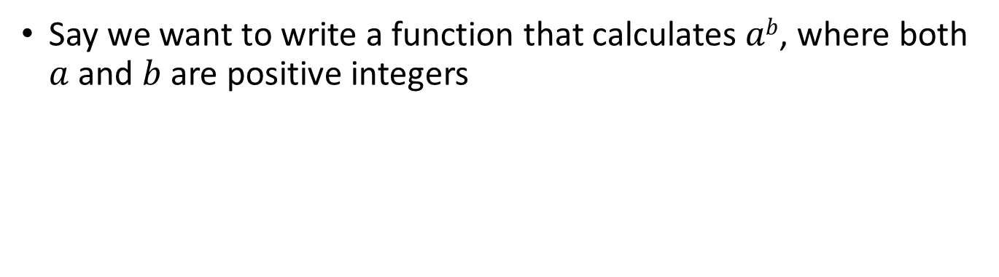
Functions with Multiple Parameter
Say we want to write a function that calculates $ab$, where both $a$ and $b$ are positive integers

Slide 27
Functions with Multiple Parameter
#include <stdio.h>
int power(int a, int b);
int main()
{
int x = 2, y = 8, z;
z = power(x, y);
printf("%d\n",z);
return 0;
}
int power(int a, int b)
{
int i, result = 1;
for(i=1; i<=b; i++)
{
result *= a;
}
return result;
}

Slide 28
Scopes
#include <stdio.h>
void power(int a, int b);
int main()
{
int x = 2, y = 8, z;
power(x, y);
printf("%d\n",result);
return 0;
}
void power(int a, int b)
{
int i, result = 1;
for(i=1; i<=b; i++)
{
result *= a;
}
}
Can we do this?
No, result is defined here (local to the power function), not inside main

Slide 29
Scopes
#include <stdio.h>
void power(int a, int b);
int main()
{
int x = 2, y = 8, z;
power(x, y);
printf("%d\n",result);
return 0;
}
void power(int a, int b)
{
int i, result = 1;
for(i=1; i<=b; i++)
{
result *= a;
}
}
Different scopes. Variable from one scope is not visible inside another
Local variable

Slide 30
Scopes
#include <stdio.h>
void power(int a, int b);
int result;
int main ()
{
int x = 2, y = 8, z;
power(x, y);
printf("%d\n",result);
return 0;
}
void power(int a, int b)
{
int i;
for(i=1, result=1; i<=b; i++)
{
result *= a;
}
}
How about this?

Slide 31
Scopes
#include <stdio.h>
void power(int a, int b);
int result;
int main ()
{
int x = 2, y = 8, z;
power(x, y);
printf("%d\n",result);
return 0;
}
void power(int a, int b)
{
int i;
for(i=1, result=1; i<=b; i++)
{
result *= a;
}
}
Global variable (declared in the global scope) is visible in both scopes

Slide 32
An Example
Lets find if N is a prime number, where N will be provided by the user
int is_prime(int a)
{
int i;
for(i=2; i<a; i++)
{
if(a%i == 0)
return 0;
}
return 1;
}

Slide 33
Another Example
Take a number N as input from the user and print this pyramid of asterisk. N is the number of asterisk in the last row (you can assume that N will always be a positive odd number).
*
***
*****
*******
*********

Slide 34
Another Example
Will it work?
void pyramid(int n)
{
int i, j;
for(i=1; i<=n; i+=2)
{
for(j=1; j<=i; j++)
{
printf("*");
}
printf("\n");
}
}

Slide 35
Another Example
Will it work?
void pyramid(int n)
{
int i, j;
for(i=1; i<=n; i+=2)
{
for(j=1; j<=i; j++)
{
printf("*");
}
printf("\n");
}
}
We should print spaces before doing this
Output for n = 9:
*
***
*****
*******
*********

Slide 36
Another Example
void pyramid(int n)
{
int i, j;
for(i=1; i<=n; i+=2)
{
for(j=1; j<=(n-i)/2; j++)
{
printf(" ");
}
for(j=1; j<=i; j++)
{
printf("*");
}
printf("\n");
}
}

Slide 37
Another Example
void pyramid(int n)
{
int i, j;
for(i=1; i<=n; i+=2)
{
for(j=1; j<=(n-i)/2; j++)
{
printf(" ");
}
for(j=1; j<=i; j++)
{
printf("*");
}
printf("\n");
}
}
Output for n = 9:
*
***
*****
*******
*********

Slide 38
ALT. Solution
void pyramid(int n)
{
int i, j, nsp = n-1, nst = 1;
for(i=1; i<=n; i++)
{
for(j=1; j<=nsp; j++)
{
printf(" ");
}
for(j=1; j<=nst; j++)
{
printf("*");
}
nsp --;
nst += 2;
printf("\n");
}
}
Output for n = 5:
*
***
*****
*******
*********

Slide 39
Yet Another Example
Take a number N as input from the user and print this diamond of asterisk. N is the number of asterisk in the middle row (you can assume that N will always be a positive odd number).
*
***
*****
*******
*********
*********
*******
*****
***
*

Slide 40
Yet Another Example
void upper_pyramid(int n)
{
int i, j;
for(i=1; i<=n; i+=2)
{
for(j=1; j<=(n-i)/2; j++)
{
printf(" ");
}
for(j=1; j<=i; j++)
{
printf("*");
}
printf("\n");
}
}
void lower_pyramid(int n)
{
int i, j;
for(i=n; i>=1; i-=2)
{
for(j=1; j<=(n-i)/2; j++)
{
printf(" ");
}
for(j=1; j<=i; j++)
{
printf("*");
}
printf("\n");
}
}

Slide 41
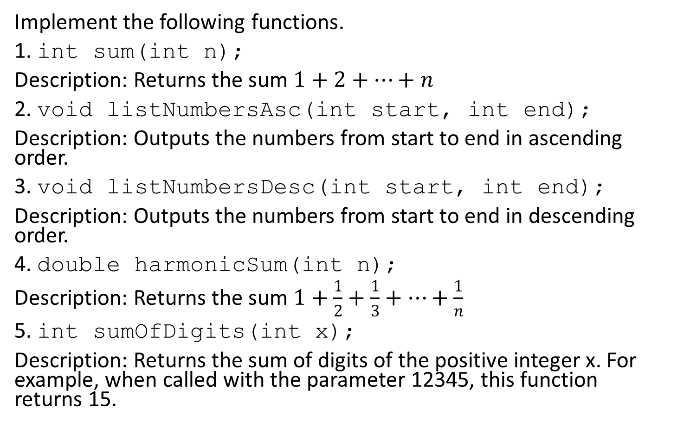
Practice
Implement the following functions.
1. int sum(int n);
Description: Returns the sum $1+2+…+n$
2. void listNumbersAsc(int start, int end);
Description: Outputs the numbers from start to end in ascending order.
3. void listNumbersDesc(int start, int end);
Description: Outputs the numbers from start to end in descending order.
4. double harmonicSum(int n);
Description: Returns the sum $1+\frac{1}{2}+\frac{1}{3}+…+\frac{1}{n}$
5. int sumOfDigits(int x);
Description: Returns the sum of digits of the positive integer x. For example, when called with the parameter 12345, this function returns 15.

