Slide 1
Teamlost

Slide 2
Table of content
Problem
Use Case Diagram
Functional Requirements
Non-Functional Requirements
Class Diagram
Sequence Diagram
Dialog Map
Architecture
Design Pattern
Demo
White & Black box Testing

Slide 3
Problem
Not every healthcare premises maintain a website
Without a website, people can only walk-in or call to get an appointment
Receptionist can’t manage phone calls during peak hours
Although there is SingHealth, but
User can book Appointment on Government healthcare premises only.

Slide 4
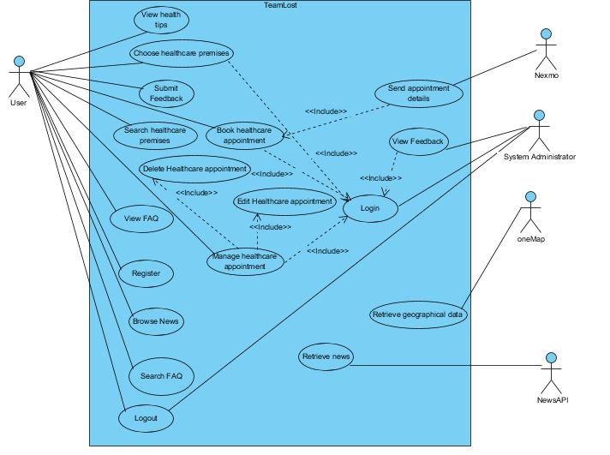
Use case diagram

Slide 5
Book healthcare appointment
Actor: | User
Description: | Allows user to book healthcare appointment.
Preconditions: | The user must be logged in. The user must have selected the location where they wish to book an appointment at.
Postconditions: | The system will display a message indicating successful booking. The system will then automatically send appointment detail to the user via SMS.
Priority: | High
Frequency of Use: | High

Slide 6
Book healthcare appointment
Flow of Events: | The system will direct user to the page to fill up all their details after user has selected specific healthcare premises. The system retrieve the address of the selected healthcare premise. The user will have to enter appointment details and proceed by clicking “Next” button. The system will do validation to check whether user has entered all the required fields in correct format. The system will display all the entered information by user for confirmation. The system will display successful message upon successful booking of selected slot. The system sends a message that includes all the booking details to user via SMS.
Alternative Flows: | AF – S3, Invalid format of appointment details The system will disable the “Next” button. User checks the entered field and re-enter the appointment details again. Return to step #4.
Exceptions: | EX1, Network not available The system will not be able to direct user to the healthcare premise page.
Includes: | Login
Special Requirements: | Users are not allowed to book an appointment at pharmacy.

Slide 7
Manage healthcare appointment
Actor: | User
Description: | Allows user to manage healthcare appointment in the system which include editing and deleting healthcare appointment.
Preconditions: | The user must be logged in. The user must have an existing appointment. The status of appointment must be “booked”.
Postconditions: | The system will display a message indicating successful changes. The system will then automatically send the changes made (delete/update) to the user via SMS.
Priority: | High
Frequency of Use: | High

Slide 8
Manage healthcare appointment
Flow of Events: | The user selects “Manage appointment” at the Appointment dropdown list. The system will display a table of user’s existing appointment with a “Edit” or “Delete” button. Once the user select an option, either one of the sub flows will be executed. If the user selected “Edit”, the Edit Healthcare Appointment subflow is executed. If the user selected “Delete”, the Delete Healthcare Appointment subflow is executed. Edit Healthcare Appointment The system retrieves and displays the current appointment information of the selected appointment that the user wishes to modify. The appointment information includes: Date Time Department , condition and preferred doctor(for making appointment at polyclinic) Department , condition ,preferred doctor and referral (for making appointment at hospital) Services and preferred dentist (for making appointment at dentist) The system requests that the user enter the new appointment date and time. Once the user provides the requested information and selects “Update” button. The system will display successful message upon successful update of the changes and send a message that includes all the updated booking details to the user via SMS. Delete Healthcare Appointment The system prompt user to confirm the cancellation of the selected appointment. Upon clicking on “Confirm”, the system will display successful message once the appointment has been cancelled successfully. System sends a message to notify user on the successful cancellation of appointment.

Slide 9
Manage healthcare appointment
Alternative Flows:
Exceptions: | EX1: No existing appointment is found The system displays error message indicating no existing appointment. EX2: Network not available The user will not be able edit/delete their appointment.
Includes: | Delete healthcare appointment Edit healthcare appointment Login
Special Requirements: | -
Assumptions: | User has already registered an account.
Notes and Issues: | -

Slide 10
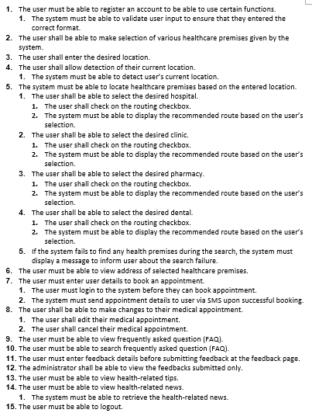
Functional requirements

Slide 11
Functional requirements
The system must be able to locate healthcare premises based on the entered location.
The user must be able to view address of selected healthcare premises.
The user must enter user details to book an appointment.
The user must login to the system before they can book appointment.
The system must send appointment details to user via SMS upon successful booking.
The user shall be able to make changes to their medical appointment.
The user shall edit their medical appointment.
The user shall cancel their medical appointment.
The administrator shall be able to view the feedbacks submitted.

Slide 12
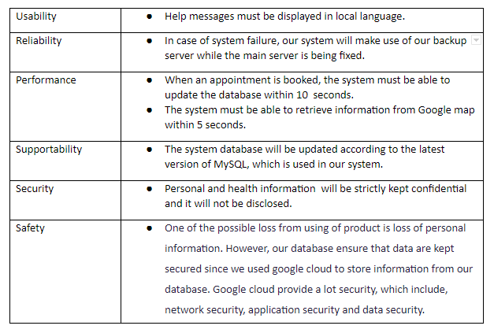
non-functional requirements

Slide 13
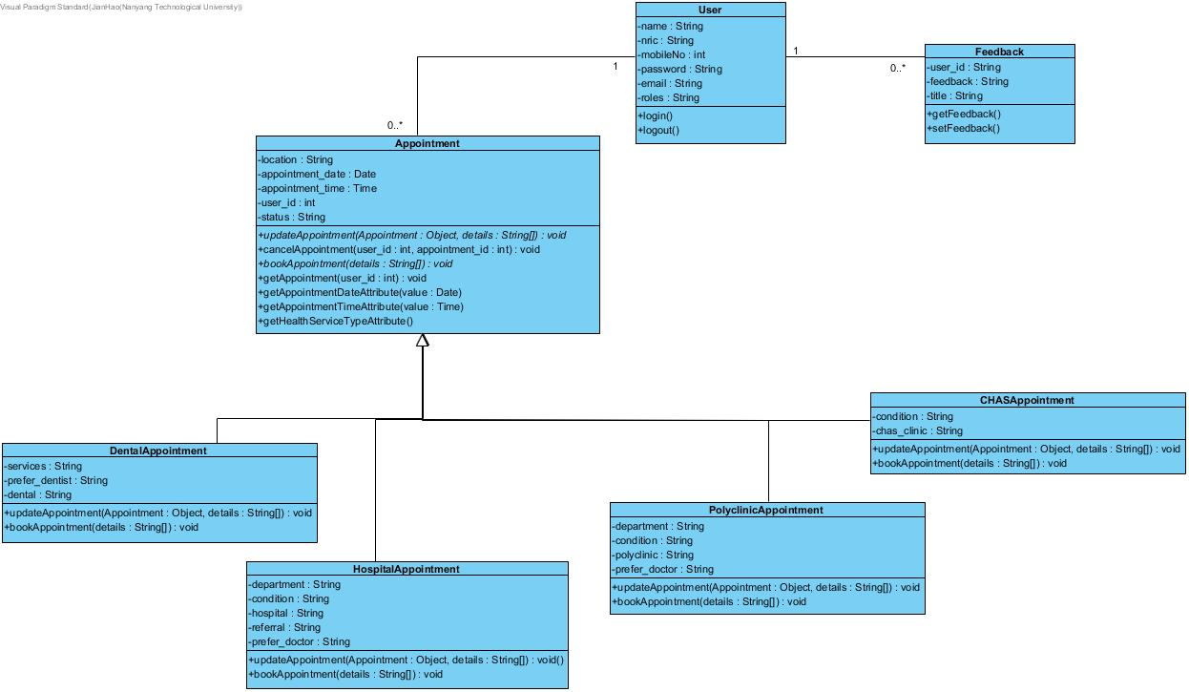
Class diagram

Slide 14
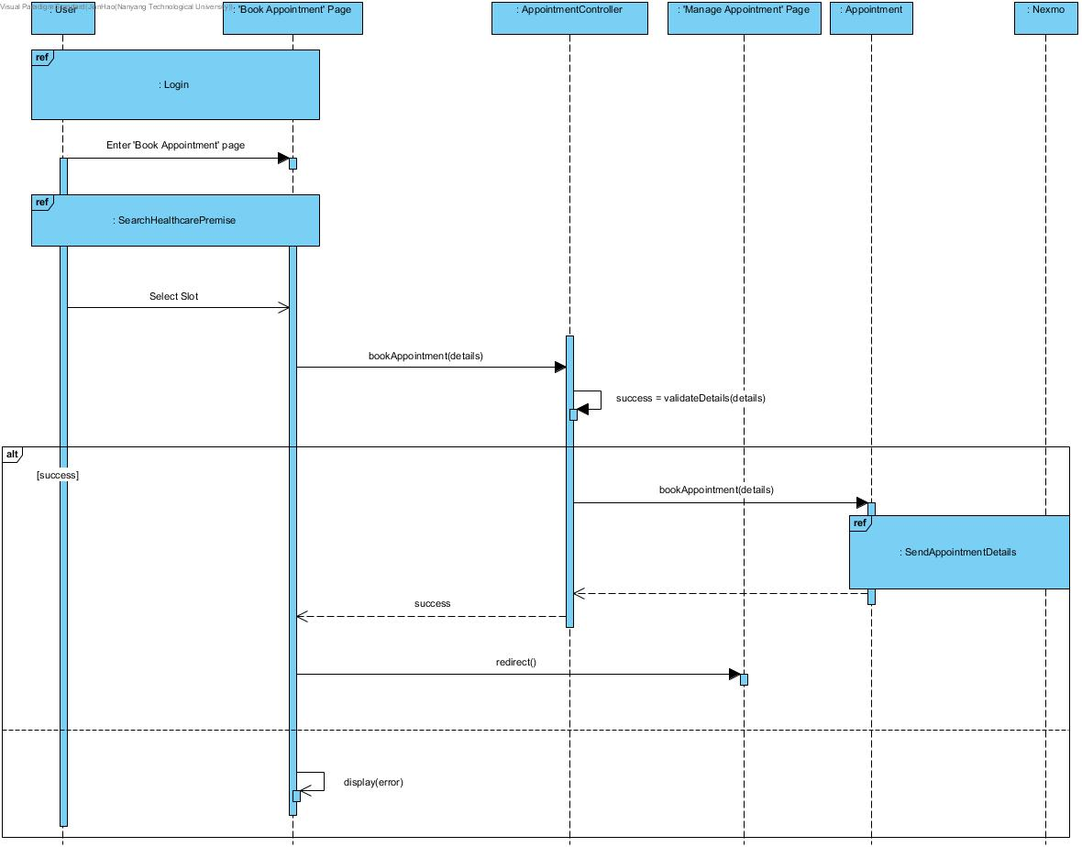
Sequence diagram
Book Healthcare Appointment

Slide 15
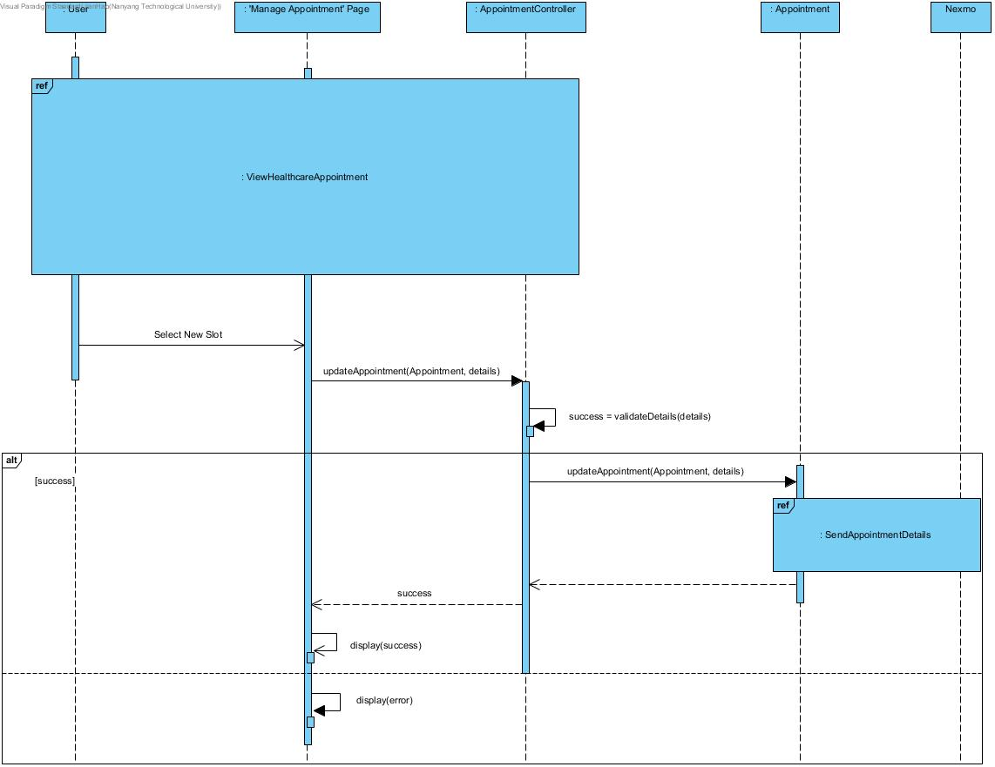
Sequence Diagram
Edit Healthcare Appointment

Slide 16
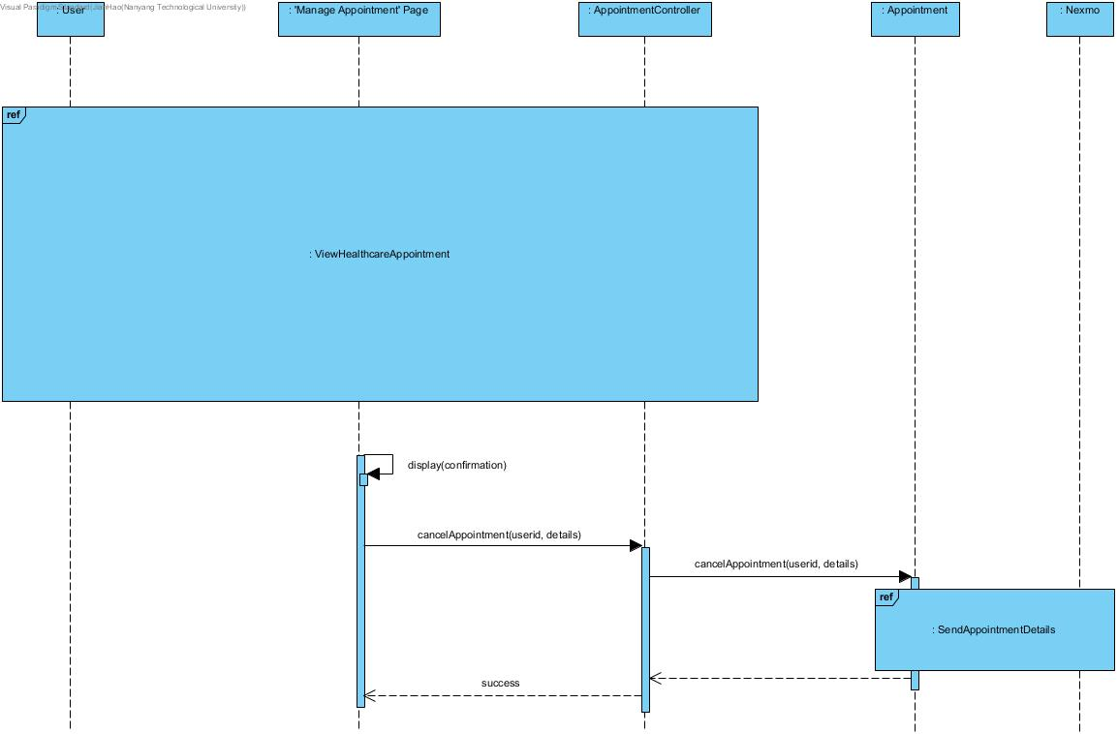
Sequence diagram
Delete Healthcare Appointment

Slide 17
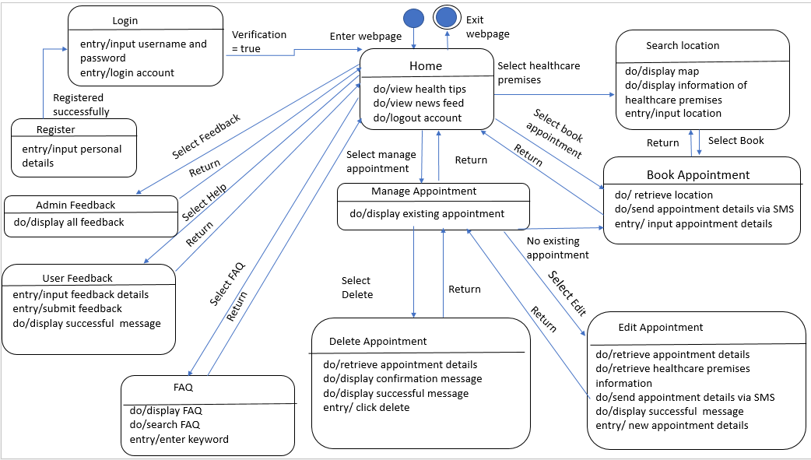
Dialog map

Slide 18
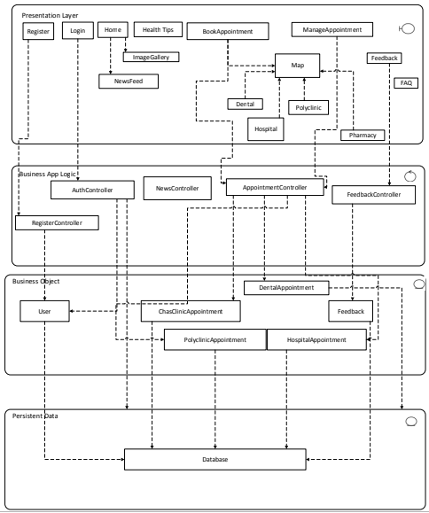
Architecture
4-tier

Slide 19
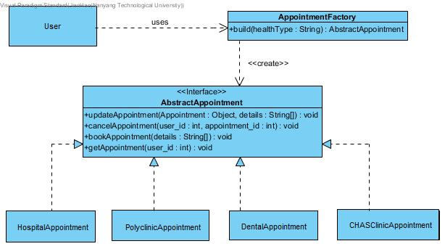
Design pattern – factory pattern

Slide 20
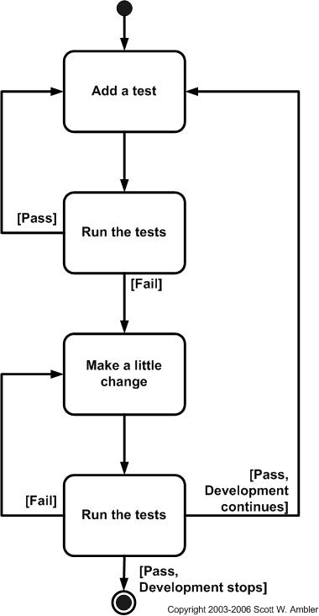

Good practices
TDD (Test Driven Development)
Bcrypt to hash password
Server side validation
Bitbucket – (GIT version control repositories)

Slide 21
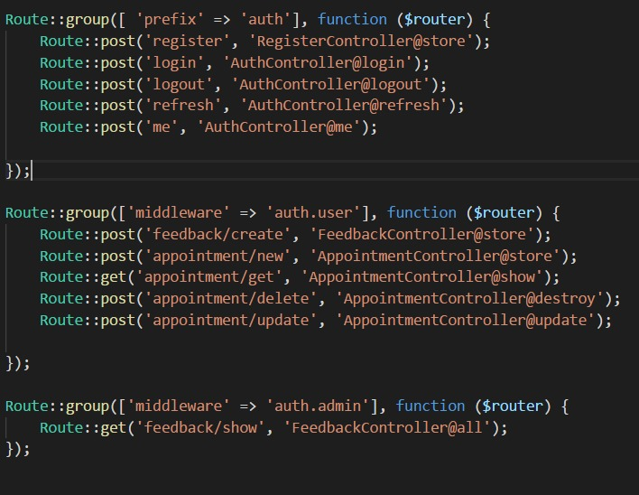
Good practices
Middleware and JWToken for
authentication purposes
Loose coupling

Slide 22
Demo

Slide 23
Black box testing
Scenario: Register user
Input : Telephone
Test Case | Valid input | Invalid input | Expected Output | Actual Output
1 | 8 digits | 7 digits | Error | Error
2 | 8 digits | 9 digits | Error | Error
3 | 8 digits | 7 digits & 1 non-digit-character | Error | Error
4 | 8 digits | Empty | Error | Error

Slide 24
Black box testing
Scenario: Register user
Input : NRIC
Test Case | Valid input | Invalid input | Expected Output | Actual Output
1 | 2 alphabets(front & back) & 7 digits | 2 alphabets & 6 digits | Error | Error
2 | 2 alphabets(front & back) & 7 digits | 2 alphabets & 8 digits | Error | Error
3 | 2 alphabets(front & back) & 7 digits | 8 digits & 1 alphabets | Error | Error
4 | 2 alphabets(front & back) & 7 digits | Empty | Error | Error

Slide 25
White box testing
Test Case | Scenario | Action | Expected Output | Actual Output
1 | The user is not logged in | Submitting feedback | Error | Error
2 | The user is logged in | Submitting feedback | Success | Success
3 | The user is not logged in | Booking an Appointment | Error | Error
4 | The user is logged in | Booking an Appointment | Success | Success

